Slide 1
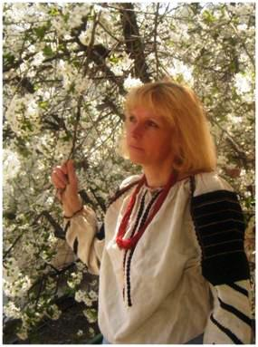
I touch the future.
I teach.
Christa Mc Auliffe
Semenchuk Liubov Marianivna
English teacher
Borshchiv Comprehensive School #1
Ternopil region

Slide 2
My Motto
Учитись важко,а учить ще важче.
Але не мусиш зупинятись ти.
Як учням віддаєш усе найкраще,
то й сам сягнеш нової висоти.
І.Драч
Educating the mind without educating the heart is no education at all.
Aristotle

Slide 3
Methodological Topic
Teaching Vocabulary Using Different Creative Methods as the Way of Students Motivation
Step 1. Use Synonyms and Antonyms.
Step 2. Develop Your Writing Skills.
Step 3. Learn Topical Vocabulary Creatively.

Slide 4
Step 1. Use Synonyms and Antonyms
Add spice and flavor to our communication
Boost our creativity and words power
Broaden the horizons of students vocabulary

Slide 5
Step 2. Develop Your Writing Skills
Encourage creative skills of gifted pupils
Include different forms of writing
Check students writing skills

Slide 6
Step 3. Learn Topical Vocabulary Creatively
Focus on lexical competence
Test yourself once by consuming and twice by producing language
Mind 3R`s: Repeat – Relax – Review

Slide 7

The Way to Success
Students motivation
Researching projects
Choice of teaching technologies
Self-analysis and self-estimation
Students creative skills development

Slide 8
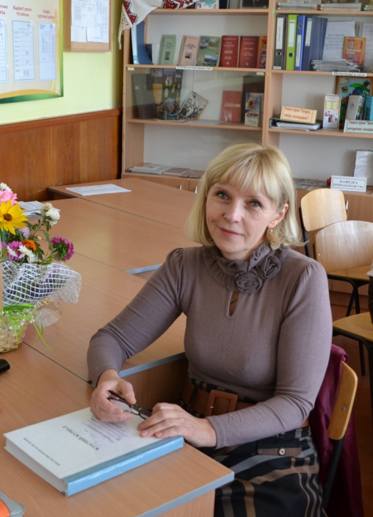
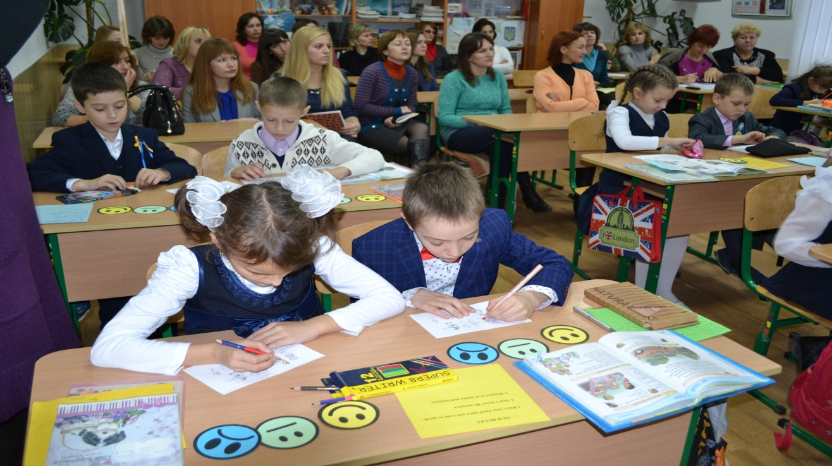
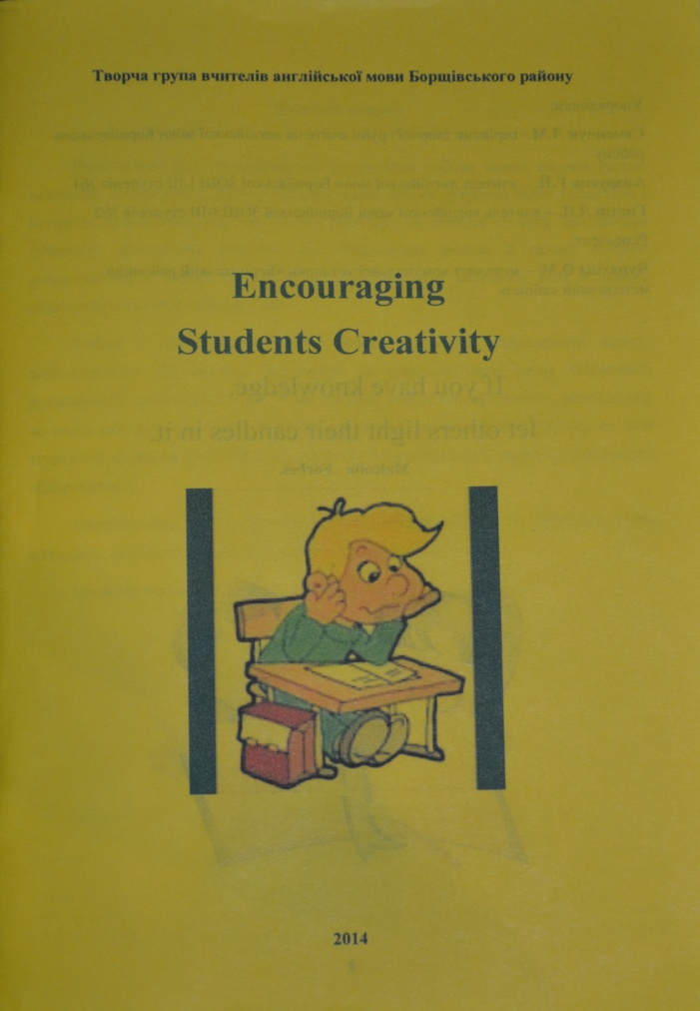
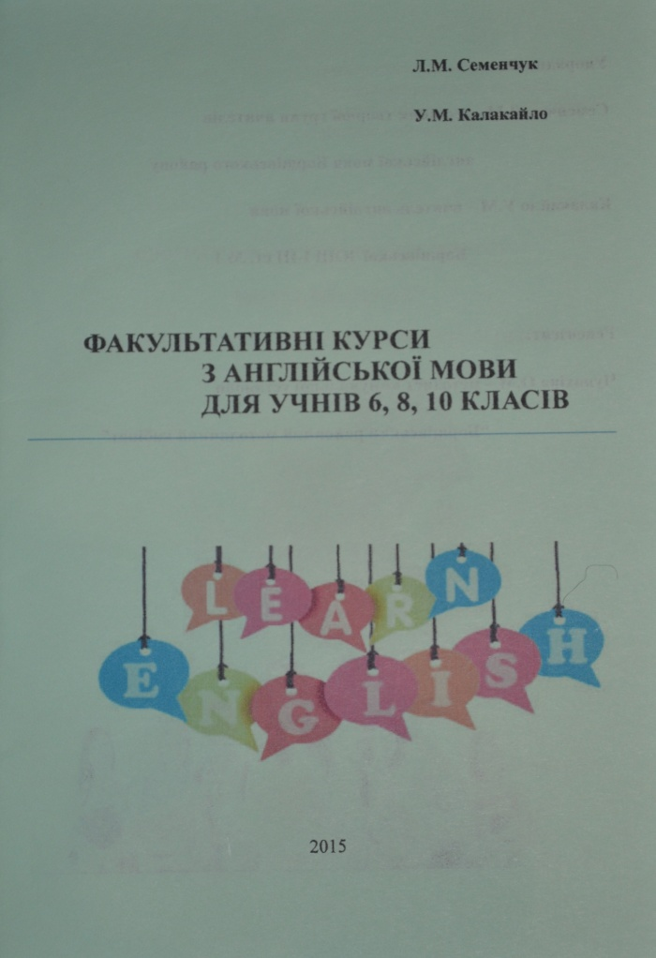
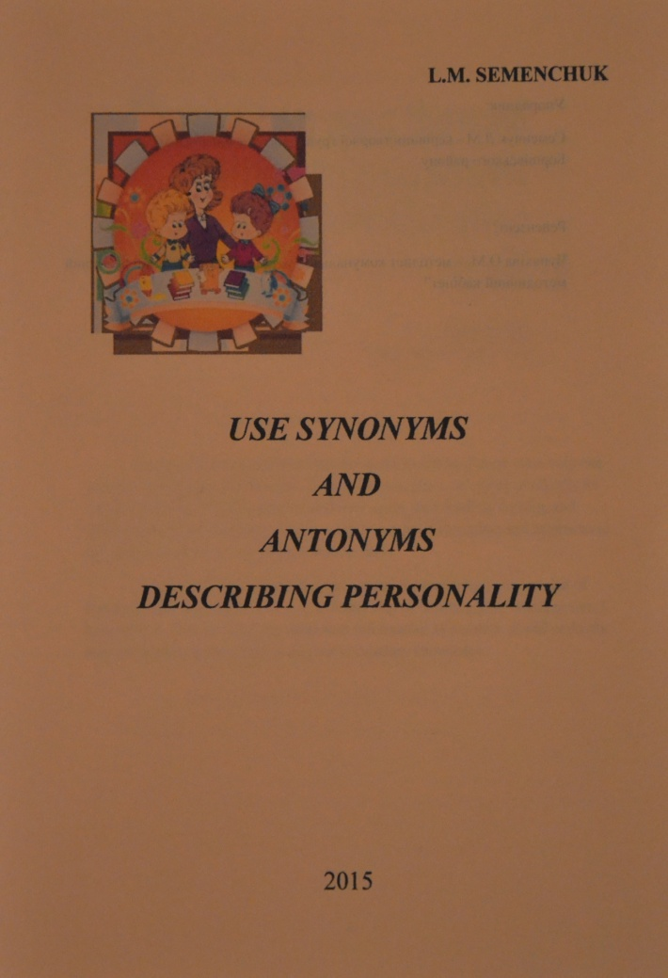
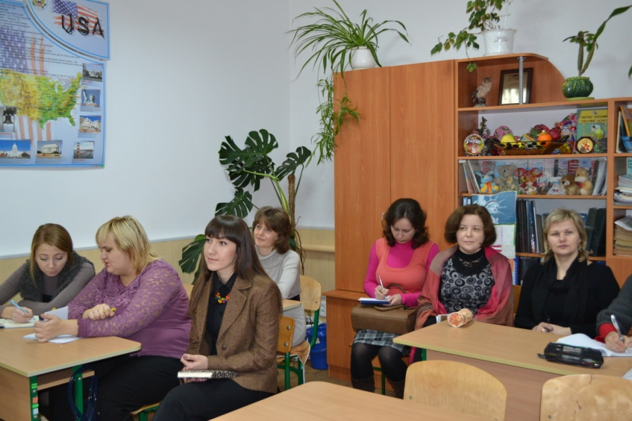
Teaching Experience
Creative team colleagues leader
Participation in conferences and seminars
Methodological Manuals

Slide 9
Gifted Students Achievements
The Second Round of English Olympiads
The Third Round of English Olympiads
Notes:
клас

Slide 10
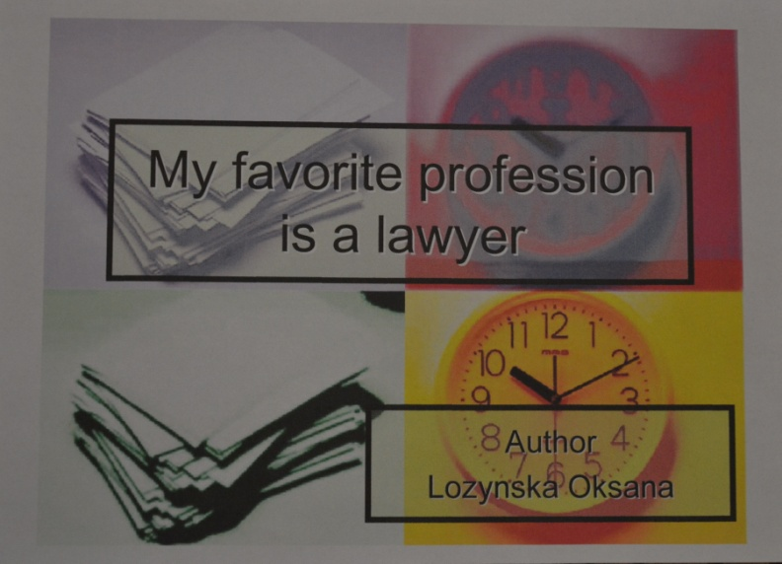
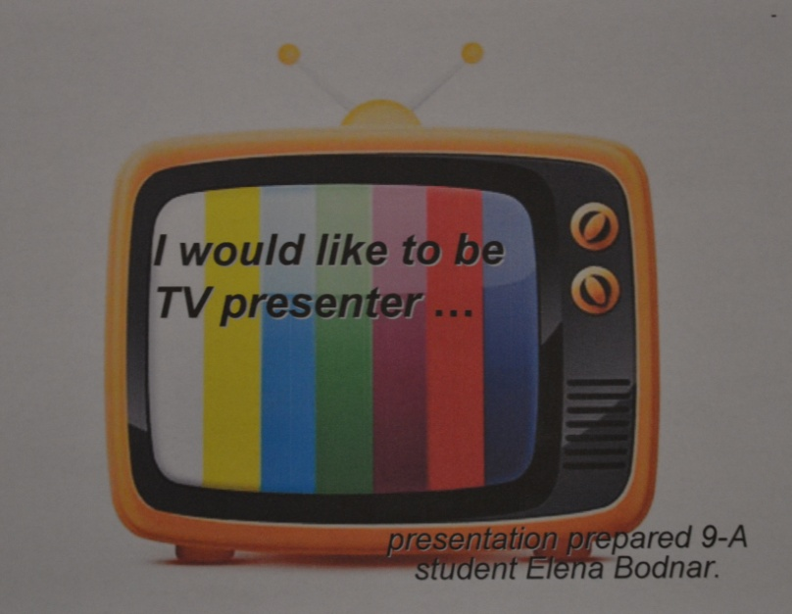
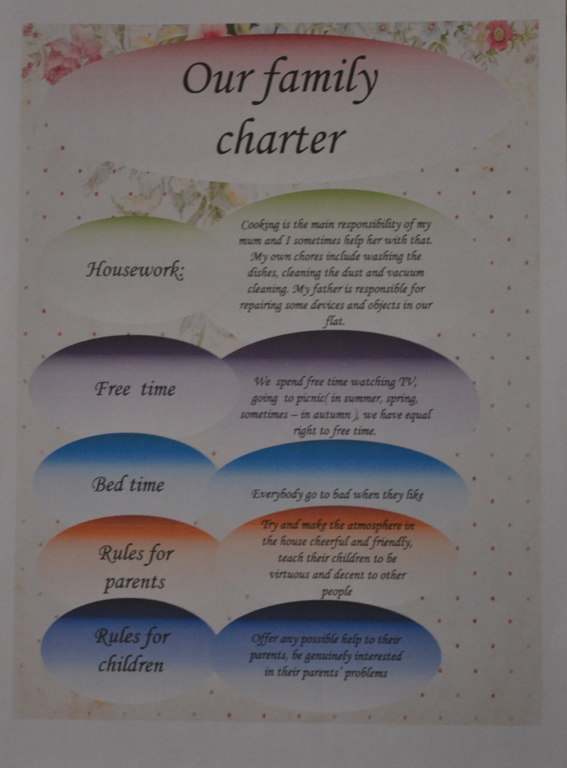
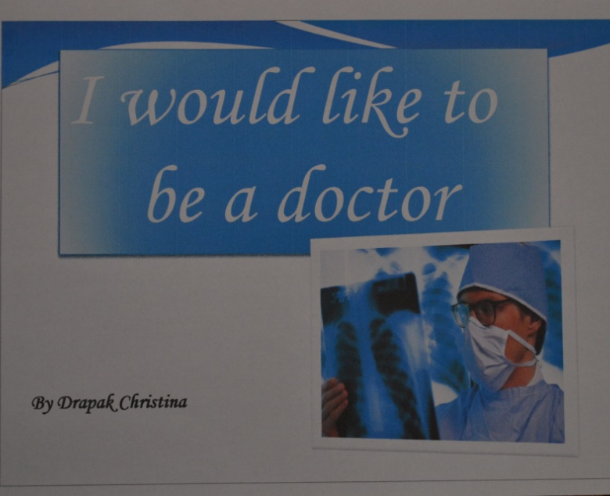
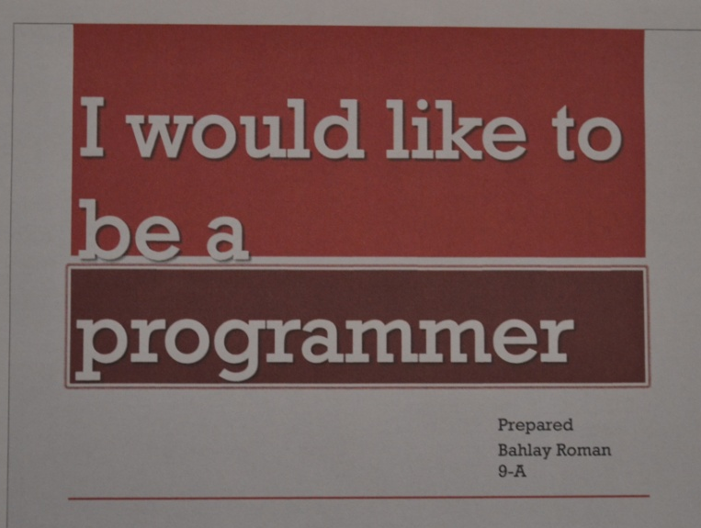
Students Projects Samples

Slide 11
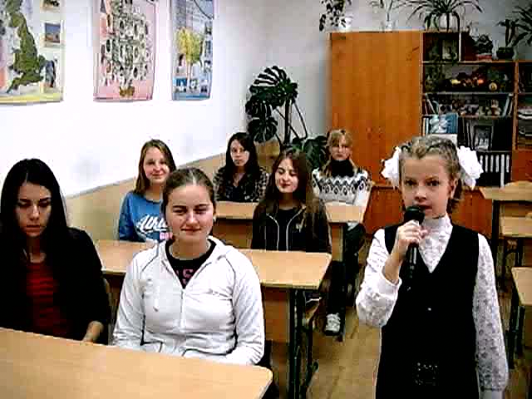
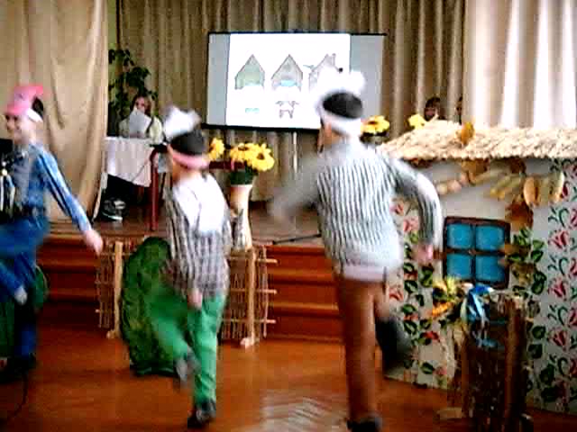
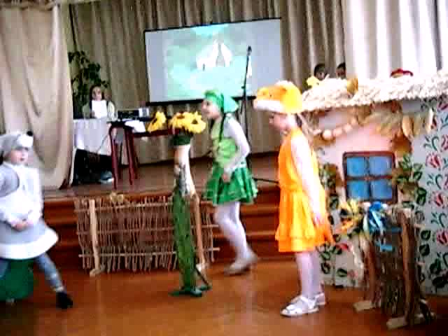
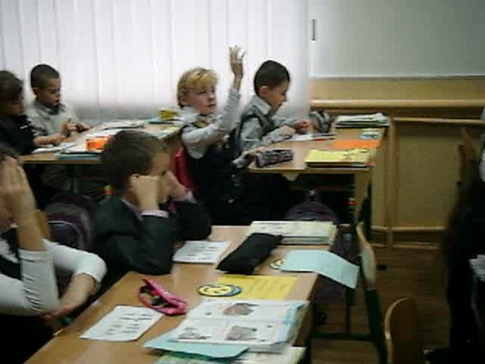
Out-of-Class Activity

Slide 12
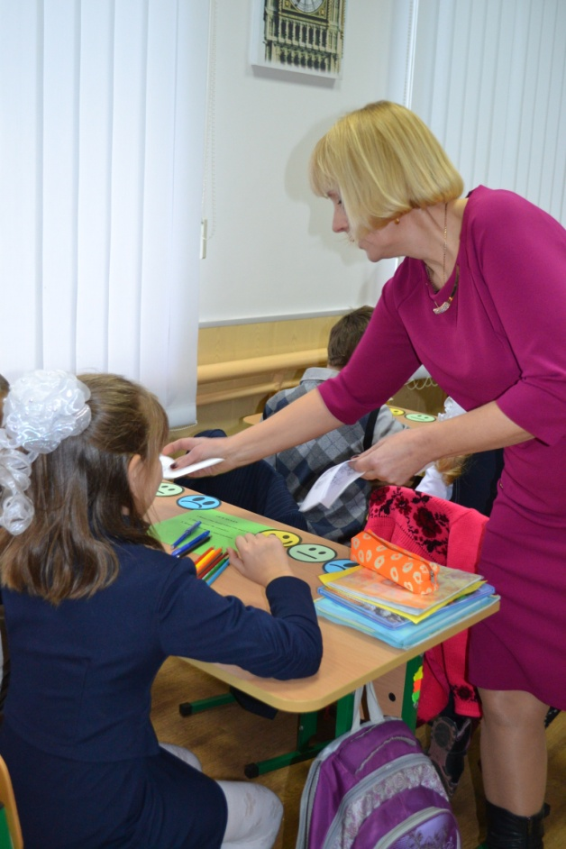
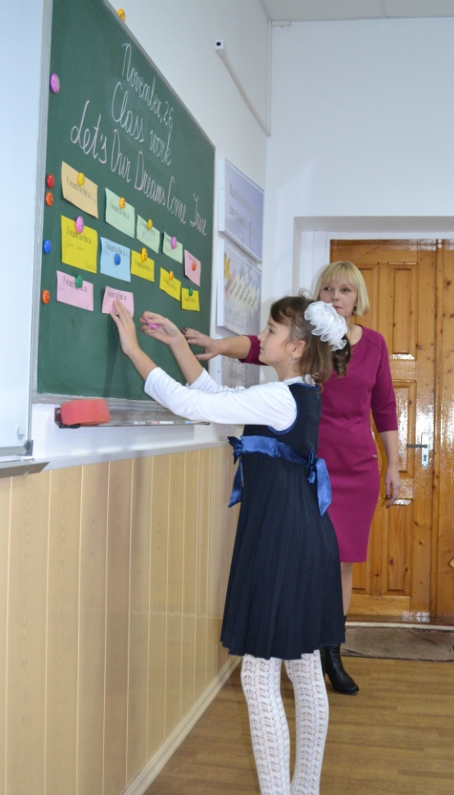
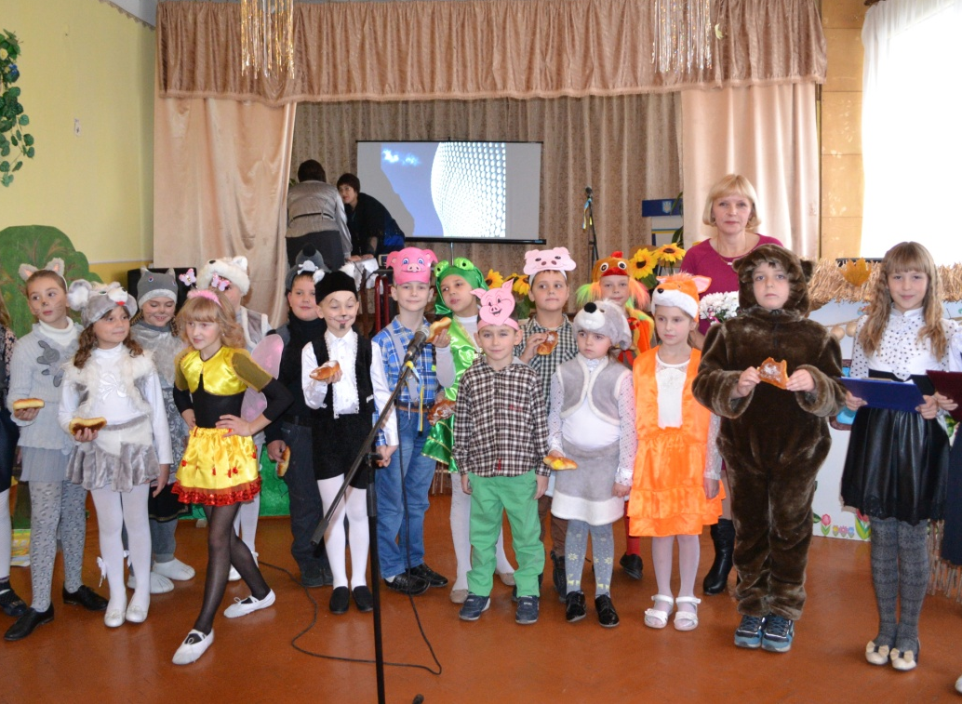
If you have knowledge, let others light their candles in it
Malcolm Forbes

