Slide 1

The World of Professions.
My Parents` Occupations.

Slide 2


Slide 4
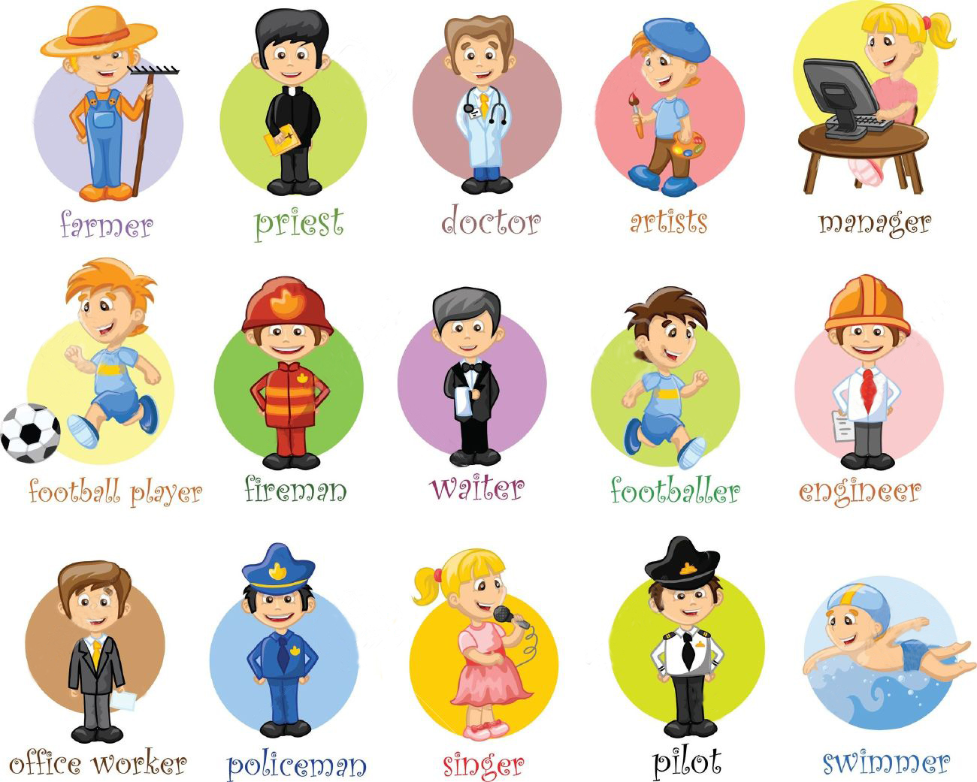

Slide 6
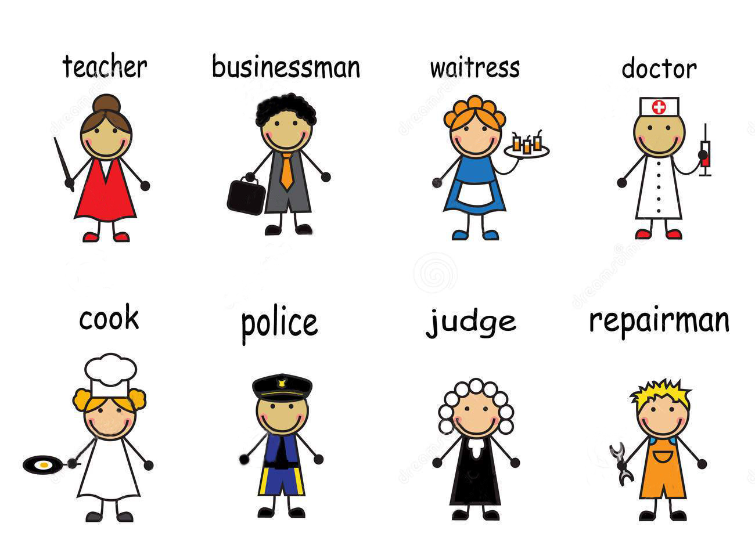

Slide 8


Slide 9


Slide 10



