Slide 1
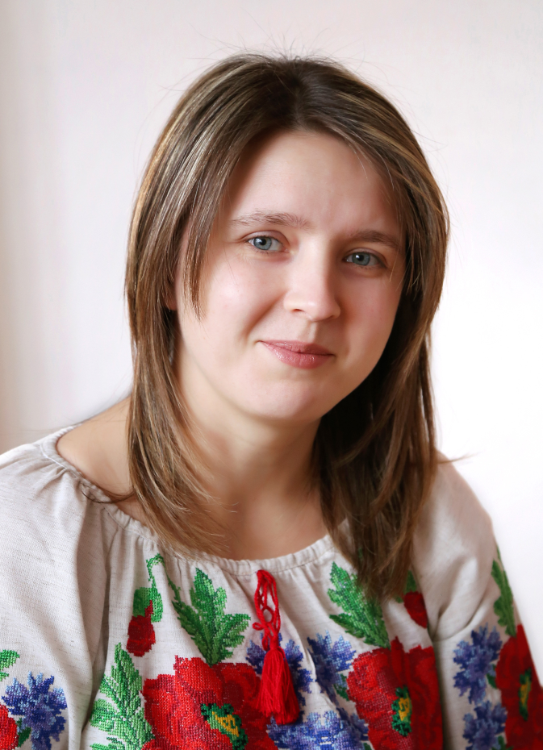
All – Ukrainian Competition “Teacher of the Year-2016”
Nataliia Melnychuk,
an English teacher of
Chortkiv Gymnasium named after M.Shashkevych

Slide 2
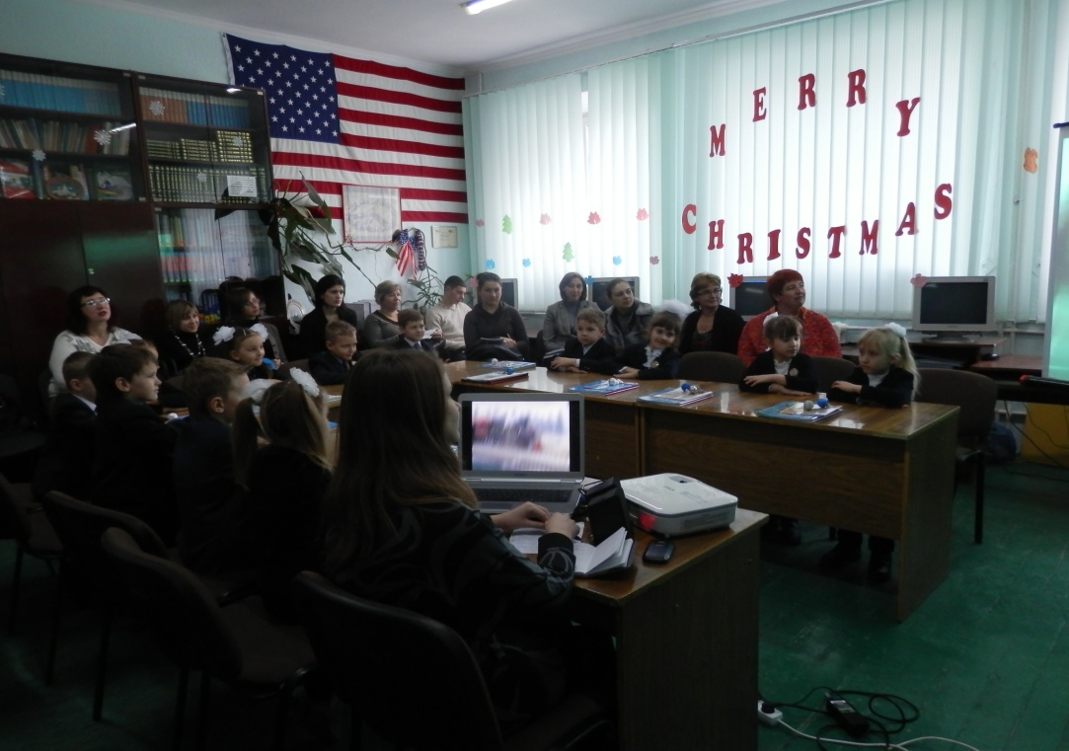
Methodological Problem
The effectiveness of using project method in the process of teaching and learning English

Slide 3
What is a project ?
The Project is a kind of creative activity for students that includes their
Experience
Imagination
Knowledge
Strong desire to share them with others

Slide 4
Advantages of the project work
Students work with a wider range of materials than their textbook offers
They can achieve a goal regardless how good they are at language
Students deal with the problems they are interested in and learn how to solve them
They are taught to be responsible for their work and its results

Slide 5
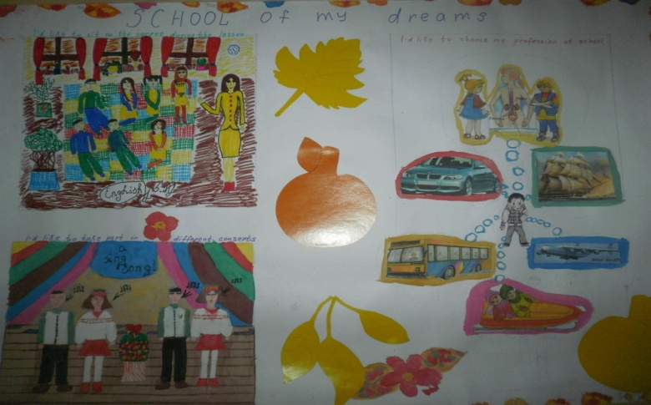
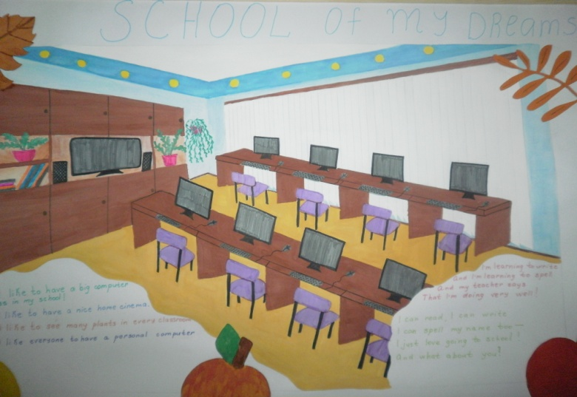
Project work “School of my dream”
We’d like it to be clean and tidy
We’d like to see many plants
in every classroom
We’d like our school to have
a modern computer class

Slide 6
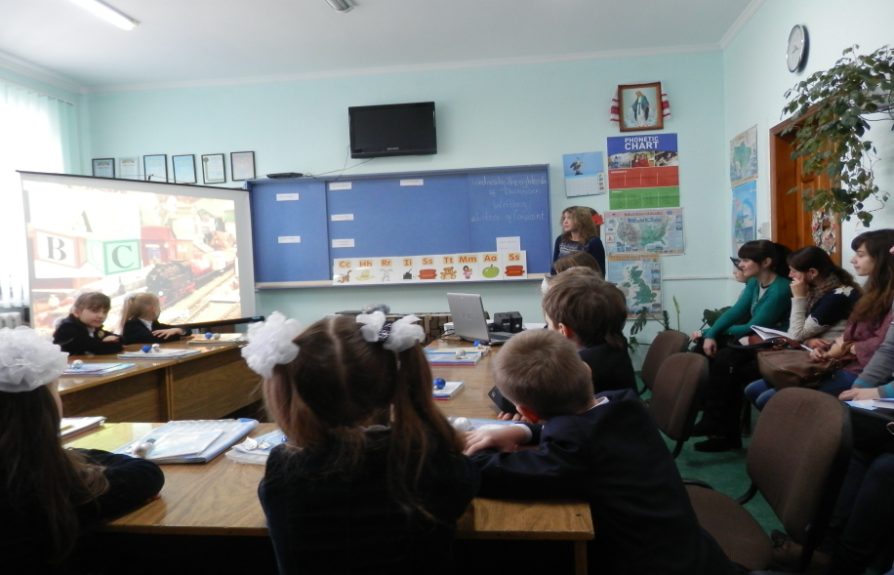
Project work“Christmas card”

Slide 7
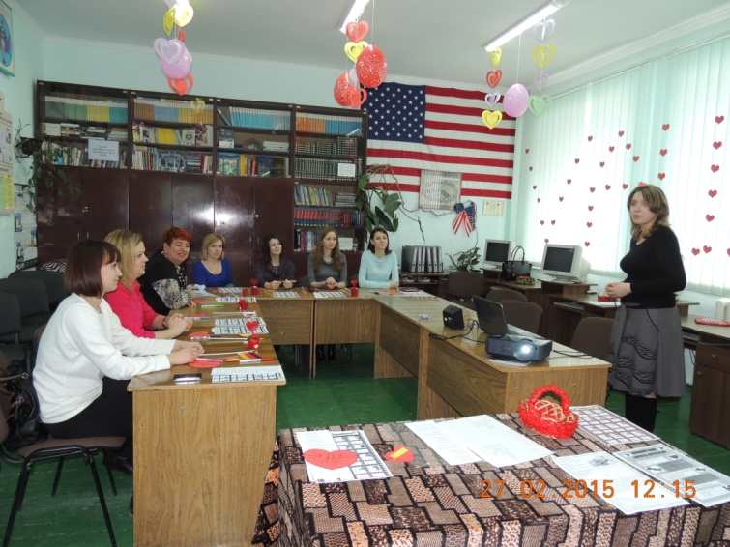
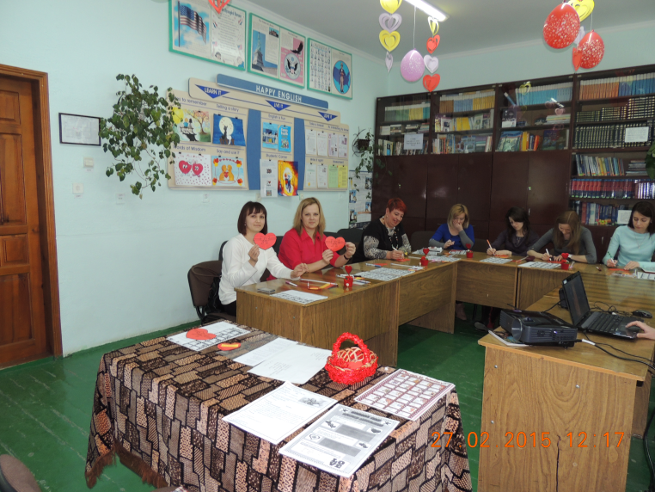
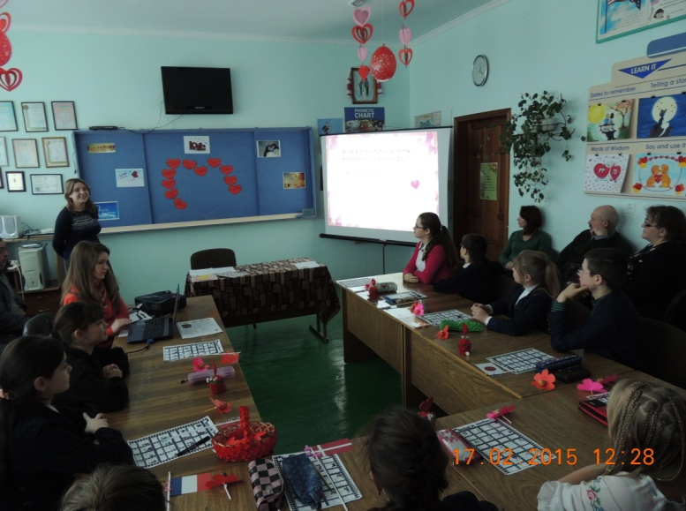
Project work “St Valentine’s Day around the world”
Workshop for teachers
An English Club “ELF”
meeting

Slide 8
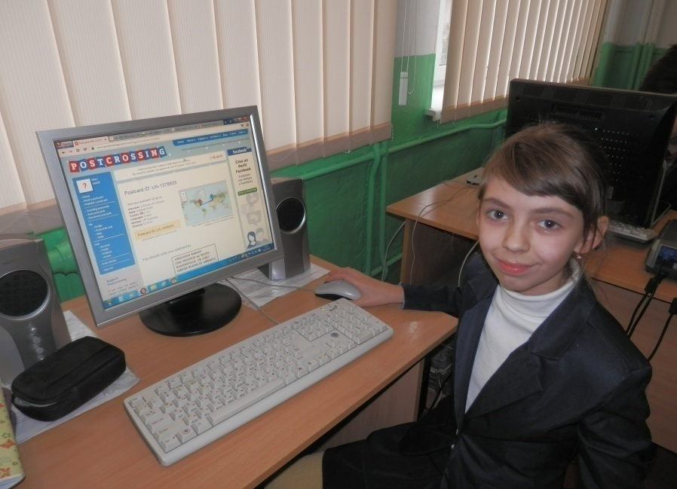
Project work “Postcrossing”
“Send a postcard and receive a postcard back from a random person in the world!”
The goal of this project is to allow people to receive postcards from all over the world, for free. Well, almost free!
The element of surprise of receiving postcards from different places in the world can turn your mailbox into a box of surprises - and who wouldn't like that?

Slide 9
Project work “Postcrossing”
Students wish love, happiness and peace to all people and nations

Slide 10
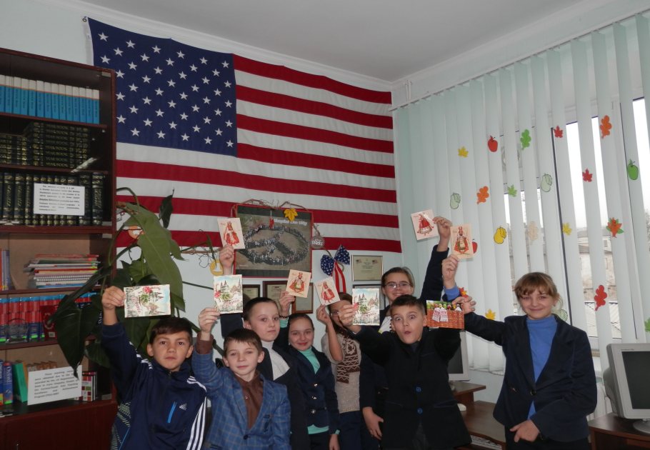
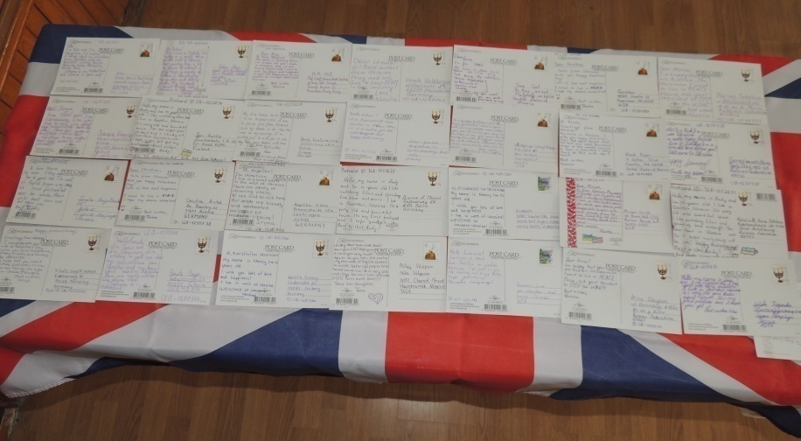
Project work “Postcrossing”
We have got a special board in the English Language Resource Centre to exhibit received postcards

Slide 11
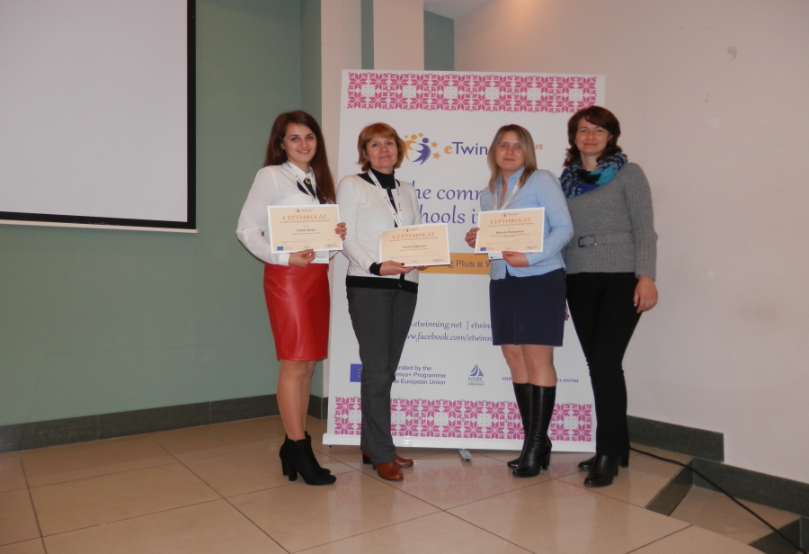
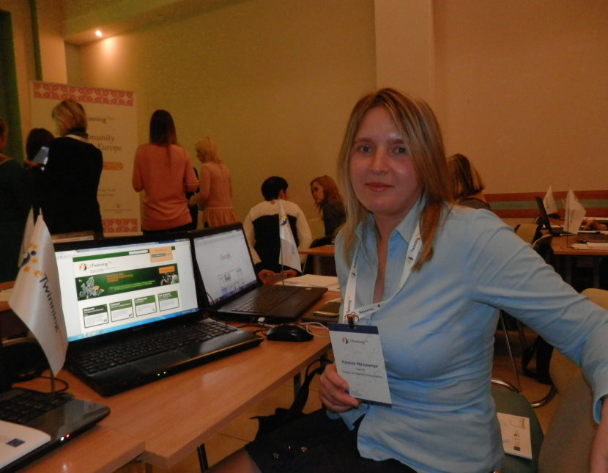
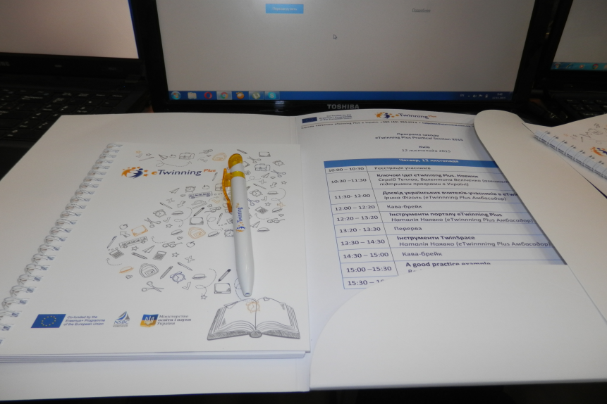
Project work“eTwinning Plus”
The eTwinning programme promotes school collaboration in Europe through the use of ICT.
It gives a chance to communicate, collaborate, develop projects, share and be part of the most exciting learning community in Europe.

Slide 12
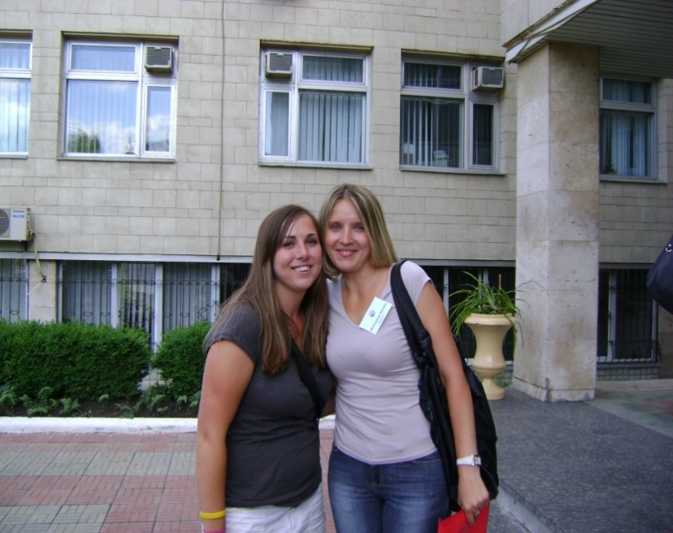
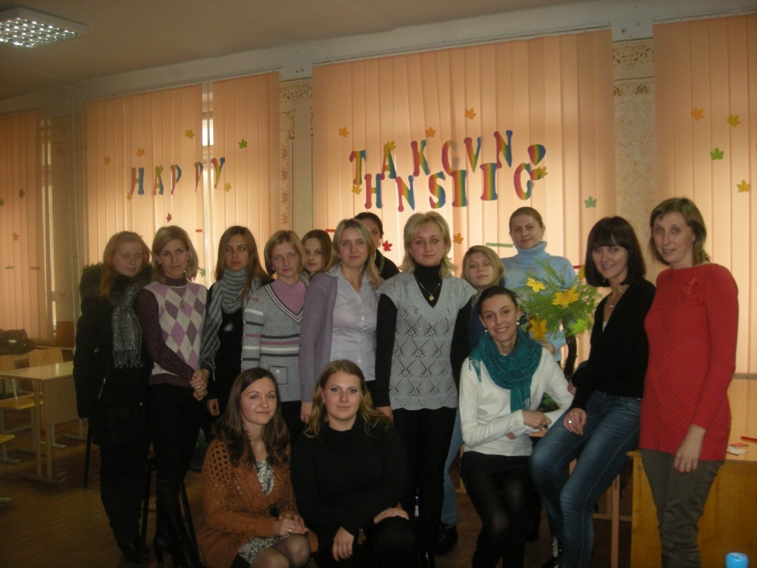
Professional development
Young Teachers’
School
Cooperation with
Peace Corps

Slide 13
English Language Resource Centre
Supports teachers professional development
Ensures the best advice to accelerate progress for your learners
Holds a range of printed materials
Provides access to online resources
Ensures a place where students can go to receive help about their English language learning

Slide 14
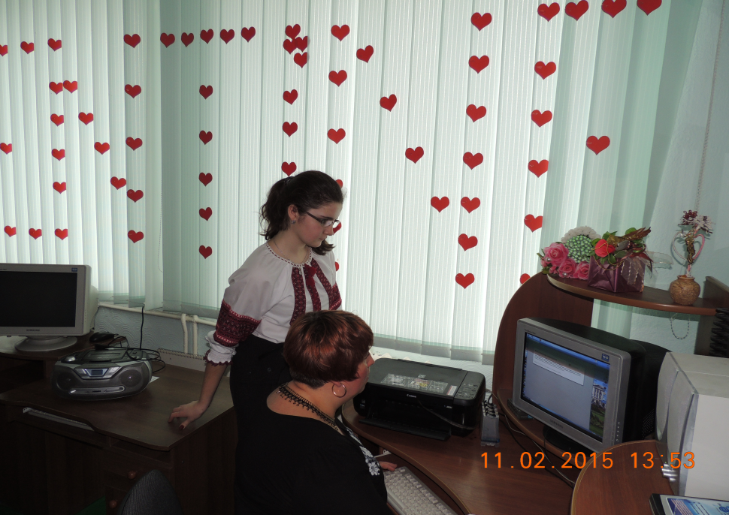
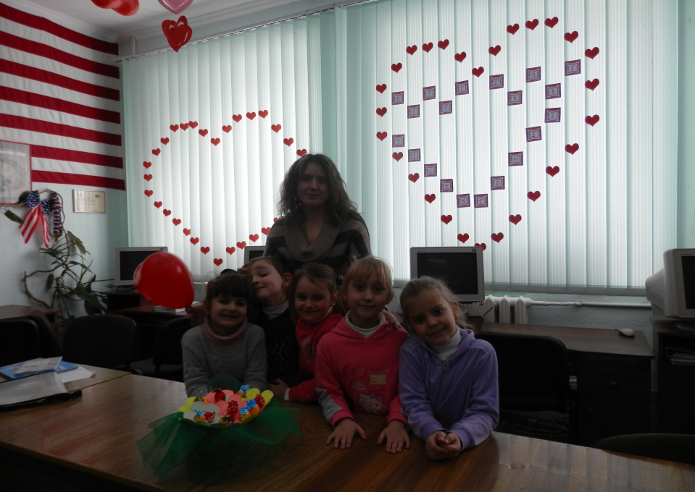
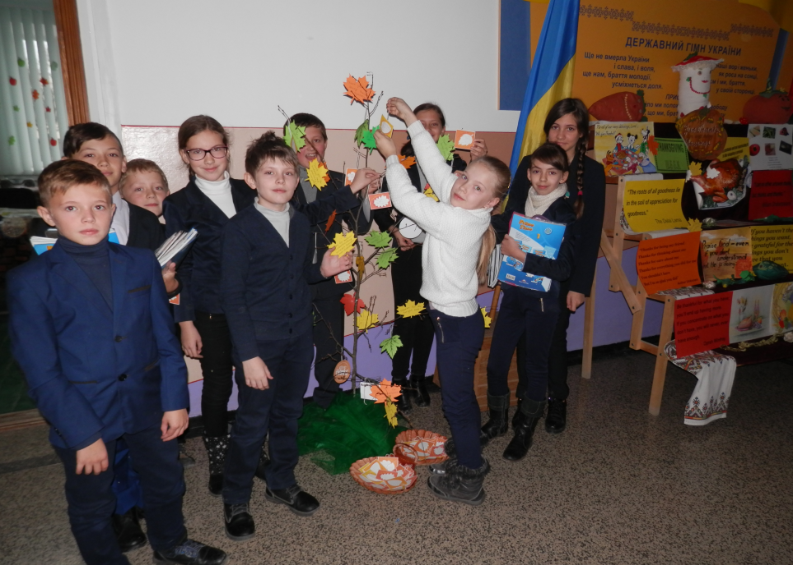
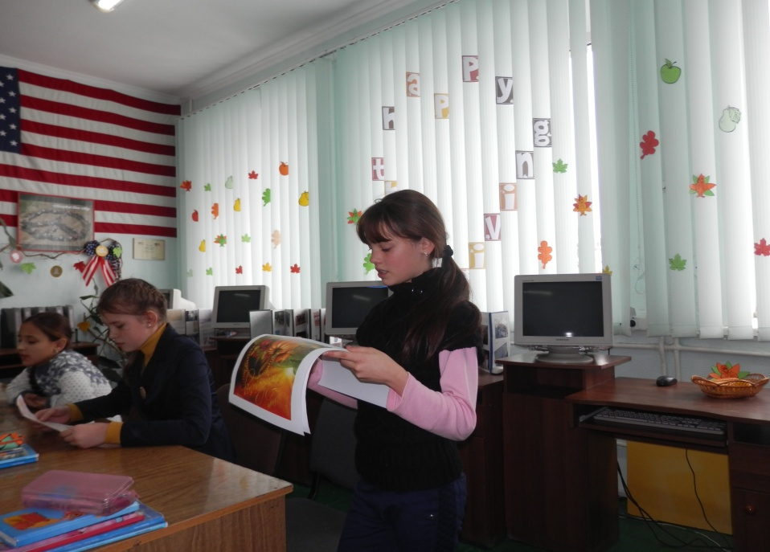
English Language Resource Centre

Slide 15
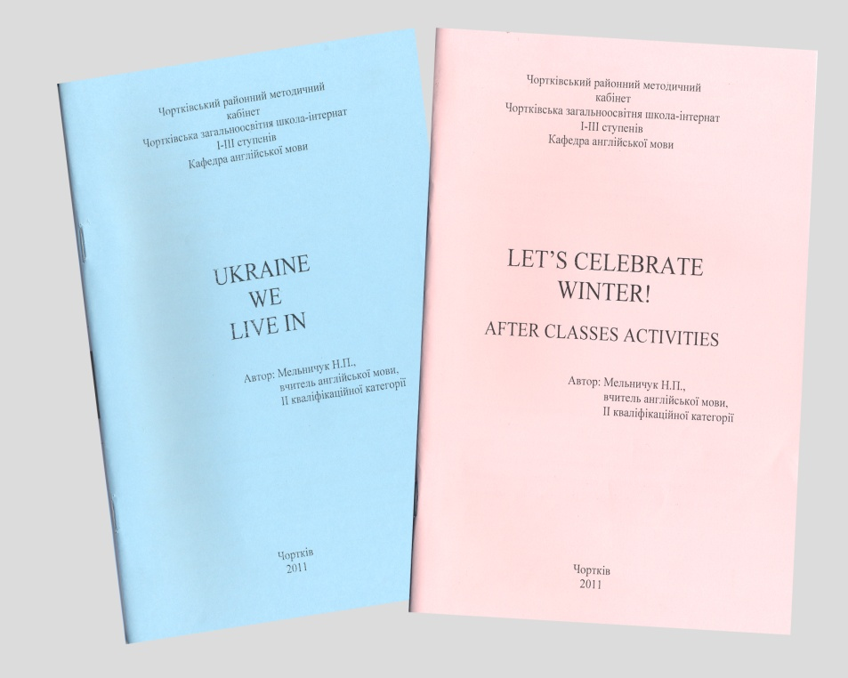
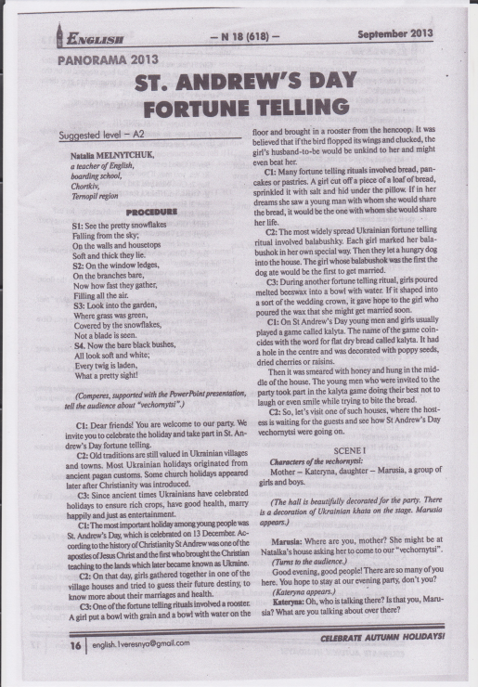
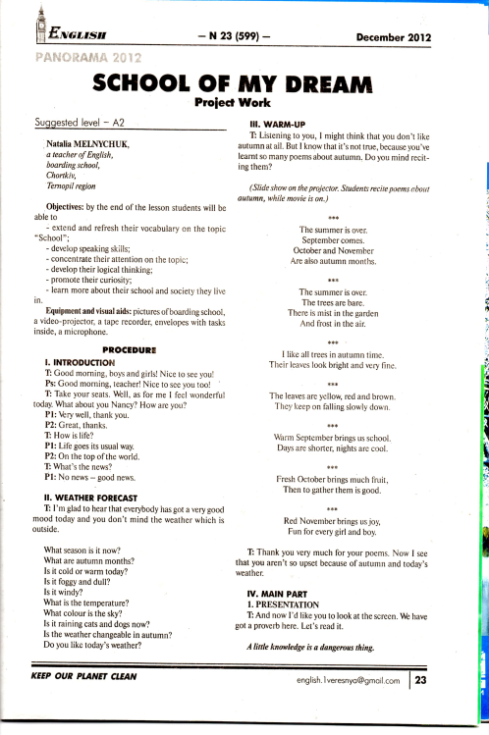
Publications
Book “Ukraine we live in”
Book “Let’s celebrate winter!”
St Andrew’s Day
fortune telling
School of my dream

Slide 16
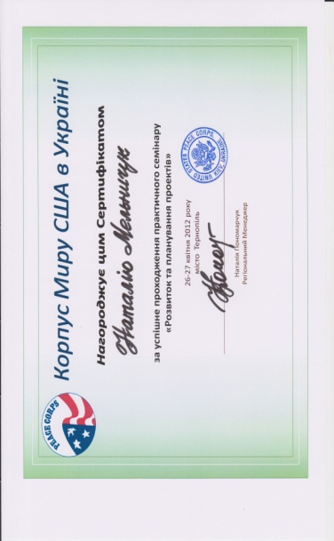
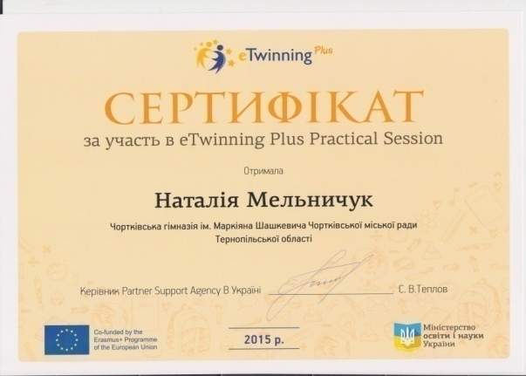
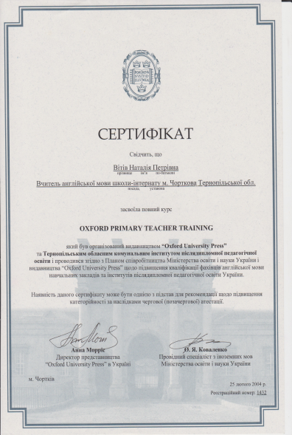
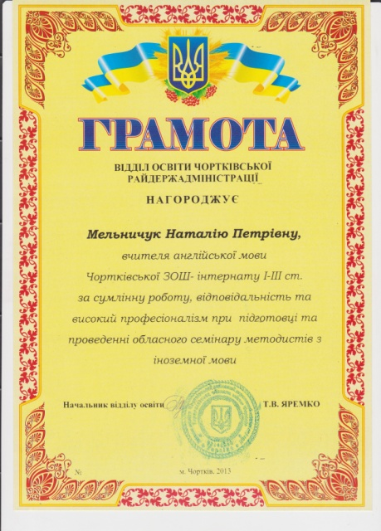
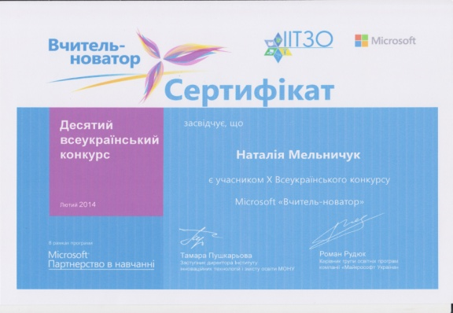
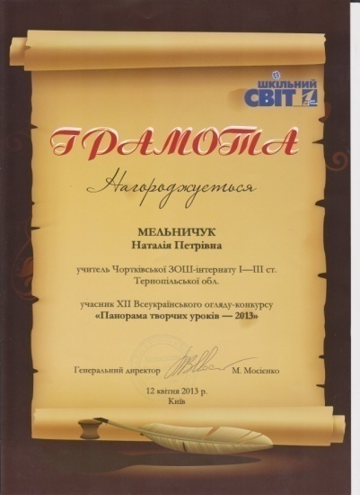
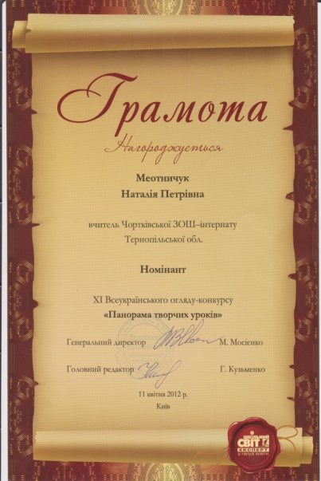
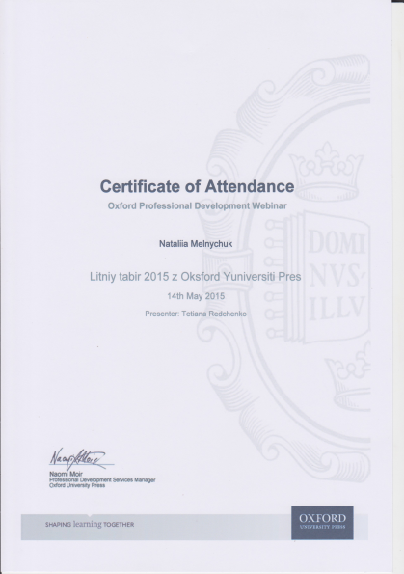
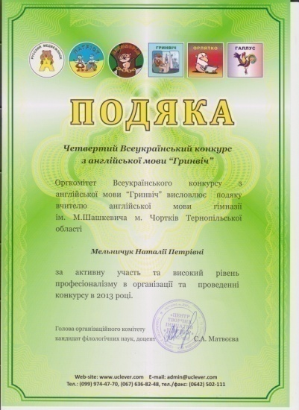
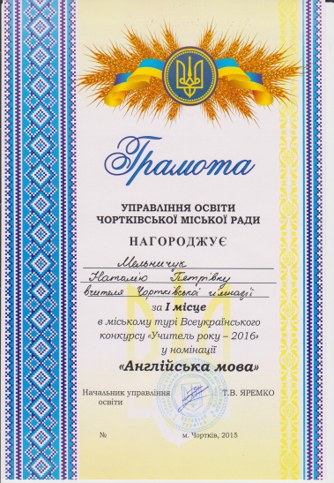
Certificates and awards

Slide 17
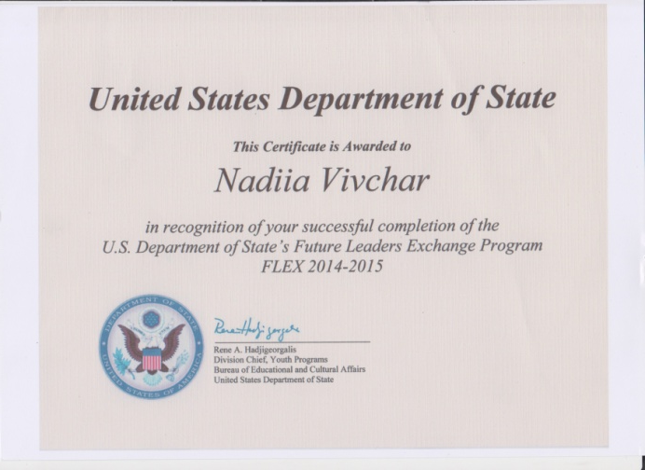
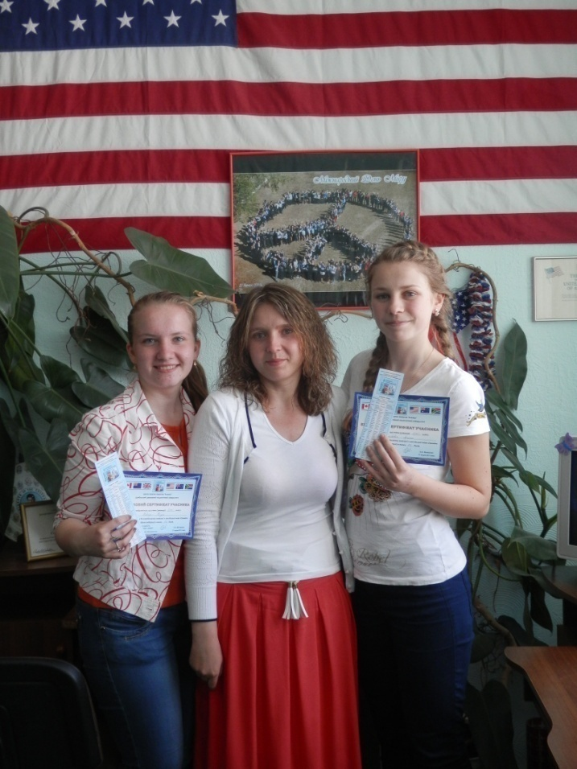
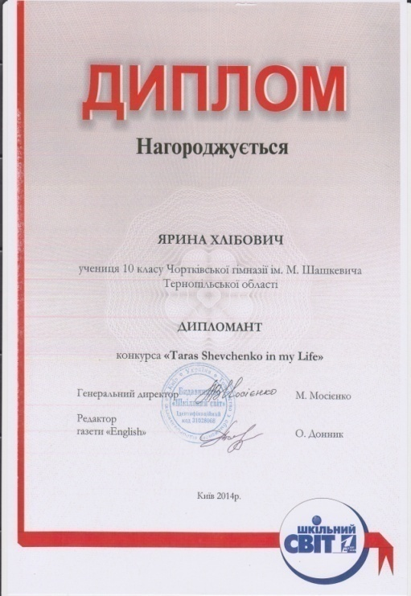
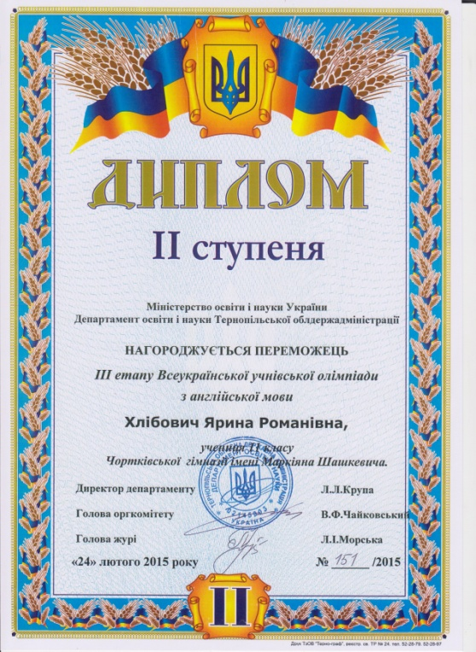
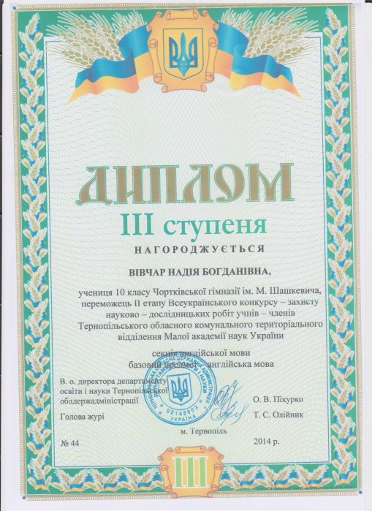
The wonder of teaching is watching caterpillars become butterflies
Вівчар Надія
Хлібович Ярина

Slide 18
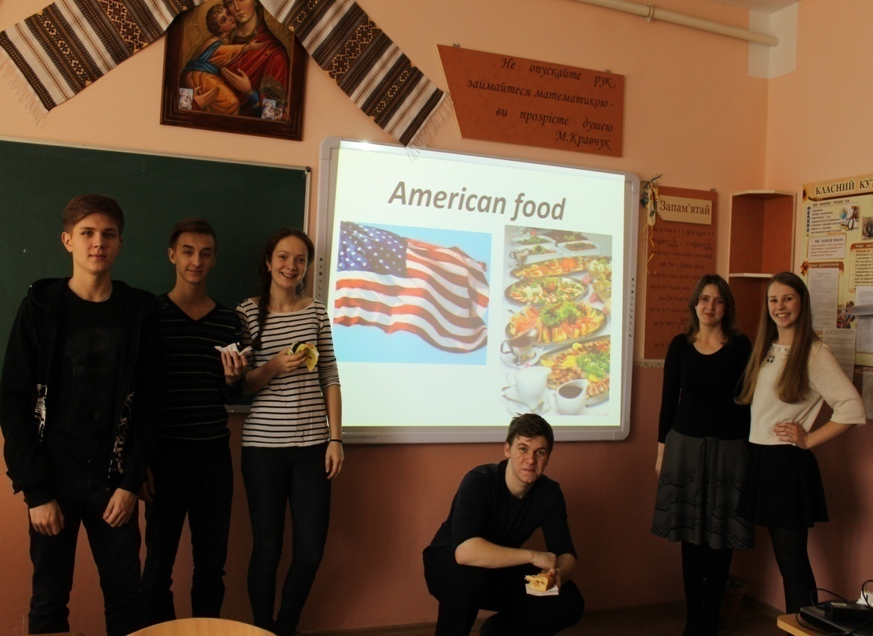
To the world you may be just a teacher but to your students you are a HERO!
With much consideration and admiration,
Nataliia Melnychuk
nataliiamln.blogspot.com

