Slide 1
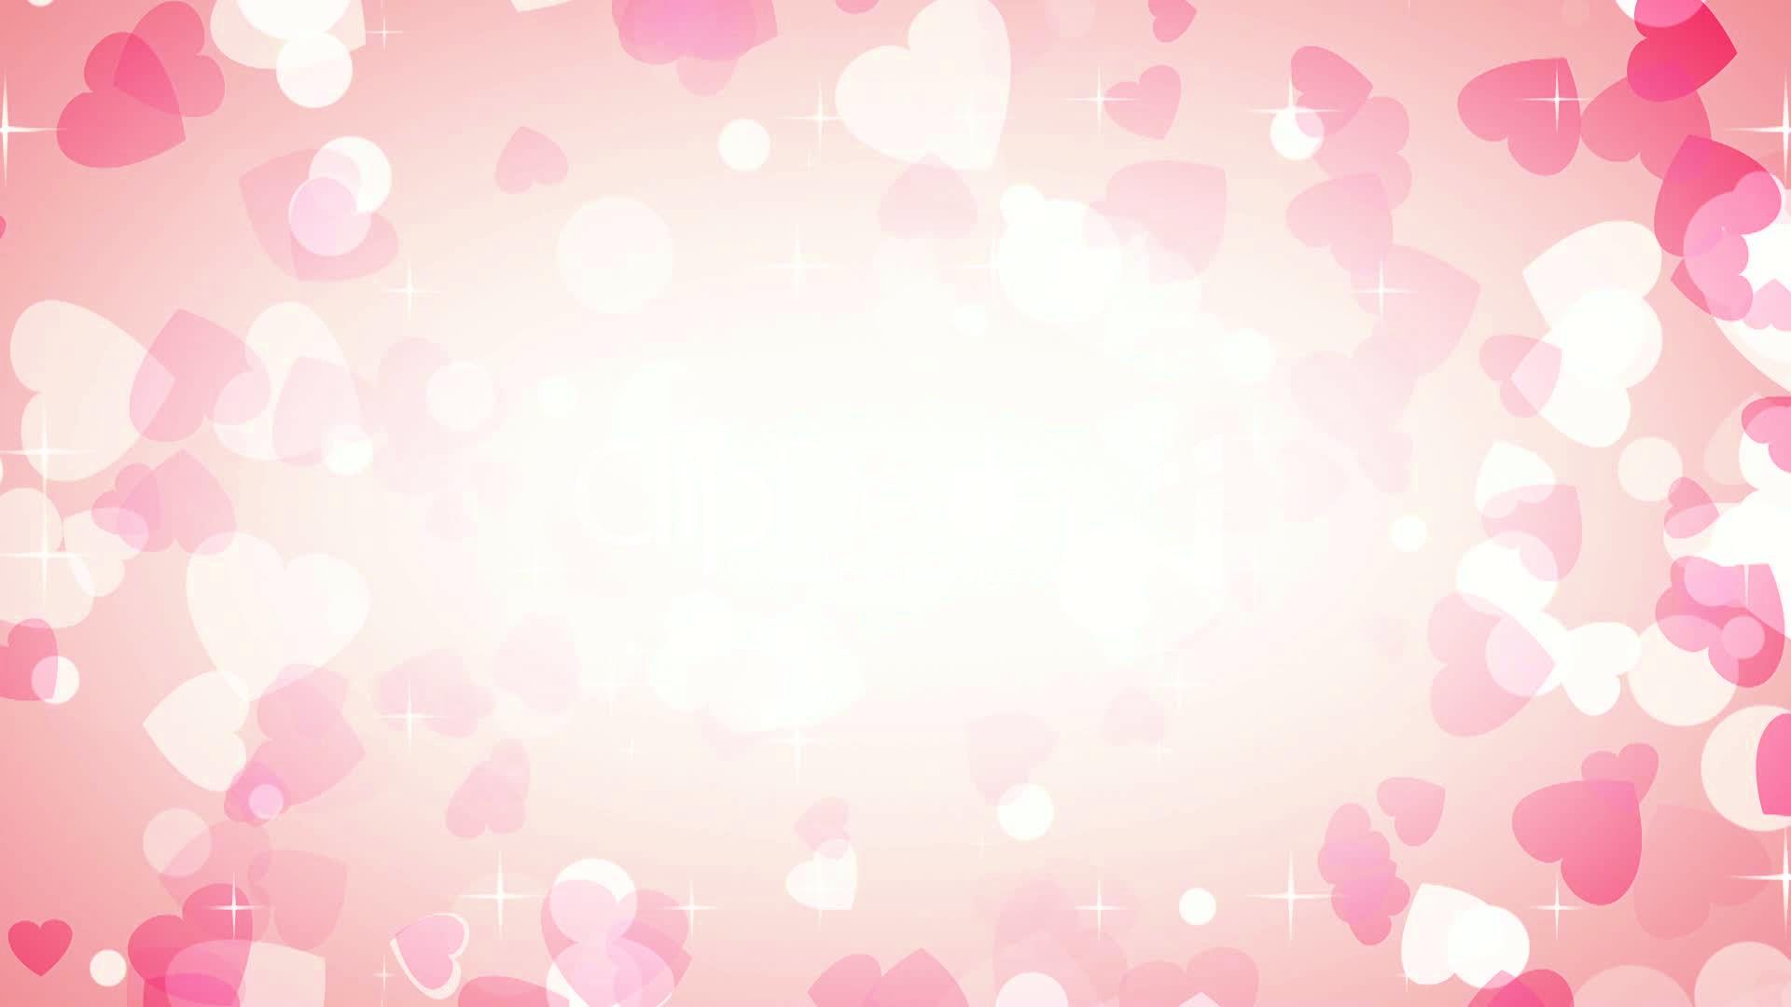
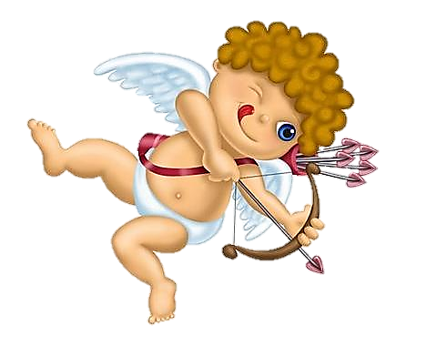
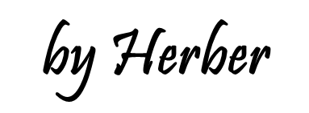

Slide 2
What did the stamp say to the envelope on Valentine's Day?
I'm stuck on you!
I love you
1/15

Slide 3
What did the valentine card say to the stamp?
Stick with me and we'll go places!
I love you
2/15

Slide 4
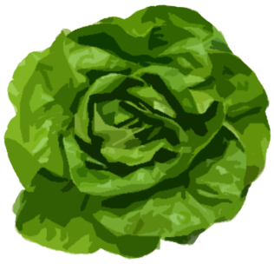
Why is lettuce the most loving vegetable?
Because it's all heart.
3/15

Slide 5
What did the paper clip say to the magnet?
I find you very attractive.
4/15

Slide 6
What did the elephant say to his girlfriend?
I love you a ton!
5/15

Slide 7
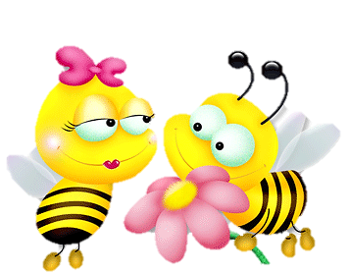
What did the boy bee say to the girl bee on Valentine's Day?
You are bee- utiful! Will you bee mine?
6/15

Slide 8
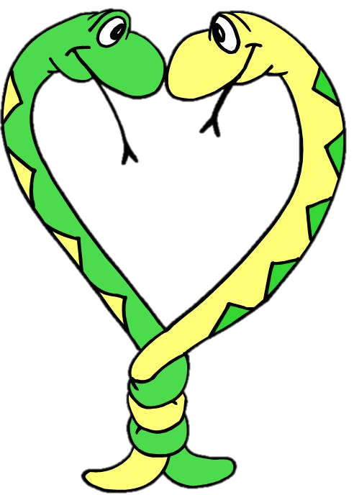
What did one snake say to the other snake?
Give me a little hug and a hiss, honey.
7/15

Slide 9
What did the boy whale say to the girl whale on Valentine's Day?
Whale you be mine?
8/15

Slide 10
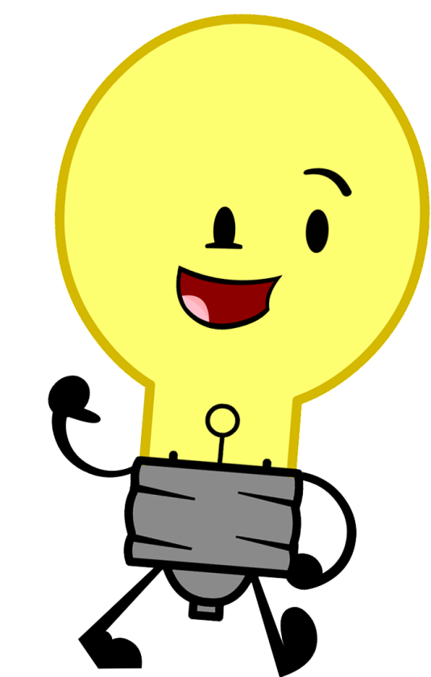
What did the light bulb say to the switch?
You turn me on.
9/15

Slide 11
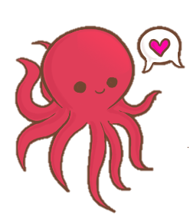
What did the boy octopus say to the girl octopus?
Can I hold your hand, hand, hand, hand, hand, hand, hand, hand?
10/15

Slide 12
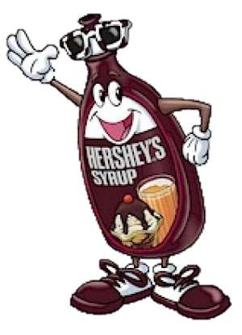
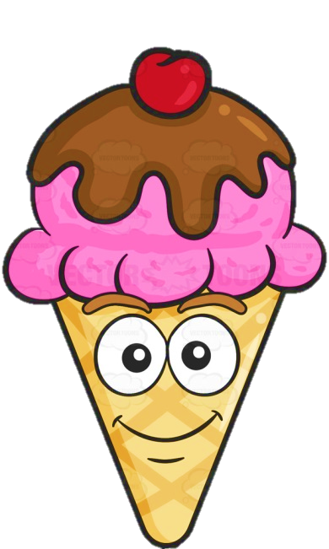
What did the chocolate syrup say to the ice cream?
"I'm sweet on you!"
11/15

Slide 13
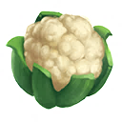
What kind of flowers do you never give on Valentine's Day?
Cauliflowers!
13/15

Slide 14
What do you call a very small Valentine?
A Valentiny.
14/15

Slide 15
Where does Valentine’s Day come after Easter?
In the dictionary.
15/15

Slide 16
