Slide 1
Happy Valentine’s
Day
Around the World

Slide 2
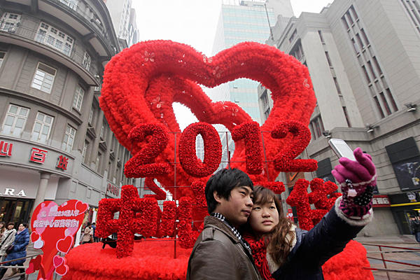
China
The Chinese celebrate Valentine’s Day on February 14th, but they also celebrate a special Valentine’s Day on July 7th. This celebration comes from a Chinese fairy tale from a long time ago. It is the only night in the year when two stars meet in the sky above. One star represents a shepherd boy and the other is his love, a weaver.

Slide 3
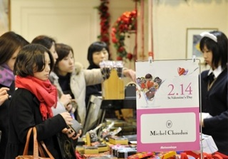
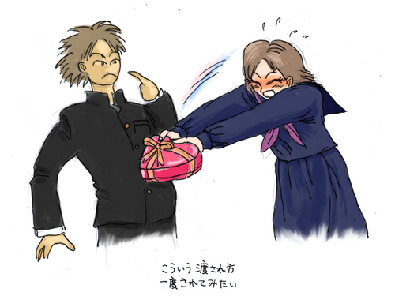
Japan
In Japan there are two Valentine’s Days as well. The first is on February 14th and the other is on March 14th. On February 14th women give chocolates to men. The men don’t have to give anything. On March 14th, which is called ‘White Day’, the men must buy chocolates (or other sweets) for their girlfriends or wives.

Slide 4
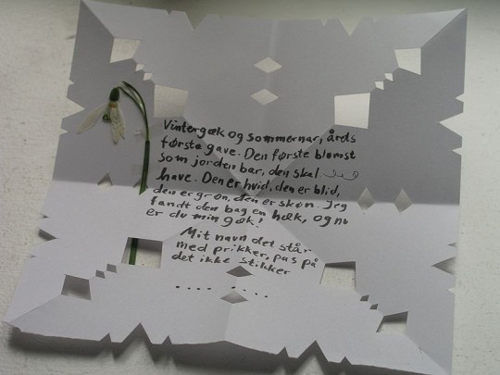
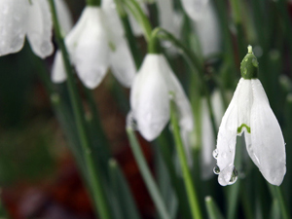
Denmark
In Denmark, Valentine’s Day is a day for young people. They express their love to each other with cards. Men sometimes send a special card called a “joking card” and they don’t sign their name. They only use dots to show how many letters in their name are. The woman has to guess who the card is from. Instead of roses men send snowdrops to their sweethearts.

Slide 5
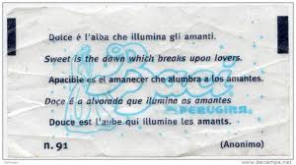
Italy
In Italy, Valentine’s Day is only celebrated by lovers. Couples go out to dinner at a romantic restaurant and afterwards give gifts of perfume, chocolates, flowers, cards or jewelry.

Slide 6
France
In France, lovers send St Valentine’s Day cards to each other. They also visit a monument to St Valentine! It’s a wall where sweethearts write their confessions in all languages; it attracts thousands of tourists.

Slide 7
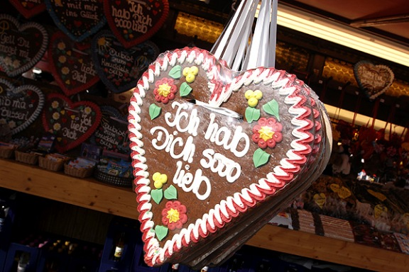
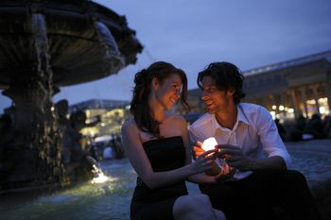
Germany
In Germany, St Valentine is considered to be a patron saint of mentally disabled people. On this day people decorate asylums with red ribbons and a special Mess is served in churches all around Germany.

Slide 8
Wales
In Wales, they cut “love spoons” of wood and give them to those they love. Those “love spoons” are decorated with hearts and keyholes. The keyholes mean : “You’ve got the keys to my heart”.

Slide 9
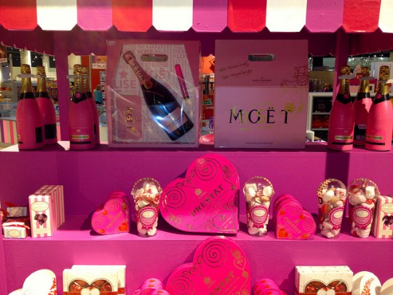
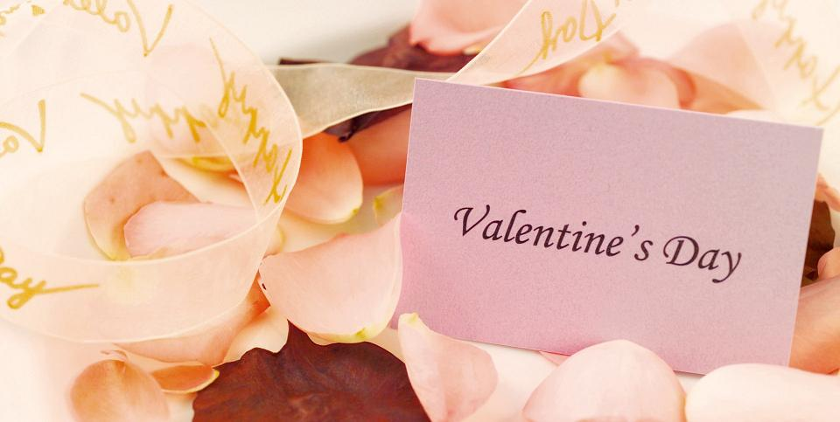
England
In England, on the eve of St.Valentine’s Day, women used to pin four bay leaves to the corner of their pillow and then eat boiled eggs with salt. They believed they would dream of their future husbands.

