Slide 1
Let’s say the chant together!
Show me something red, red!
Here’s something red, red!
Show me something blue, blue!
Here’s something blue, blue!
Show me something green, green!
Here’s something green, green!
Show me something yellow too!
Here’s something yellow too!

Slide 2
Which clothes do you like?
Clothes

Slide 3
Clothes
Theme and objectives
Vocabulary
Speaking activities
Game “Let’s help a mouse!”
Reading: Text “My Clothes”
Listening Activity
Speaking/Writing “Which clothes do you like?”
Vocabulary review

Slide 4
Vocabulary
Tie
Trousers
Shoes
Coat
Blouse
Skirt
7. Hat
8. Sweatshirt
9. Trainers
10. Jacket
11. Gloves
12. Jeans

Slide 5
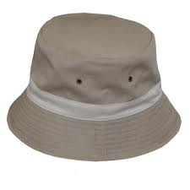
Who’s wearing it?
Nina is wearing a hat.

Slide 6
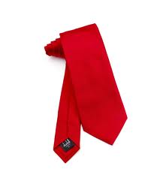
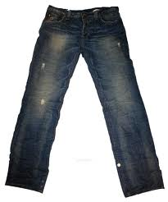
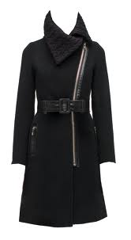
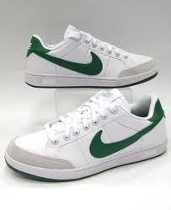
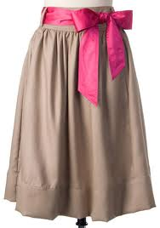

Slide 7
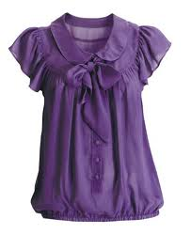
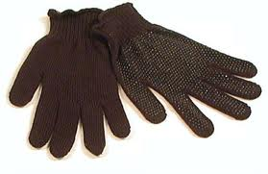
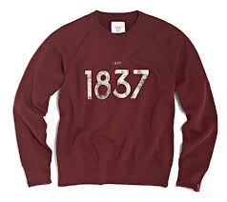
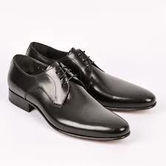

Slide 8
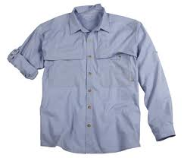
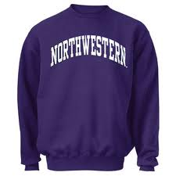
What colour is…?
The shirt is light blue.
The sweatshirt is dark blue.

Slide 9
What colour is…?
What colour is Mr Clark’s tie?
It’s red.
What colour are his shoes?
They are black.

Slide 10
Correct the false statements
Nina is wearing an orange sweatshirt.
Nina and Matt are wearing black trainers.
Mrs Clark is wearing a dark red skirt.
Mr and Mrs Clark are wearing brown shoes.
Matt is wearing a brown jacket.
Nina is wearing a yellow hat.

Slide 11
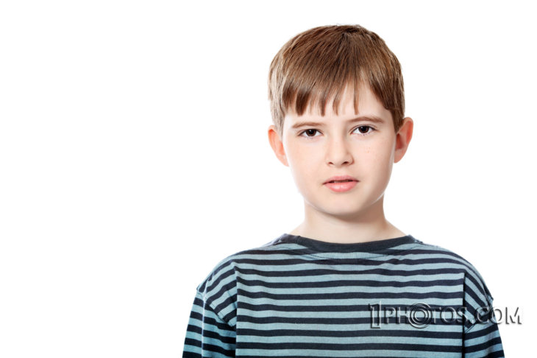
My Clothes

Slide 12
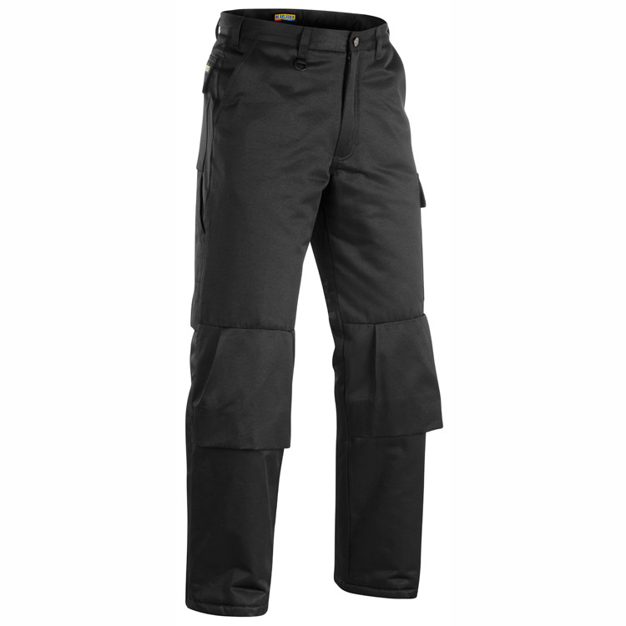
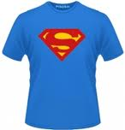
I like and . I don’t like shirts,
but I like T-shirts and .
I also like baseball caps. My favourite colours are blue and red. At school I usually wear my black
or blue ,
and a
or sweatshirt.
At the moment I’m wearing blue ,and a red and blue .

Slide 13
Listening
This person loves wearing jeans.
This person likes trainers.
This person doesn’t like hats.
This person doesn’t like blouses.

Slide 14
Which clothes do you like?
Do you like…?
Which clothes do you like?
Which clothes don’t you like?
What are your favourite colours?

Slide 15
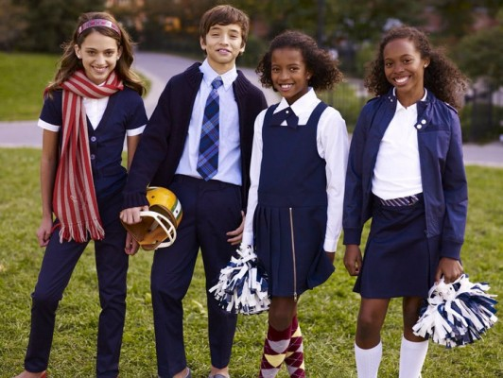
What do you usually wear at school?

Slide 16
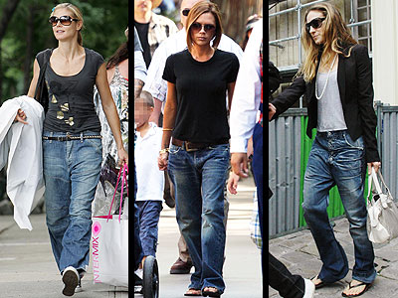
What do you usually wear at home?

Slide 17
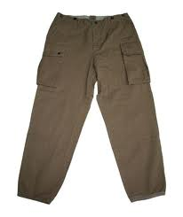
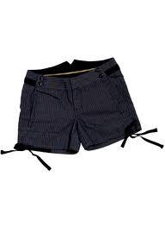
My clothes

Slide 18
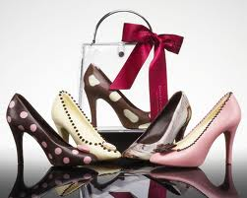
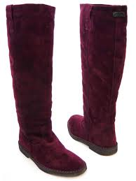
I like…

Slide 19
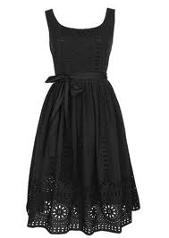
My sister likes…

Slide 20
My brother likes…

Slide 21
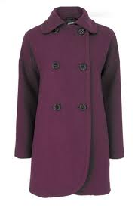
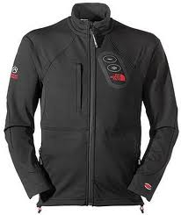
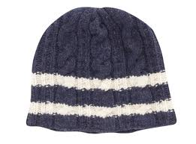
When it’s cold I wear…

Slide 22
Disappearing dialogue
Do you like baseball caps?
Yes, I do. Do you like sunglasses?
Yes, I do. Which clothes do you like?
I like skirts, dresses, blouses. And I really love my new purple boots.
And I hate skirts. I never wear dresses and blouses.
Which clothes do you like?
I like jeans, T-shirts and sweatshirts. My favourite T-shirt is red with a picture of eagle on it.

Slide 23
Do you … baseball caps?
Yes, I do. Do you like …… ?
… , I do. Which … do you like?
I like skirts, … , blouses. And I really love my new …… boots.
And I hate …. . I never wear dresses and … .
Which clothes do you ….. ?
I like ….. , T-shirts and sweatshirts. My favourite T-shirt is red with a ….. of eagle on it.

Slide 24
Do you … baseball …..?
……., I do. Do you like …… ?
… , I do. Which … do you ……?
I … skirts, … , blouses. And I …….. love my new …… boots.
And I hate …. . I never …. dresses and ……….
…….. clothes do you ….. ?
I like ….. , T-shirts and ………… . My favourite ….. is …… with a ….. of eagle on it.

