Slide 1
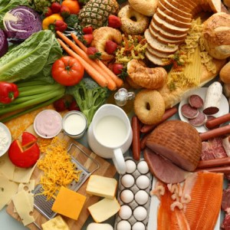
The Food We Eat

Slide 2
The Food We Eat

Slide 3




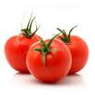



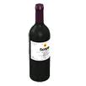



I go shopping
I forgot to buy … I have extra…
Shopping list
I have bought…
eggs
honey
bread
cherry yogurt
a bottle of wine
butter
jam
coffee
cheese
a pack of rice
4 apples

Slide 4
Some/any
Boy: Let’s make some chocolate cake.
Girl: OK. Good idea! Is there _______ flour?
Boy: Yes, there’s _________ in the cupboard.
Girl: Is there ________ sugar?
Boy: No, there isn’t _______ sugar.
Girl: But there’s ________ honey.
Are there ________ eggs?
Boy: No, there aren’t ________ eggs.
But there are _______ chocolate chips and there’s ________ butter.
Girl: Well, let’s make ________ biscuits!

Slide 5
Disappearing dialogue
Boy: Let’s make some chocolate cake.
Girl: OK. Good idea! Is there any flour?
Boy: Yes, there’s some in the cupboard.
Girl: Is there any sugar?
Boy: No, there isn’t any sugar.
Girl: But there’s some honey.
Are there any eggs?
Boy: No, there aren’t any eggs.
But there are some chocolate chips and there’s some
butter.
Girl: Well, let’s make some biscuits!

Slide 6
Boy: Let’s make some ________ cake.
Girl: OK. Good idea! Is there any ________?
Boy: Yes, there’s some in the __________.
Girl: Is there ________ sugar?
Boy: No, there ________ any sugar.
Girl: But there’s ________ honey.
Are ______ any eggs?
Boy: No, there aren’t any _____.
But there are some chocolate _____ and there’s _____
butter.
Girl: Well, let’s _______ some biscuits!

Slide 7
Boy: Let’s ______ some ________ cake.
Girl: OK. _______ idea! Is there any ________?
Boy: Yes, _______ is some in the __________.
Girl: ____ there ________ sugar?
Boy: No, there ________ any _______.
Girl: _____ there’s ________ honey.
Are ______ any ______?
Boy: No, _______ aren’t any _____.
But there __ some chocolate _____ and there’s _____
butter.
Girl: Well, let’s _______ some ________!

Slide 8
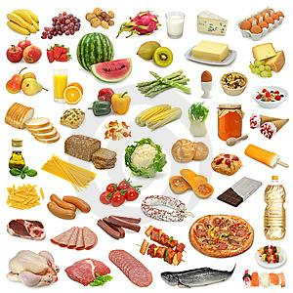
What do you like to eat?
Do you like ……..?
Yes, I do. I love it./ No, I don’t.
How often do you have ………?
I eat ………. once a week.

Slide 9












Vocabulary review
My favourite food is and . But on Sundays my
mother cooks for lunch. We eat it with and
Then we usually have some .
Sometimes we eat or for dinner. And we often
eat and for breakfast. I eat a lot of but I
don’t like .

Slide 10
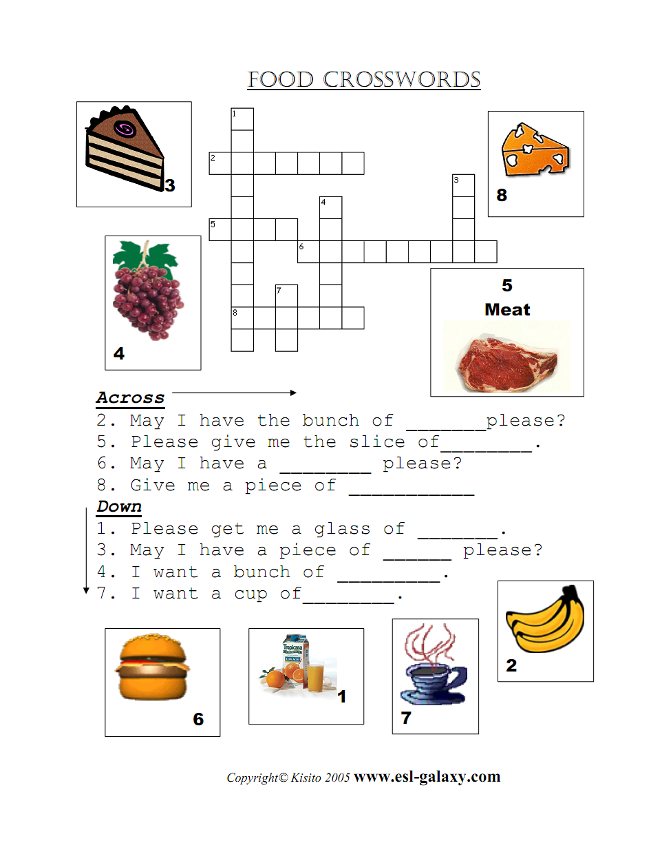

Slide 11
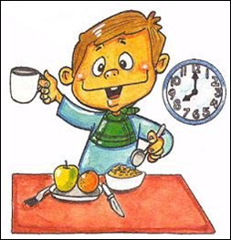
Tom goes to eat breakfast

Slide 12
