Slide 1
Hobbies and Interests
Greeting
Topic and objectives
Homework
New vocabulary
Speaking
Listening
Vocabulary review
A game “Magic bag”
Conclusions
Homework

Slide 2
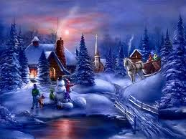
Let’s speak about winter

Slide 3

Hobbies and interests

Slide 4
Homework
Dialogues
Do you like…?
Yes, I do/No, I don’t.
How often…?
Sometimes/Often/Never.

Slide 5
New vocabulary
Watching TV
Reading
Playing computer games
Going out with friends
Listening to pop music
Going to the cinema
Playing chess
Collecting badges
Playing with cars
Making models
Drawing and painting
Playing the guitar

Slide 6
Speaking
Answer the questions.
What are your hobbies?
What’s your favourite hobby?
Do you like listening to music?
Do you like reading?
Do you like going to the cinema?
Do you like going out with the friends?
Do you like drawing and painting?
Do you like playing computer games?
Do you like watching TV?

Slide 7



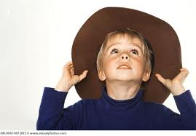
Listening

Slide 8
Meg | Freddy | Layla | Tim

Slide 9
vocabulary review

Slide 10
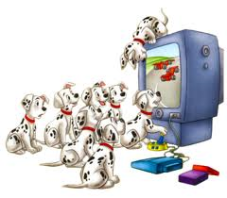

Slide 11


Slide 12


Slide 13


Slide 14


Slide 15
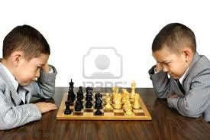

Slide 16
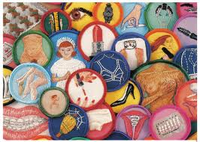

Slide 17
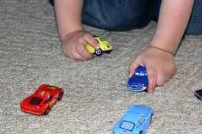

Slide 18
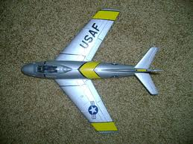

Slide 19
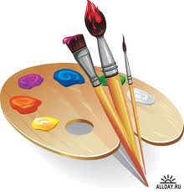

Slide 20
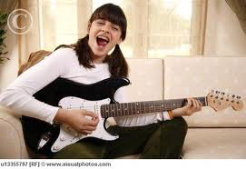

Slide 21
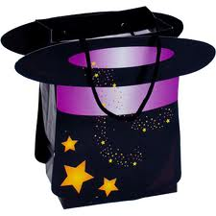
Let’s play “a magic bag”

Slide 22

Thank you and good bye

