Slide 1
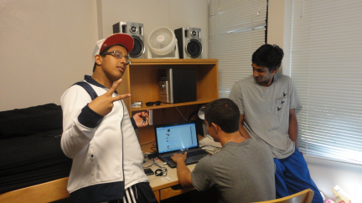
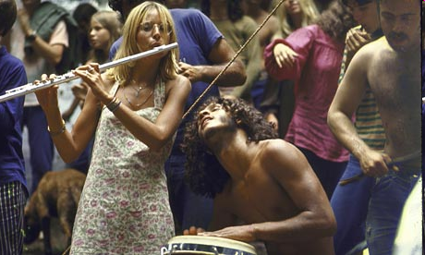
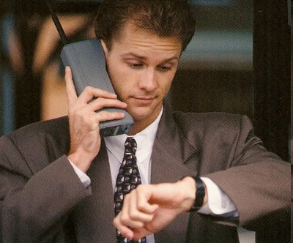
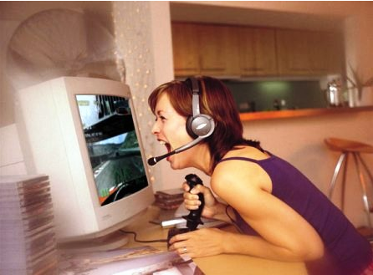
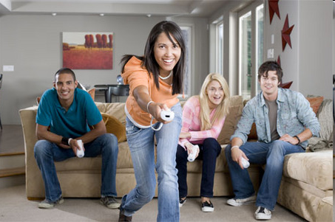
1) Describe. 2) Compare and contrast. 3) Speculate. 4) React.
Talking about photos

Slide 2
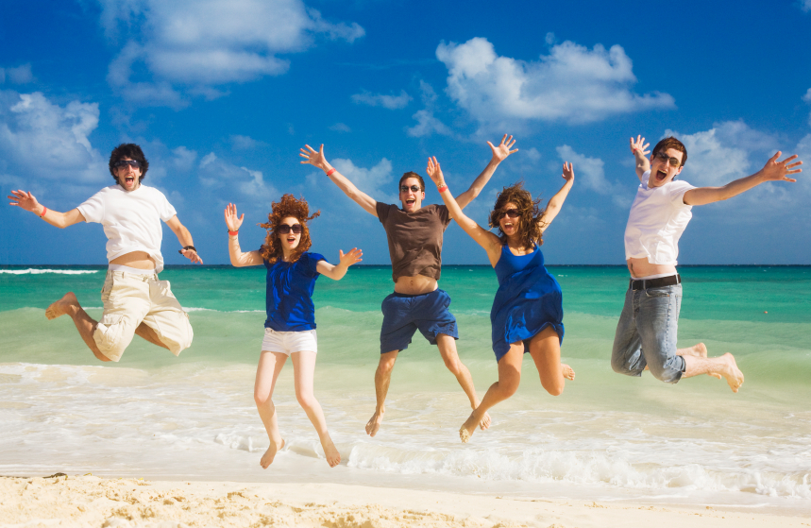
1) Describe. 2) Compare and contrast. 3) Speculate. 4) React.
1) Describe the photo.
Describe what you can see and what is happening in the photos.
Say where it’s happening; ie on the right / left, at the bottom / top, in the middle, behind, in front...
Use Present Continuous. What are they doing?
What clothes are they wearing
What’s the weather like?
Are they inside or outside?
Use adjectives. Do they look happy, sad, angry, bored, tired..?
How does the photo make you feel?
Would you like to be there? Why / Why not?

Slide 3
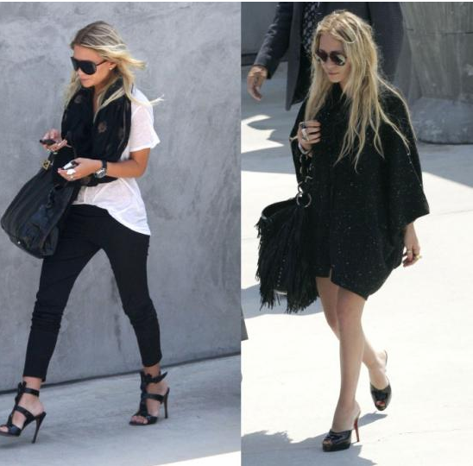
1) Describe. 2) Compare and contrast. 3) Speculate. 4) React.
Comparing and contrasting photos
What vocabulary do we use?
Similarities; all, ...
... and
Differences; ... but ...

Slide 4
1) Describe. 2) Compare and contrast. 3) Speculate. 4) React.
Comparing and contrasting photos
What vocabulary do we use?
Similarities; all, most, some, both...
... and, also, as well, too
Differences; ... but / however / whereas / while / on the other hand...
Although...
“In both photos the woman is blond. In the photo on the left she is wearing a white shirt whereas in the photo on the right she is wearing a black coat”.

Slide 5
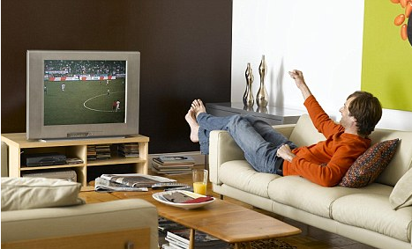
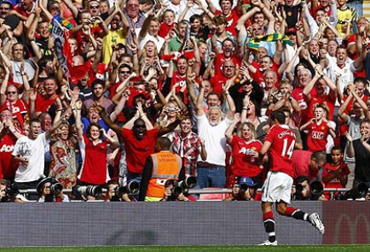
1) Describe. 2) Compare and contrast. 3) Speculate. 4) React.
Speculate about the situation
What language do we use?

Slide 6
1) Describe. 2) Compare and contrast. 3) Speculate. 4) React.
Speculate about the situation
What language do we use?
Use may / might / could / must / can’t be...
He seems to / appears to be...
Make some sentences

Slide 7
1) Describe. 2) Compare and contrast. 3) Speculate. 4) React.
Speculate about the situation
What language do we use?
Use may / might / could / must / can’t be...
He seems to / appears to be...
Make some sentences
“They seem to be very happy. Their team must be winning”.

Slide 8
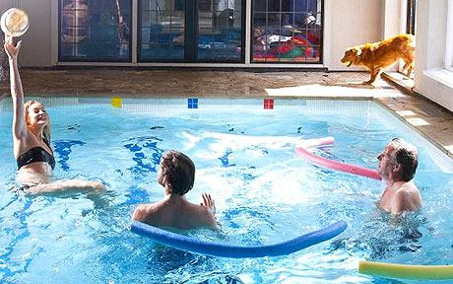
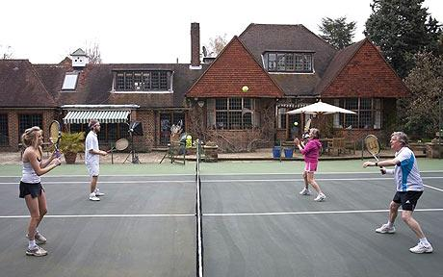
1) Describe. 2) Compare and contrast. 3) Speculate. 4) React.
Give your reaction
What language can we use?

Slide 9
1) Describe. 2) Compare and contrast. 3) Speculate. 4) React.
Give your reaction
What language can we use?
I’d love / hate to do that!
It looks great / dangerous / awful!
It makes me want to try / go there...
It wouldn’t suit me.

Slide 10
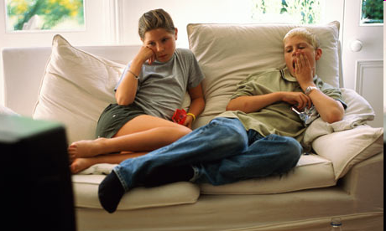
1) Describe. 2) Compare and contrast. 3) Speculate. 4) React.
Now talk about some of the following photos.

Slide 11
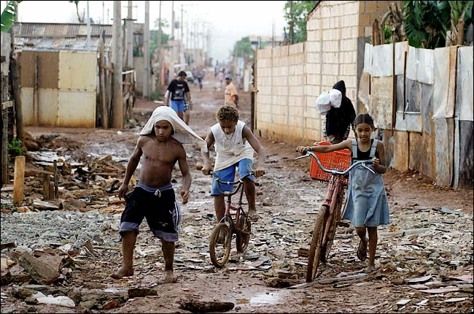
1) Describe. 2) Compare and contrast. 3) Speculate. 4) React.

Slide 12
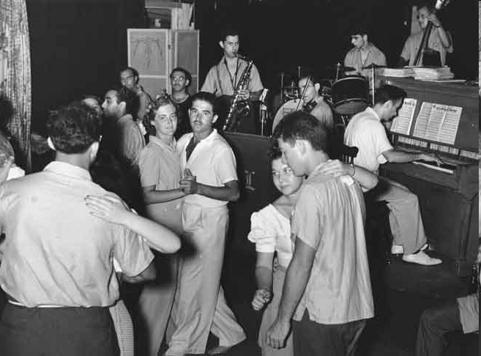
1) Describe. 2) Compare and contrast. 3) Speculate. 4) React.

Slide 13
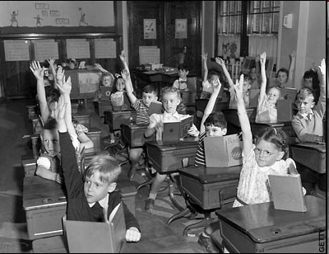
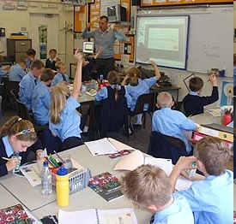
1) Describe. 2) Compare and contrast. 3) Speculate. 4) React.

Slide 14
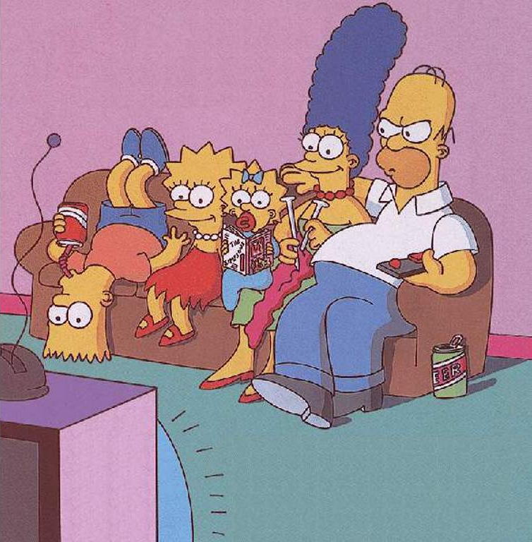
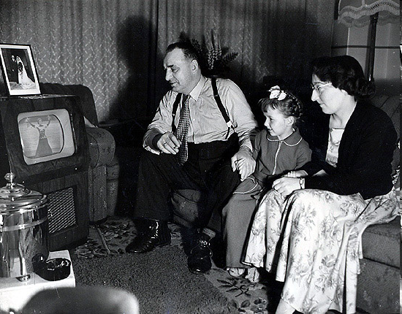
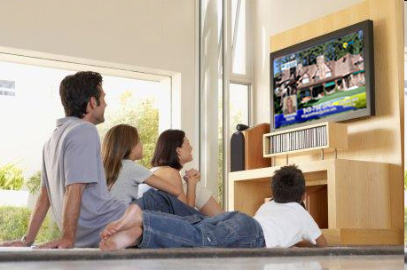
1) Describe. 2) Compare and contrast. 3) Speculate. 4) React.

Slide 15
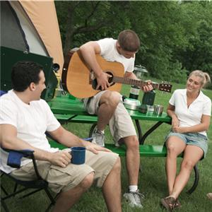
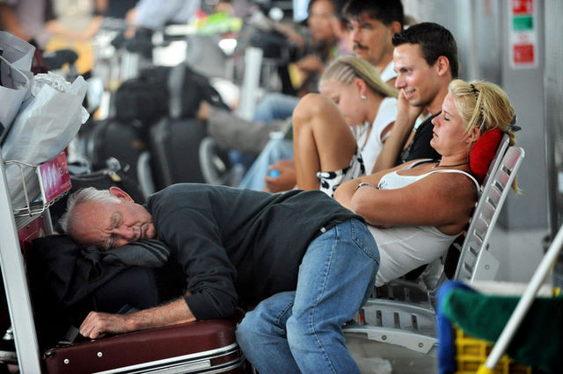
1) Describe. 2) Compare and contrast. 3) Speculate. 4) React.

Slide 16
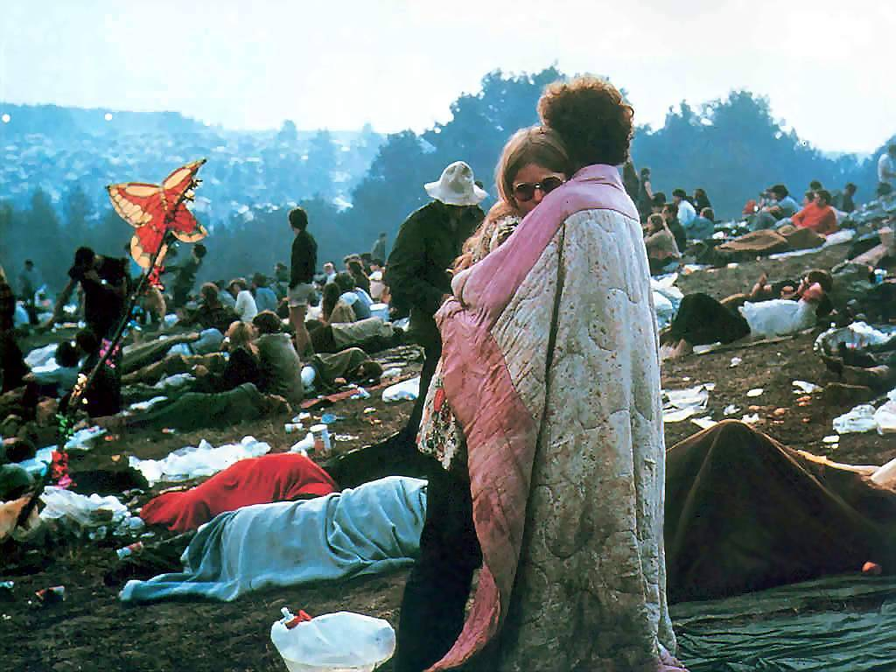
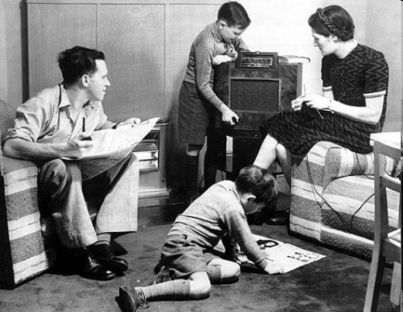
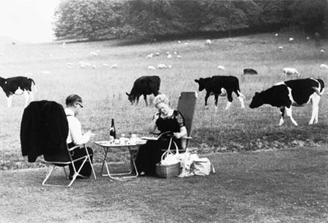
1) Describe. 2) Compare and contrast. 3) Speculate. 4) React.

Slide 17
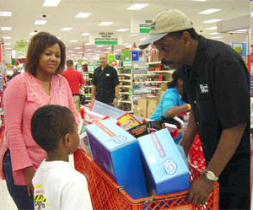
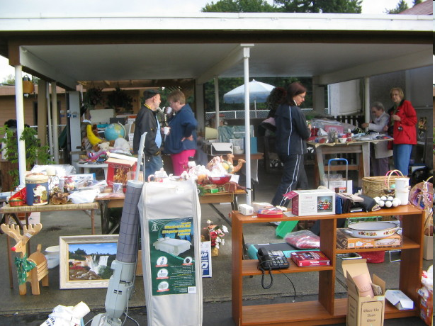
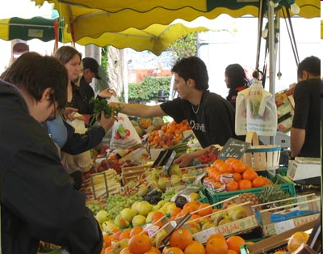
1) Describe. 2) Compare and contrast. 3) Speculate. 4) React.

Slide 18
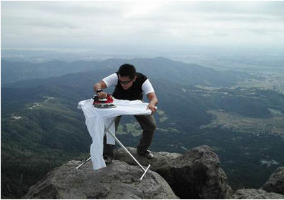
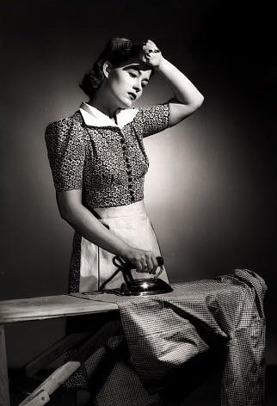
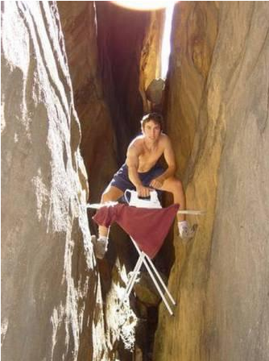
1) Describe. 2) Compare and contrast. 3) Speculate. 4) React.

Slide 19
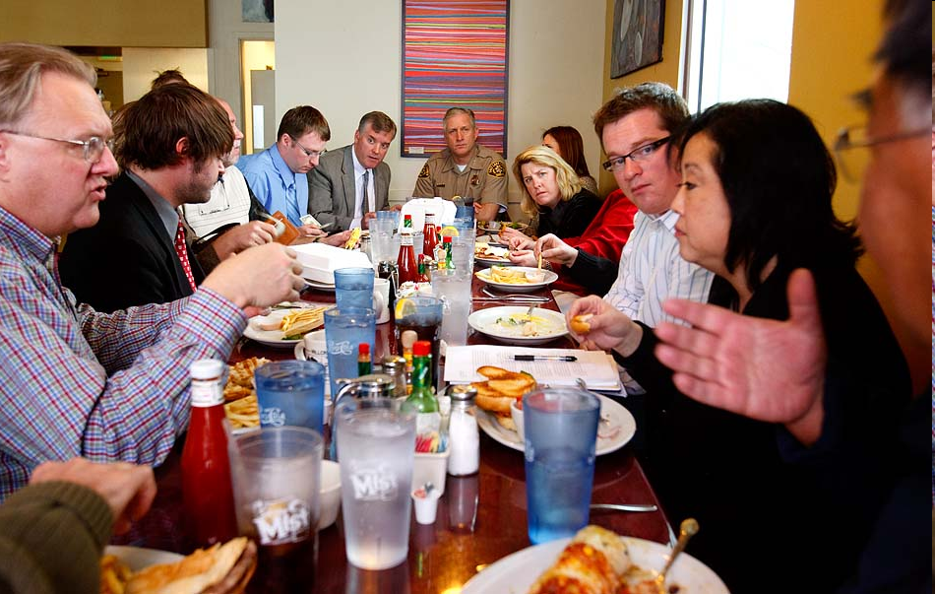
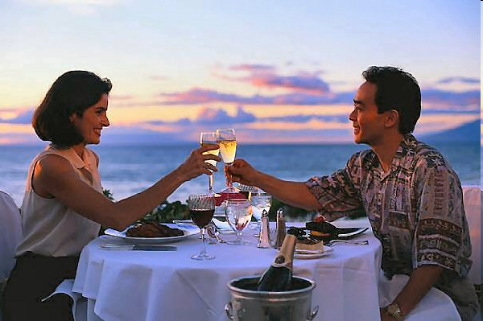
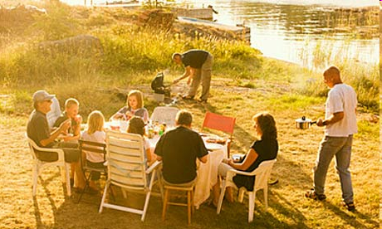
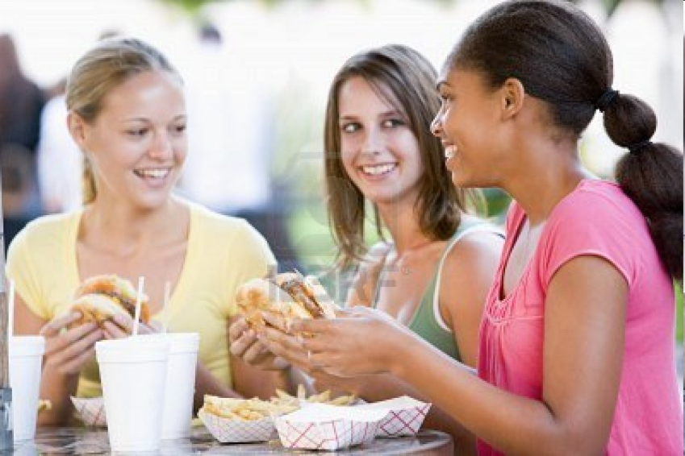
1) Describe. 2) Compare and contrast. 3) Speculate. 4) React.

Slide 20
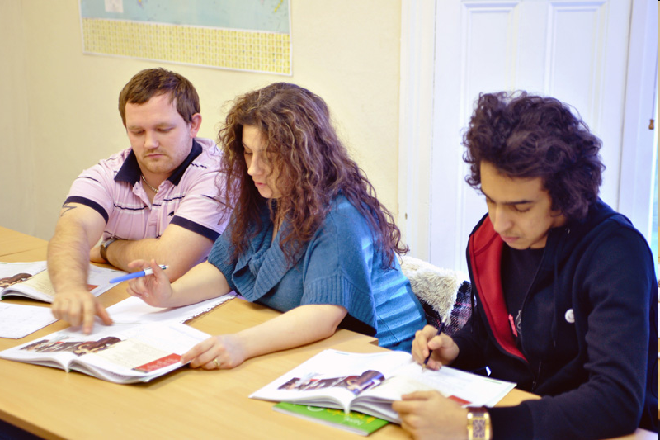
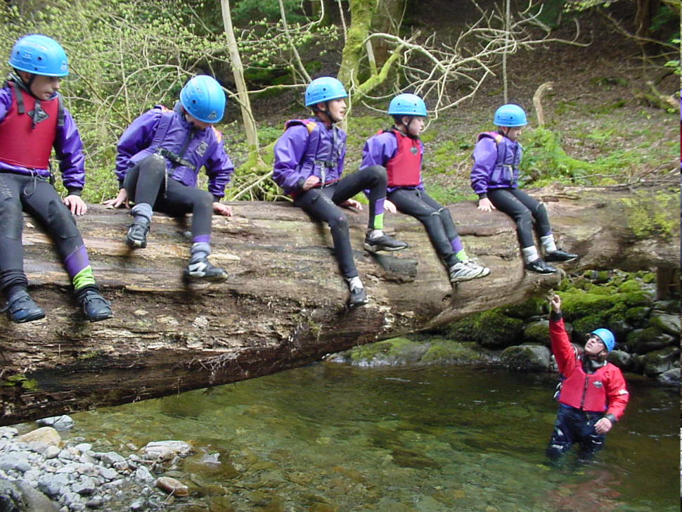
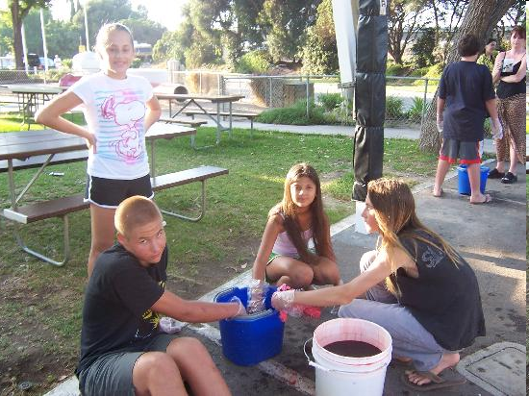
1) Describe. 2) Compare and contrast. 3) Speculate. 4) React.

Slide 21
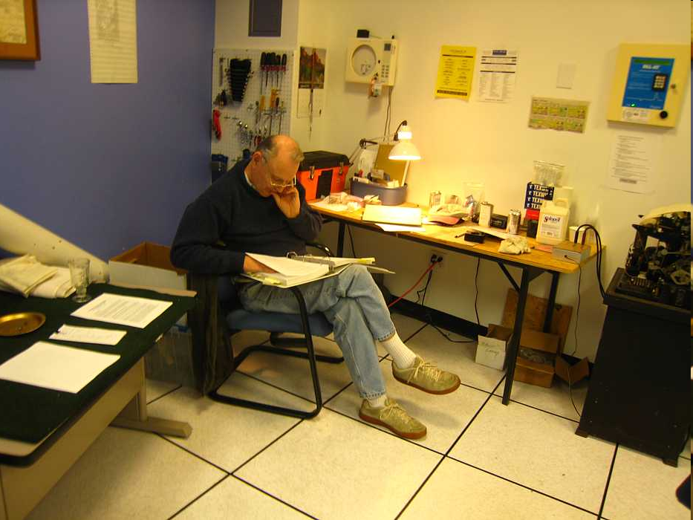
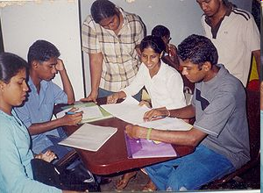
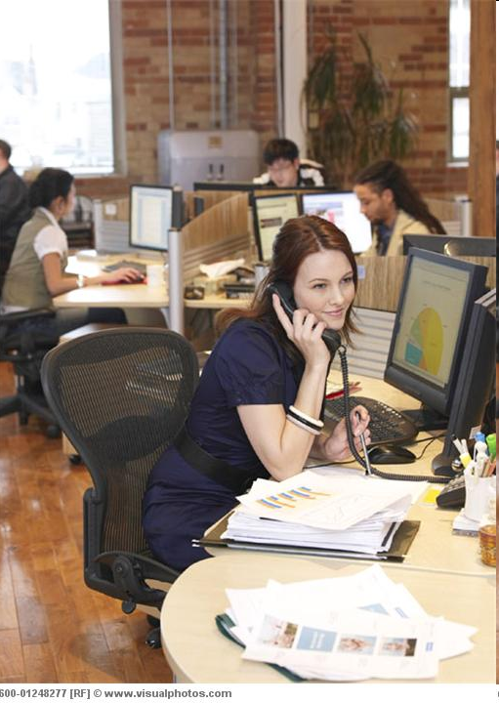
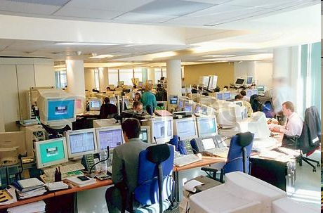
1) Describe. 2) Compare and contrast. 3) Speculate. 4) React.

Slide 22
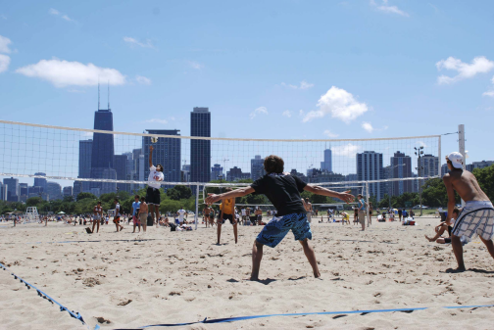
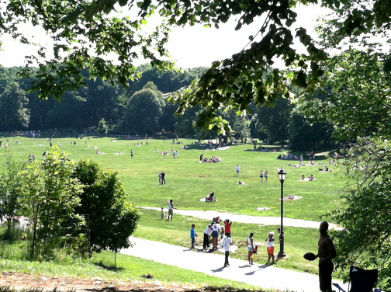
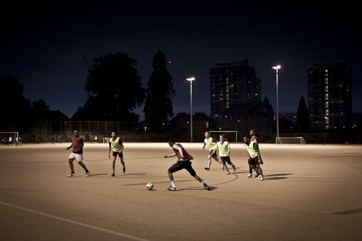
1) Describe. 2) Compare and contrast. 3) Speculate. 4) React.

Slide 23
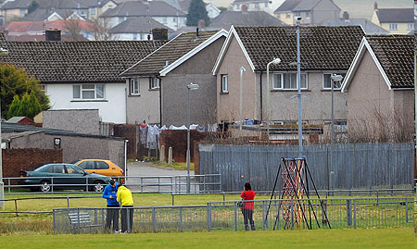
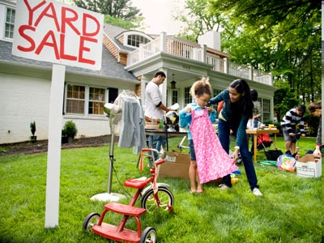
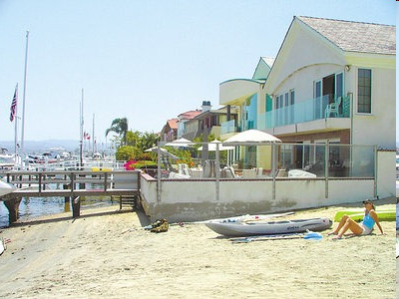
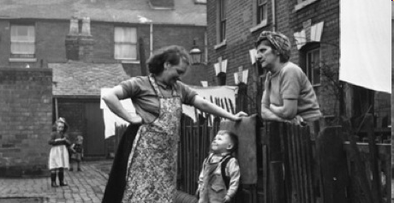
1) Describe. 2) Compare and contrast. 3) Speculate. 4) React.

Slide 24
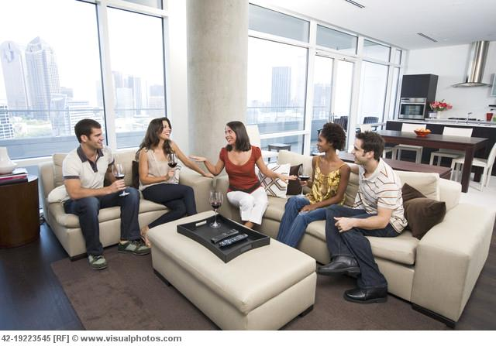
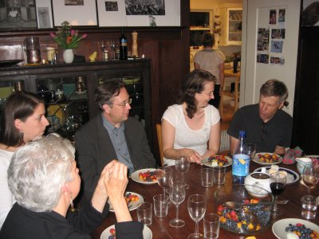
1) Describe. 2) Compare and contrast. 3) Speculate. 4) React.

Slide 25
1) Describe. 2) Compare and contrast. 3) Speculate. 4) React.

Slide 26
1) Describe. 2) Compare and contrast. 3) Speculate. 4) React.

Slide 27
1) Describe. 2) Compare and contrast. 3) Speculate. 4) React.

Slide 28
1) Describe. 2) Compare and contrast. 3) Speculate. 4) React.
1) Describe the photo.
Describe what you can see and what is happening in the photos.
Say where it’s happening; ie on the right / left, at the bottom / top, in the middle, behind, in front...
Use Present Continuous. What are they doing?
What clothes are they wearing
What’s the weather like?
Are they inside or outside?
Use adjectives. Do they look happy, sad, angry, bored, tired..?
How does the photo make you feel?
Would you like to be there? Why / Why not?
2) Comparing and contrasting photos
Similarities; all, most, some, both...
... also, as well, too.
Differences; ... but / however / whereas / while / on the other hand...
Although...
3) Speculate about the situation
Use may / might / could / must / can’t be...
He seems to / appears to be...
4) Give your reaction
I’d love / hate to do that!
It looks great / dangerous / awful!
It makes me want to try / go there...
It wouldn’t suit me.

