Slide 1
“Taking into account
the individual characteristics of students through personality oriented learning of foreign language”
Teacher of English
Demchyshyn Mariia Vasylivna
School of Dubenka
Monastyrysk district
Ternopil region

Slide 2
Mariia demchyshyn high education:ivano-frankivsk pedagogical institute(1992)
My vital credo: “If you want to be somebody really special, be yourself”
My teaching credo:
«Knowledge has a value only when it helps a man to become a Man »
«The personality orientated education claims that the man is the greatest value around whom other public priorities are founded ", - says І.D. Bekh

Slide 3
Purpose and objectives
-Form professional competence in relation to the individual features of students in the personality orientated studies; -find out factors of influence are on the individual featuresof students; -improve application of innovative technologies with taking into account of individual features of students; -raise motivation of students in relation to the study of English and discover the use of individual experience of child; -to get to know personalities themselves

Slide 4
Використання інноваційних технологій
- project studies;
-developing studies;
-development of the
critical thinking;
-personality orientated
studies;
-computer technologies
D.Dyui
О.Pometun
М.Lipman
І.Yakymanska
А.Yershov

Slide 5
PERSONALITY ORIENTED LESSON
orientation
actualization, problems, intrigue, playing situation , forming of cognitive interest
aims
projects
encouragement, creation of evidently-vivid presentations, educational-cognitive game, situation of success
implementation
Control, evaluation
Search of alternative decisions,
implementation of creative tasks,
creation of situation of mutual help

Slide 6
I use in my work:
Group work
Tasks of level differenciation
Project work
Personality oriented education
Pair work
Games
Untraditional
lessons

Slide 7
pupils
Technology of multilevel training
A group: strong children,creative work
B group:suffient children
C group:children need a support

Slide 8
Advantages of the personality oriented studies before traditional:
-education of cognitive interest;
-creation of positive motivation of studies;
-forming of strong and operating knowledge;
-development of intellectual sphere of personality;
-forming abilities and skills of self-education;
-development of cognitive activity and independence;
-forming of social competence (cooperation, work in groups).

Slide 9
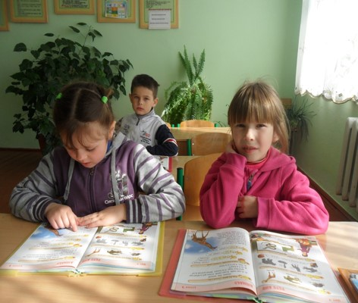
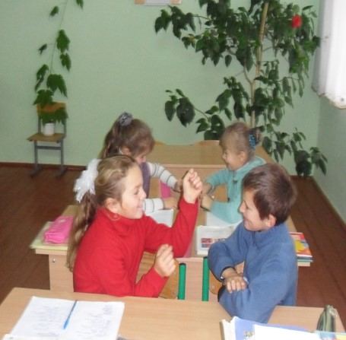
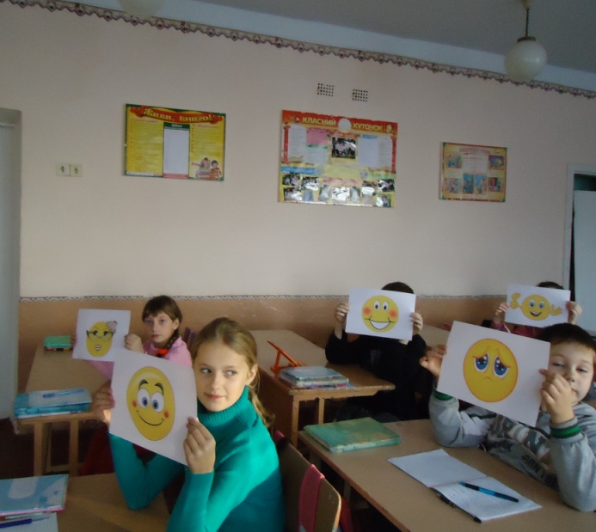
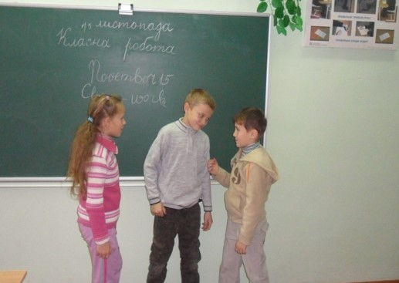
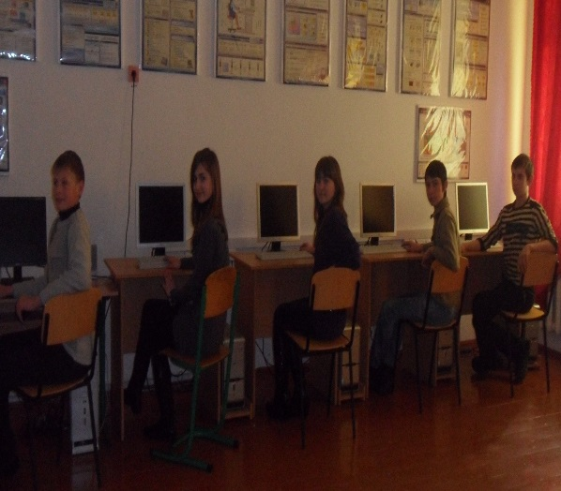
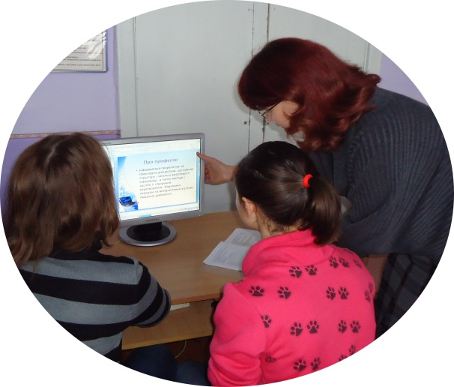
Welcome to my lessons
«reading is exciting»
Work in pairs
I am smiling
Work in groups
It technologies

Slide 10
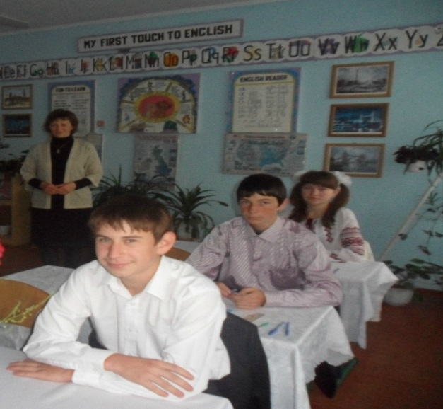
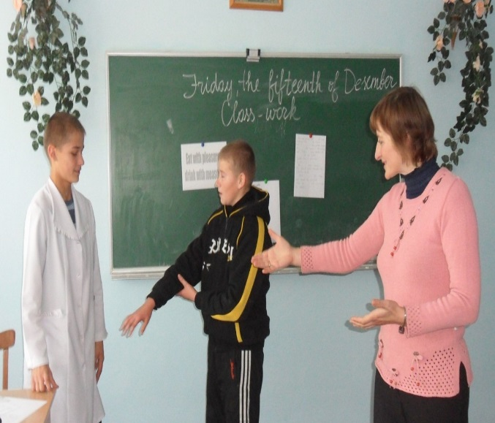
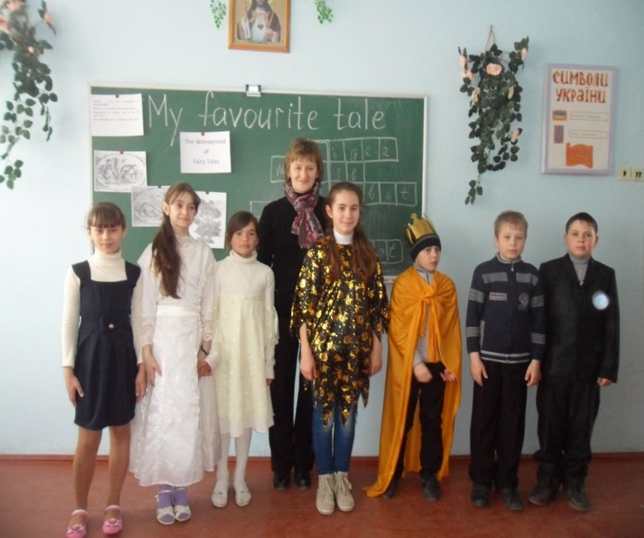
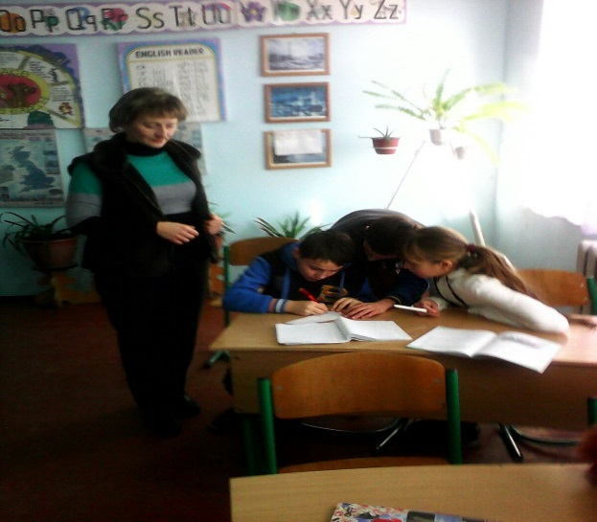
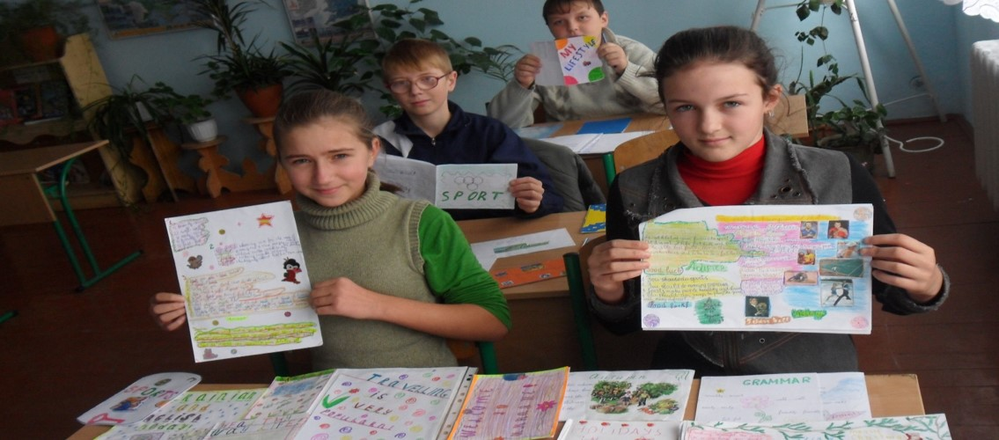
SCHOOL IS COOL!
Untraditional lessons
«travelling to london
«health is above wealth»
«My favourite tale»
«cooking is my hobby»
Project work

Slide 11
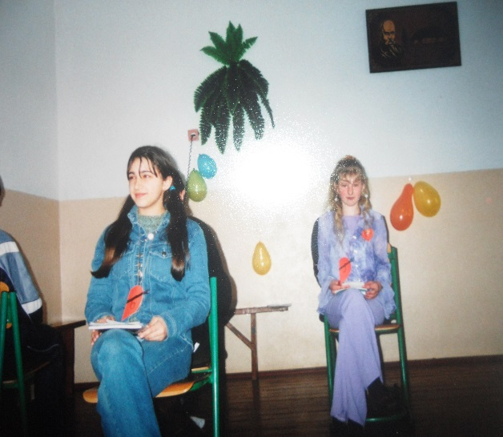
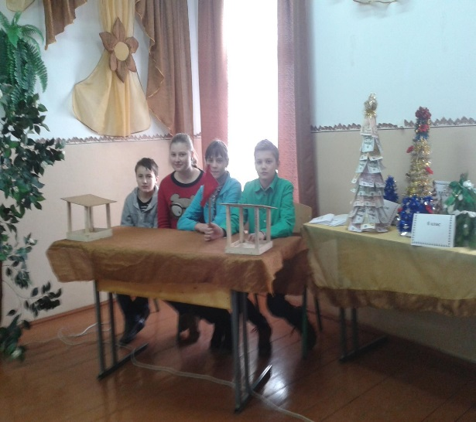
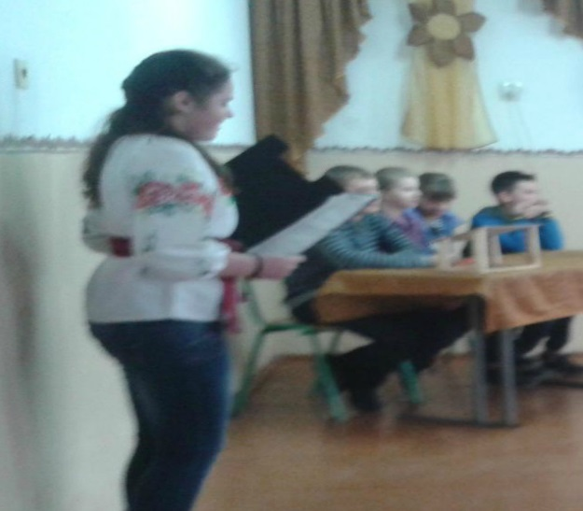
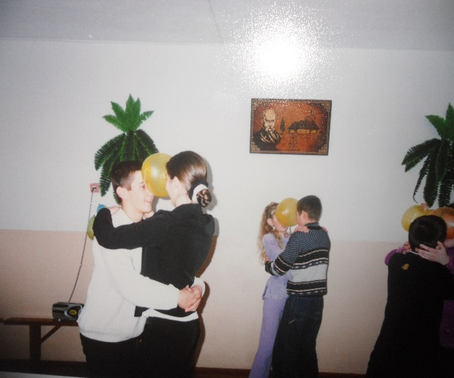
Extracurricular activity
Parties and Holidays
St. Valentine`s day
Christmas at school
Harvest holiday
Baloon party

Slide 12
Diagnostic
If pedagogics wants to educate a person in all aspects, it must know how to do it in
all aspects.

Slide 13
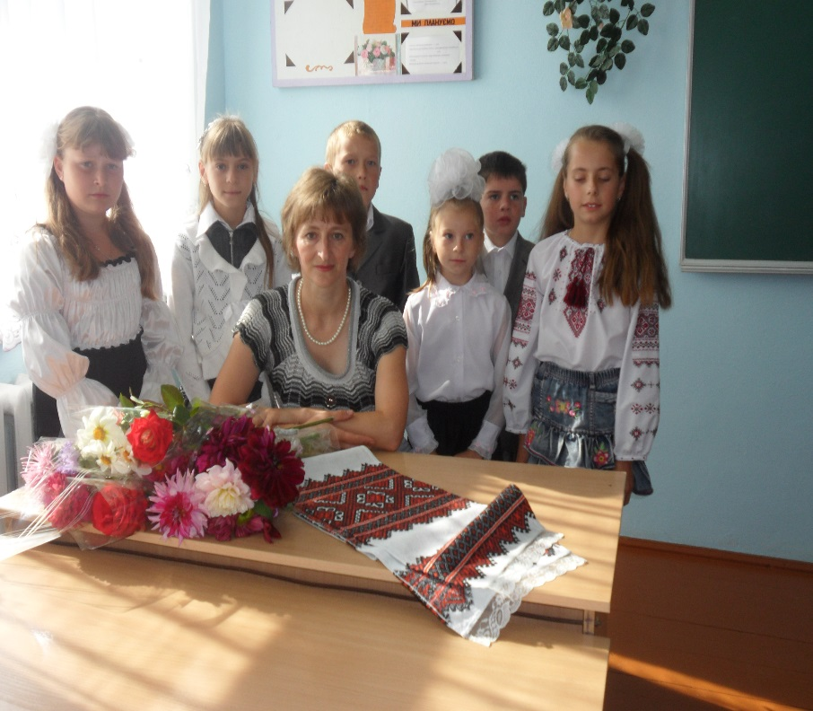
TEACHER`S P. S.
Учителю суджено бути пошуковцем, винахідником, а відтак, слід сповна усвідомити сутність змін, які приносить новий час, аби підготувати людину до життя в нинішньому столітті.
Від здатності вчителя дати гідну відповідь на виклики XXI століття залежатимуть долі мільйонів поки що маленьких українців, та й, власне, майбутнє самої України.
I am not intended to become better than others, I just want to become better of myself

