Slide 1
School Subjects Days of the week
I
G
SCHOOL LIFE
B
C
Е
F
A
D
H
G
F
Е
D
C
B
A

Slide 2
Phonetic drill
[eı] | [ð] | [aı] | [α:]
eight | they | light | class
say | their | write | large

Slide 3
Read the poem
“How Many Days Has My Baby To Play”.
How many days has my baby to play?
How many days has my baby to play?
Sundаy, Monday, Tuesday, Wednesday,
Thursday, Friday, Saturday.
My baby plays every day.

Slide 4
?
Put in right order
Put in right order
Wednesday
Sunday
?
?
Saturday
Friday
Monday
Tuesday
Thursday

Slide 5
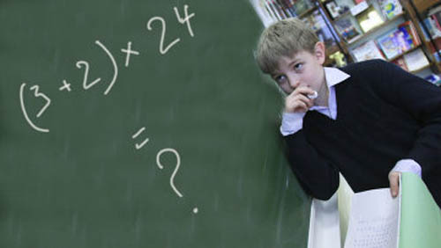
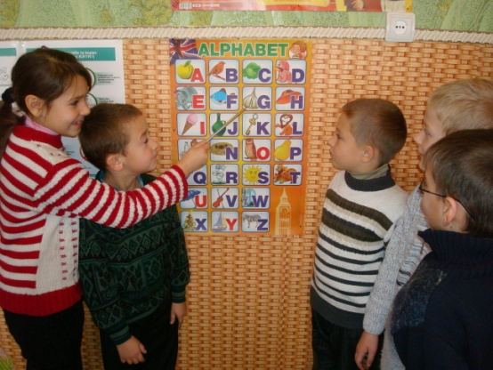
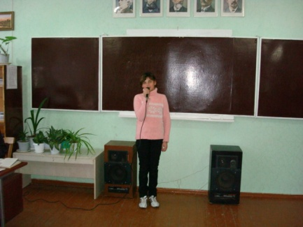
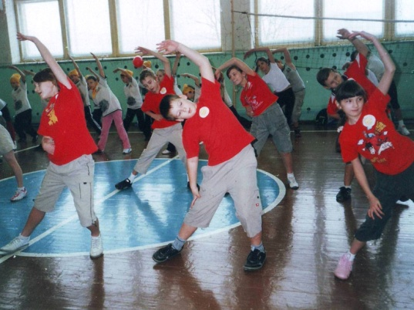
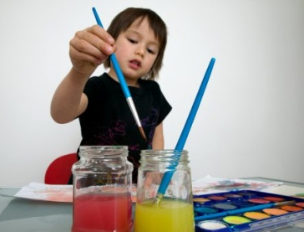
Read and match
Read and match
a) b) c) d)
1. draw, paint
2. speak, read and write English
3. count, do sums
e) 4. read texts, learn poems
5. sing songs, play music
6. jump, run, play sport
f)

Slide 6
New words
Reading [ri:dıŋ]
Music ['mju:zık]
Art [α:t]
Sport [spͻ:t]
English ['ıŋɡlıʃ]
Maths [mӕθs]
Ukrainian [ju:'kreınjən]

Slide 7
Guess the puzzle
r | e | a | d | i | n | g | h
i | n | i | k | h | g | h | g
s | g | d | h | j | h | k | l
y | l | u | i | h | m | h | f
u | i | i | g | f | a | r | t
f | s | p | o | r | t | h | j
b | h | d | f | g | h | f | g
n | e | n | m | u | s | i | c

Slide 8
Guess the puzzle
r | e | a | d | i | n | g | h
i | n | i | k | h | g | h | g
s | g | d | h | j | h | k | l
y | l | u | i | h | m | h | f
u | i | i | g | f | a | r | t
f | s | p | o | r | t | h | j
b | h | d | f | g | h | f | g
n | e | n | m | u | s | i | c

Slide 9
Checking
1. What day is it today? a) I like Art.
2. Which lesson do you like? b) It’s Monday.
3. Do you like Music? c) It’s on Monday and Wednesday.
4 When is Maths? d) No, I don’t. I don’t like singing.

Slide 10
Talk with your friend
A. Which lesson do you like?
B. I like …
A. What do you do at this lesson?
B. We …

