Slide 1
Teaching English grammar at primary school
Class 4. High Fly 3.
Present Simple (positive,negative,questions)

Slide 2
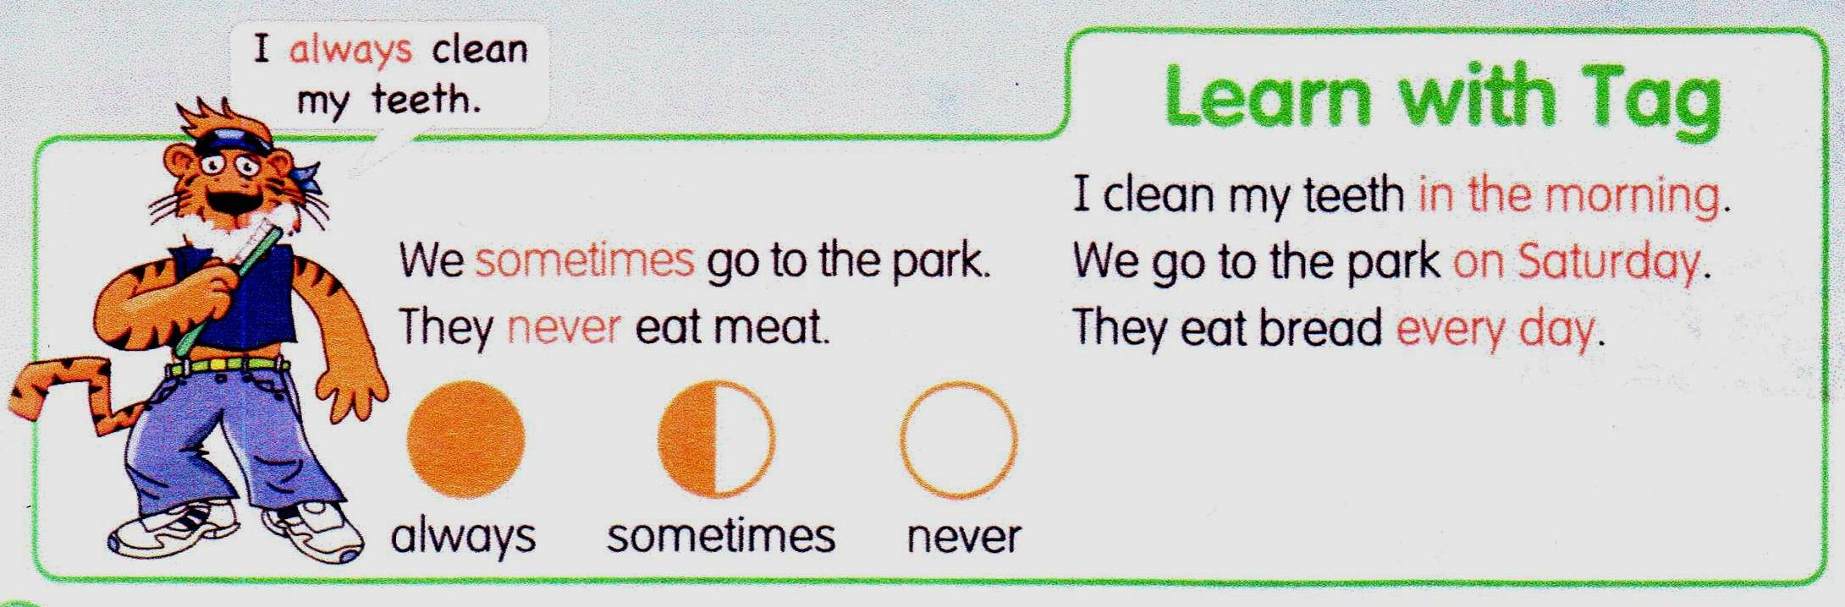
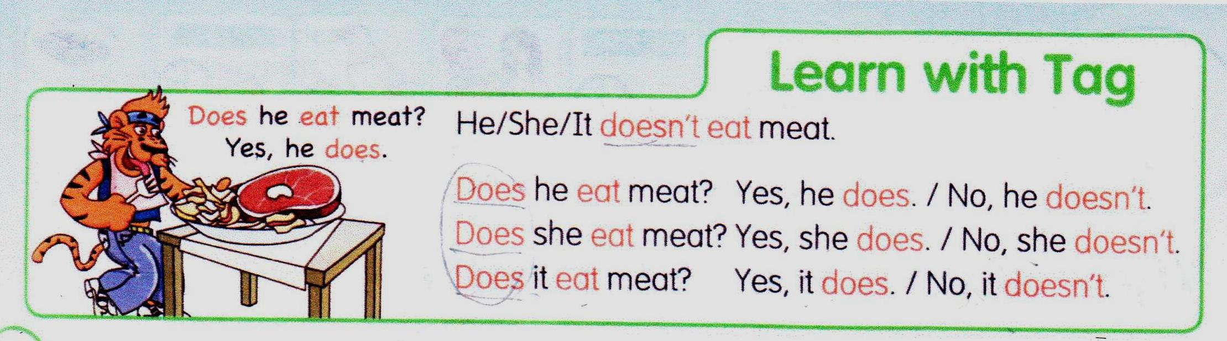
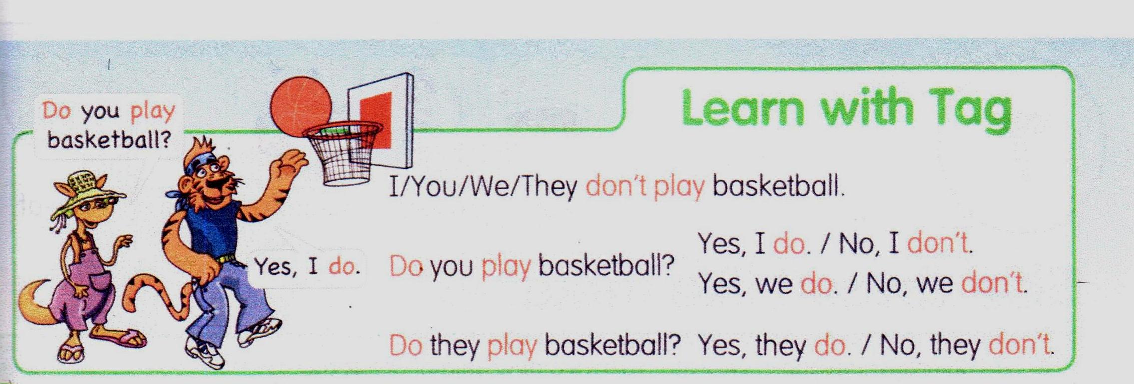

Slide 3
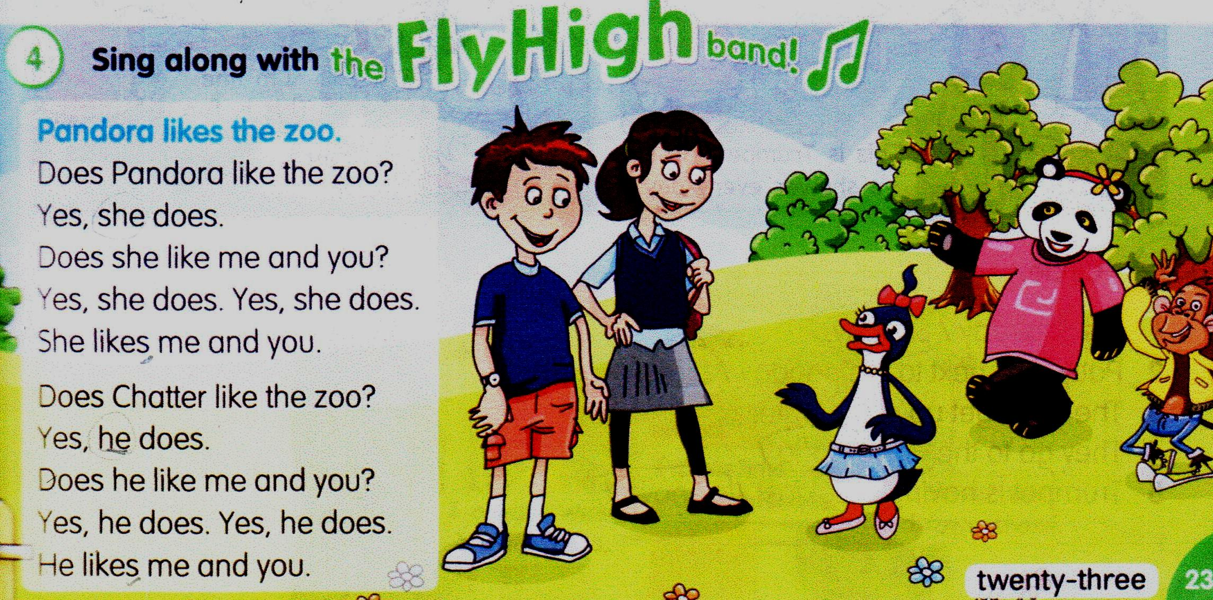


Slide 4
Play “Guess what I do”
I do it
at the weekend.

Slide 5
Teaching English grammar at basic school
Class 7. Access 2.
“Will” for prediction(positive,negative,questions)
Speaking activity “Global warming – global changes”

Slide 6

The Earth is our home

Slide 7
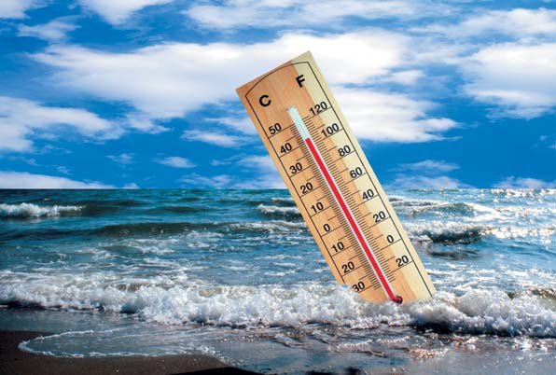
Global warming - global changes

Slide 8
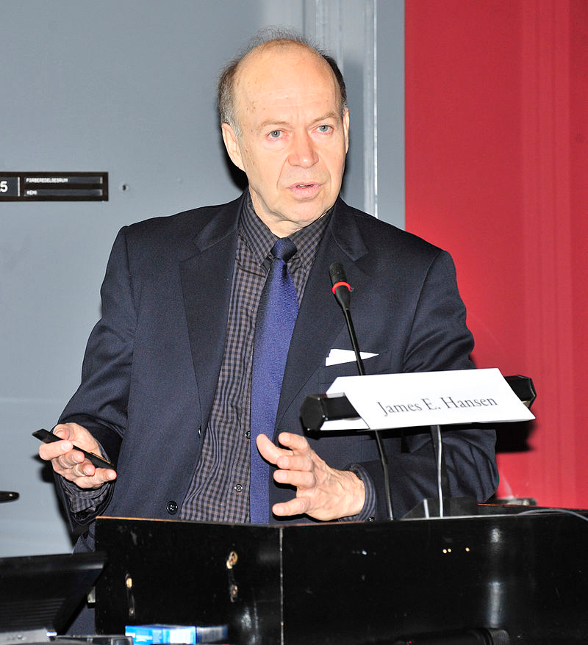
«Global warming isn't a prediction; it's happening»
James Hansen

Slide 9
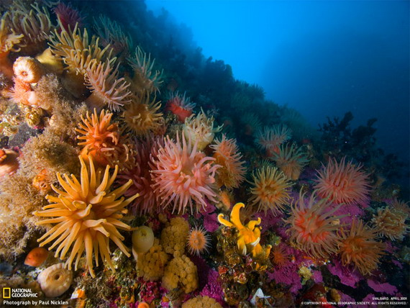
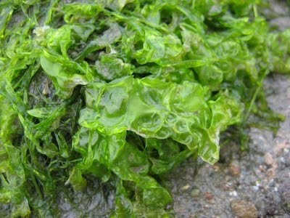
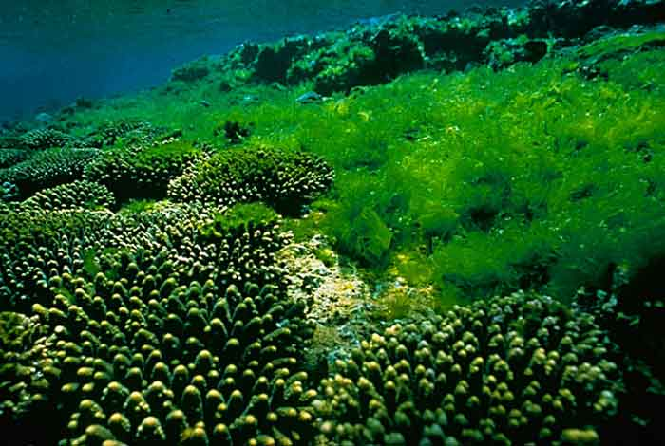
Water
plants

Slide 10
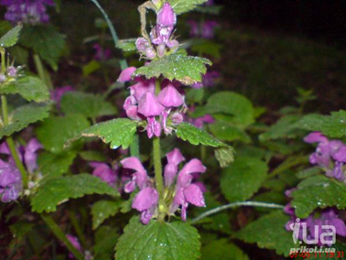
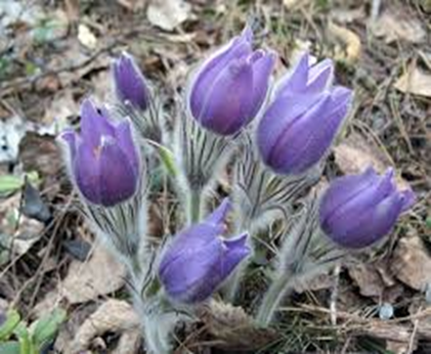
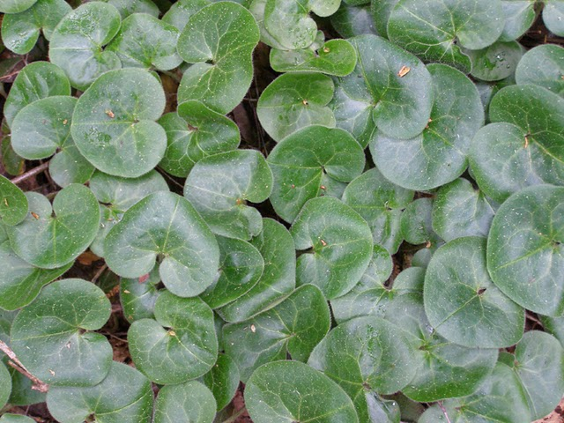
Land
plants

Slide 11
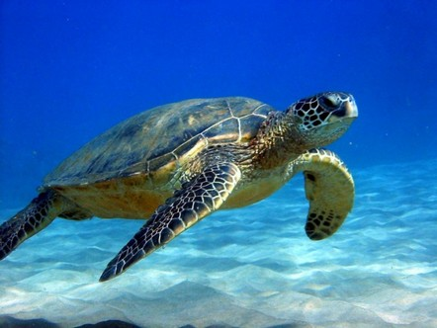
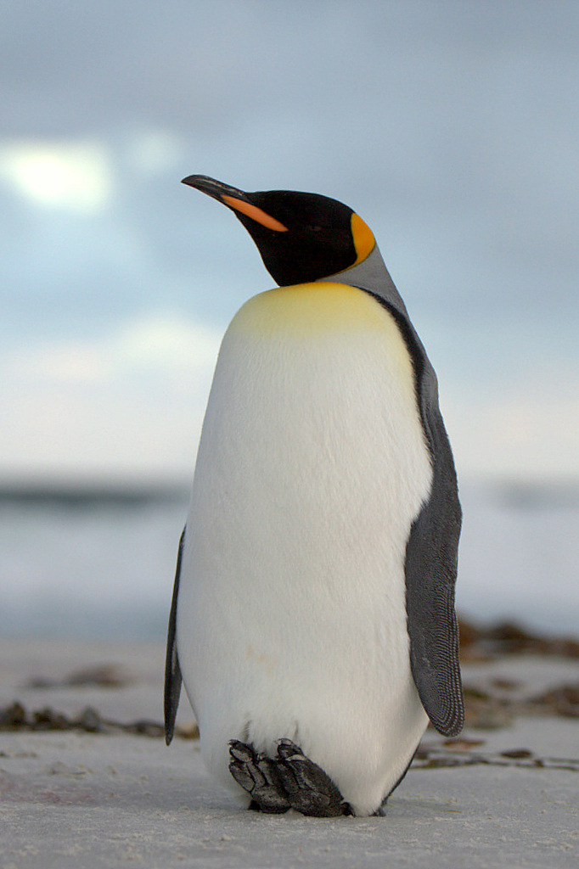
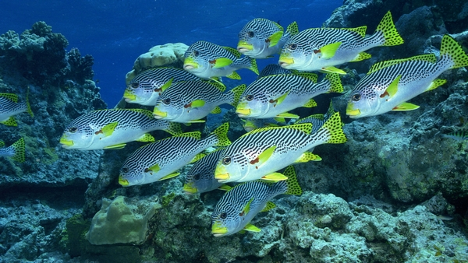
Sea animals

Slide 12
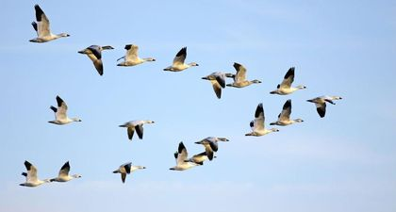
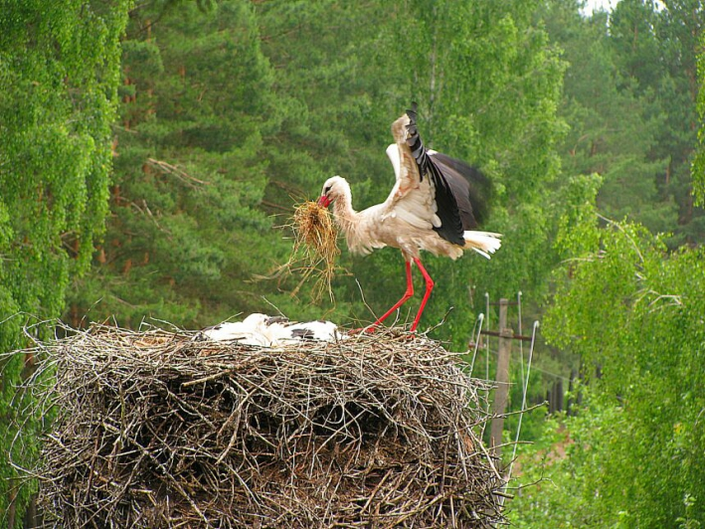
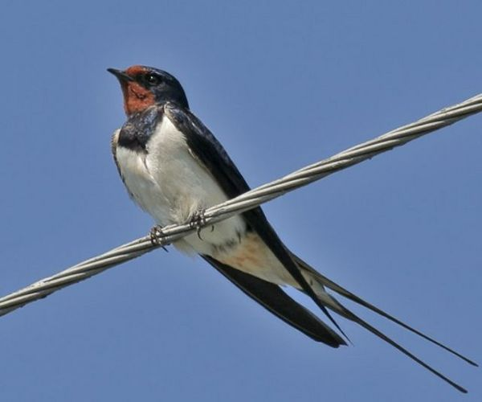
Birds

Slide 13
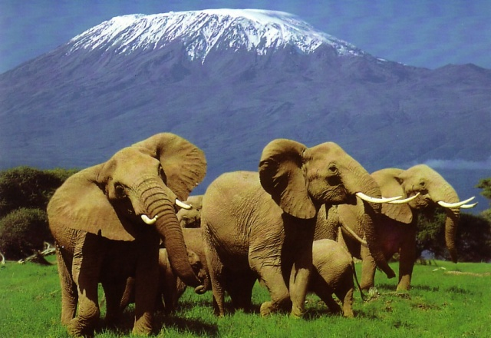
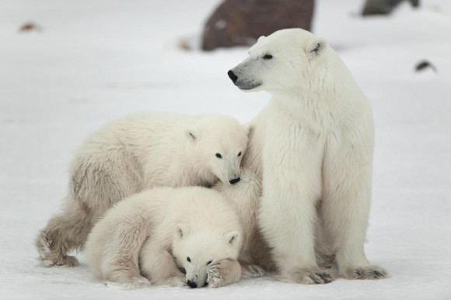
Land
animals

Slide 14
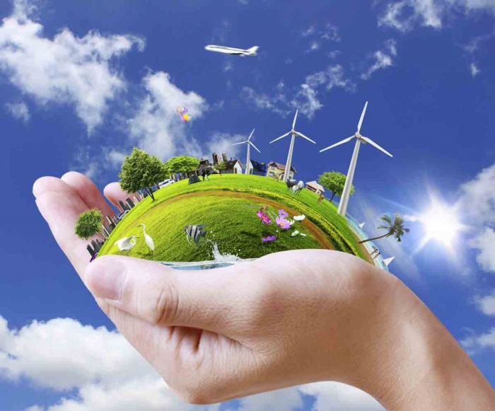
Solutions

Slide 15
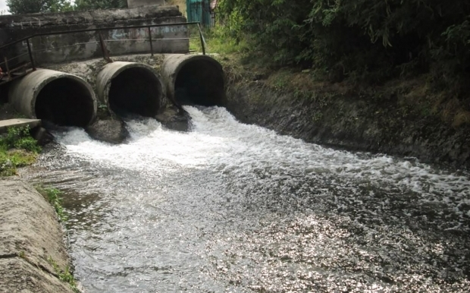
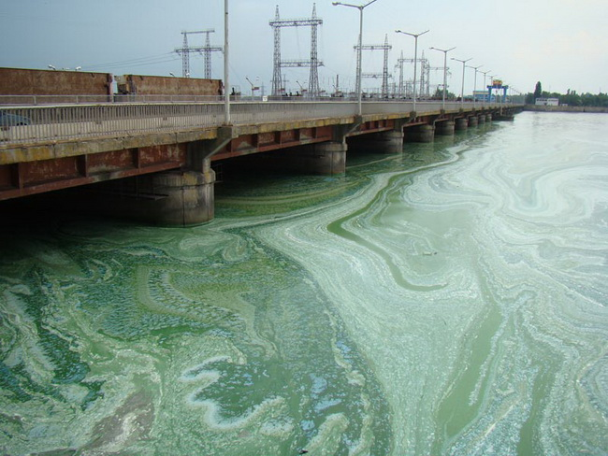
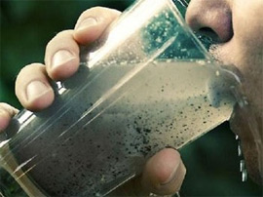
Polluted
water

Slide 16
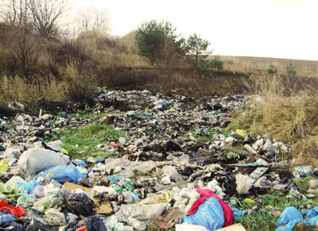
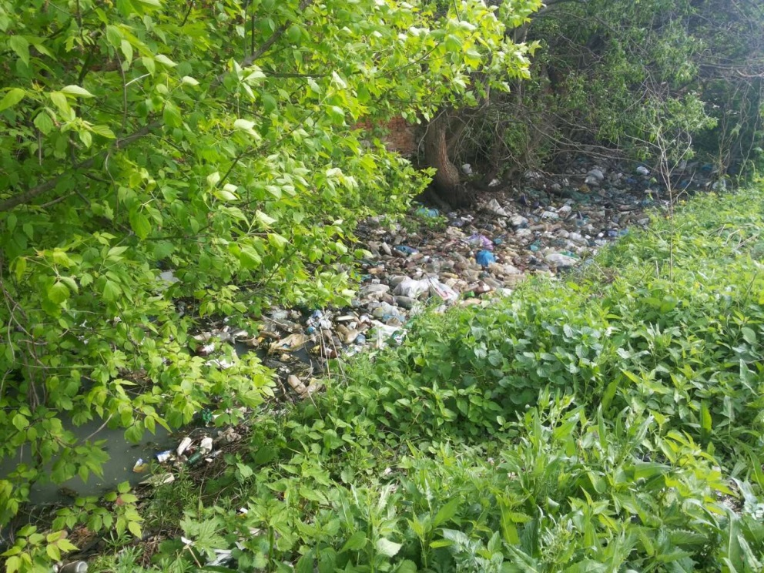
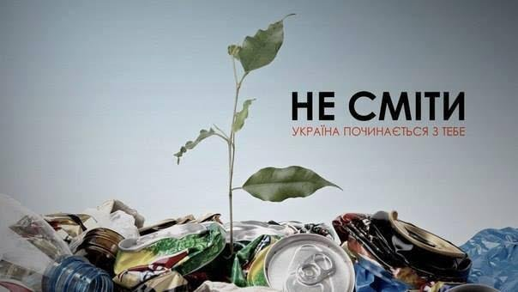
Rubbish

Slide 17
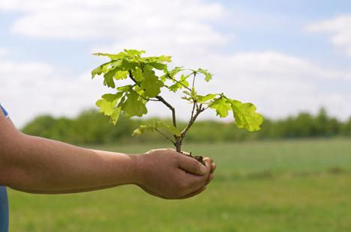
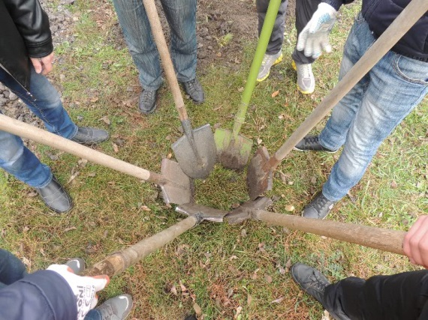
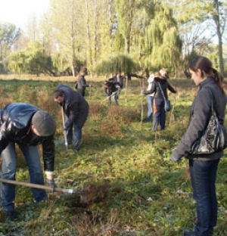
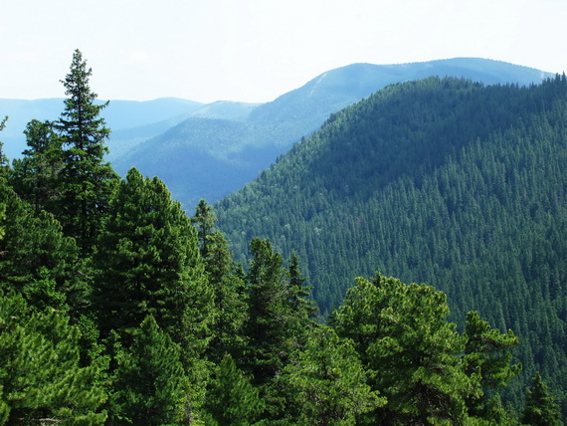
Protect forests

Slide 18

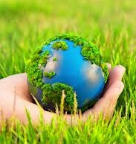

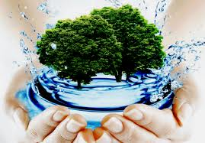
Thank you
for listening.

Slide 19
Teaching English grammar at high school
Class 10. Access 4.
Present Perfect Simple vs Present Perfect Continuous ( positive, negative, questions)

Slide 20
Speaking and writing activities
Complete the conversation, using the present perfect.
A: Sam, let's check if we 1) have done (do) everything for Claire's surprise party.
B: OK. 2) .................................................. (you/book) the table at the restaurant?
A: Yes. And I 3) ................................(order) the flowers.
B: Great! What about the balloons?
A: I 4) ....................................(already/ask) Ben to organise the decorations.
B: Good thinking. Now, Sally 5) ....................... (buy) Claire's present and 6) ....................... (call) all her friends.
A: That's fine. 7)........................................ (you/tell) Claire we're taking her to the theatre?
B: Yes. Don't worry. She has no idea what we are planning!
A: Oh, I almost forgot! 8) .............................. (you/check) if Sally 9) .............................. (bake) the cake?
B: She just called me. It's all under control!

Slide 21
2.
Complete the second sentence so that it means the same as the first. Use up to three words.
1 I last phoned Helen in April. I haven't phoned Helen since April.
2 The last time we saw Henry was a week ago. We ................................Henry for a week.
3 It's a month since he went to the cinema. He......................to the cinema for a month.
4 She wrote to Alison in September. She......................to Alison since September.

Slide 22
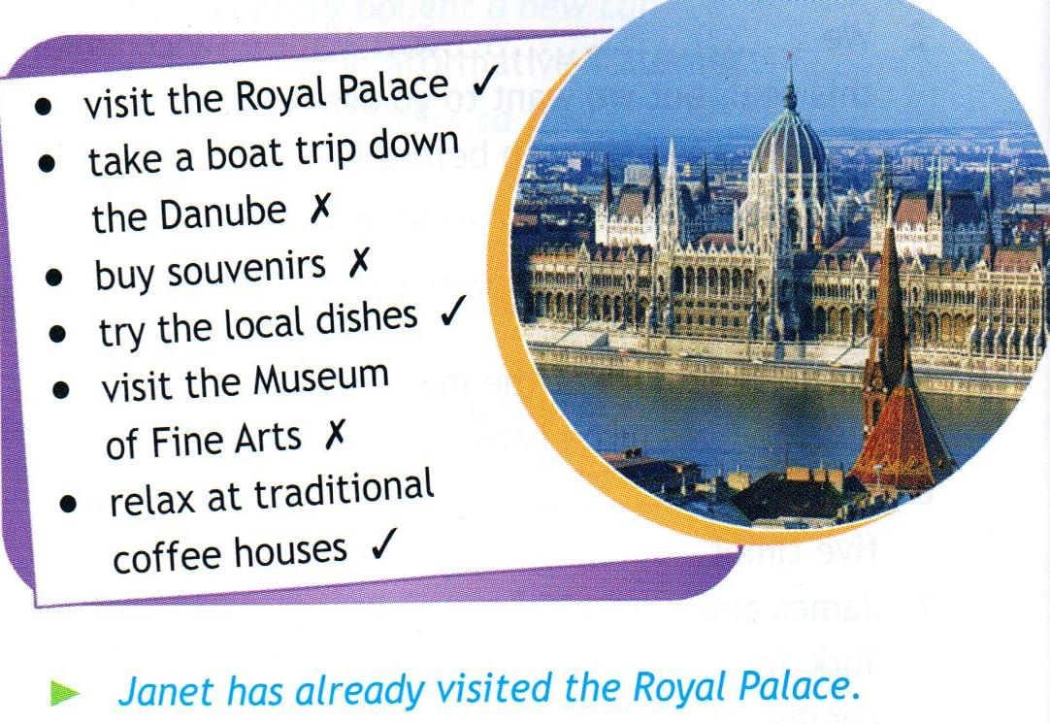
Speaking
Janet is on holiday in Budapest. Look at her notes and say what she has already done/ hasn't done yet.

Slide 23
Imagine the situation. Use the verbs in the present perfect continuous to write sentences, as in the example.
• redecorate • walk • cry • sneeze • wait • rain
1 Jenny's upset. She ► 's been crying all evening.
2 He's wet. He ................................................... in the rain.
3 Paula has a cold. She .................................................. since yesterday.
4 The house looks nice. They................................................. it for the last month.
5 The ground is wet. It ...................................................... all morning.
6 They're angry. They................................................. in a queue for more than three hours.

Slide 24
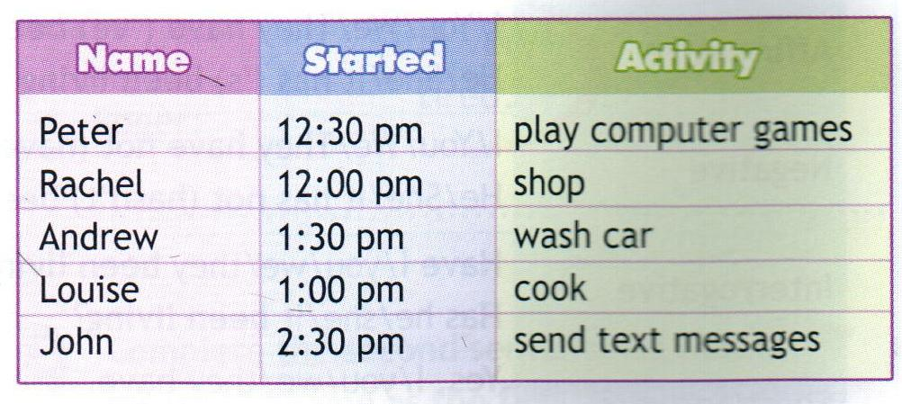
It's 3 o'clock on Saturday afternoon. Look at the information and write what the people have been doing and for how long they have been doing it, as in the example.
Peter ► has been playing computer games for two and a half hours/since 12:30. Rachel .........................................................
Andrew ........................................................
Louise..........................................................
John.........................................;. ..............

Slide 25
Complete the second sentence so that it means the same as the first. Use the present perfect continuous form of the verbs in brackets.
1 I got to the bus stop an hour ago and my bus hasn't arrived yet. I've been waiting for my bus for an hour, (wait)
2 I started guitar lessons years ago. ________for years. (learn)
3 The rain started at midday and it hasn't stopped. ________since midday. (rain)
4 We started this phone call an hour ago. ________on the phone for an hour. (chat)
5 I started feeling ill on Saturday and I still feel ill. ________since Saturday. (not feel well)
6 My dad fell asleep two hours ago and he hasn't woken up yet. _________for two hours. (sleep)

Slide 26
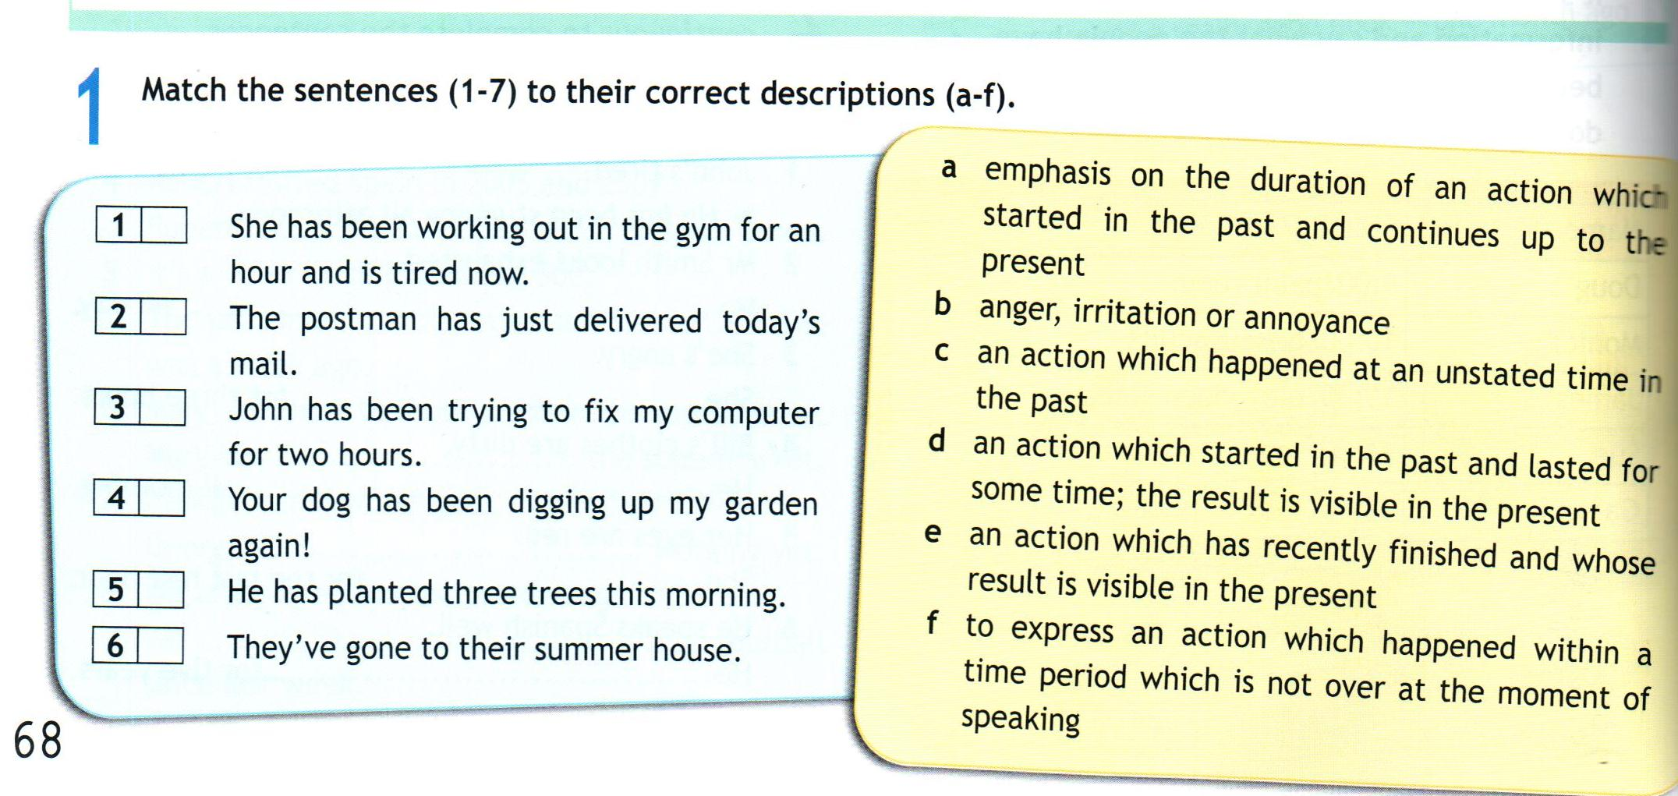

Slide 27
Complete one sentence in each pair with the present perfect simple and the other with the present perfect continuous.
1 spend
a I can't afford that dress. I______.._ all my money.
b We________too much money recently - we should save more.
2 have
a Americans________Thanksgiving dinners for hundreds of years.
b I'm not hungry. I________my dinner.
3 talk
a Look at the time! We________for hours!
b I don't know Tom well, but we________on the phone once or twice.

Slide 28
Complete the letter below putting the verbs in brackets into the present perfect or present perfect continuous.
Dear Billy,
I'm sorry I 1) .................. (not/be) in touch lately, but I 2)............................(study) hard for my exams. Anyway, I've got some great news! I 3)......... ................ (sign up) for cooking lessons! They 4)......................................(not/start) yet, but they'll start in a week's time. My friend Mae 5).................. (take) the same class for a few weeks now, and she says that it's lots of fun. She's very excited as she 6)............................ (learn) how to make delicious meals. 7) ............................... (you/ever/think) about doing something like this? I 8)............. ............. (never/bake) anything in my life, but I think it'll be interesting and creative. I'll tell you my impressions after the first lesson! Well, that's all for now. Let me know what you 9)......................(do) with yourself lately.
Talk to you soon, Jane

Slide 29
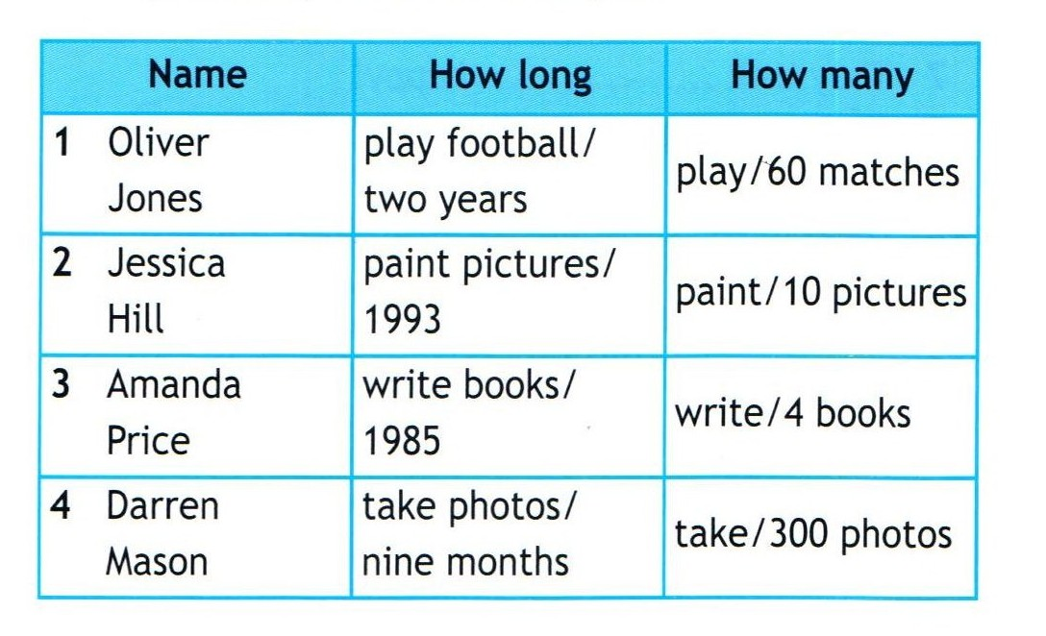
Speaking
The people below like doing different things. Look at the table and, in pairs, ask and answer questions, as in the example.
A: How long has he been playing football?
B: He has been playing football for two years.
A: How many matches has he played so far?
B: He's played 60 matches.

Slide 30
Thank you very much.

