Slide 1
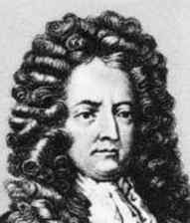
Daniel Defoe
(1660-1731)

Slide 2
Daniel Defoe
1. Robinson Crusoe: the middle-class hero
Robinson shares restlessness with classical heroes of travel literature
An act of transgression, of disobedience
His isolation on the island after the shipwreck

Slide 3
Daniel Defoe
2. Robinson Crusoe: a spiritual autobiography
Full of religious references to God, sin, providence, salvation
The hero reads the Bible to find comfort and guidance
Defoe explores the conflict between
economic motivation and spiritual salvation

Slide 4
Daniel Defoe
3. Robinson Crusoe: the island
The ideal place for Robinson to prove his qualities
Robinson organizes a primitive empire
Not a return to nature, but a chance
to exploit and dominate nature

Slide 5
Daniel Defoe
4. Robinson Crusoe: the individual and society
The society Robinson creates on the island is not an alternative to
but an exaltation of 18th-century England,
its ideals of mobility, material productiveness, and individualism
Though God is the prime cause of everything,
the individual can shape his destiny
through action

Slide 6
Daniel Defoe
5. Robinson Crusoe: the style
Clear and precise details.
Description of the primary qualities of objects.
solidity, extension and number
Simple, matter-of-fact and concrete language.

