Slide 1
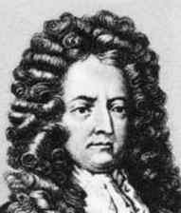
Daniel Defoe
(1660-1731)

Slide 2
Daniel Defoe
Moll Flanders
Insights into some social problems
Set in urban society
Women were not able to support
themselves legally in 18th-century society
Moll rejects emotional experience
Moll is Crusoe’s female counterpart
The novel includes «documents»

Slide 3
Daniel Defoe
Moll Flanders
It has insights into some social problems like crime and the provisions for poor orphans.
Moll rejects emotional experience, seen as an impediment to the accumulation of capital.
The novel includes «documents» – Moll’s memorandums, quoted letters, hospital bills – in order to increase the illusion of verifiable fact.

