Slide 1
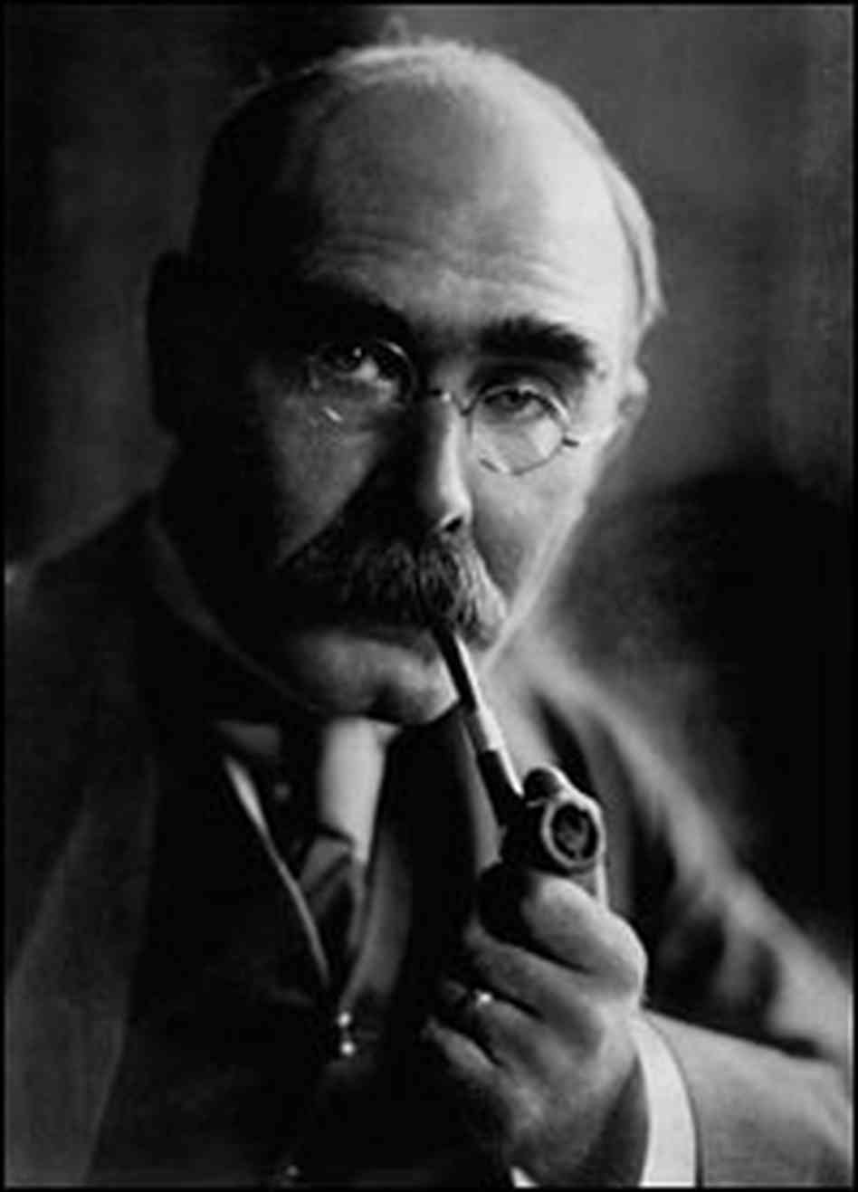
RUDYARD KIPLING 1865-1936
RUDYARD KIPLING was born in Bombay on December 30th 1865, son of John Lockwood Kipling, an artist and teacher of architectural sculpture, and his wife Alice. His mother was one of the talented and beautiful Macdonald sisters, four of whom married remarkable men, Sir Edward Burne-Jones, Sir Edward Poynter, Alfred Baldwin, and John Lockwood Kipling himself.

Slide 2
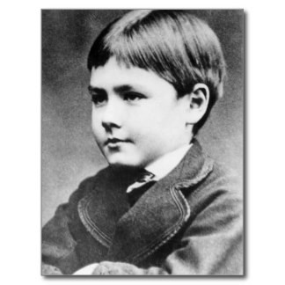
Young Rudyard's earliest years in Bombay were blissfully happy, in an India full of exotic sights and sounds. But at the tender age of five he was sent back to England to stay with a foster family in Southsea, where he was desperately unhappy. The experience would colour some of his later writing.

Slide 3
In 1882, aged sixteen, he returned to Lahore, where his parents now lived, to work on the Civil and Military Gazette , and later on its sister paper the Pioneerin Allahabad. In his limited spare time he wrote many remarkable poems and stories which were published alongside his reporting. When these were collected and published as books, they formed the basis of his early fame.

Slide 4
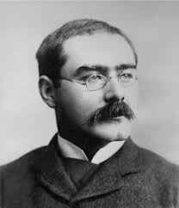
After a world trip, he returned with Carrie to her family home in Brattleboro, Vermont, USA, with the aim of settling down there. It was in Brattleboro, deep in New England, that he wrote Captains Courageous and The Jungle Books , and where their first two children, Josephine and Elsie, were born.

Slide 5
He was also much involved in the work of the Imperial War Graves Commission, and King George V became a personal friend. The Kiplings travelled a great deal, and at the outset of one of their visits, in January 1936, Rudyard died, just three days before his King. He had declined most of the many honours which had been offered him, including a knighthood, the Poet Laureateship, and the Order of Merit, but in 1907 he had accepted the Nobel Prize for Literature.

Slide 6
