Slide 1
1. Comment on the slide show.
2. Characterize the main heroes of the ballet.
3. Compare your own ideas about the play with the director’s ones.
4. Did you enjoy the ballet? Explain, why.

Slide 2
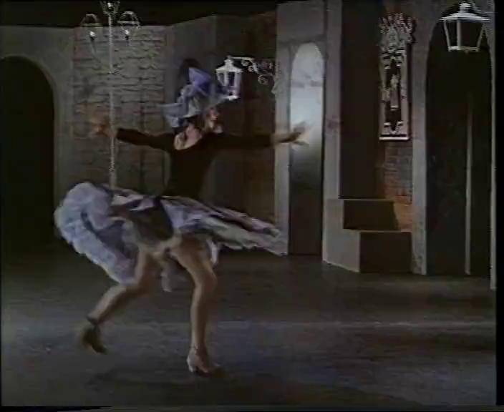

Slide 3
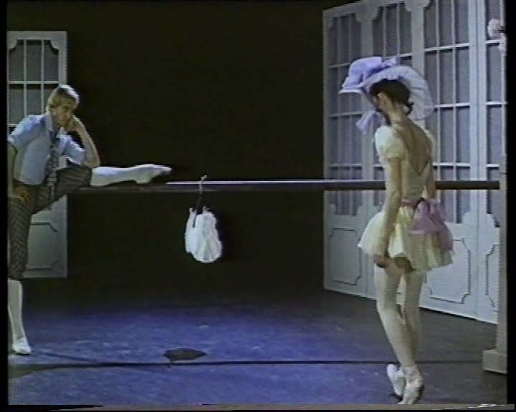

Slide 4
