Slide 2

The Walt Disney Company is the largest in the world. Founded on October 16, 1923, by Walt and Roy Disney as the Disney Brothers Cartoon Studio.

Slide 3

Walt Disney
Disney was born on December 5, 1901,
in Chicago.

Slide 4
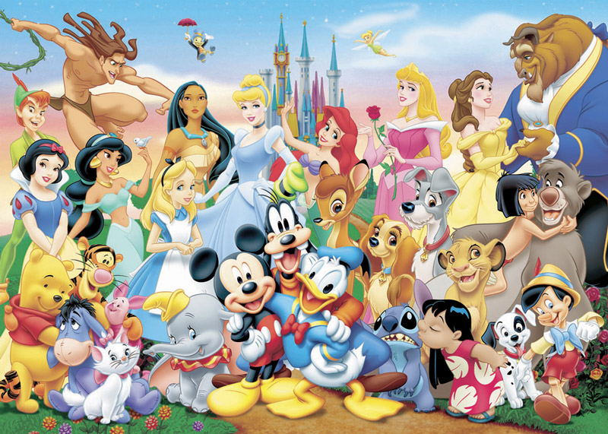
Welcome to the world of Walt Disney

Slide 5

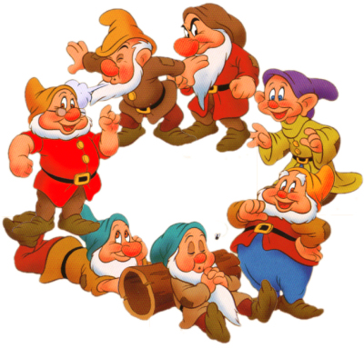
SNOW WHITE & THE 7 DWARFS

Slide 6
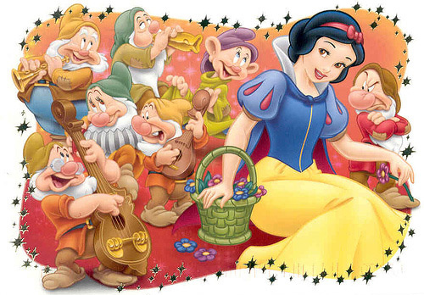

Slide 7
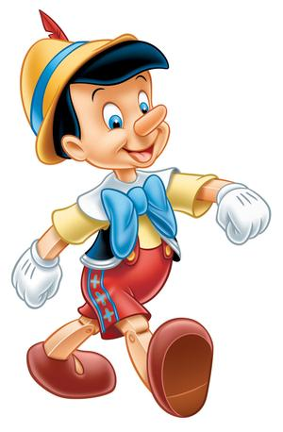
PINOCCHIO

Slide 8
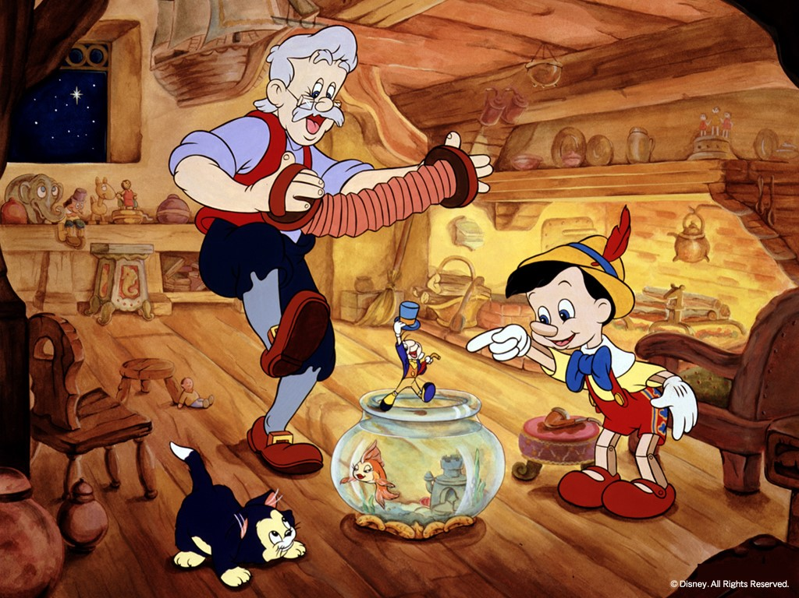

Slide 9


Slide 10


Slide 11


Slide 12


Slide 13


Slide 14


Slide 15


Slide 16
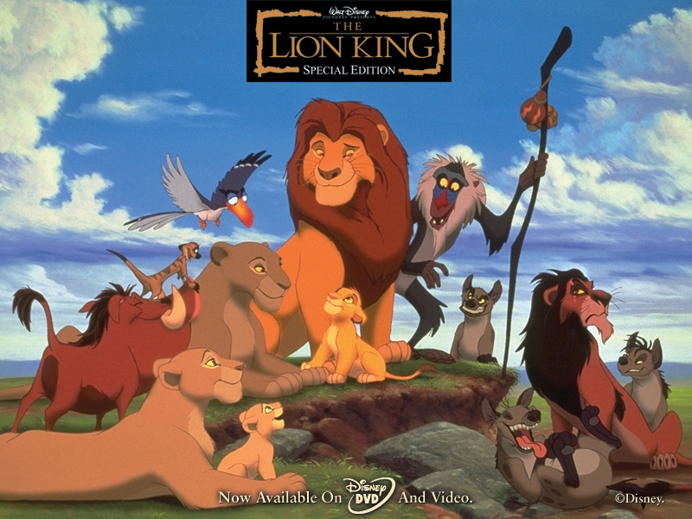

Slide 17
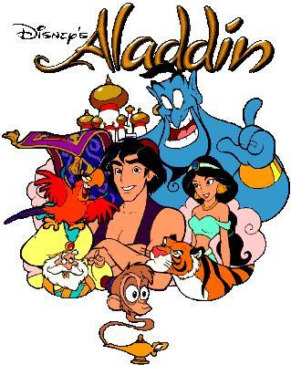

Slide 18
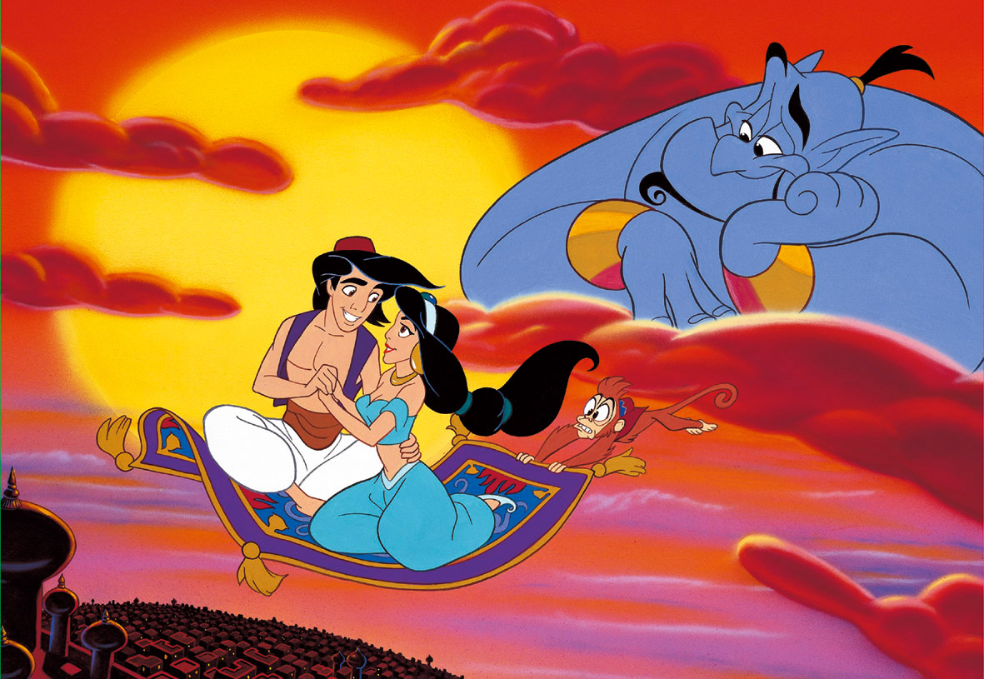

Slide 19


Slide 20
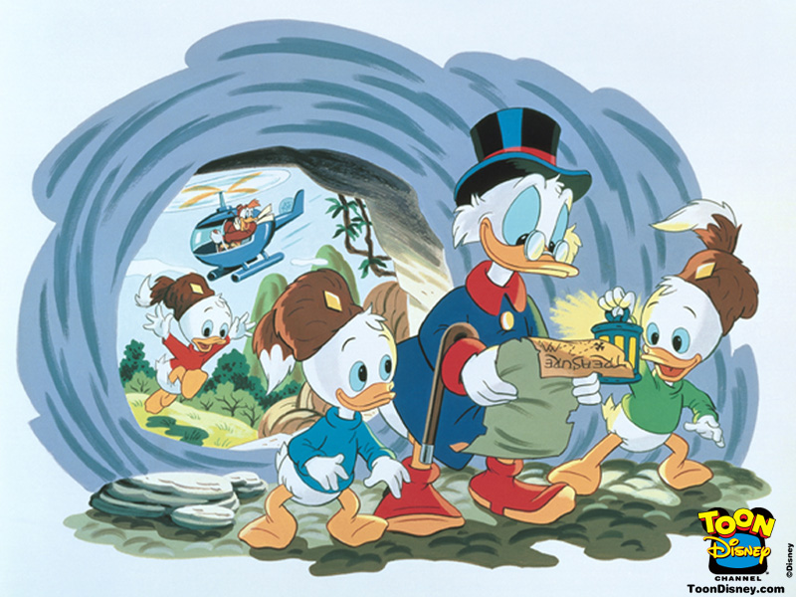

Slide 21

MICKEY
MOUSE

Slide 22
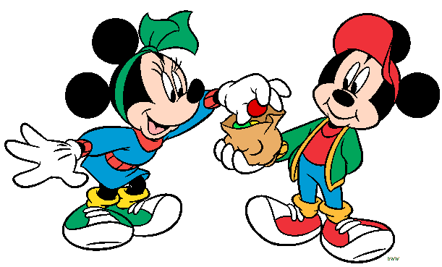

Slide 23


Slide 24


Slide 25


