Slide 1
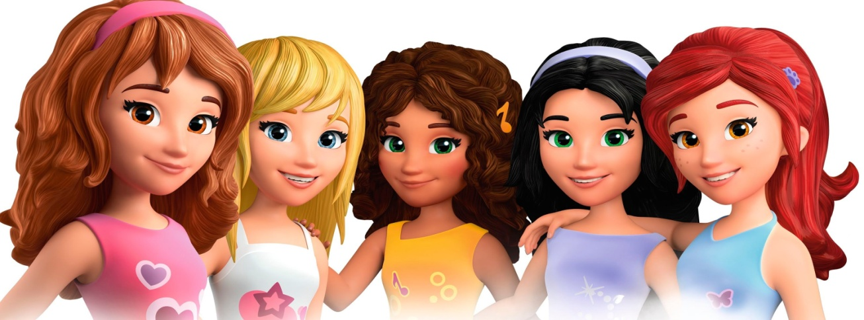
What qualities do you need to be good friends
A FRIEND IN NEED IS A FRIEND INDEED

Slide 2

Describe the personality

Slide 3
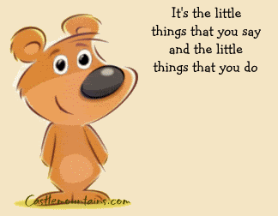
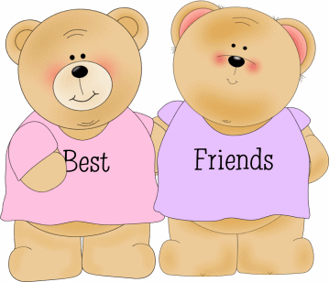
If you want to have a good friend

Slide 4


Slide 5
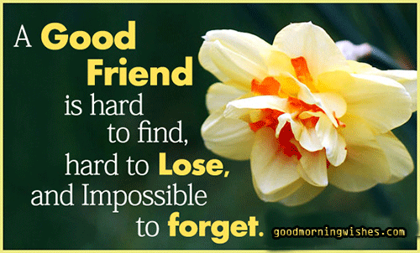
Learn to be a good friend

Slide 6
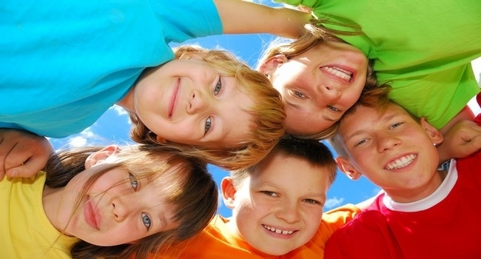
We are good friends

