Slide 1
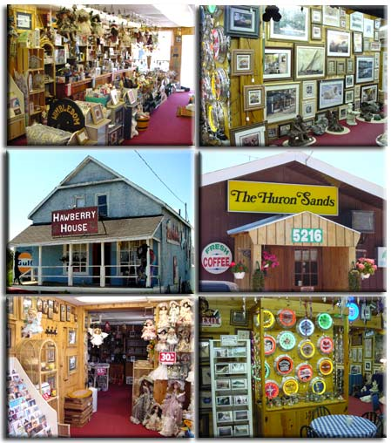
City
What buildings
can you see
in the city?

Slide 2
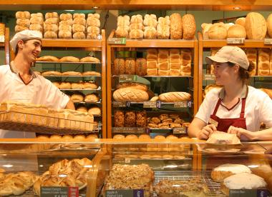
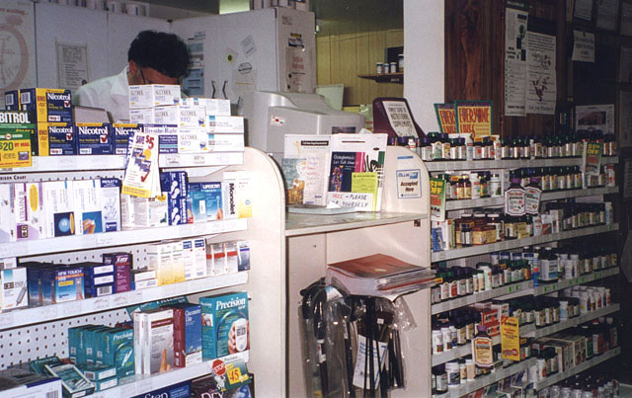
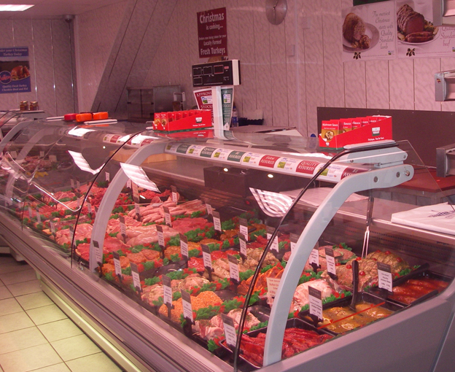
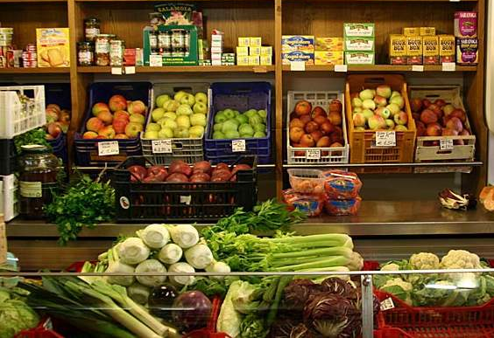
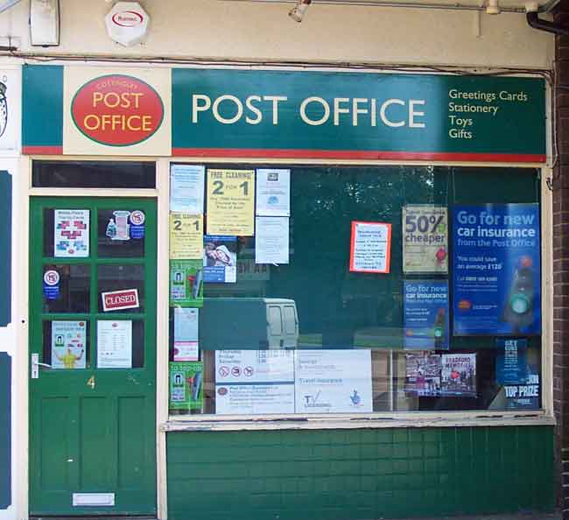
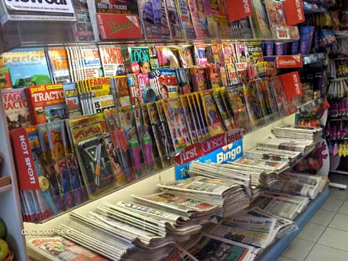
S h o p s

Slide 3
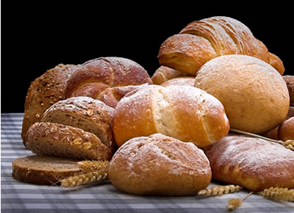
baker’s хлібний магазин, булочна
baker’s
a place where you can buy bread

Slide 4
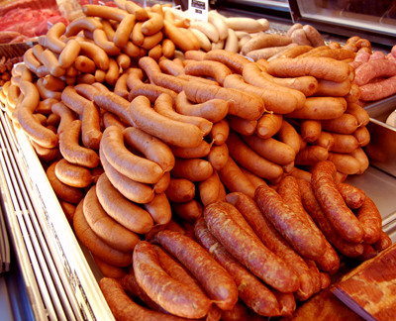
butcher’s м'ясний магазин
butcher’s
a place where
you can buy meat
and sausages

Slide 5
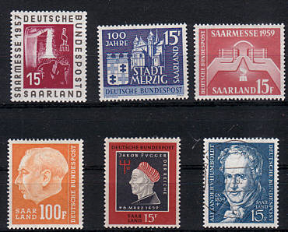
post office пошта
post office
a place where
you can buy stamps

Slide 6
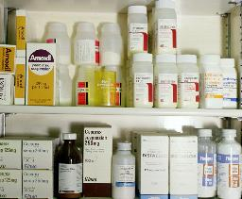
chemist’s аптека
chemist’s -
a place where you can buy medicine

Slide 7
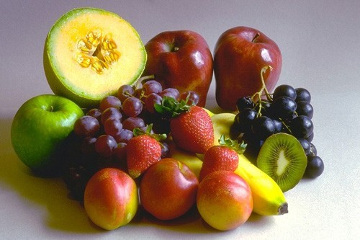
greengrocer’s овочевий магазин
greengrocer’s
a place where you can buy vegetables and fruits

Slide 8

newsagent’s газетний кіоск
newsagent’s
a place where you can get
a newspaper

Slide 9
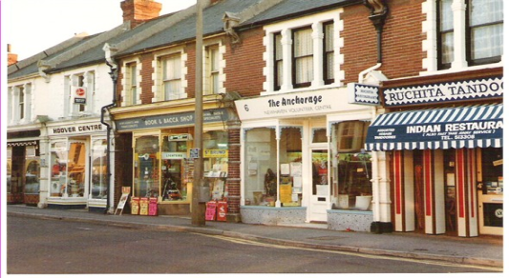
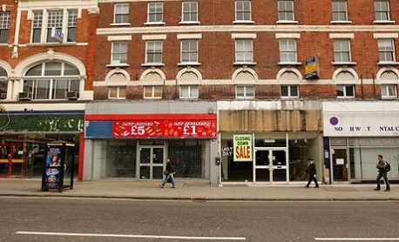
shops
baker’s
butcher’s
chemist’s
post office
greengrocer’s
newsagent’s
магазини
м’ясний
овочевий
пошта
булочна
газетний кіоск
аптека

Slide 10
baker’s
chemist’s
a place where
you can get
some bread
a place where
you can get
some medicine
butcher’s
greengrocer’s
a place where
you can buy meat
and sausages
a place where
you can get
vegetables and fruits
newsagent’s
post office
a place where
you can get
a newspaper
a place where
you can get some stamps

Slide 11

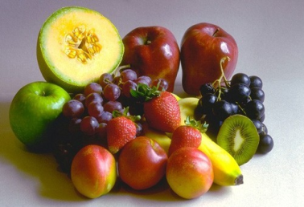


shops things
butcher’s
post office
newsagent’s
greengrocer’s
baker’s
chemist’s
stamps
fruits
sausage
bread
medicine
newspaper

Slide 12





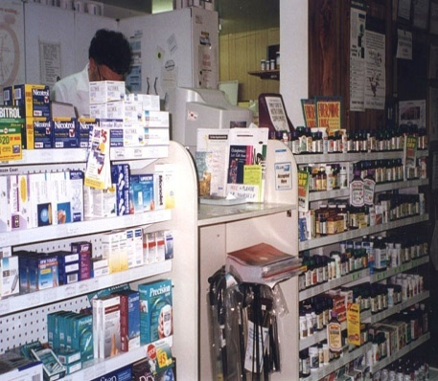





What is missing?

Slide 14
What is missing?
?

Slide 15
What is missing?

Slide 17
What is missing?
?

Slide 18
What is missing?

Slide 20
What is missing?
?

Slide 21
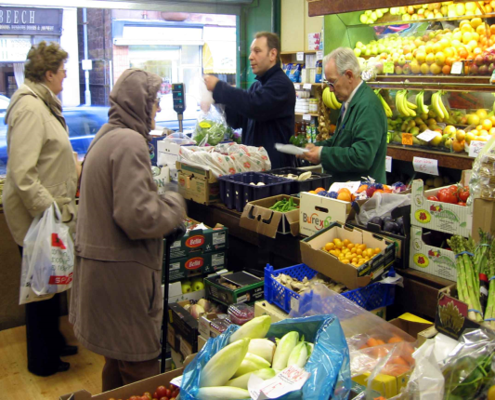
What is missing?

Slide 22


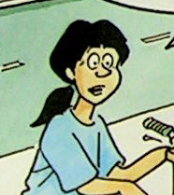
Read, match people and shops
Bill went to the
baker’s to get some bread rolls
for Minnie.
1
Helen went to the chemist’s to get
some medicine
and vitamins.
2
Sally went to
the post office
to post letters.
3

Slide 23
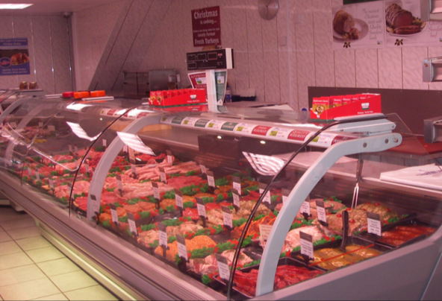
Mum went to the butcher’s to get some meat and sausages.
Read, match people and shops
4
Adam went to the newsagent’s to get
a newspaper for
his dad.
5
Dad went to the greengrocer’s to get
some apples and bananas.
6

Slide 24
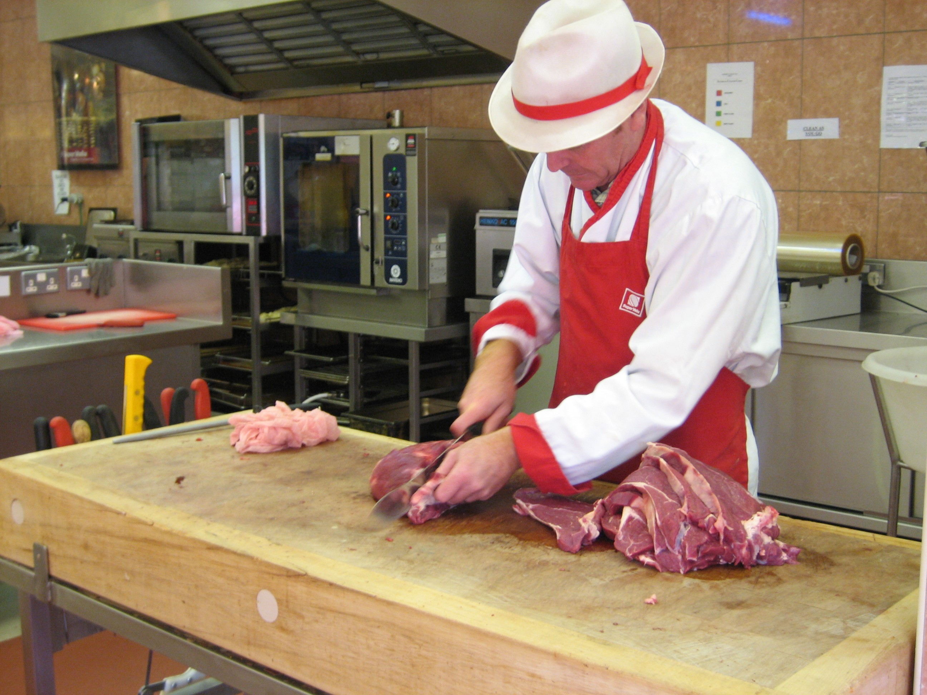
Guess the shop

Slide 25
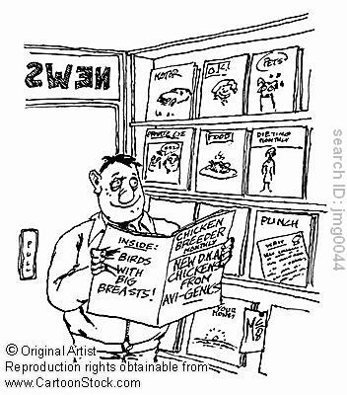
Guess the shop

Slide 26
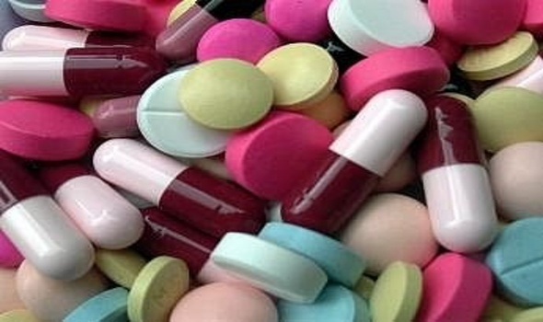
Guess the shop

Slide 27
Choose what you can get here.
bread
cakes
bread rolls
toasts
lemon, bread, chocolate, bread rolls, cakes, sausages, toasts, eggs

Slide 28
Choose what you can get here.
carrots
oranges
tomatoes
lemons
apples
chocolate, lemons, oranges, cheese, carrots, milk, tomatoes, apples, meat

Slide 29
Choose what you can get here.
vitamins
medicine
toothbrush
toothpaste
toothbrush, fruits, vitamins, meat, bread rolls, milk, medicine, toothpaste

Slide 30
Make your sentences:
We go to the ... to get ….
baker’s
butchers
post office
greengrocer’s
newsagent’s
chemist’s

