Slide 1
Buchach
Ptyts Oksana

Slide 2
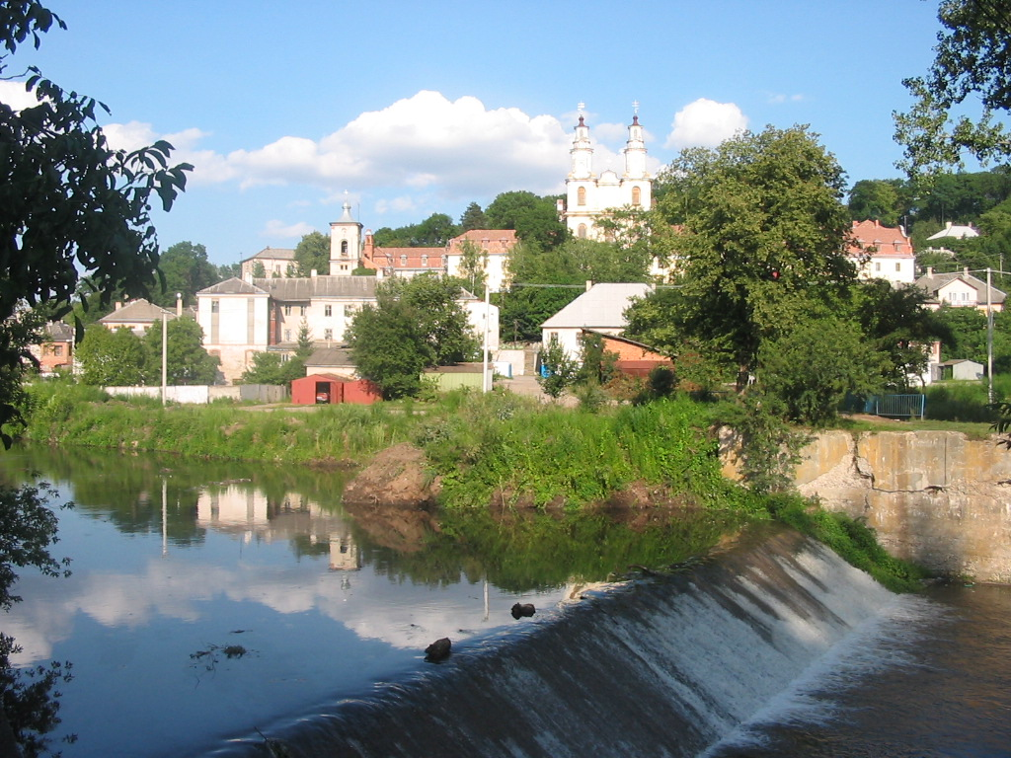
Buchach is a city located on the Strypa River (a tributary of the Dniester) in Ternopil Oblast (province) of western Ukraine.

Slide 3
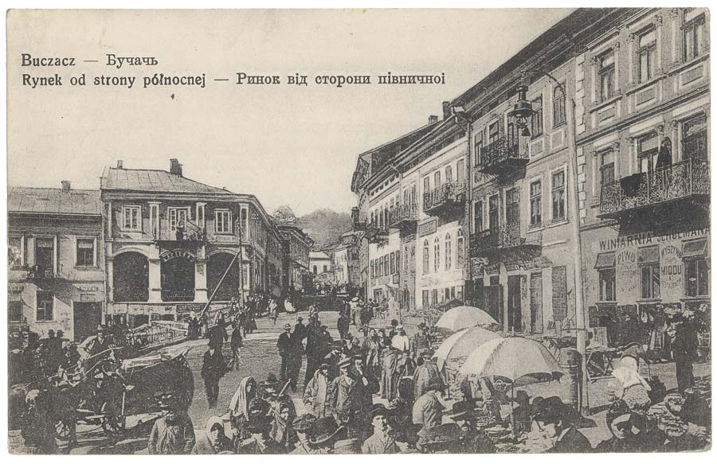
The earliest recorded mention of Buchach is in 1260

Slide 4
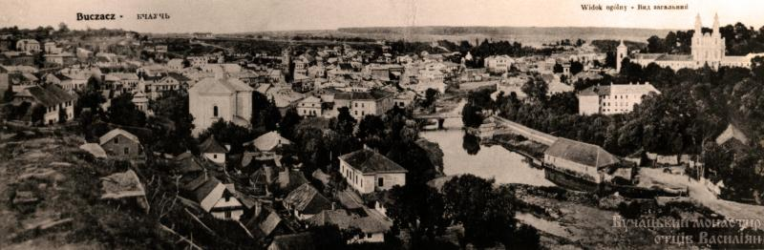
Most of the buildings in Galytska street are old and quaint.

Slide 5
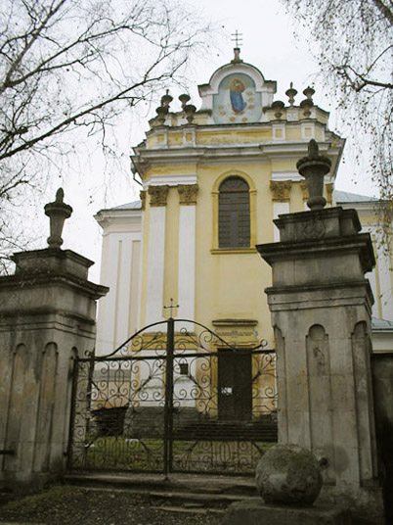
You may have a look at the City Hall, go to St Maria’s Protectress Church or the Assumption Cathedral.

Slide 6
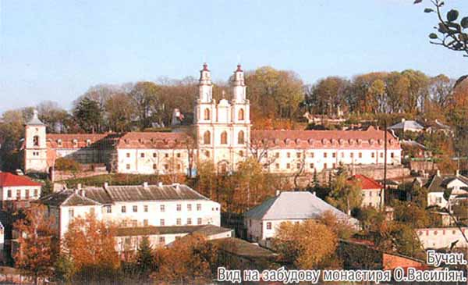
The Basilian Monastery which stands on the Fedir mountain is also worth visiting.

Slide 7

Shmuel Yosef Agnon (1888–1970), Nobel Prize-winning author

Slide 8
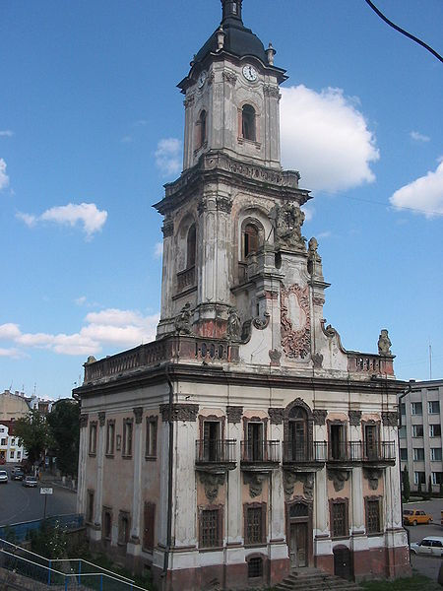
The old city hall of Buchach, joint work of an architect Bernard Meretyn and a sculptor Jan Jerzy Pinzel.

Slide 9
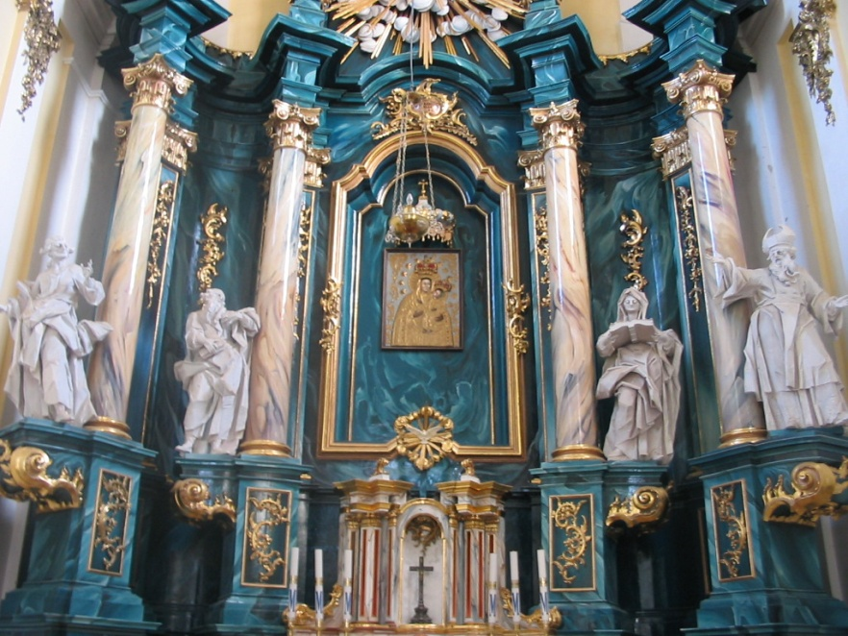
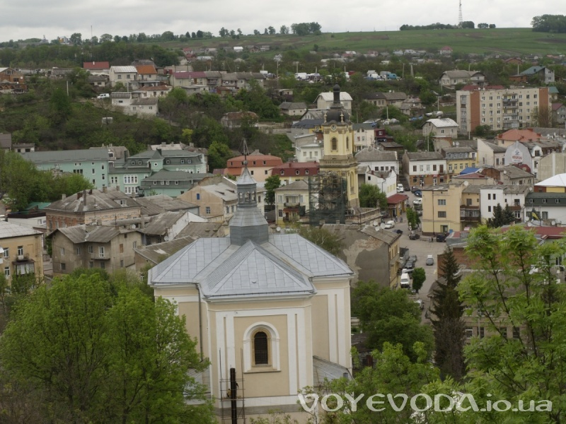
However you like to spend your time , you are certain to enjoy your stay in Buchach.

