Slide 2
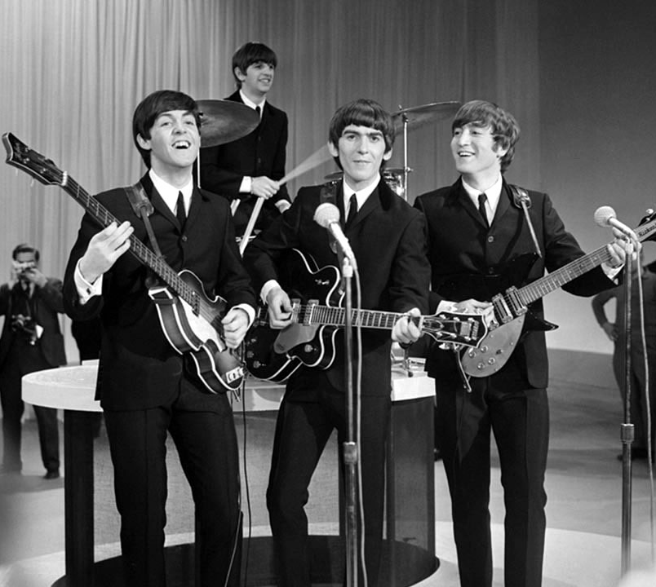
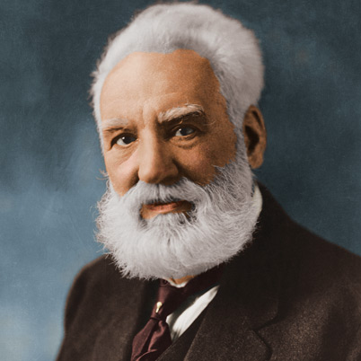
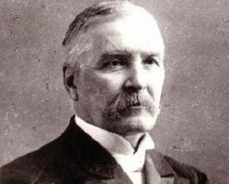
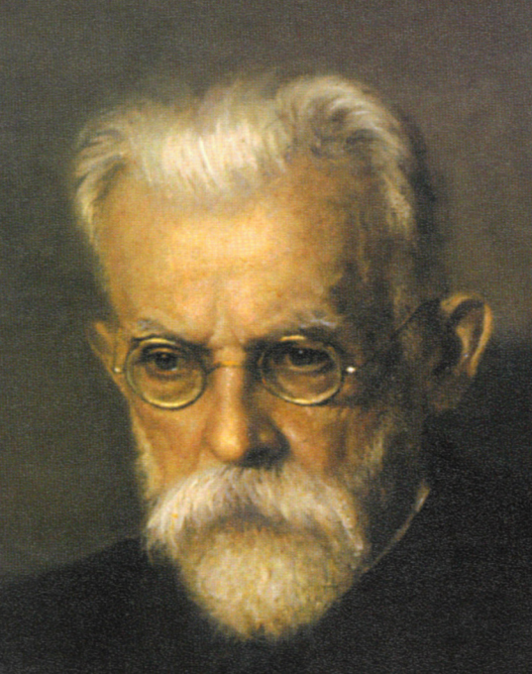
The Beatles
Alexander Graham Bell
Mykola Lysenko
Volodymyr Vernadsky

Slide 3
Outstanding People of Great Britain and Ukraine: Their Contribution to Society

Slide 4
How did the inventions influence the development of mankind?

Slide 5
1. How many Nobel Prizes have the UK scientists received in the last 50 years?
A. 36 B. 26
2. Marie Curie was …………………
A. a Chemist B. a Biologist
3. Alexander Graham Bell invented the ……………….
A. Radio C. Door Bell
4. Alexander Fleming discovered penicillin in ………………
A. 1898 B. 1908
5. Charles Dickens was a famous English …………………..
A. artist B. musician
6. Volodymir Vernadsky was a famous …………… scientist
A. American C. British
C. 46
C. a Physicist
B. Telephone
C. 1928
C. writer
B. Ukrainian

Slide 6
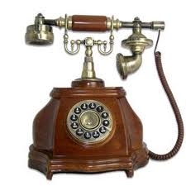
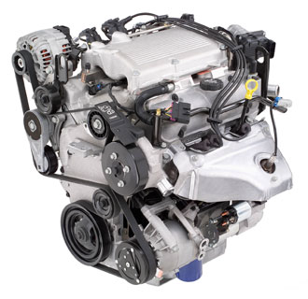
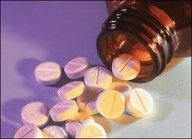
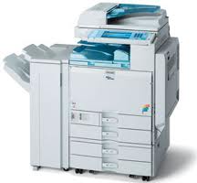
computer
telephone
car engine
penicillin
copying machine

Slide 7
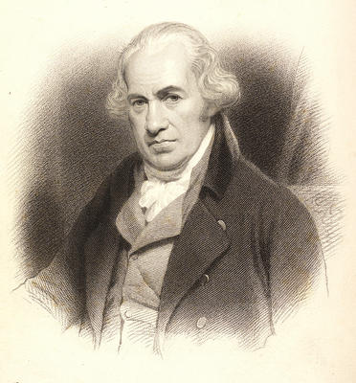
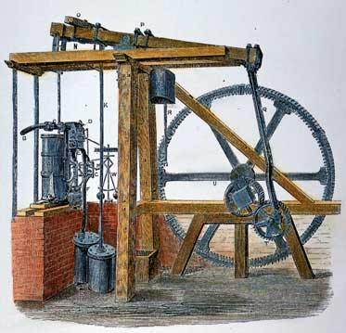
James Watt
(1736 - 1819)

Slide 8
What was James Watt famous for?
Where was he born?
Did he go to school?
When did he die?
What did he invent?
Do you think his inventions did good or harm to mankind?

Slide 9
E
C
G
B
F
A
D

Slide 10
What was James Watt famous for?
Where was he born?
Did he go to school?
When did he die?
What did he invent?
Do you think his inventions did good or harm to mankind?

Slide 11
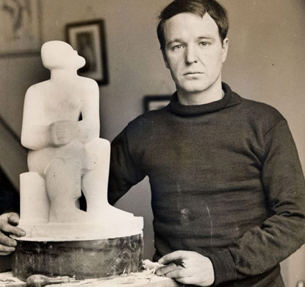
Henry Moore
(1898 - 1986)

Slide 13
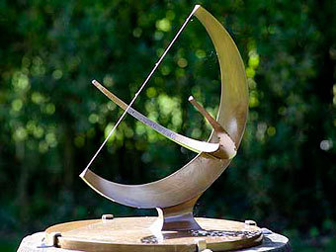

Slide 14
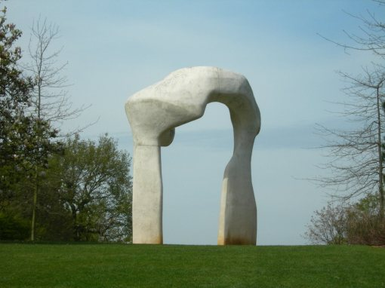

Slide 15
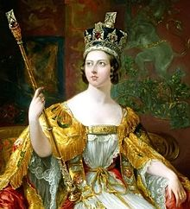

Slide 17
a) a copying machine and an engine
(creat)
created
Alexander Fleming
b) penicillin in 1928
(discover)
discovered
Alexander Graham Bell
c) the telephone in 1876
invented
(invent)
James Watt
d) the first electric engine
(make)
made
Charles Darwin
e) famous for his theory of evolution
(become)
became
Isaac Newton
f) the theory of gravitation
discovered
(discover)
Michael Faraday

Slide 18
FAMOUS UKRAINIAN SCIENTISTS AND INVENTORS

Slide 19
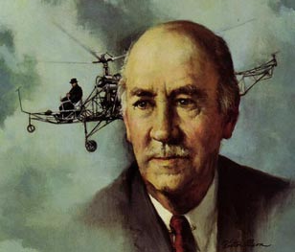
Igor Sihorsky
(1889 - 1972)

Slide 20
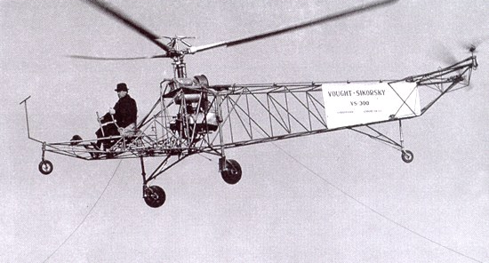
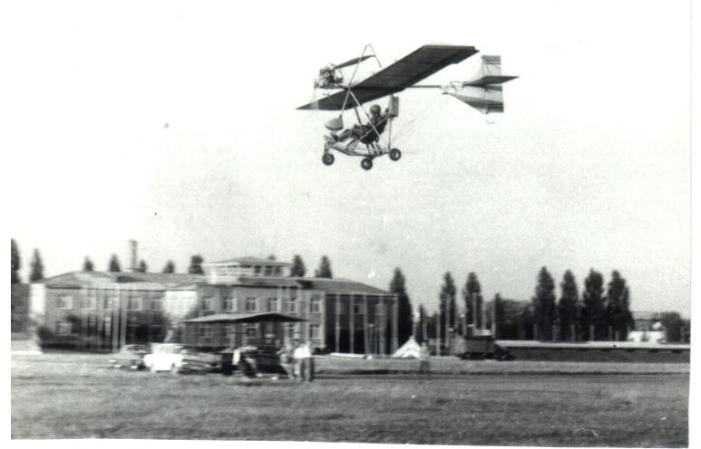
the first
helicopter (1939)
the first multi – engine plane

Slide 21
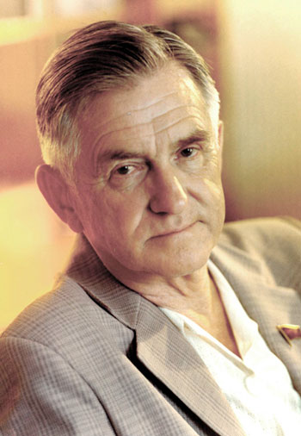
Oleg Antonov
(1906 - 1984)

Slide 22
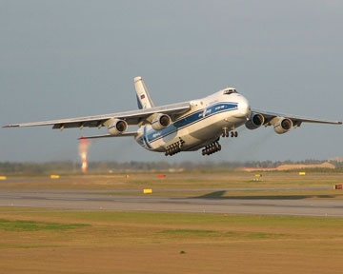
“Ruslan”

Slide 23
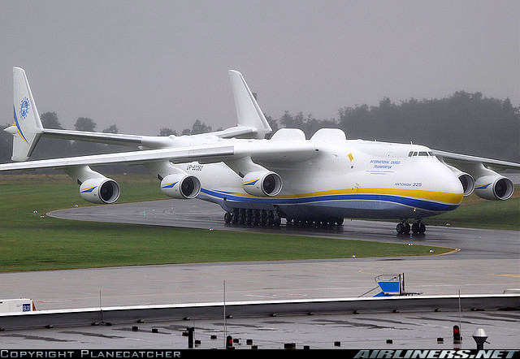
AN-225 "MRIYA"

Slide 24
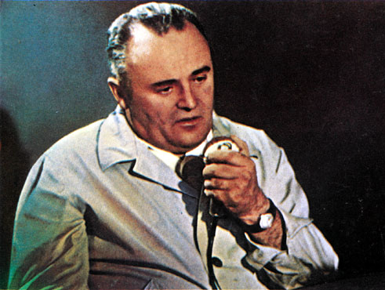
Sergey korolyov
(1906 - 1966)

Slide 25
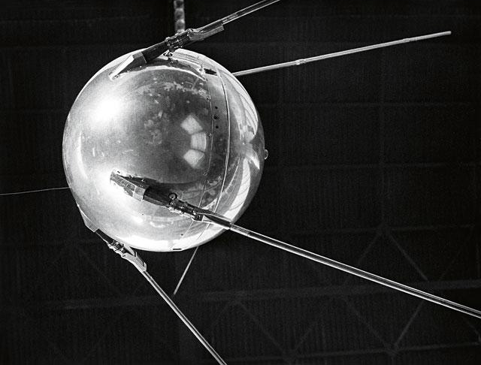
The first sputniks

Slide 26
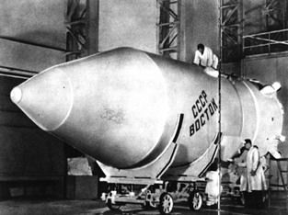
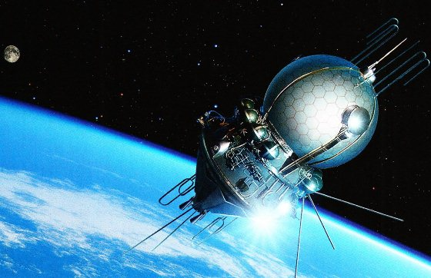
vostok
voshod

Slide 27
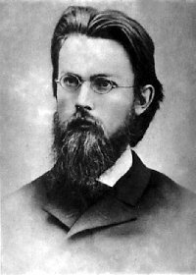
Volodymir vernadsky
(1863 - 1945)

Slide 28
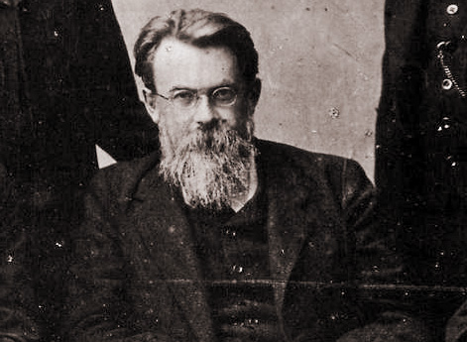
The first president of the Ukrainian academy of sciences

Slide 29
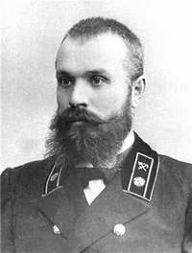
Yevhen paton
(1870 - 1953)

Slide 30
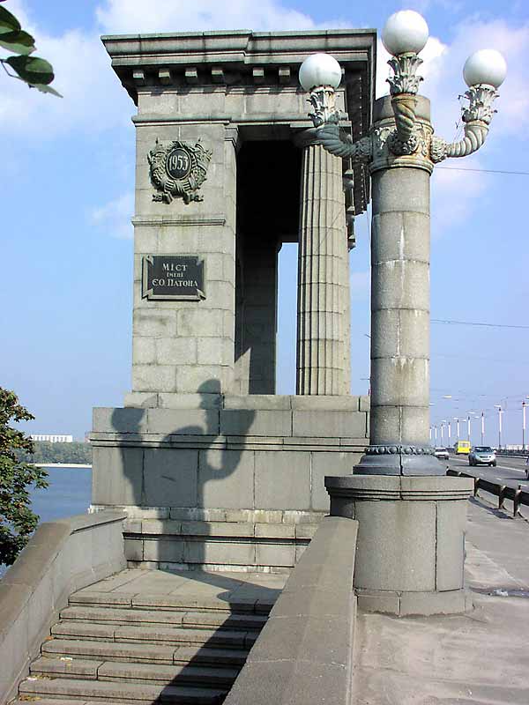
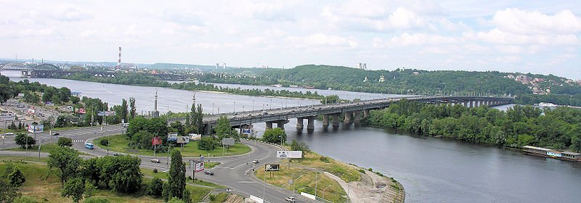

Slide 31
welding

Slide 32
Ukrainian famous musicians and composers

Slide 33
Semen –Hulak-Artemovsky (1813-1873)

Slide 35
Solomiya Krushelnytska (1872-1952)

Slide 36
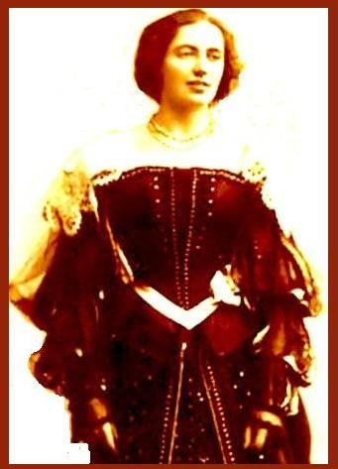

Slide 37
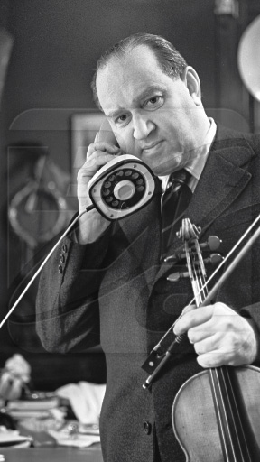
David –Oistrakh (1908-1994)

Slide 39
Svyatoslav Richter (1915-1997)

Slide 40
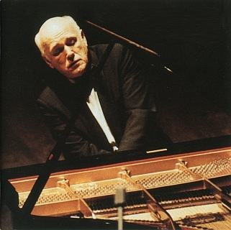
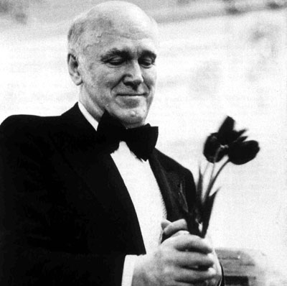

Slide 41
What is the role of those inventions / discoveries?
What inventions did the British / Ukrainian make?
Are the effects of the discoveries / inventions positive or negative?

Slide 42
How did the inventions influence the development of mankind?

