Slide 1
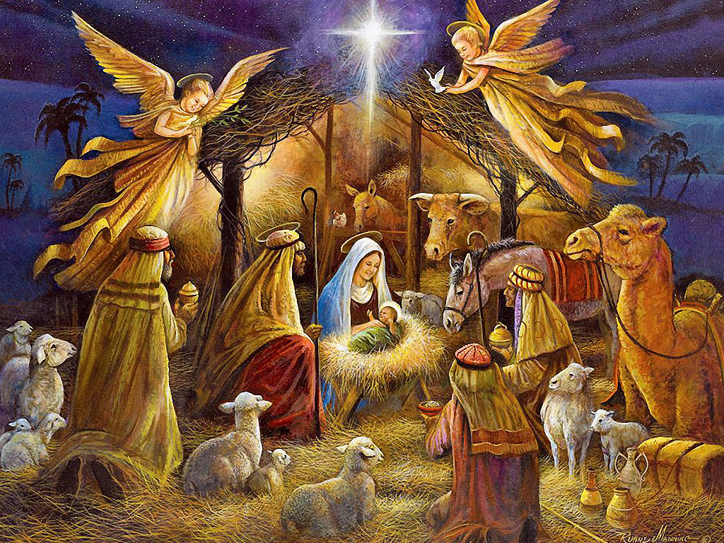
DECEMBER, 23 at 1.25 P.M
ASSEMBLY HALL
WELCOME TO OUR CHRISTMAS PLAY

