Slide 1
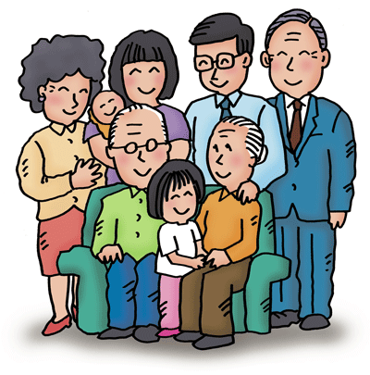
Family
a
g
t
d
e
h
r
u
_ _ _ _ _ _ _ _
- a female child

Slide 2
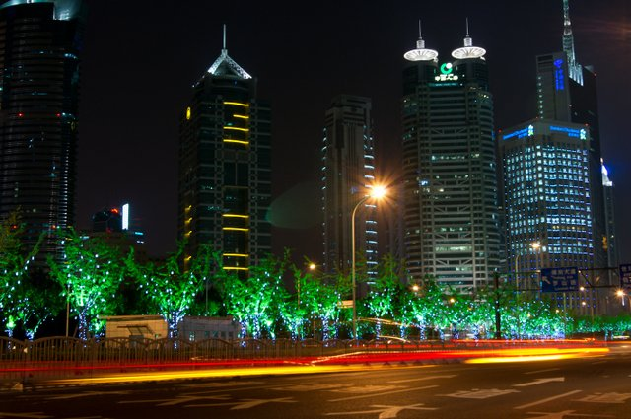
Free time
i
g
g
s
g
i
h
e
h
t
i
s
s
e
g
n
e
t
i
s
n
e
_ _ _ _ _ _ _ _ _ _ _
- visiting the sights of a city

Slide 3
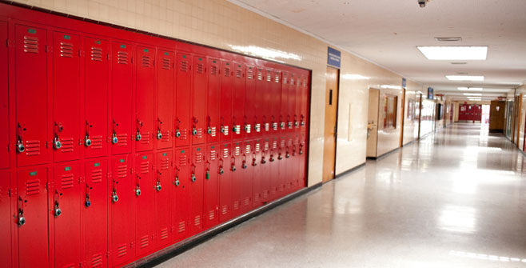
Parts of school
l
i
b
r
a
r
y
i
r
r
l
b
a
y
_ _ _ _ _ _ _
- a building that contains a collection of books

Slide 4
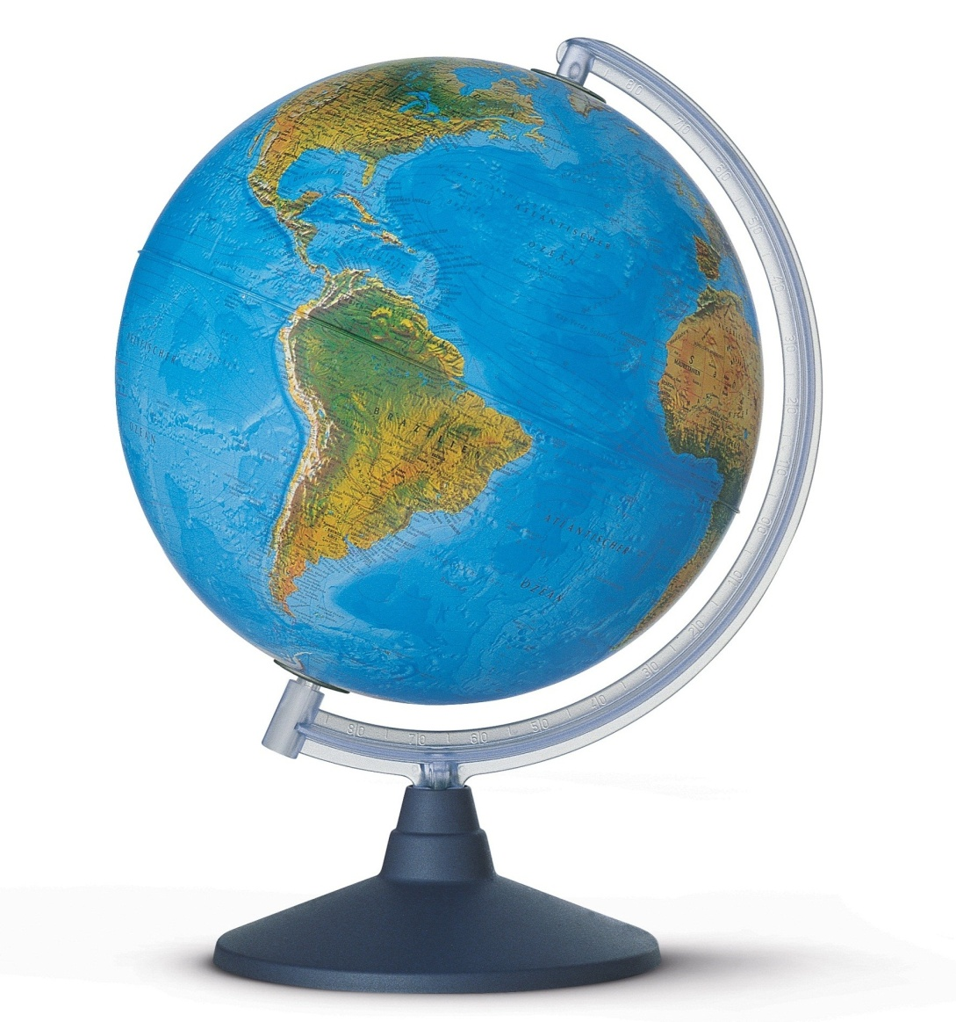
Geographical features
d
e
s
e
r
t
e
s
r
e
d
t
_ _ _ _ _ _
- a large area of land, covered with sand

Slide 5
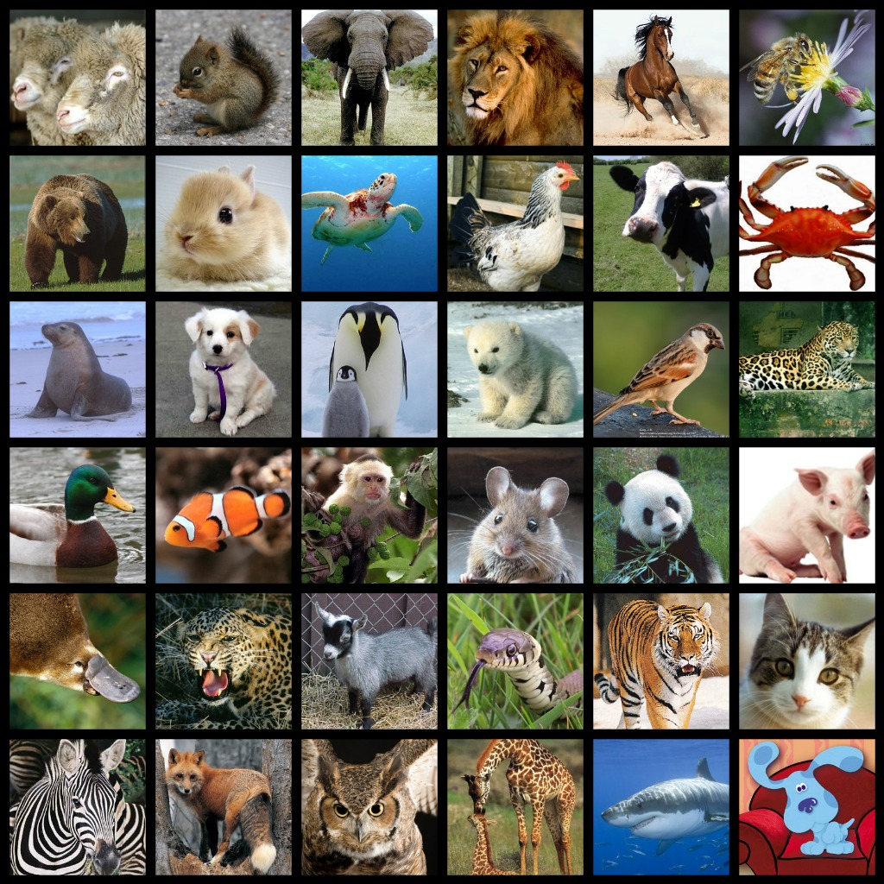
Animals
e l d a p r o
l e o p a r d
_ _ _ _ _ _ _
- a large wild animal of the cat family

Slide 6
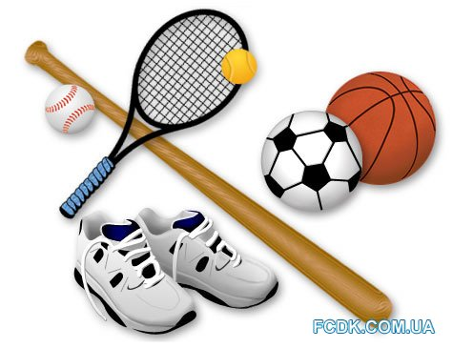
Sport
l c c y g n i
c y c l i n g
_ _ _ _ _ _ _
- the sport or activity of riding a bicycle

Slide 7
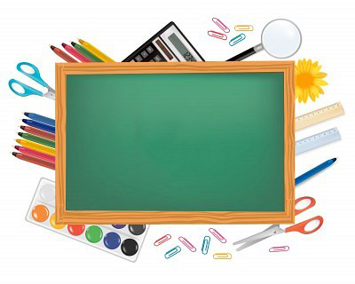
School subjects
y g b o o l i
b i o l o g y
_ _ _ _ _ _ _
- the study of living organisms

Slide 8
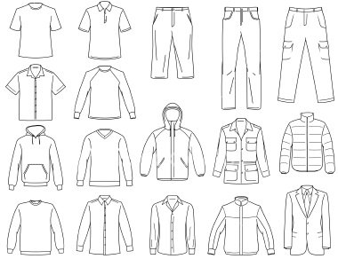
Clothes
k c e a t j
j a c k e t
_ _ _ _ _ _
- a short coat with sleeves

Slide 9
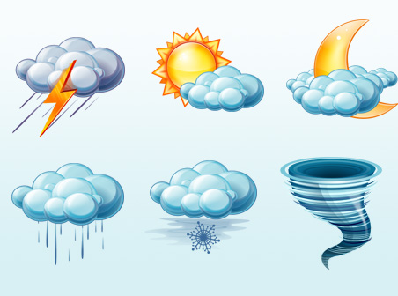
Weather and climate
t e m p e r a t u r e
e p e r e t m a r u t
_ _ _ _ _ _ _ _ _ _ _
- it shows how hot or cold something is

Slide 10
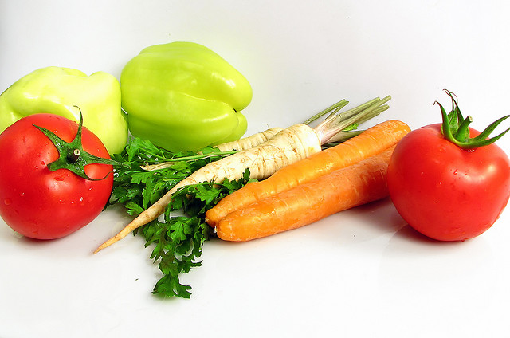
Food
v e g e t a b l e
g e l e b t v a e
_ _ _ _ _ _ _ _ _
- a plant that we eat

Slide 11
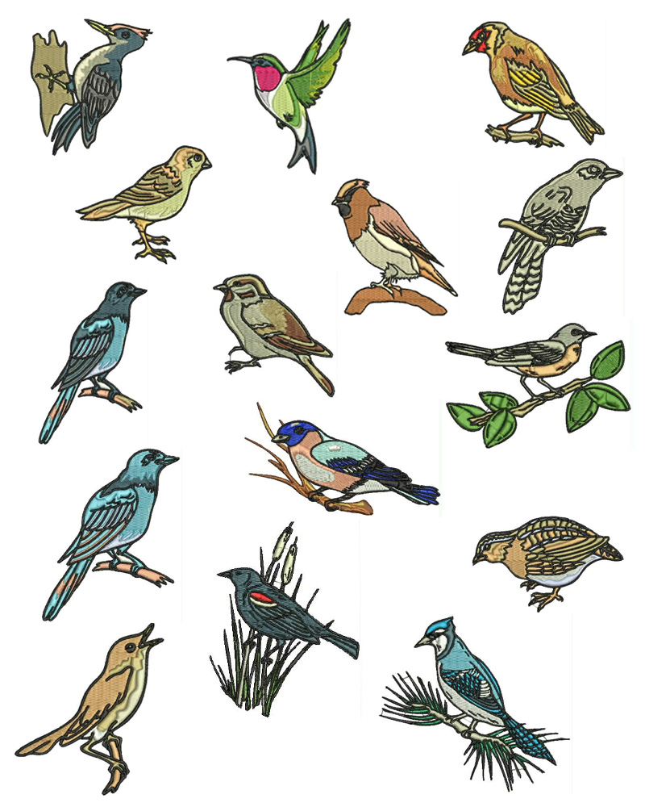
Birds
e n i u n p e g
p e n g u i n
_ _ _ _ _ _ _
- a large white and black bird which can’t fly

Slide 12
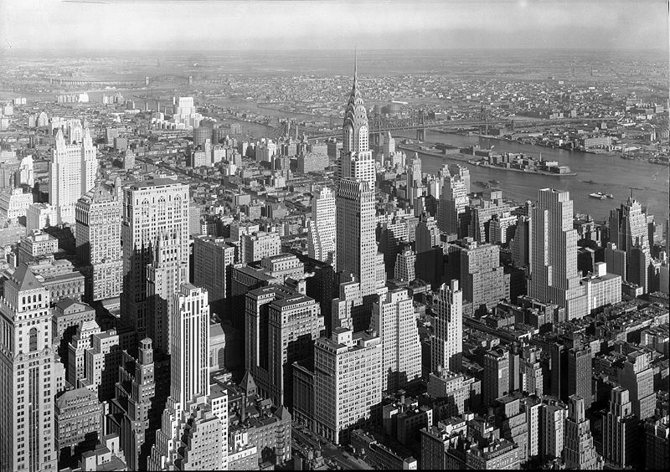
City places
e t a h r e t
t h e a t r e
_ _ _ _ _ _ _
- a building where plays are performed

