Slide 1
ROUND 3

Slide 2
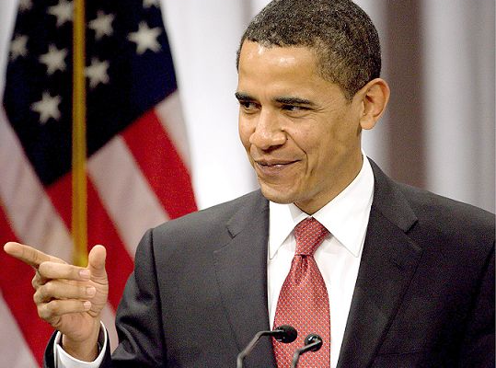
Celebreties
1.Britney Spears | 2.Queen Elizabeth II
3.Vladimir Klichko | 4.Barack Obama
А
В
С
D

Slide 3
Celebreties
D-1.Britney Spears | A- 2.Queen Elizabeth II
B-3.Vladimir Klichko | C-4.Barack Obama
А
В
С
D

Slide 4
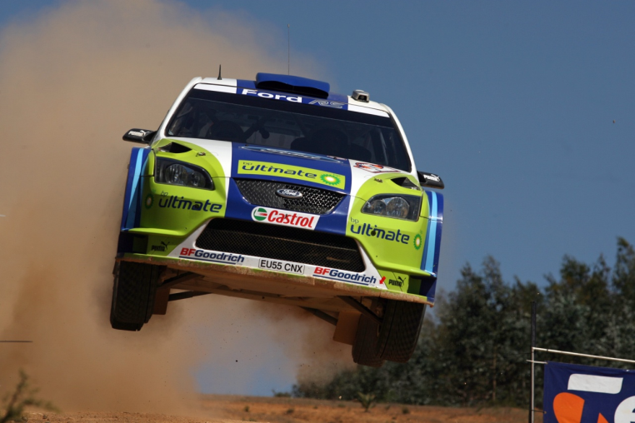
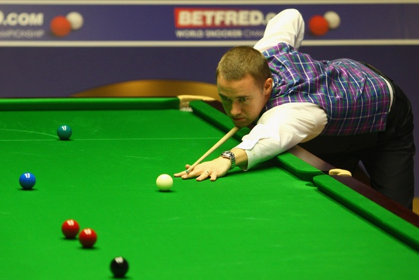
Sport
1. Golf | 3.Snooker
2.Rugby | 4.Rally
В
А
С
D

Slide 5
Sport
B-1. Golf | D-3.Snooker
A-2.Rugby | C-4.Rally
В
А
С
D

Slide 6
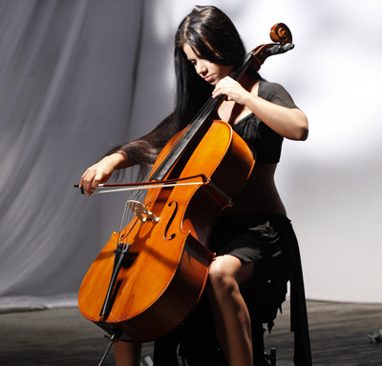
Musical instruments
1.Saxophone | 3.Flute
2.Violin | 4.Cello
А
В
С
D

Slide 7
Musical instruments
B-1.Saxophone | C-3.Flute
A-2.Violin | D-4.Cello
А
В
С
D

Slide 8
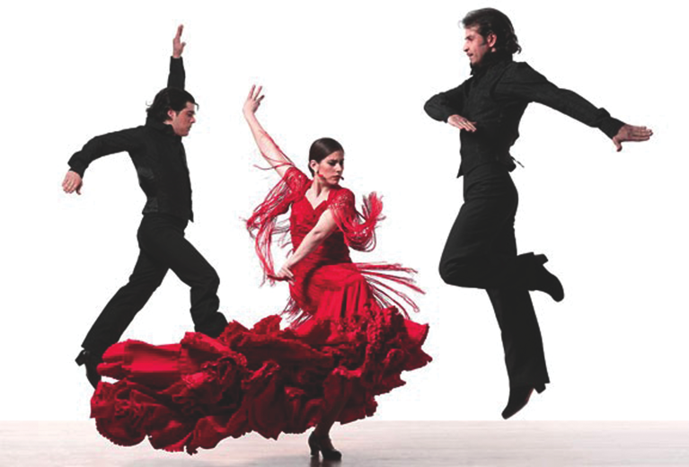
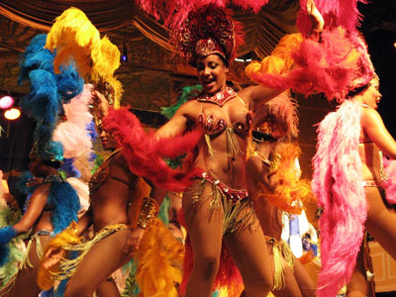
Dances
1.Rock-n-roll | 3.Samba
2.Flamenco | 4.Tango
А
В
D
С

Slide 9
Dances
C-1.Rock-n-roll | D-3.Samba
B-2.Flamenco | A-4.Tango
А
В
D
С

Slide 10
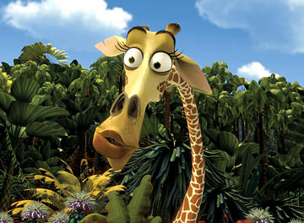
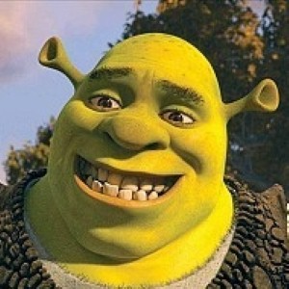
Cartoon characters
1.Scrat | 3.Shreck
2.Spongebob | 4.Melman
В
А
С
D

Slide 11
Cartoon characters
B-1.Scrat | D-3.Shreck
A-2.Spongebob | C-4.Melman
В
А
С
D

Slide 12
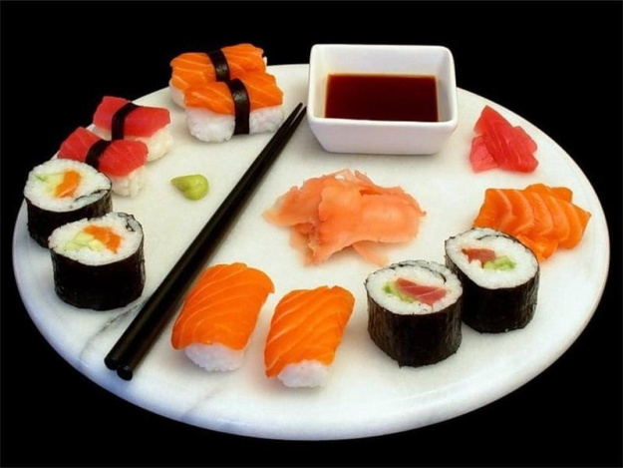
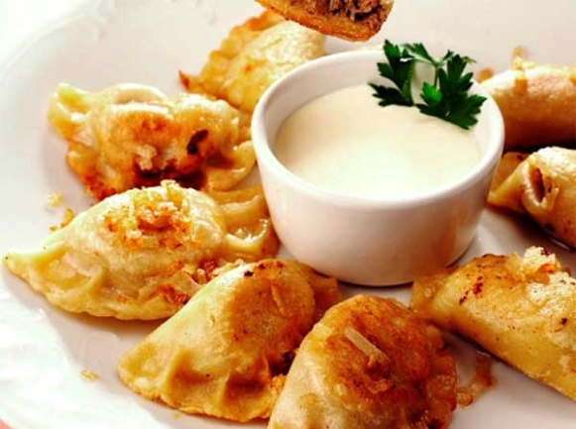
Food
1.Pasta | 3.Sushi
2.Croissants | 4.Varenyky
А
В
С
D

Slide 13
Food
A-1.Pasta | C-3.Sushi
B-2.Croissants | D-4.Varenyky
А
В
С
D

Slide 14
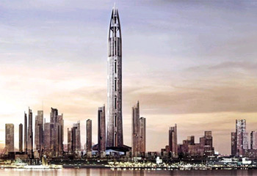
Towers
1.The Tower of London | 3.The Dubai Tower
2.The Eiffel Tower | 4.The Tower of Pisa
А
В
С
D

Slide 15
Towers
C-1.The Tower of London | D-3.The Dubai Tower
B-2.The Eiffel Tower | A-4.The Tower of Pisa
А
В
С
D

Slide 16
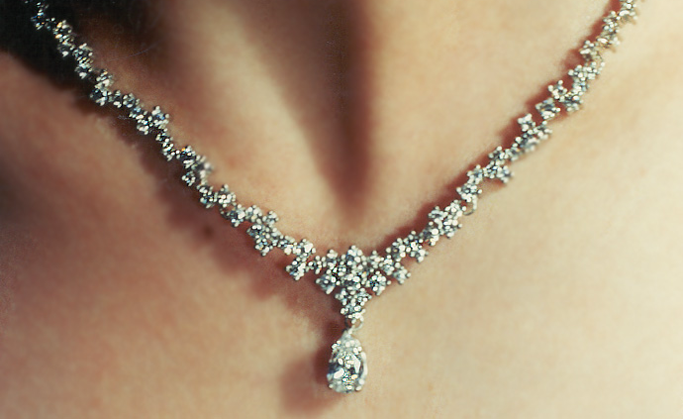
Accessories
1.Earrings | 3.Belt
2.Necklace | 4.Bracelet
А
В
С
D

Slide 17
Accessories
B-1.Earrings | D-3.Belt
C-2.Necklace | A-4.Bracelet
А
В
С
D

Slide 18
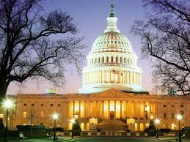
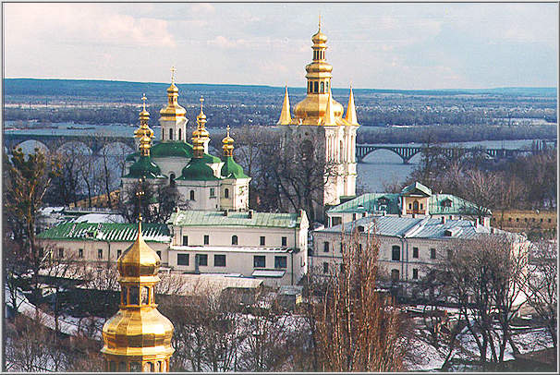
Capitals
1.Tokio | 3.Kyiv
2.London | 4.Washington
А
В
С
D

Slide 19
Capitals
B-1.Tokio | D-3.Kyiv
A-2.London | C-4.Washington
А
В
С
D

Slide 20
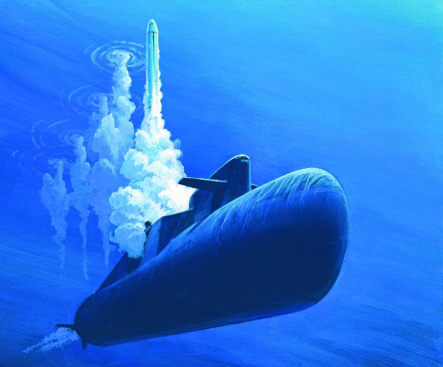
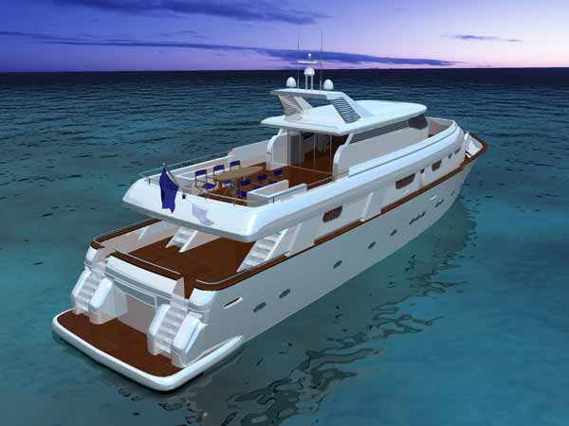
Transport
1.Double-decker | 3.Submarine
2.Yacht | 4.Helicopter
А
В
С
D

Slide 21
Transport
B-1.Double-decker | C-3.Submarine
D-2.Yacht | A-4.Helicopter
А
В
С
D

