Slide 1
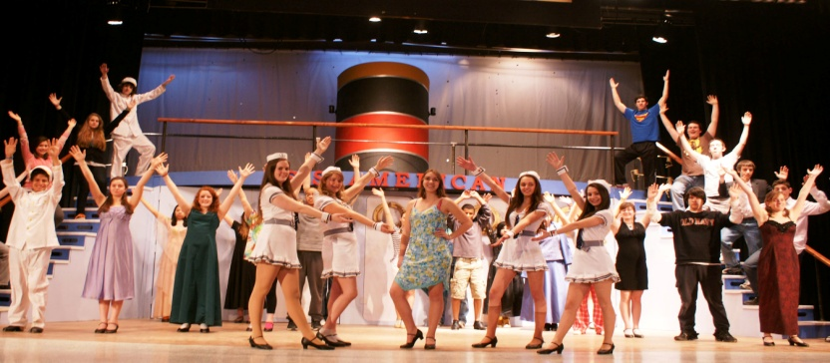
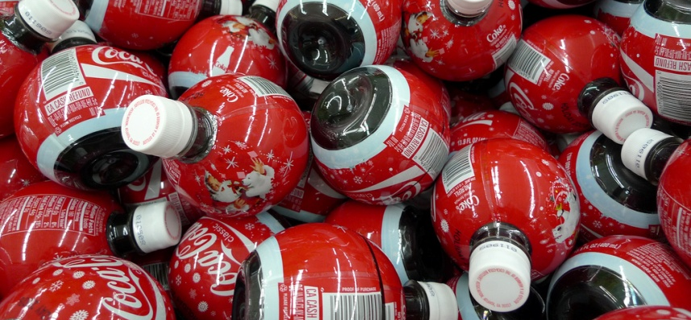
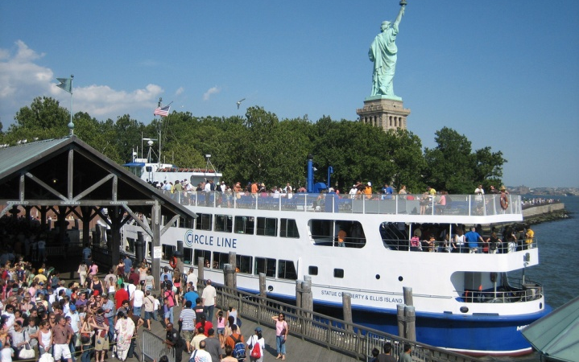
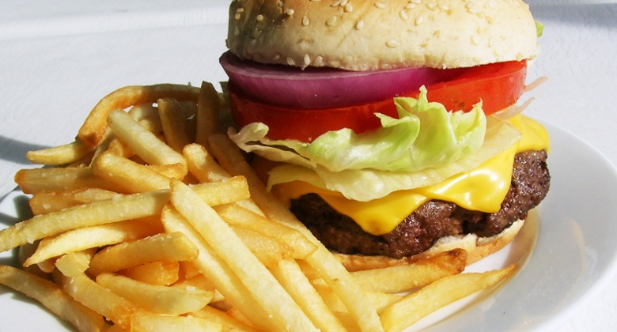
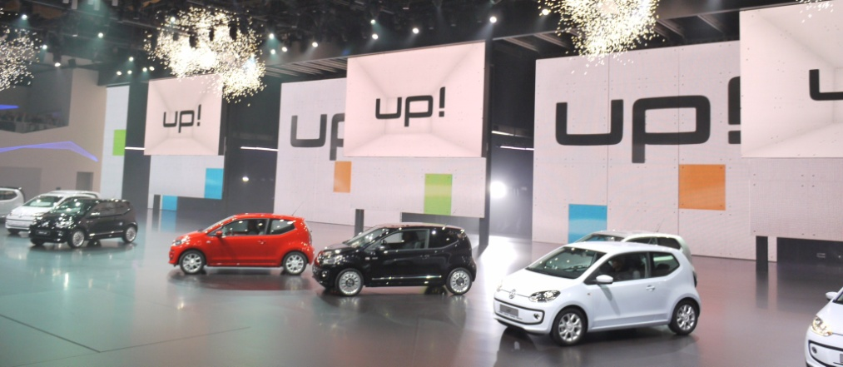
A musical at the theatre
A soft drink
A new kind of frozen potato dish
A cross-Channel ferry
A motor fair

Slide 2
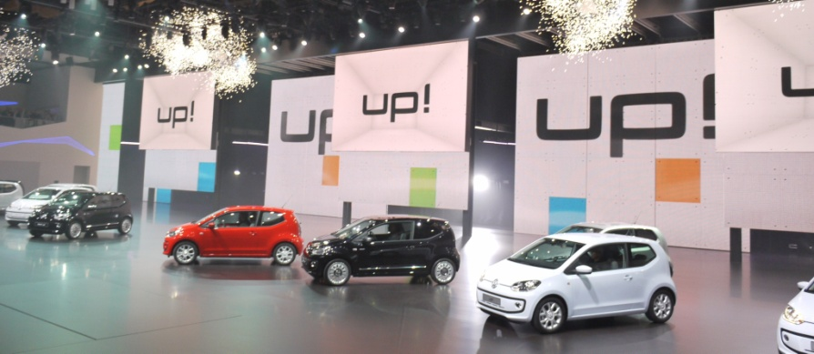
1.
A new kind of frozen potato dish
A cross-Channel ferry
2.
A musical at the theatre
A motor fair
3.
4.
5.
A soft drink

