Slide 1
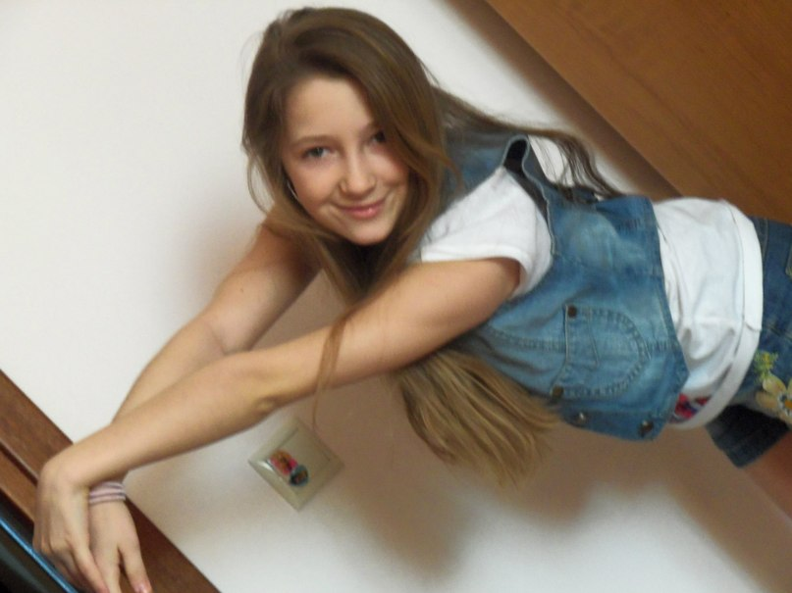
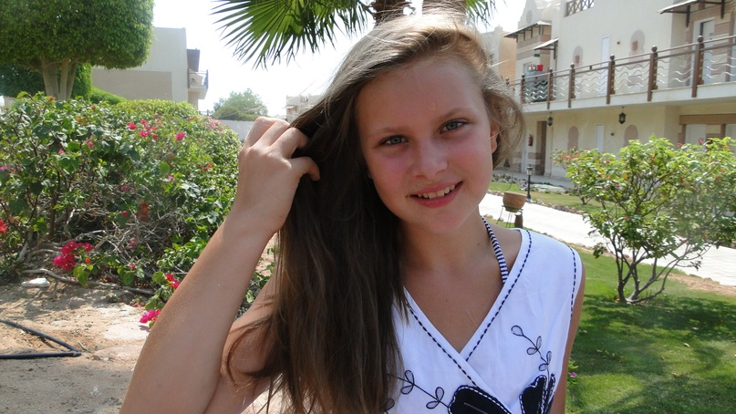
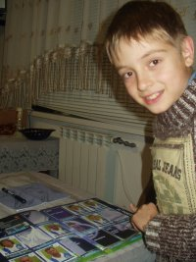
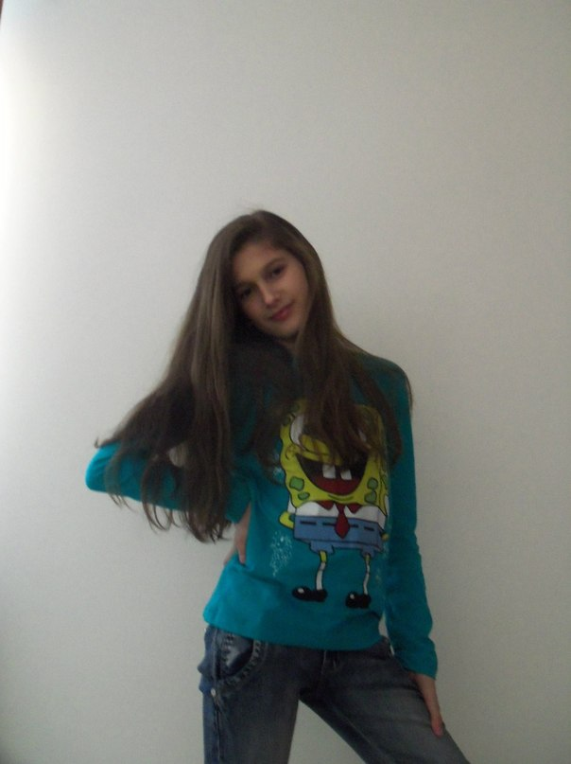
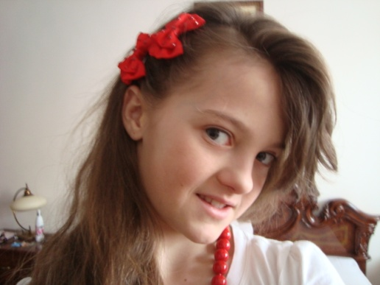
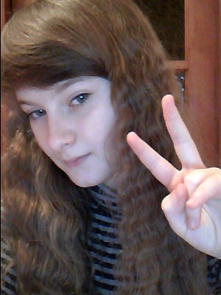
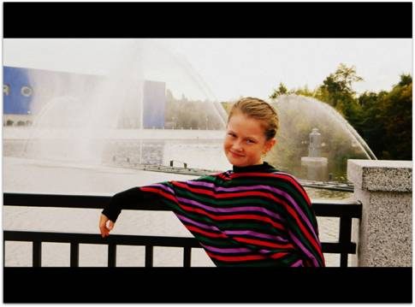
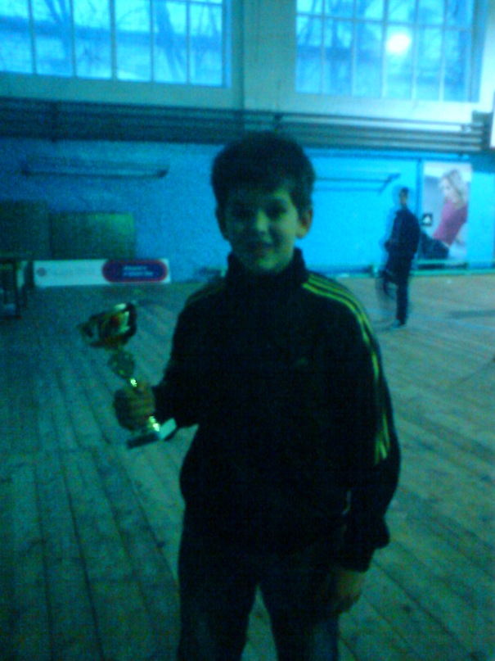
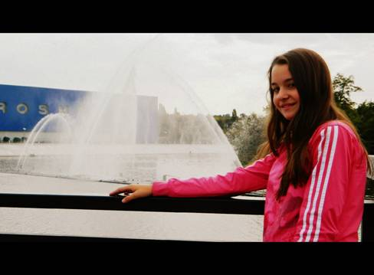
Space Kids

Slide 2
Bohdan Makarchuk
I’m interested in astronomy and physics.
I want to be a scientist.

Slide 3
Sasha Kozitska
I like singing.
I’ m fond of R’n’B music.

Slide 4
Tanya Koval
I have always been a great lover of dancing.

Slide 5
Solomia Sampara
I love reading books about animals,
I have read almost all of them.

Slide 6
Yulia Kuchmiy
I want to be a fashion designer.
I enjoy designing clothes.

Slide 7
Diana Voronyak
I’m a real cinema goer. I like comedies and science fiction films.

Slide 8
Olena Hnatkivska
Art is my hobby. I’m keen on painting.

Slide 9
Nastya Yazlyuk
Hip hop is all my life. I’m crazy about Eminem and Black Eyed Peas!

Slide 10
Victor Chaklosh
I’m good at playing football.
I think it’s great!

Slide 11
Brave and bright, Space Kids are always right!!!

