Slide 1



Slide 2
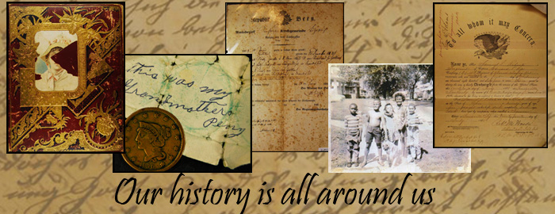


Slide 3
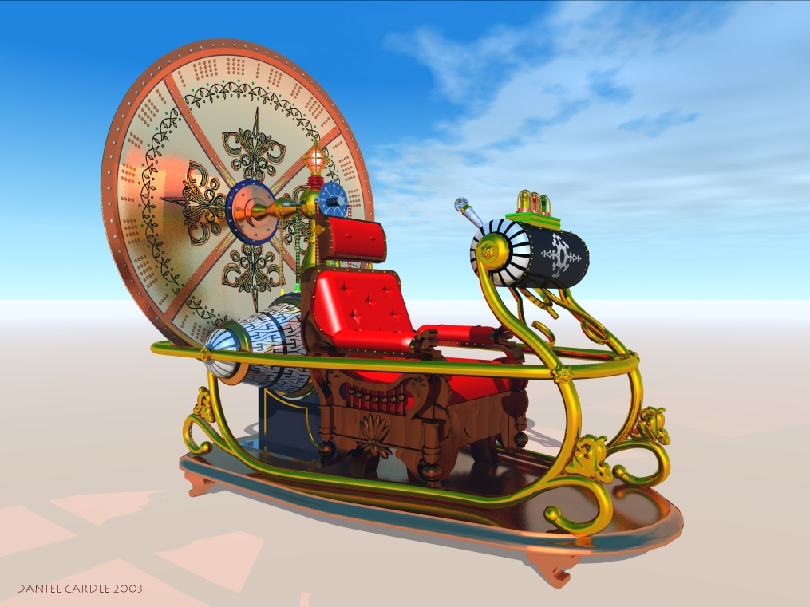



Slide 4
ROUND 1

Slide 5
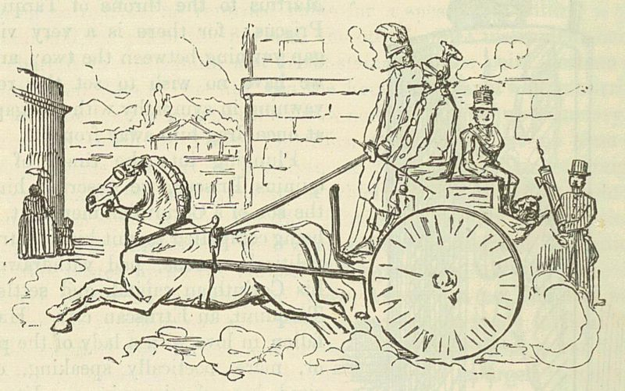
There was a…..

Slide 6
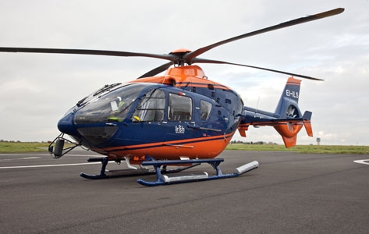
There wasn’t a…..

Slide 7
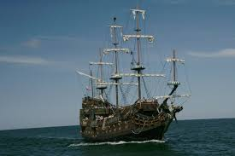
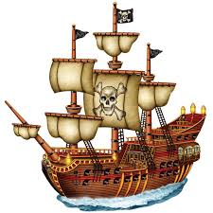
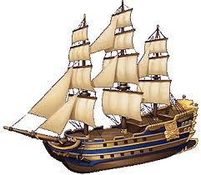
There were…..

Slide 8
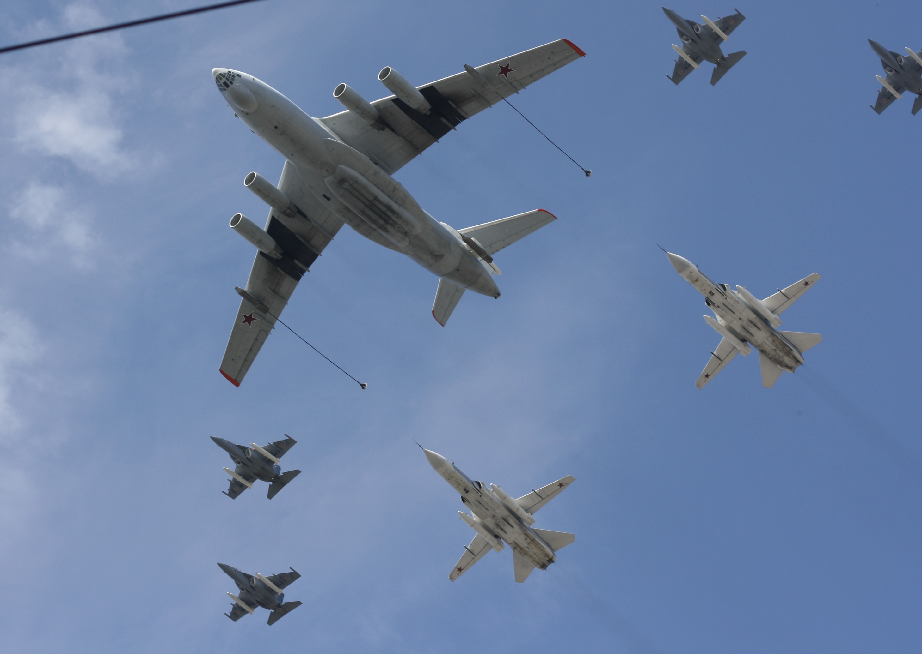
There weren’t…..

Slide 9
ROUND 2

Slide 10


TERNOPIL
200 years ago

Slide 11
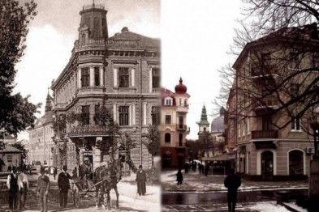

TERNOPIL
200 years ago
TERNOPIL
now

Slide 12
ROUND 3

Slide 13
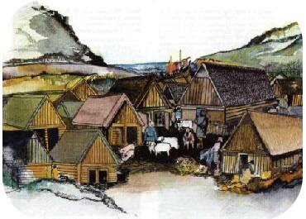
The Vikings

Slide 14
I had - I didn’t have
He had - He didn’t have
She had - She didn’t have
We had - We didn’t have
They had - They didn’t have

Slide 15
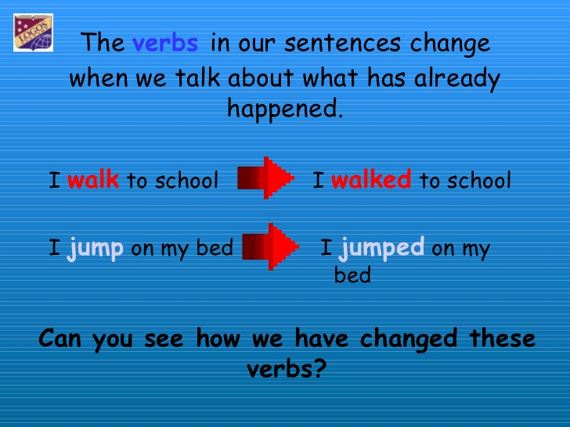

Slide 16
Using this rule can you find the missing word?
Question 1:
They _________ using clothes long time ago.
a. start b. started c. starts

Slide 17
Brilliant!!!
You chose the correct answer!
Start + ed = started!
Remember add “ed”

Slide 18
Question 1:
I ______b.___ reading a book yesterday
a. start b. started c. starts

Slide 19
Question 2:
The Vikings _________ building their houses.
a. finishes b. finish c. finished

Slide 20
Question 3:
They ______ to protect themselves from animals.
a. wanted b. wants c. want

Slide 21
Question 4:
They _________ a lot when they saw funny birds.
a. laughing b. laugh c. laughed

Slide 22
ROUND 4

Slide 23



Slide 24
Start

Slide 25
Started

Slide 26
Finish

Slide 27
Finished

Slide 28
Want

Slide 29
Wanted

Slide 30
Laugh

Slide 31
Laughed

Slide 32
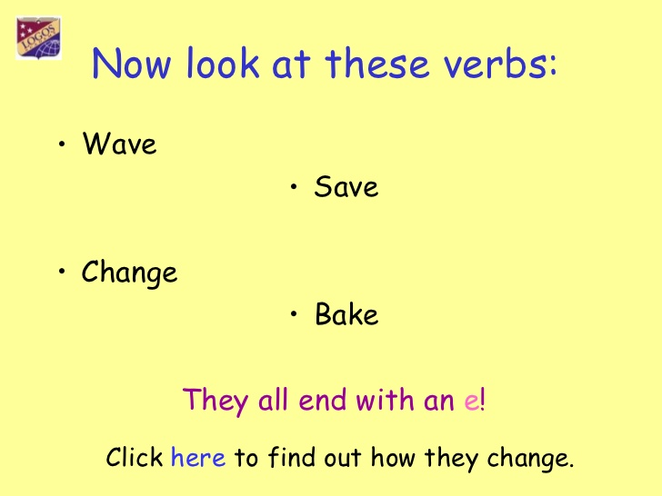
Now

Slide 33
They only add “d”!
Waved Baked
Saved Ruled

Slide 34
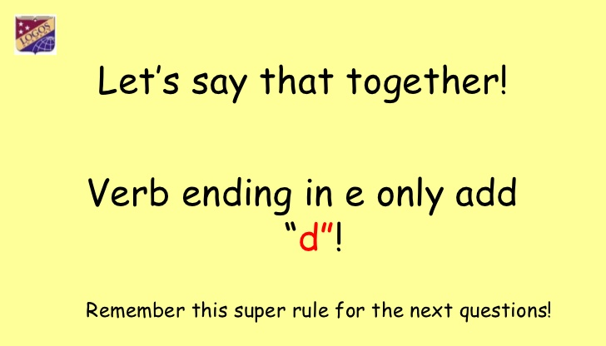

Slide 35
Love

Slide 36
Loved

Slide 37
Hate

Slide 38
Hated

Slide 39
Use

Slide 40
Used

Slide 41
Live

Slide 42
Lived

Slide 43
Now look!
Which one is correct:
a. loveed b. loved
a. hated b. hateed
a. useed b. used
a. liveed b. lived

Slide 44
Well done!!!!!
You have remembered the rule!
Only add d!

Slide 45



Slide 46
1. Are Max and Amy at school?
2. What are they doing?
3. What do they have?
4. Can they read the secret message?
5. When did the Ancient Egyptians live?
6. Did they use pictures or words to write?
7. What was in the message?
8. Did they do their home task?

Slide 47
ROUND 5

Slide 48
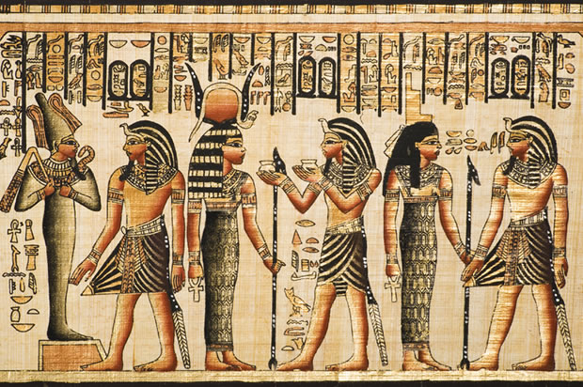
The Ancient Egyptians

Slide 52
The Ancient Egyptians

Slide 53


Slide 54
We visited Ternopil 200 hundred years ago
We visited the Vikings 1000 years ago
We visited Ancient Egypt 5000 thousand years ago

Slide 55
Don’t forget:
When we talk about things that happened before we use past tense.

Slide 56
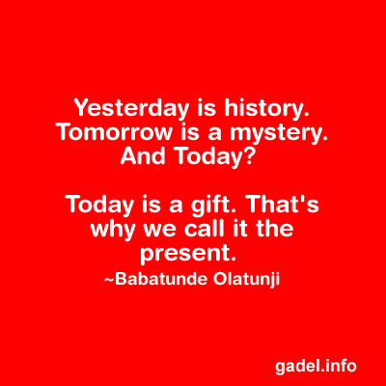
Listening

