Slide 1
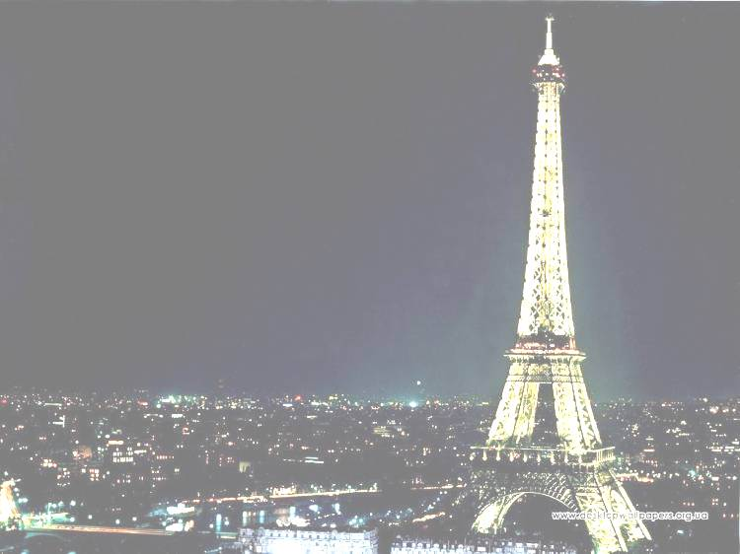
HOW WELL
DO
YOU
KNOW EUROPE

Slide 2
ROUND 1

Slide 3
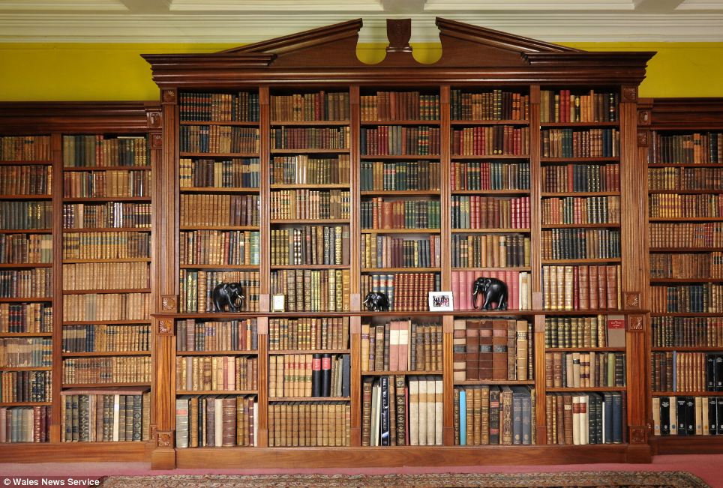
In English libraries books, unfortunately, are often stolen. What books are stolen most often?
End
1
2
3
4
5
6
7
8
9
10
11
12
13
14
15
16
17
18
19
20
21
22
23
24
25
26
27
28
29
30
31
32
33
34
35
36
37
38
39
40
41
42
43
44
45
46
47
48
49
50
51
52
53
54
55
56
57
58
59
60

Slide 4
The Guinness World Records is often stolen!

Slide 5
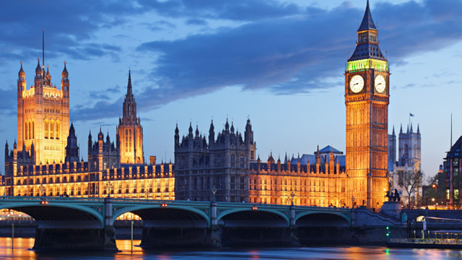
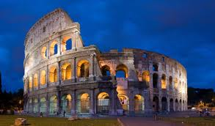
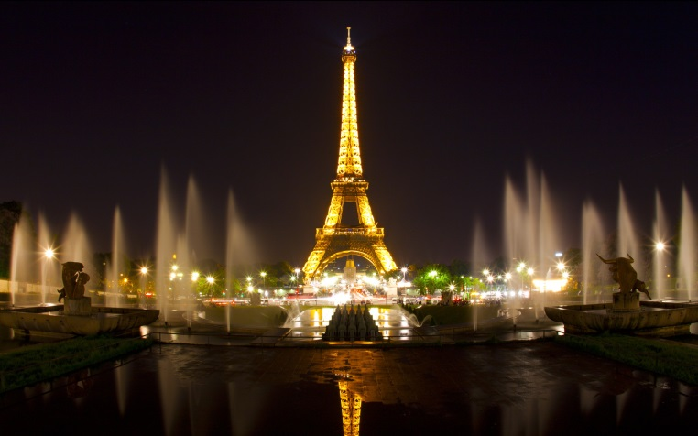
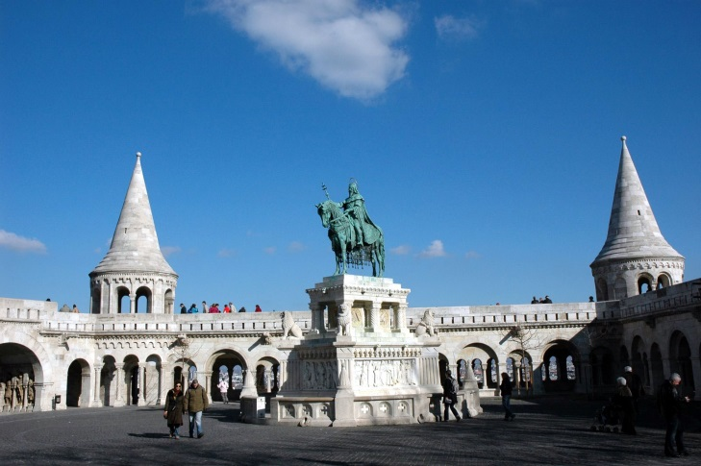
What is the largest city in Europe with a population of just under 10 million people?
End
1
2
3
4
5
6
7
8
9
10
11
12
13
14
15
16
17
18
19
20
21
22
23
24
25
26
27
28
29
30
31
32
33
34
35
36
37
38
39
40
41
42
43
44
45
46
47
48
49
50
51
52
53
54
55
56
57
58
59
60

Slide 6
Paris, France

Slide 7
What is the most populated country in Europe?
GERMANY
POLAND
End
1
2
3
4
5
6
7
8
9
10
11
12
13
14
15
16
17
18
19
20
21
22
23
24
25
26
27
28
29
30
31
32
33
34
35
36
37
38
39
40
41
42
43
44
45
46
47
48
49
50
51
52
53
54
55
56
57
58
59
60
SWEDEN
NORWAY

Slide 8
GERMANY

Slide 9
Which of the following countries has the biggest number of official languages?
Switzerland
Ukraine
End
1
2
3
4
5
6
7
8
9
10
11
12
13
14
15
16
17
18
19
20
21
22
23
24
25
26
27
28
29
30
31
32
33
34
35
36
37
38
39
40
41
42
43
44
45
46
47
48
49
50
51
52
53
54
55
56
57
58
59
60
Poland
Italy

Slide 10
Switzerland

Slide 11
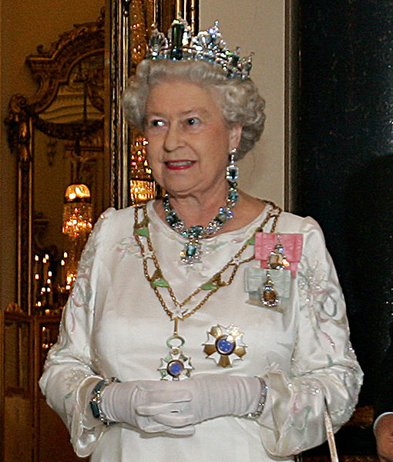
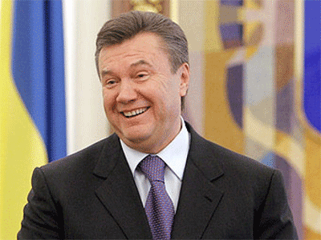
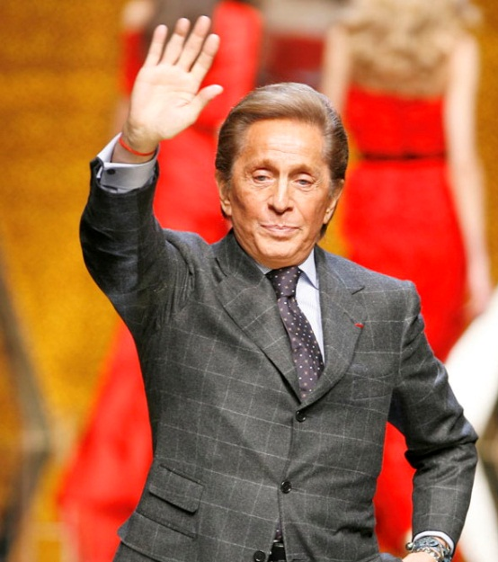
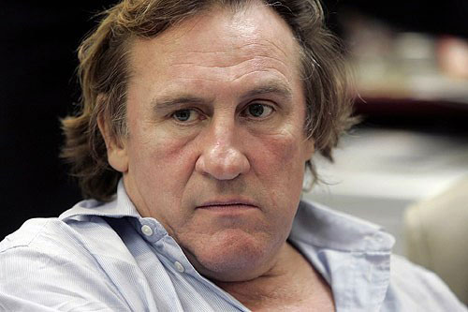
Who of these people doesn’t have passport?
End
1
2
3
4
5
6
7
8
9
10
11
12
13
14
15
16
17
18
19
20
21
22
23
24
25
26
27
28
29
30
31
32
33
34
35
36
37
38
39
40
41
42
43
44
45
46
47
48
49
50
51
52
53
54
55
56
57
58
59
60

Slide 13
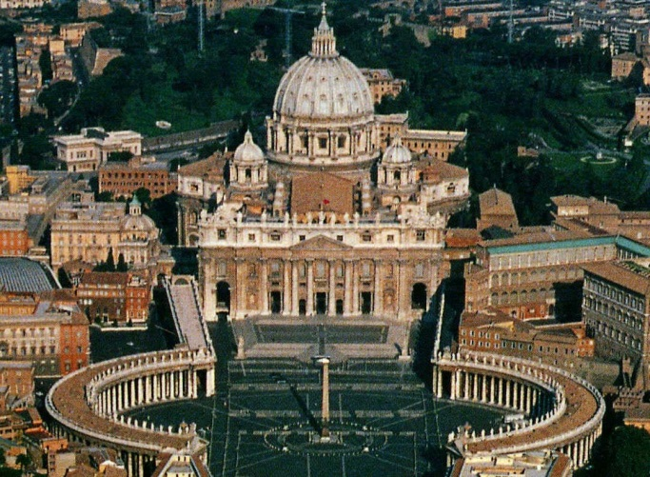
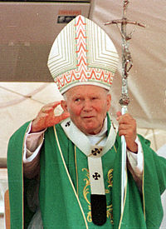
Where are ​​these photos taken?
End
1
2
3
4
5
6
7
8
9
10
11
12
13
14
15
16
17
18
19
20
21
22
23
24
25
26
27
28
29
30
31
32
33
34
35
36
37
38
39
40
41
42
43
44
45
46
47
48
49
50
51
52
53
54
55
56
57
58
59
60
1) Monaco | 2) Vatican
3) Luxembourg | 4) Italy

Slide 14
Vatican

Slide 15
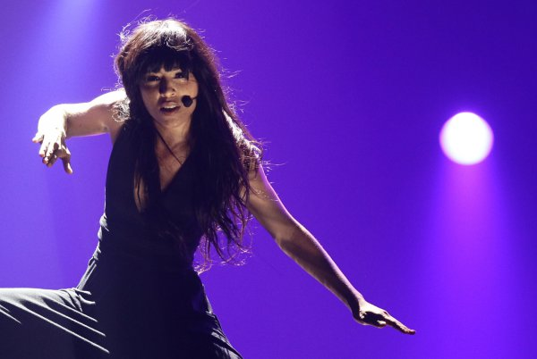
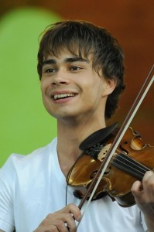
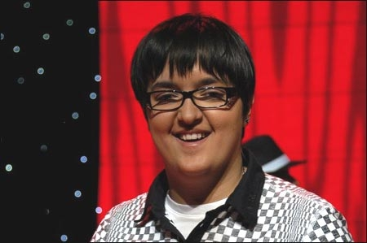
What contest did all these people win?
End
1
2
3
4
5
6
7
8
9
10
11
12
13
14
15
16
17
18
19
20
21
22
23
24
25
26
27
28
29
30
31
32
33
34
35
36
37
38
39
40
41
42
43
44
45
46
47
48
49
50
51
52
53
54
55
56
57
58
59
60
1) Grammy
2) Eurovision
3) New Wave
4) X-Factor

Slide 16
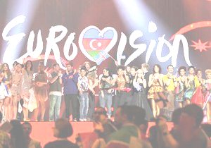

Slide 17
Look at the video and try to guess the place

Slide 19
Paris, France

Slide 21
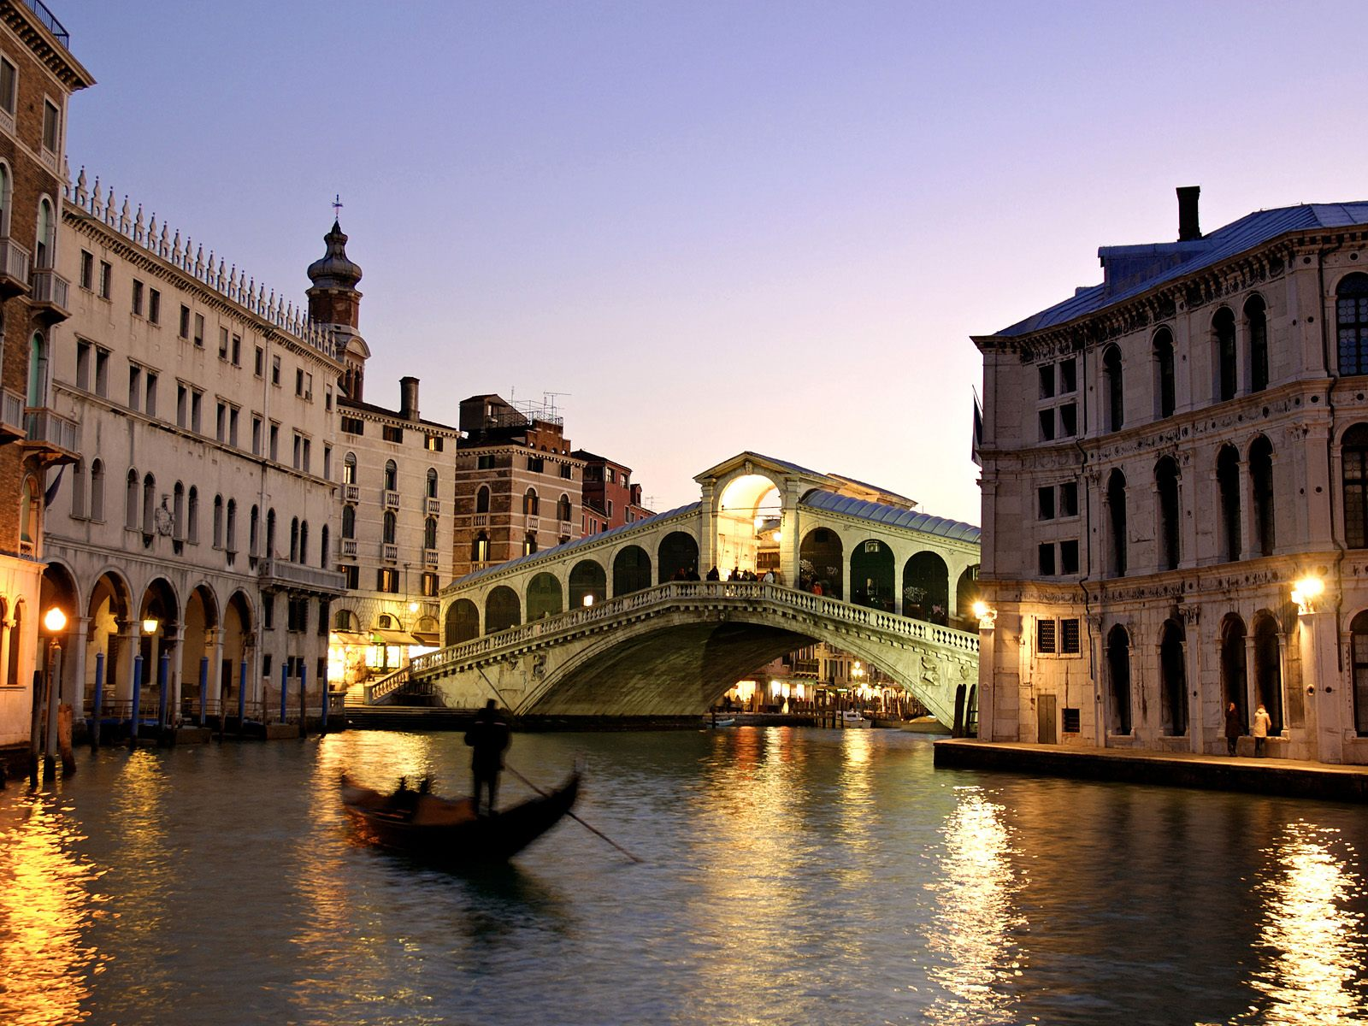
Venice, Italy

Slide 22
BONUS
There are nearly 750 000 words in English language. In your opinion how many of them are borrowed from other languages?
End
1
2
3
4
5
6
7
8
9
10
11
12
13
14
15
16
17
18
19
20
21
22
23
24
25
26
27
28
29
30
31
32
33
34
35
36
37
38
39
40
41
42
43
44
45
46
47
48
49
50
51
52
53
54
55
56
57
58
59
60

Slide 23
70%

Slide 24
BOYS
VS
GIRLS

Slide 25
ROUND 2
Arrange the letters

Slide 26
C
A
B
1:30
1:29
1:28
1:27
1:26
1:25
1:24
1:23
1:22
1:21
1:20
1:19
1:18
1:17
1:16
1:15
1:14
1:13
1:12
1:11
1:10
1:09
1:08
1:07
1:06
1:05
1:04
1:03
1:02
1:01
1:00
0:59
0:58
0:57
0:56
0:55
0:54
0:53
0:52
0:51
0:50
0:49
0:48
0:47
0:46
0:45
0:44
0:43
0:42
0:41
0:40
0:39
0:38
0:37
0:36
0:35
0:34
0:33
0:32
0:31
0:30
0:29
0:28
0:27
0:26
0:25
0:24
0:23
0:22
0:21
0:20
0:19
0:18
0:17
0:16
0:15
0:14
0:13
0:12
0:11
0:10
0:09
0:08
0:07
0:06
0:05
0:04
0:03
0:02
0:01
End
1:30
Arrange the letters

Slide 27
C
A
B
1:30
1:29
1:28
1:27
1:26
1:25
1:24
1:23
1:22
1:21
1:20
1:19
1:18
1:17
1:16
1:15
1:14
1:13
1:12
1:11
1:10
1:09
1:08
1:07
1:06
1:05
1:04
1:03
1:02
1:01
1:00
0:59
0:58
0:57
0:56
0:55
0:54
0:53
0:52
0:51
0:50
0:49
0:48
0:47
0:46
0:45
0:44
0:43
0:42
0:41
0:40
0:39
0:38
0:37
0:36
0:35
0:34
0:33
0:32
0:31
0:30
0:29
0:28
0:27
0:26
0:25
0:24
0:23
0:22
0:21
0:20
0:19
0:18
0:17
0:16
0:15
0:14
0:13
0:12
0:11
0:10
0:09
0:08
0:07
0:06
0:05
0:04
0:03
0:02
0:01
End
1:30
Arrange the letters

Slide 28
BONUS
How many countries of the world have English as an official language?
End
1
2
3
4
5
6
7
8
9
10
11
12
13
14
15
16
17
18
19
20
21
22
23
24
25
26
27
28
29
30
31
32
33
34
35
36
37
38
39
40
41
42
43
44
45
46
47
48
49
50
51
52
53
54
55
56
57
58
59
60

Slide 29
105

Slide 30
BOYS
VS
GIRLS

Slide 31
ROUND 3

Slide 33
ALEXANDER RYBAK
FAIRYTALE

Slide 34
Beyoncе
Run The World

Slide 35
BOYS
VS
GIRLS

Slide 36
ROUND 4

Slide 38
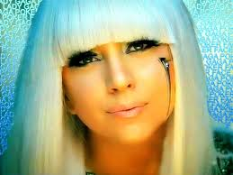

Slide 39
BOYS
VS
GIRLS

Slide 40
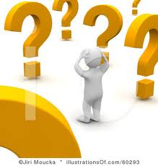
ROUND 5

Slide 41
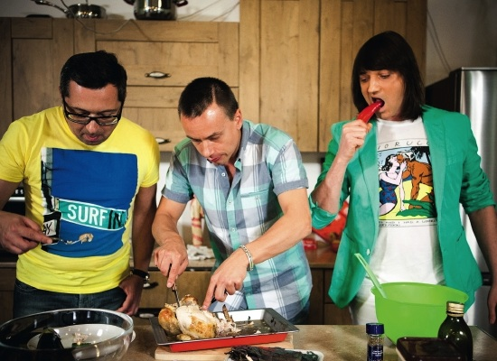
60

Slide 42
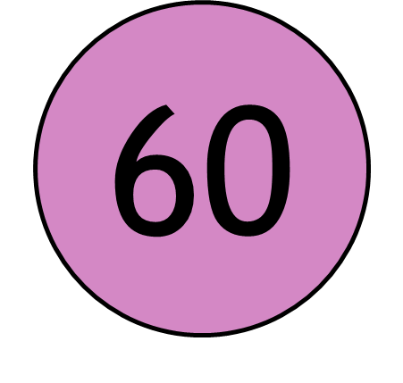

Slide 43
BOYS
VS
GIRLS

Slide 44
ROUND 6

Slide 45
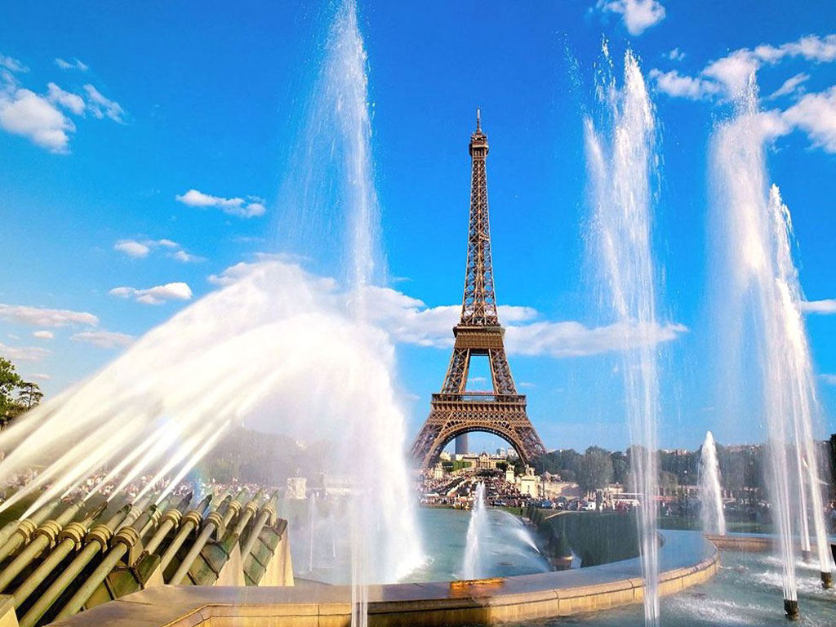
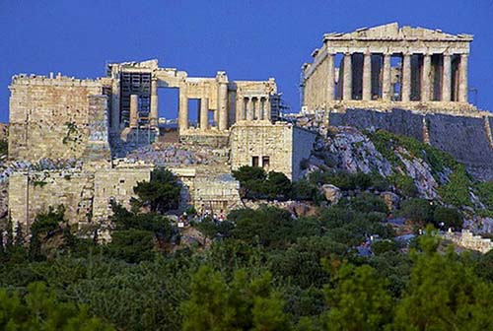
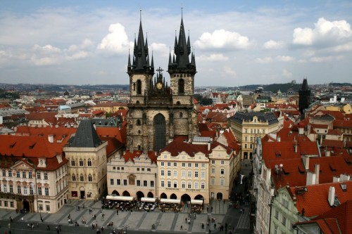
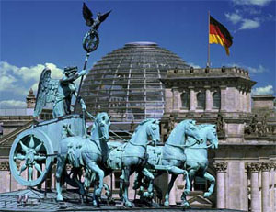
Vatican
Paris
Athens
Prague
Berlin

Slide 46
3 431 420
2 233 818
1 218 644
745 514
821

Slide 47
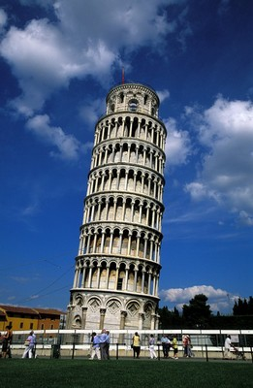
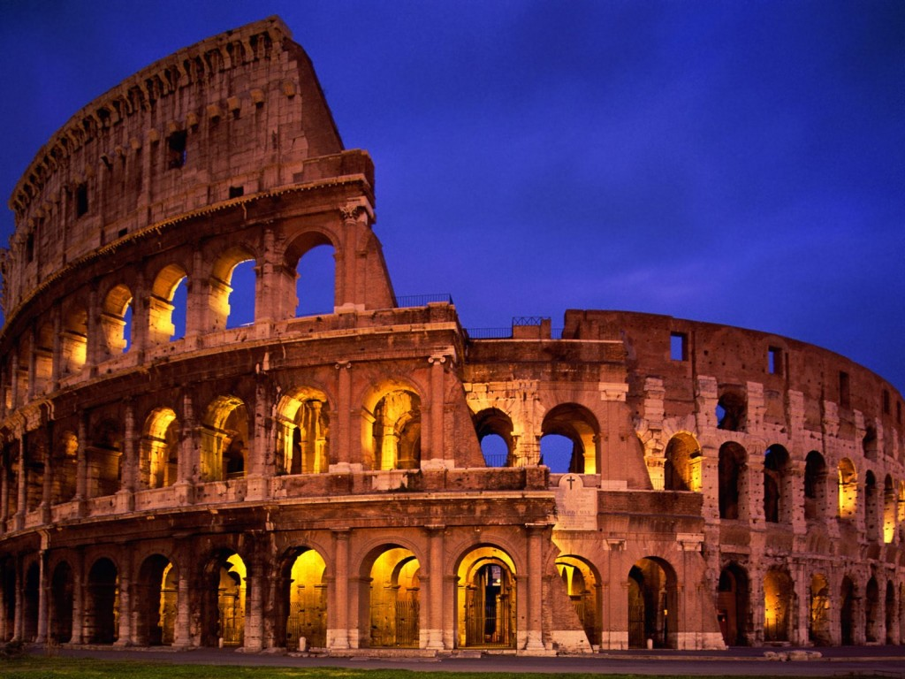
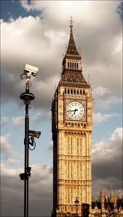
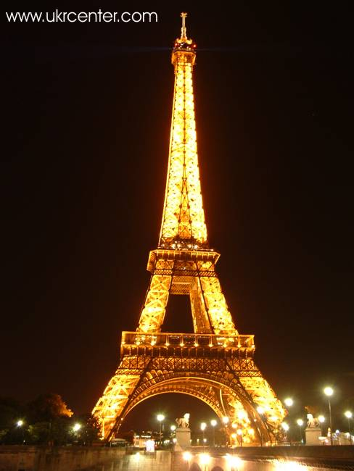
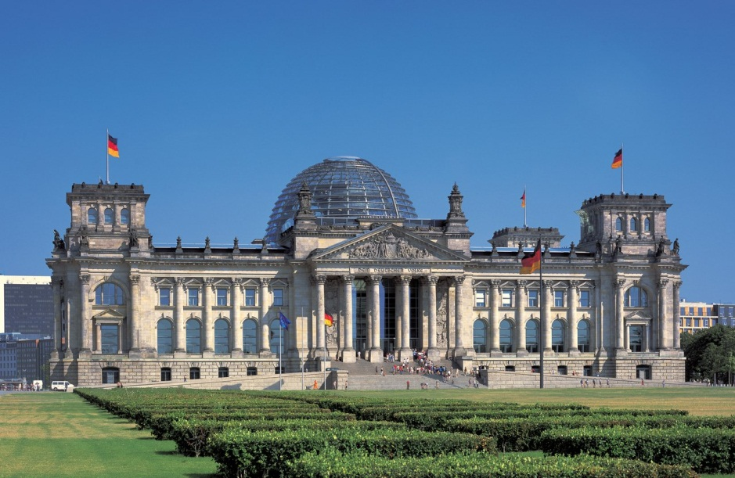
Leaning Tower of Pisa
Coliseum
Big Вen
Eiffel Tower
Reichstag

Slide 48
300 m
56 m
50 m
96,3 m
23,5 m

Slide 49
BOYS
VS
GIRLS

Slide 50
ROUND 7

Slide 51
Who is the shortest person in Europe ?
Who is the cansler of Germany ?
Who is the best soccer coach in Europe ?
Who is the most beautiful person in Europe ?
Who is the most influential person in Europe ?
Who died first : Romeo or Juliet ?
Who was George Sand ?
Who was the first Nobel Prise Winner of Uk in sprint ?

Slide 52
Who is the tallest person in Europe ?
Who is the best striker in Europe ?
Who is the richest person living in Europe ?
Who is the oldest person in Europe ?
Who offically rules England now ?
Who is the richest person in Europe ?
Who won the first qolden medal for Ukraine ?
Who was Marko Vovchock ?

Slide 53
BOYS
VS
GIRLS
Thank you for attention!!!

