Slide 1

Learning is fun!

Slide 2



Round 1

Slide 3
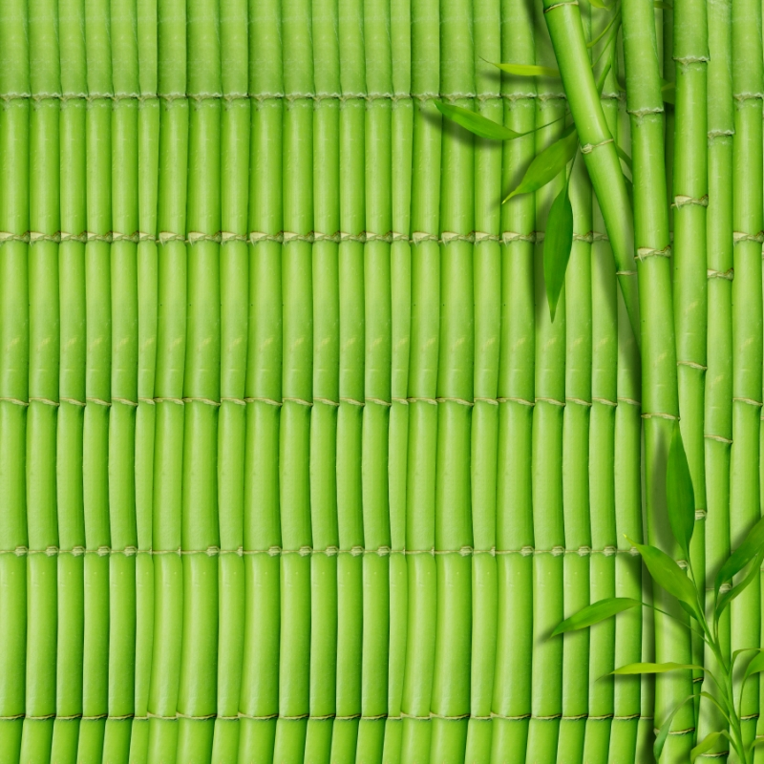
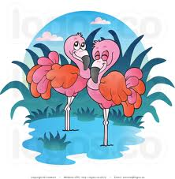
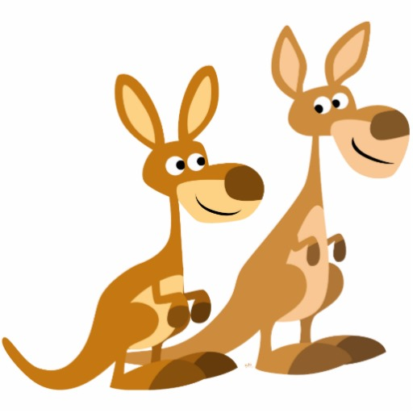
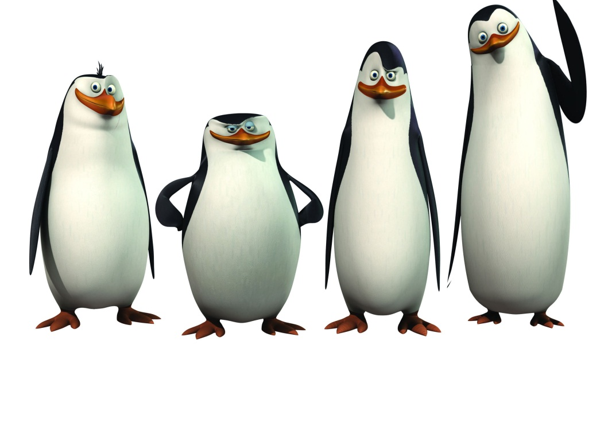
Flamingos
Kangoroos
Penguins

Slide 4


Slide 5

Round
2

Slide 6
is The penguin the sea swimming in

Slide 7

The penguin is swimming in the sea

Slide 8
kangaroo The jumping is jungle in the

Slide 9
The kangaroo is jumping in the jungle

Slide 10
Water flamingo standing the in The

Slide 11
The flamingo is standing in the water

Slide 12
Round
3

Slide 13

Dog, straw, horse, fork.

Slide 14
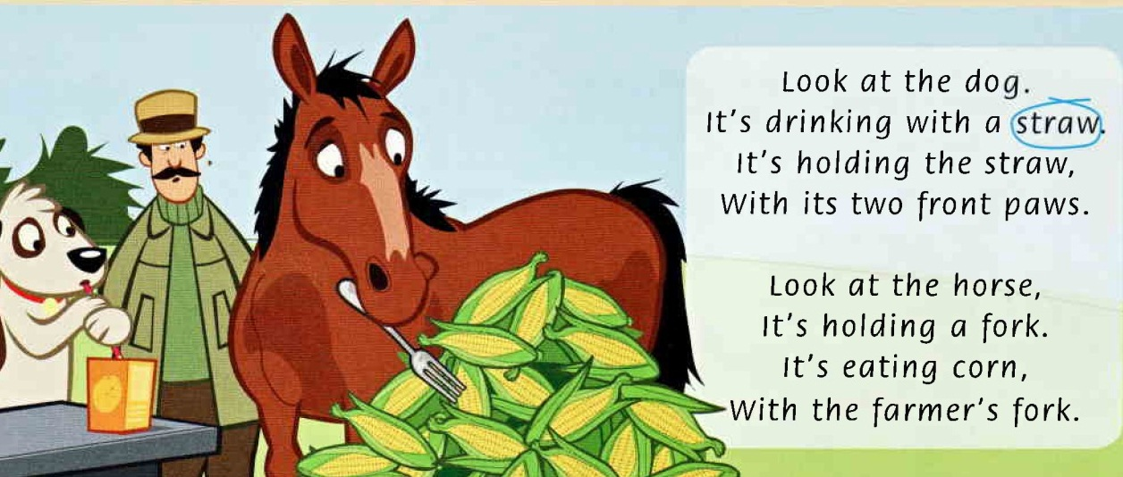

Slide 15
Mall, tall, small, ball.

Slide 16
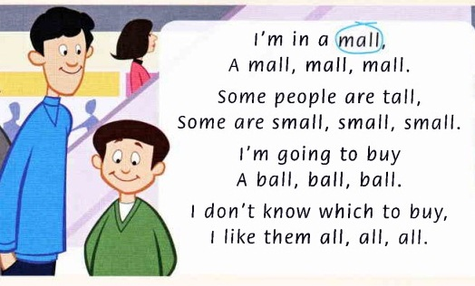

Slide 17
kite, skipping, rope, space, purple face.

Slide 18
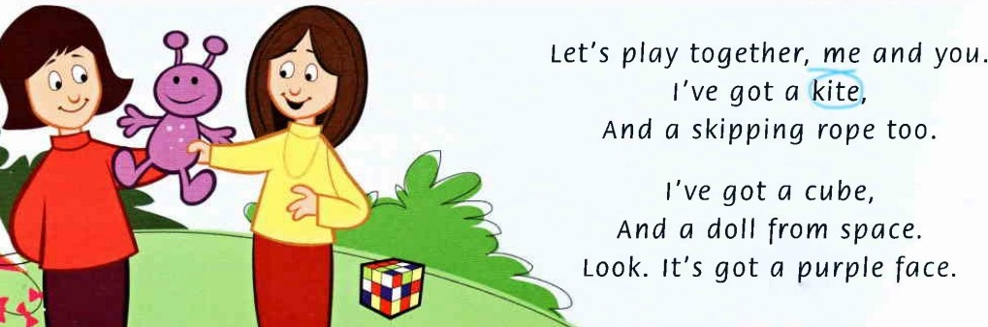

Slide 19
Round
4

Slide 20
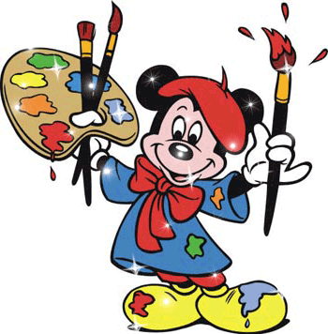

Slide 21

Round
5

Slide 22

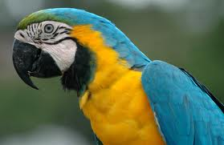

Slide 23
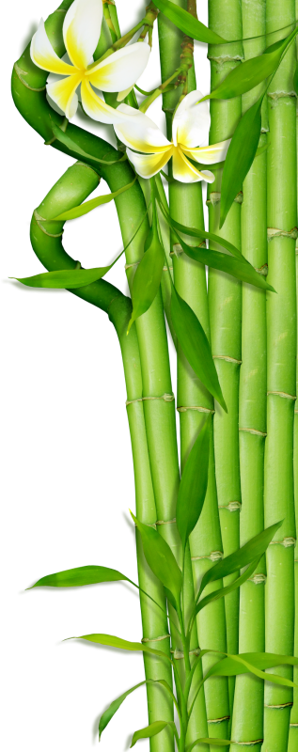
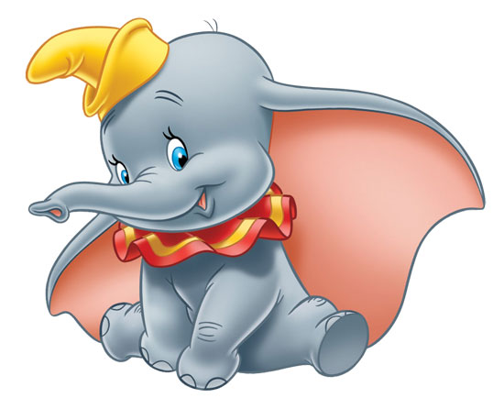

Slide 24
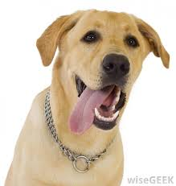

Slide 25
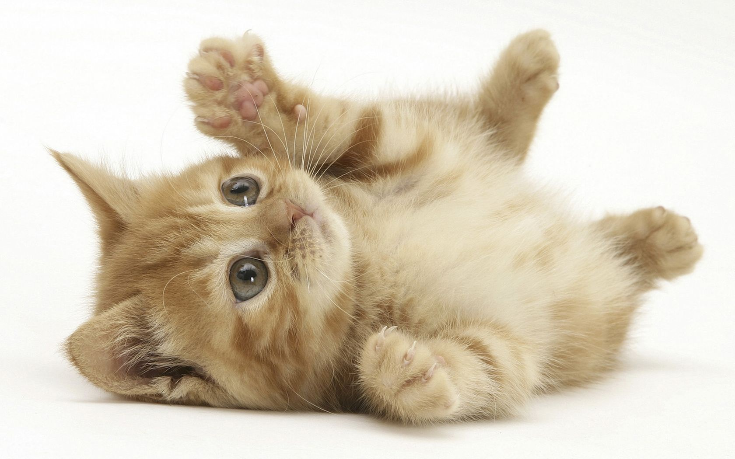

Slide 26
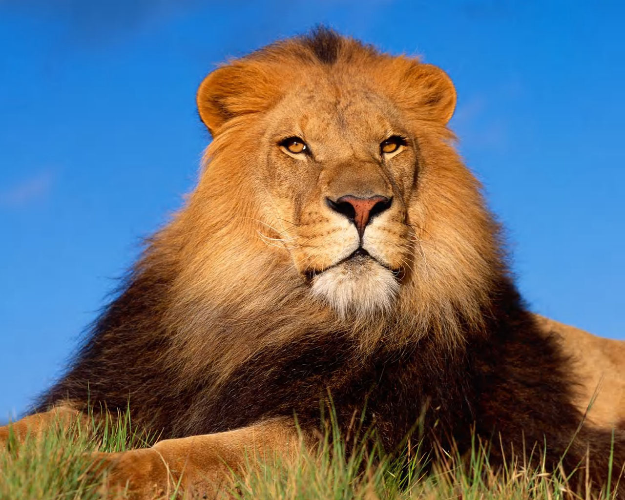

Slide 27
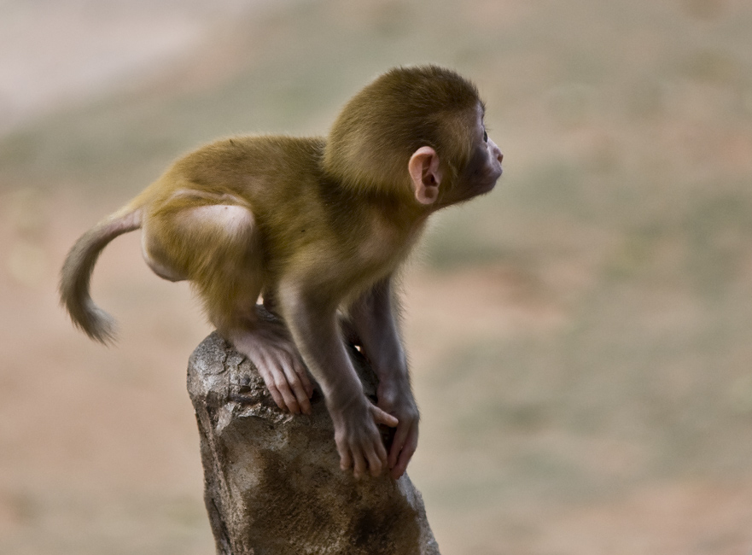

Slide 28
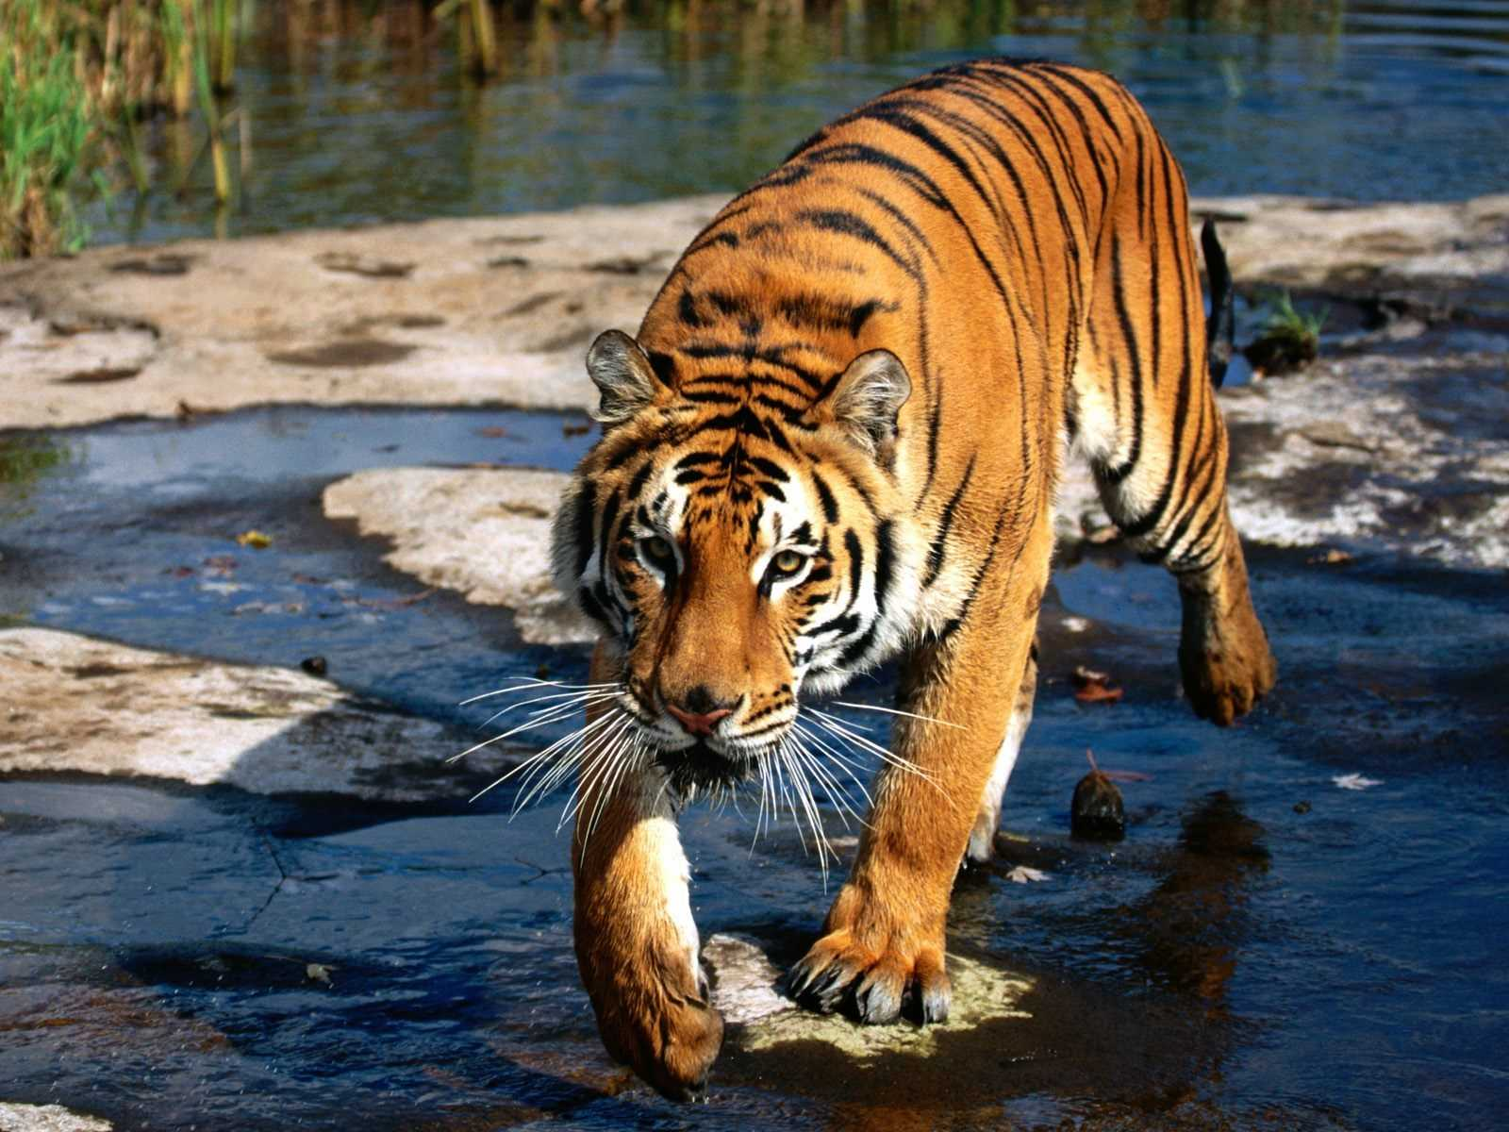

Slide 29
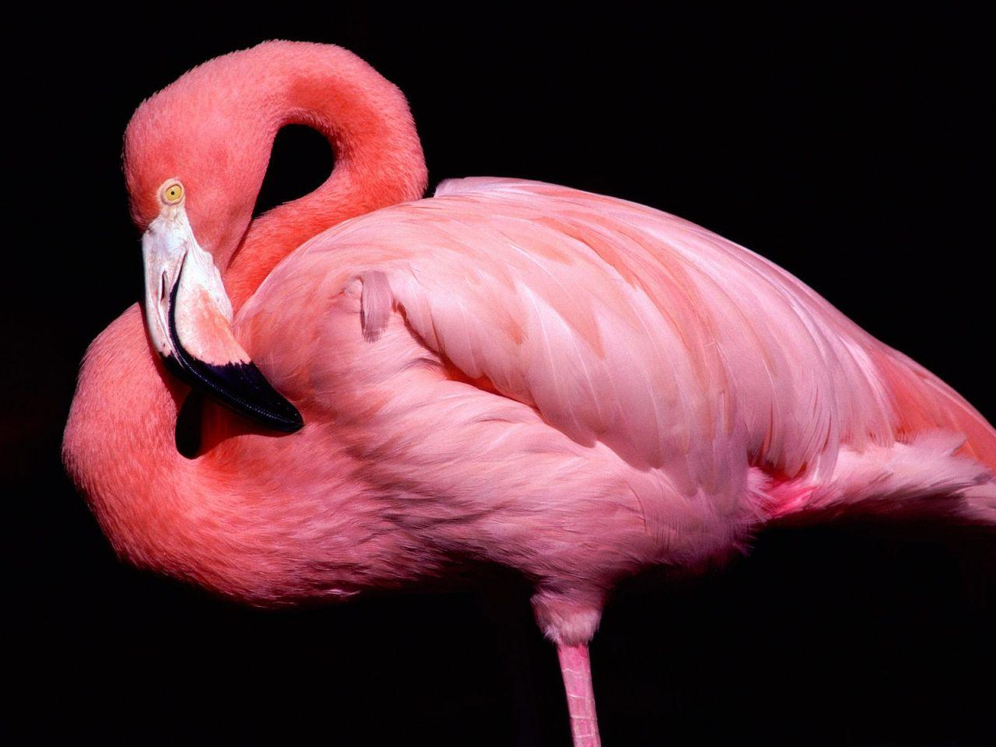

Slide 30
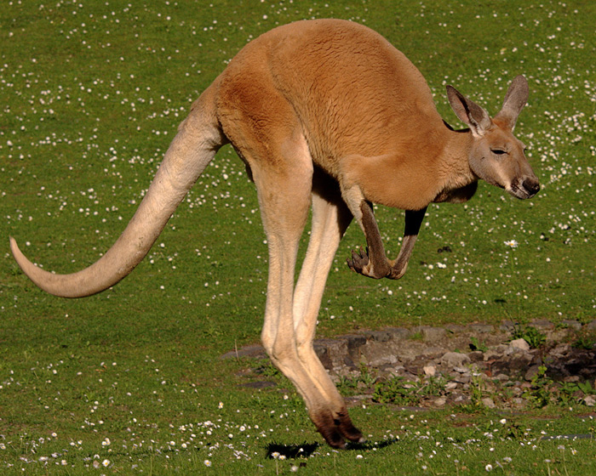

Slide 32
Round
6

Slide 33


Slide 34
F
O
P
R
Round
7
Z
V
W

Slide 35

I spy

Slide 36
Round
8

Slide 37
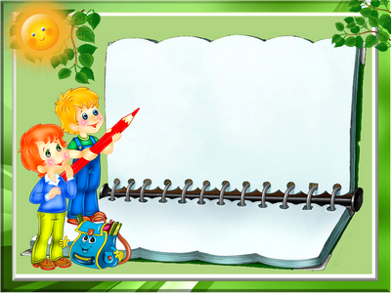
P

Slide 38
Round
9

Slide 39
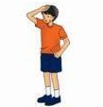


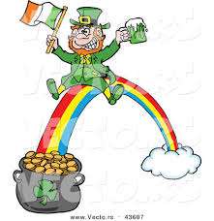
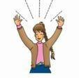
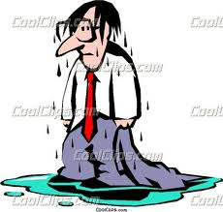
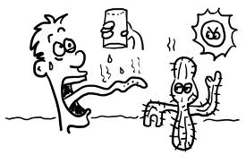
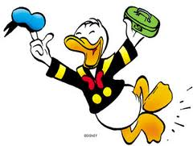
Hot wet happy thirsty cold dry
Sad tired angry funny lucky glad

Slide 40
Cold
hot
tired
sad
thirsty
Angry
happy
wet
dry
funny
lucky
glad

Slide 41


Slide 42
Let's greet the winners!

