Slide 1
LANGUAGES UNITE US IN DIVERSITY

Slide 2
Let you be understood
all over the world

Slide 3
Аlways help you find
the way.

Slide 4
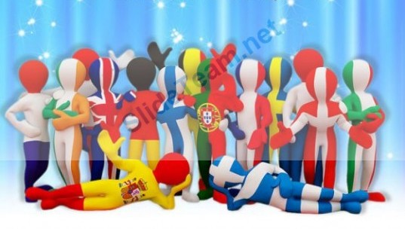
Never make you feel lonely

Slide 5
Give you confidence
in life

Slide 6
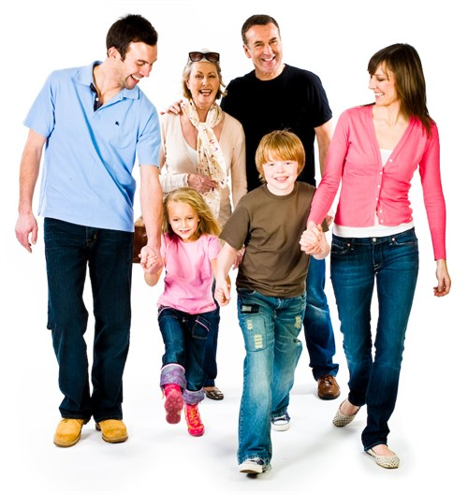
Unite people
of
different ages

Slide 7
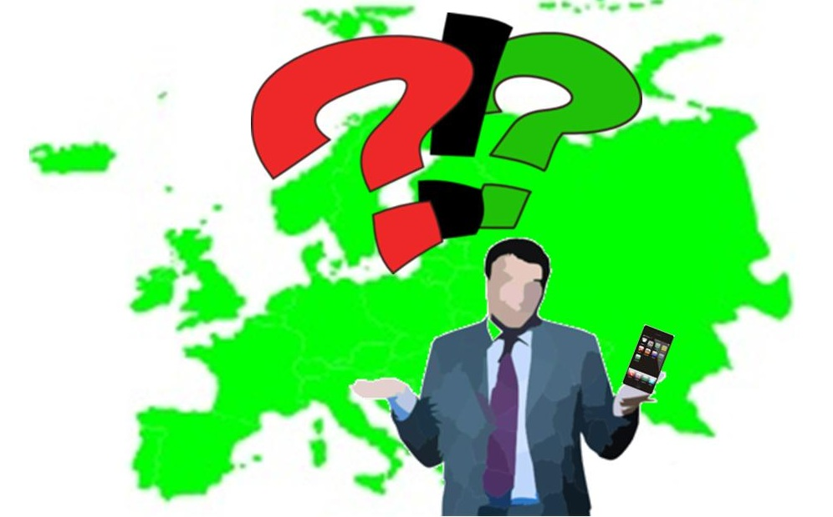
Actually you can’t live
without

Slide 8
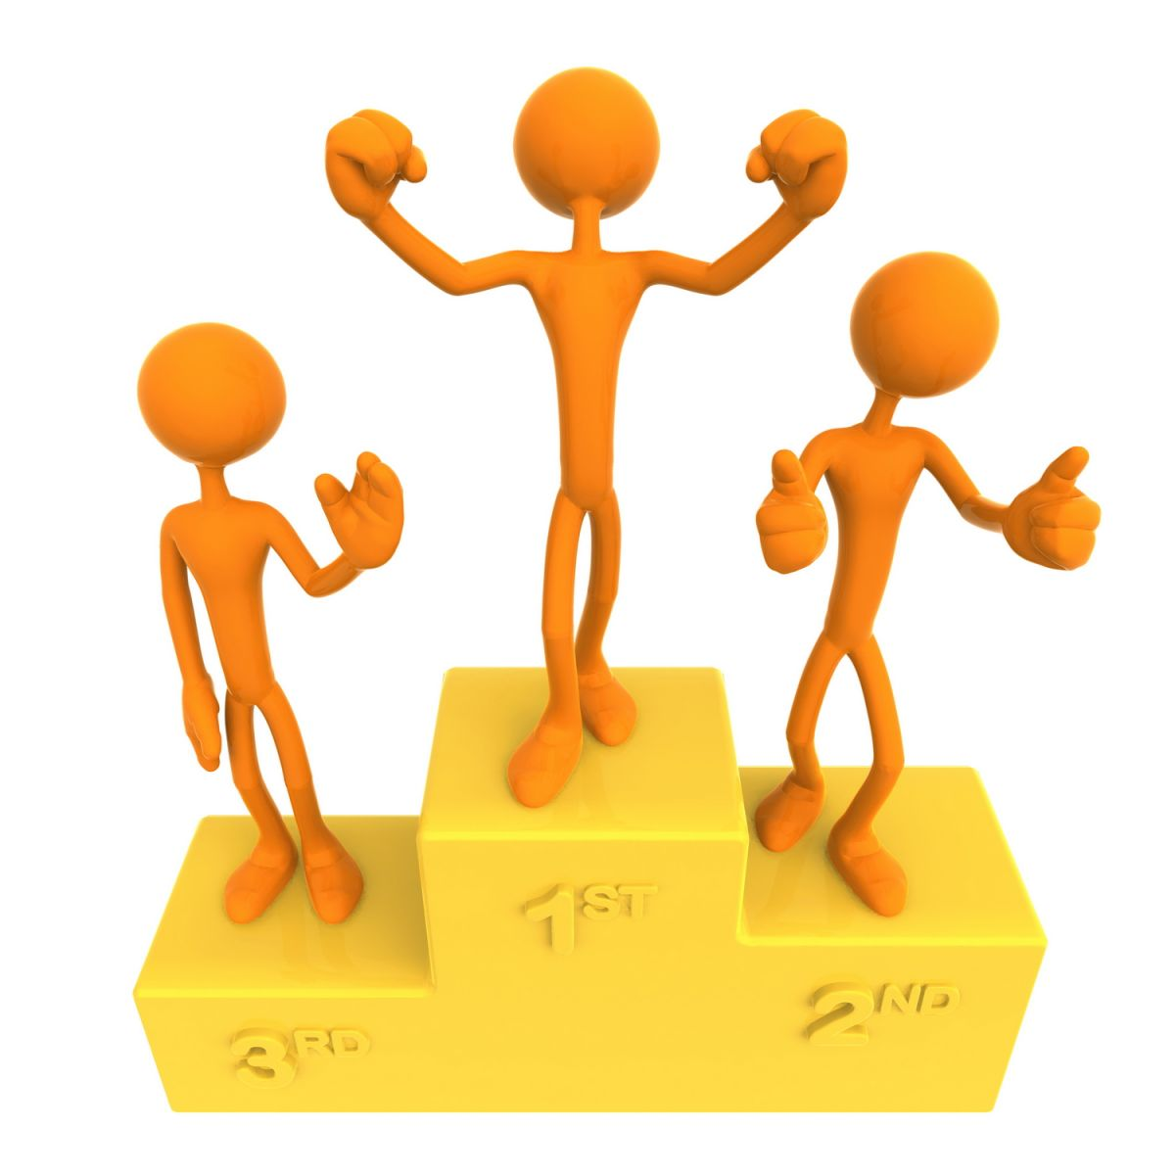
Get you through life successfully

Slide 9
Every day you speak and hear

Slide 10
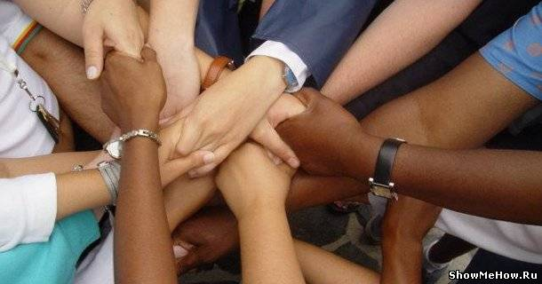
Strangers are made friends

Slide 11
LANGUAGES
unite us
in diversity

Slide 12
LANGUAGES UNITE US IN DIVERSITY

Slide 13
Round
1

Slide 14
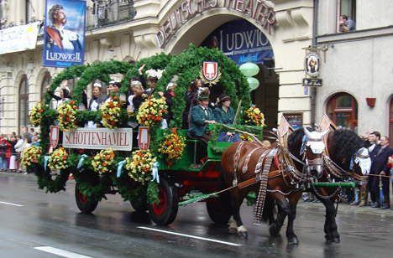
Germany

Slide 15
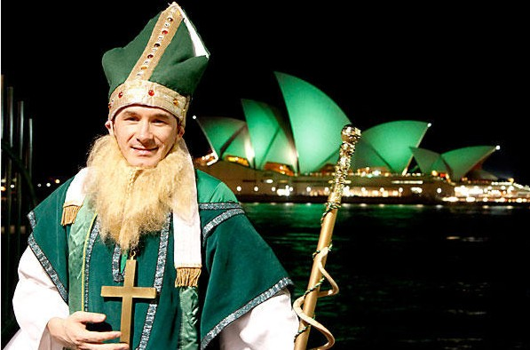
Ireland

Slide 16
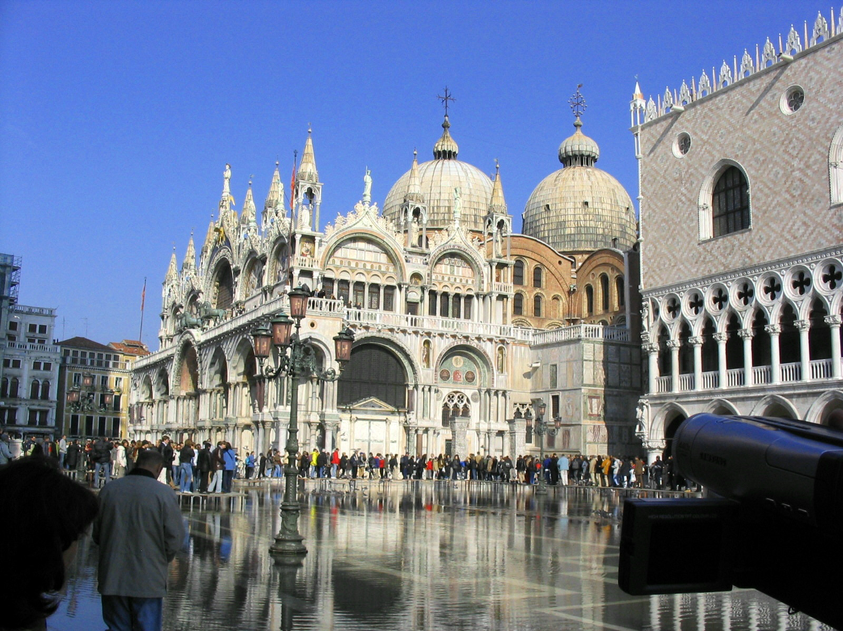
Italy

Slide 17
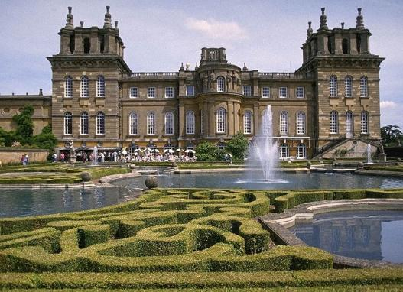
England

Slide 18
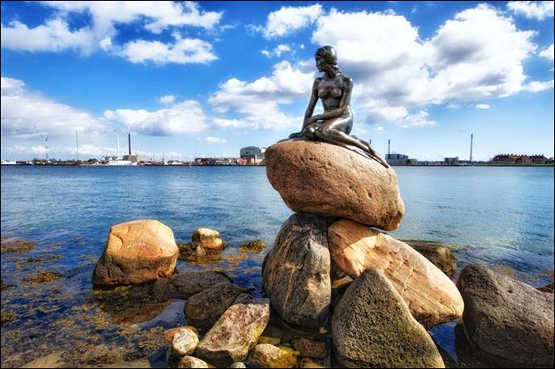
Denmark

Slide 19
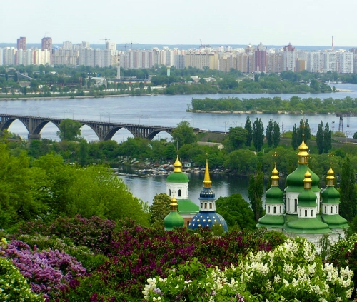
Ukraine

Slide 20
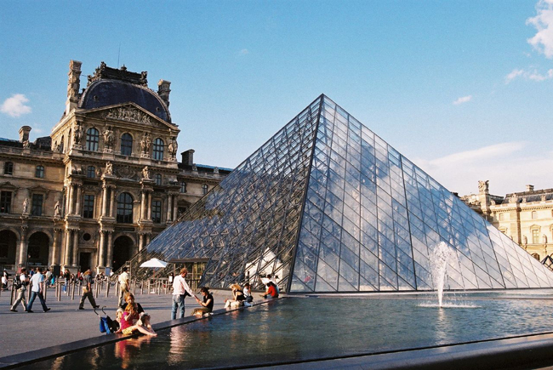
France

Slide 21
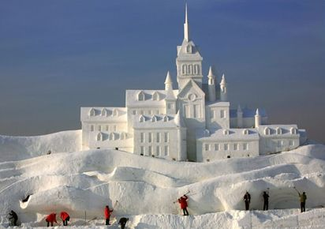
Iceland

Slide 22
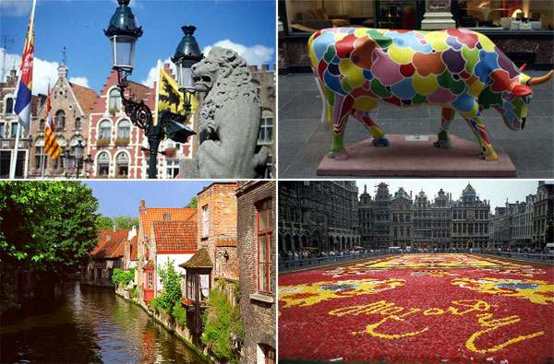
Belgium

Slide 23
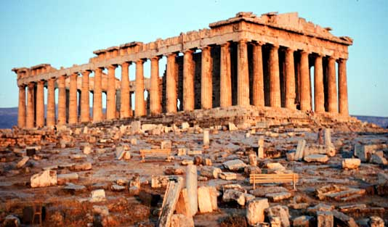
Greece

Slide 24
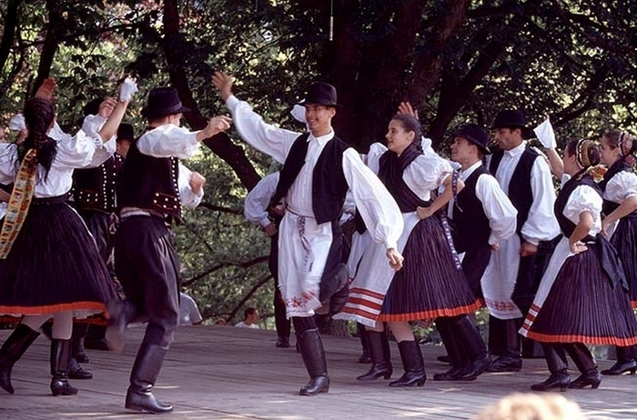
Hungary

Slide 25
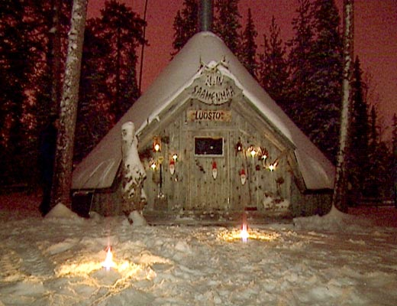
Finland

Slide 26
LANGUAGES UNITE US IN DIVERSITY

Slide 27
Round
2

Slide 30
Time is…
money

Slide 31
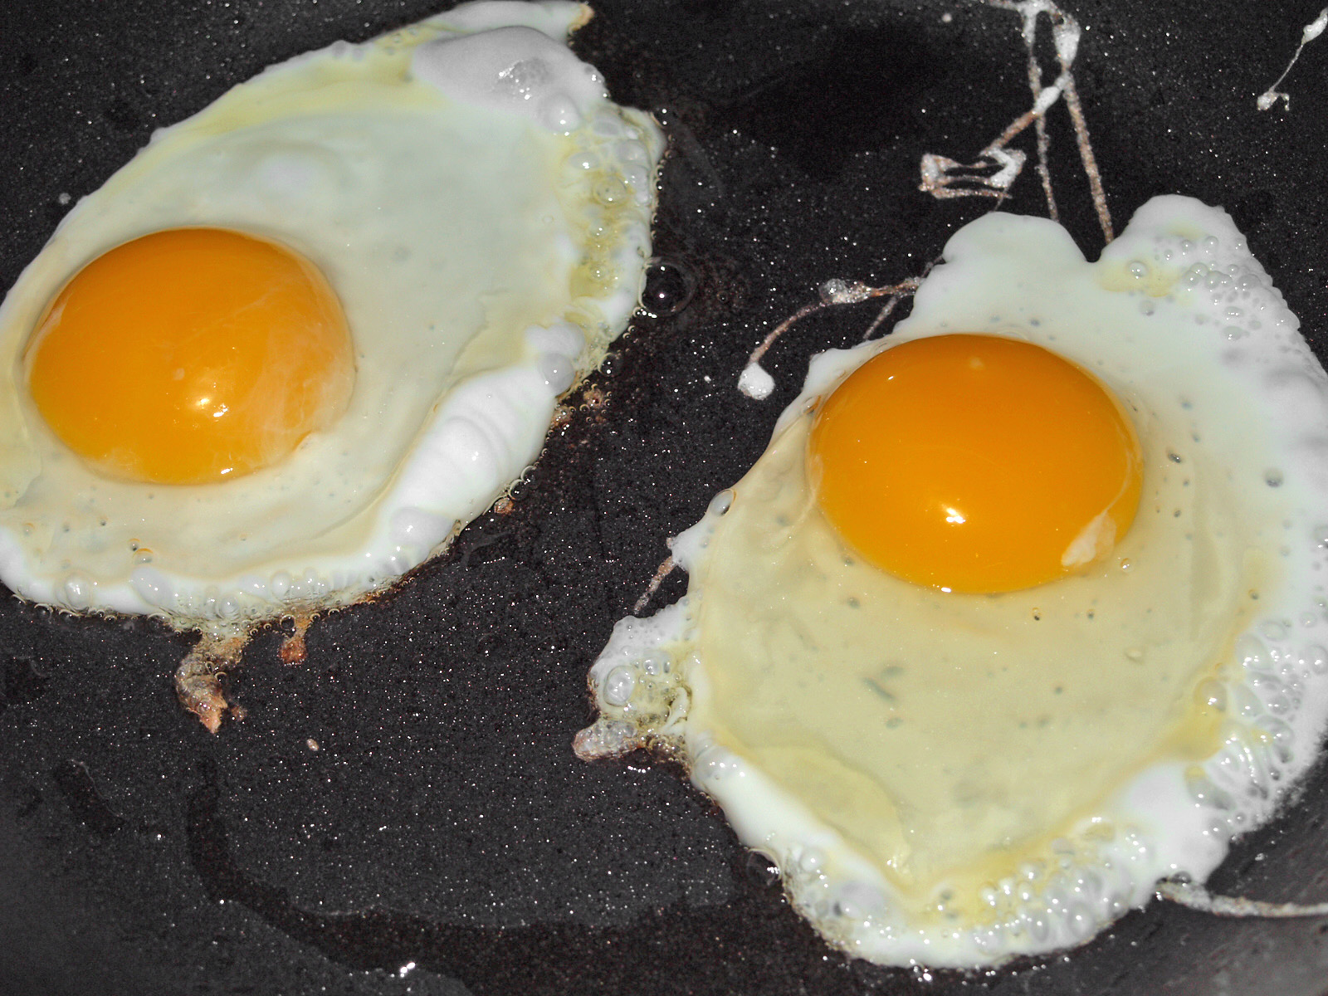

Slide 32
You can’t make
an omelette
without…
breaking eggs

Slide 33
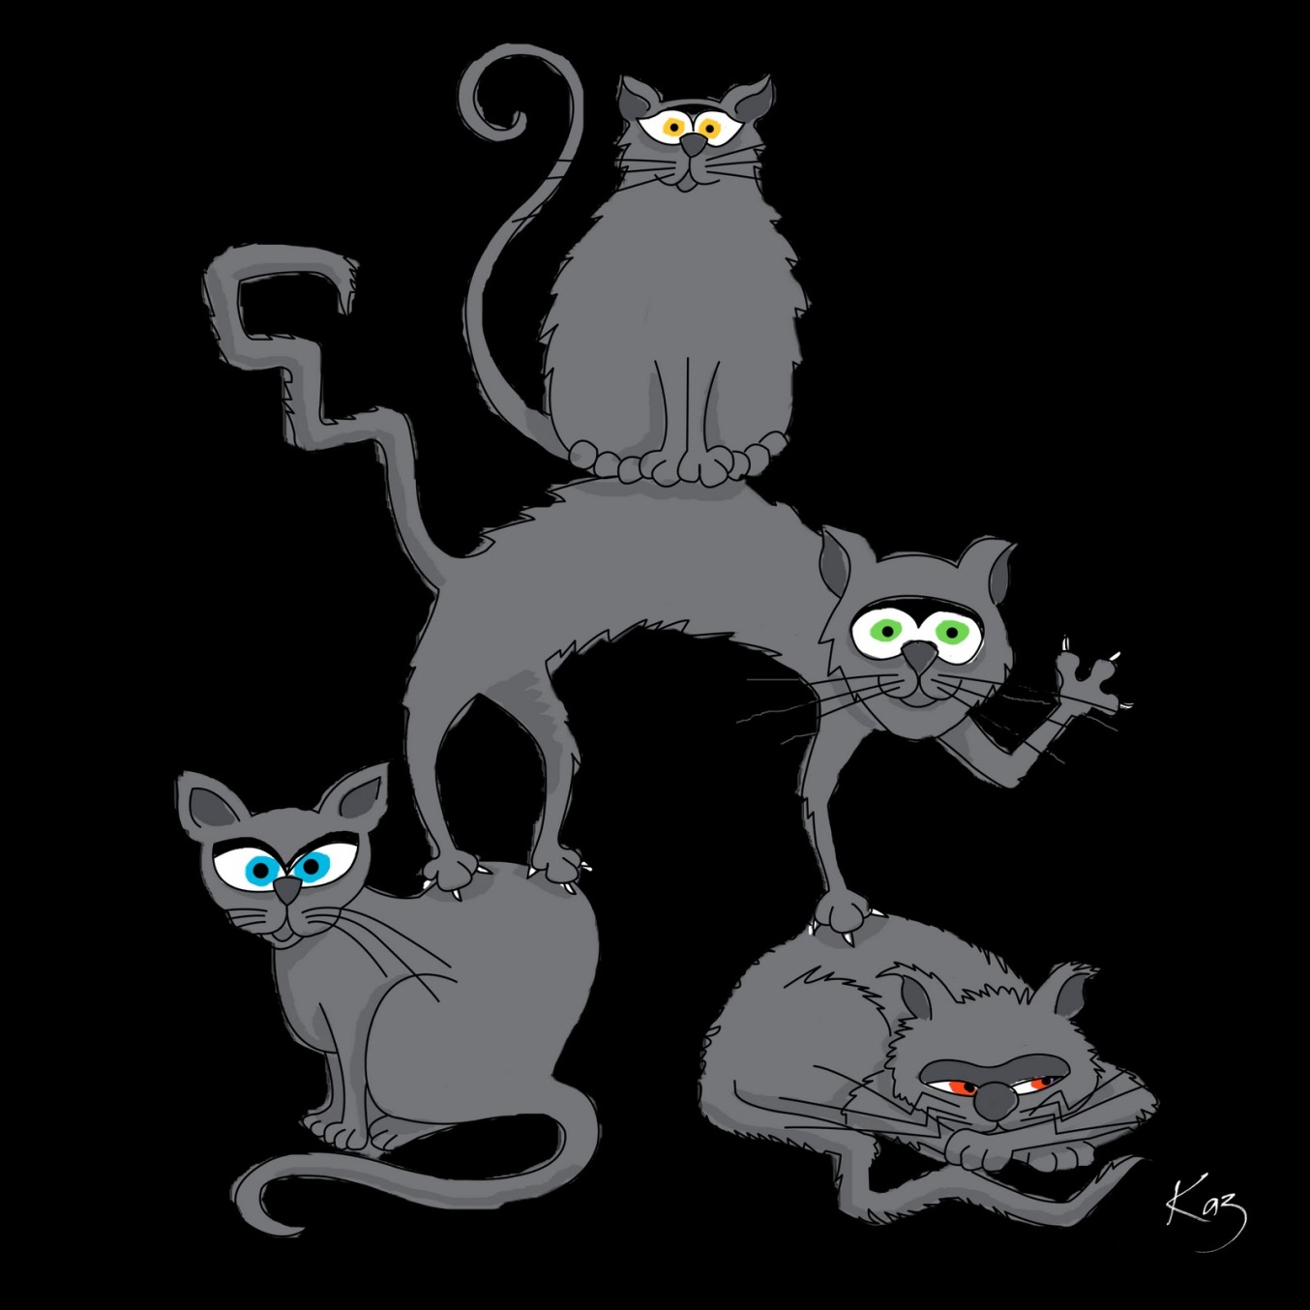

Slide 34
All cats are grey in…
the dark

Slide 36
Nie chwal
dnia przed …
zachodem słońca

Slide 37
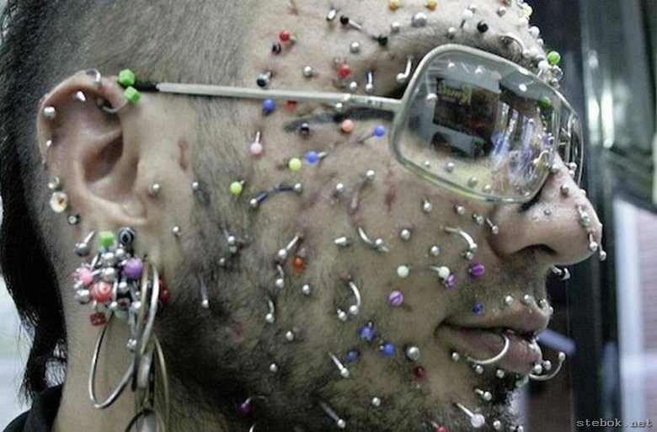

Slide 38
Co za bardzo…
to nie zdrowo

Slide 40
Głupia głowa ...
nie siwie

Slide 41
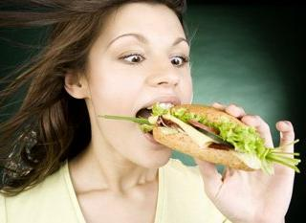

Slide 42
Hunger ist
der beste…
Koch

Slide 43
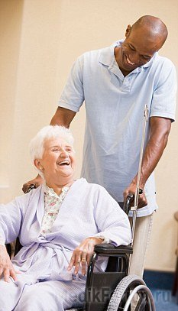

Slide 44
Lachen ist die
beste…
Medizin

Slide 46
Besser spät als…
nie

Slide 47
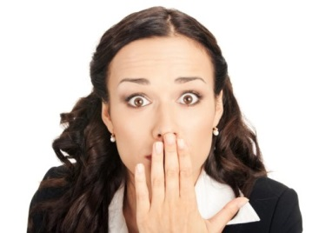

Slide 48
Слово не горобець…
вилетить,
не спіймаєш

Slide 49
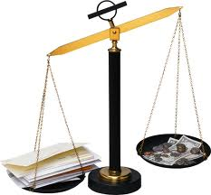

Slide 50
Слово старше ніж…
гроші

Slide 52
Дурний язик…
голові не приятель

Slide 53
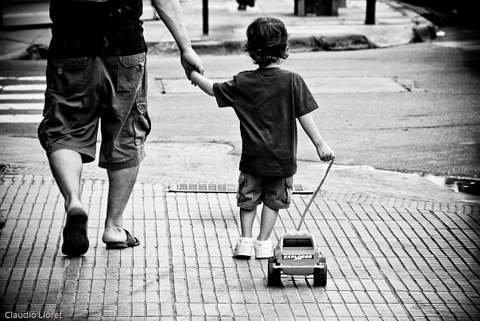

Slide 54
Tel rat...
tel chat

Slide 55
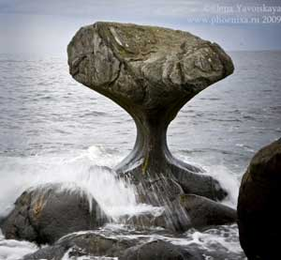

Slide 56
Goutte à goutte
l’eau…
creuse la pièrre

Slide 57
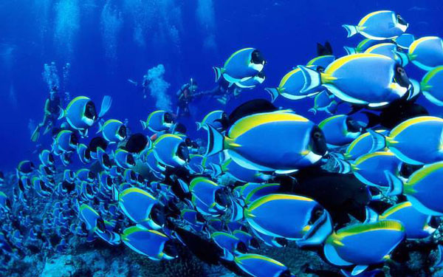

Slide 58
Etre heureux
comme…
un poisson
dans l’eau

Slide 59
LANGUAGES UNITE US IN DIVERSITY

Slide 60
I gotta feeling...

Slide 61
That today's gonna be a good day
That today's gonna be a good day
That today's gonna be a good day

Slide 62
A feeling... Woohoo
That today's gonna be a good day
That today's gonna be a good day
That today's gonna be a good day

Slide 63
Today's the day, Let's live it up I got my language, Let's speak it up

Slide 64
Go out and use it Don`t put it off Be active, friendly, Let's get, get off

Slide 65
I know that we have a show If we dance it together and
just love it all I feel cool, pleased and
I want it go on Let's go way out spaced out losing all control (Chi CHi Chi)

Slide 66
Today's the day, Let's live it up I got my language, Let's speak it up

Slide 67
Go out and use it Don`t put it off Be active, friendly, Let's get, get off

Slide 68
English is great!
Italian`s cool!
French is fantastic!
German`s not fool!

Slide 69
Spanish is super!
Russian is fine!
Ukrainian`s native!
Let`s all unite!

Slide 70
I gotta feeling... That today's gonna be a good day
That today's gonna be a good day
That today's gonna be a good day

Slide 71
A feeling... Woohoo That today's gonna be a good day
That today's gonna be a good day
That today's gonna be a good day

Slide 72
Today's the day, Let's live it up I got my language, Let's speak it up

Slide 73
Go out and use it Don`t put it off Be active, friendly,
Let's get, get off

Slide 74
LANGUAGES UNITE US IN DIVERSITY

