Slide 1
A Sound Mind In a Sound Body

Slide 2
Physically, Mentally, Socially and Spiritually Healthy People are Our Biggest Concern.

Slide 3
JUMBLED PROVERBS

Slide 4
are eat We what we

Slide 5
We are what we eat.

Slide 6
is enjoy for I The of I reason quality the exercise life

Slide 7
The reason I exercise is for the quality of life I enjoy.

Slide 8
complete of and harmony state body a is of mind Health the

Slide 9
Health is a state of complete harmony of the body and mind.

Slide 10
life in intellect the are and Health blessing two

Slide 11
Health and intellect are the two blessings in life.

Slide 12
cold a take Never to forget be healthy to shower

Slide 13
Never forget to take a cold shower to be healthy.

Slide 14
eliminate To good bad them habits replace ones with to means

Slide 15
To eliminate bad habits means to replace them with good ones.

Slide 16
in a body sound mind A sound

Slide 17
A sound mind in a sound body.

Slide 18
eat To health : lightly breathe insure good deeply moderately live

Slide 19
To insure good health: eat lightly, breathe deeply, live moderately.

Slide 20
Principles of a Healthy Way of Life:

Slide 21
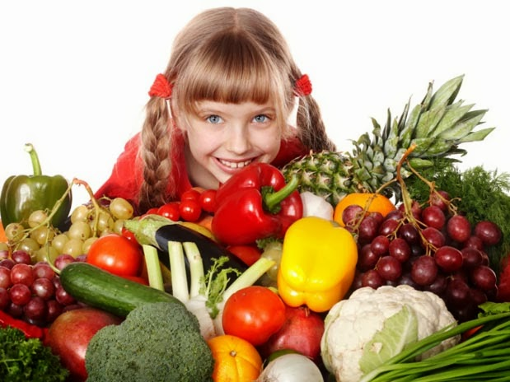

Slide 22
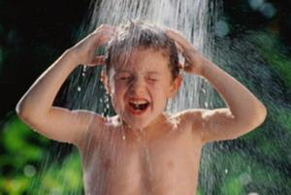

Slide 24
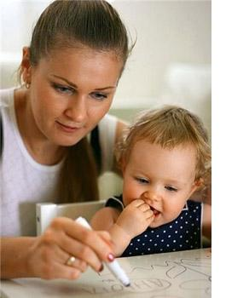

Slide 25
Does Your Health Depend on What You Eat?

Slide 26
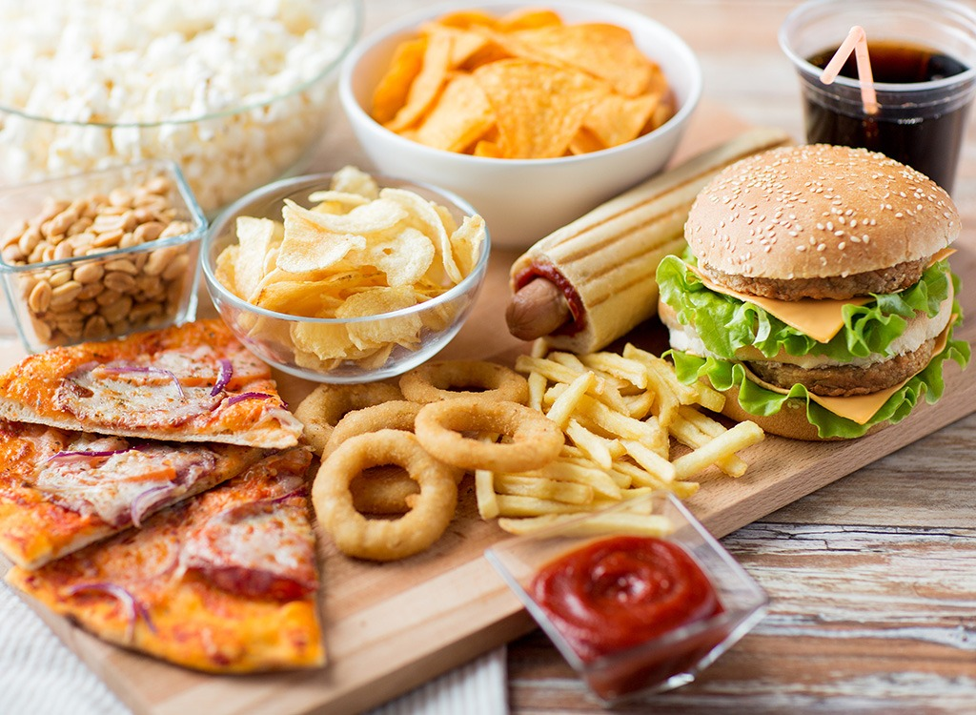
Why is fast food bad for you?

Slide 27
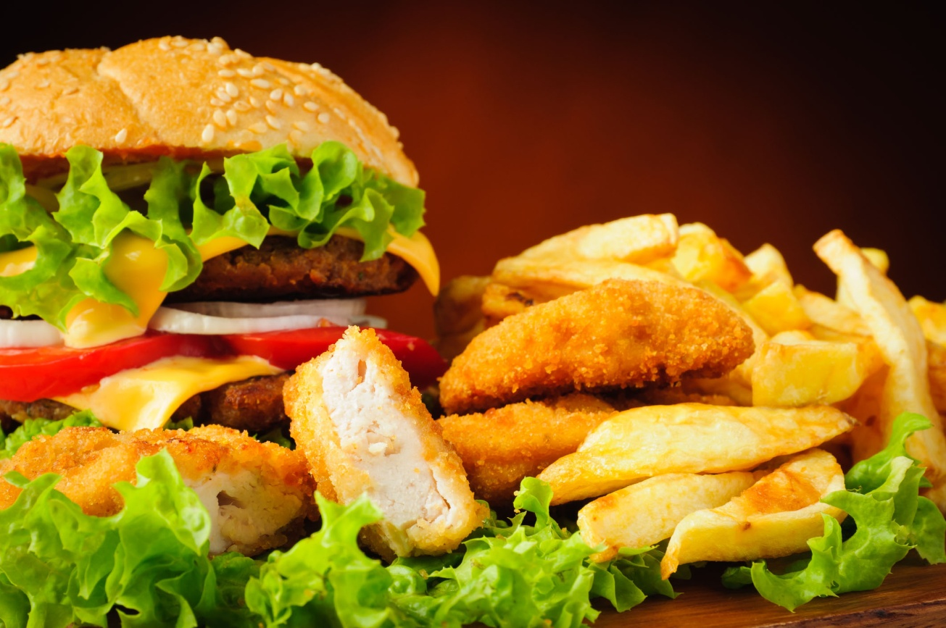
Over time, consuming too much fast food can cause side effects.

Slide 28
Obesity

Slide 29
Heart Disease
People who eat fast-food four or more times a week, increase the risk of dying from heart disease.

Slide 30
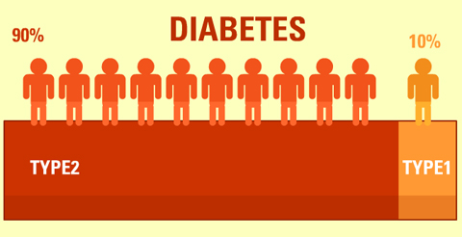
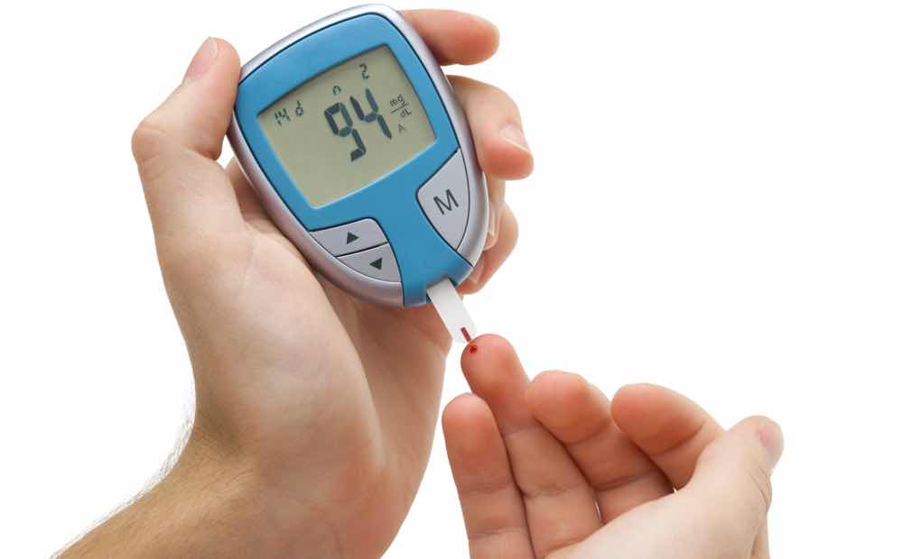
Type 2 Diabetes
‘Obesity’ can lead to the development of diabetes.

Slide 31
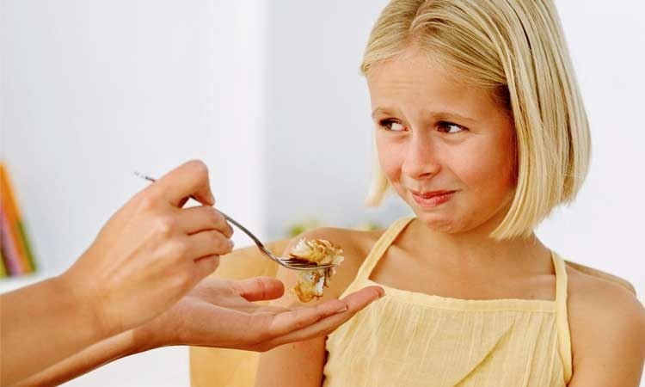
Not Regular Timing of Eating and the Loss of Appetite

Slide 32
Waste of Money and Stress

Slide 33
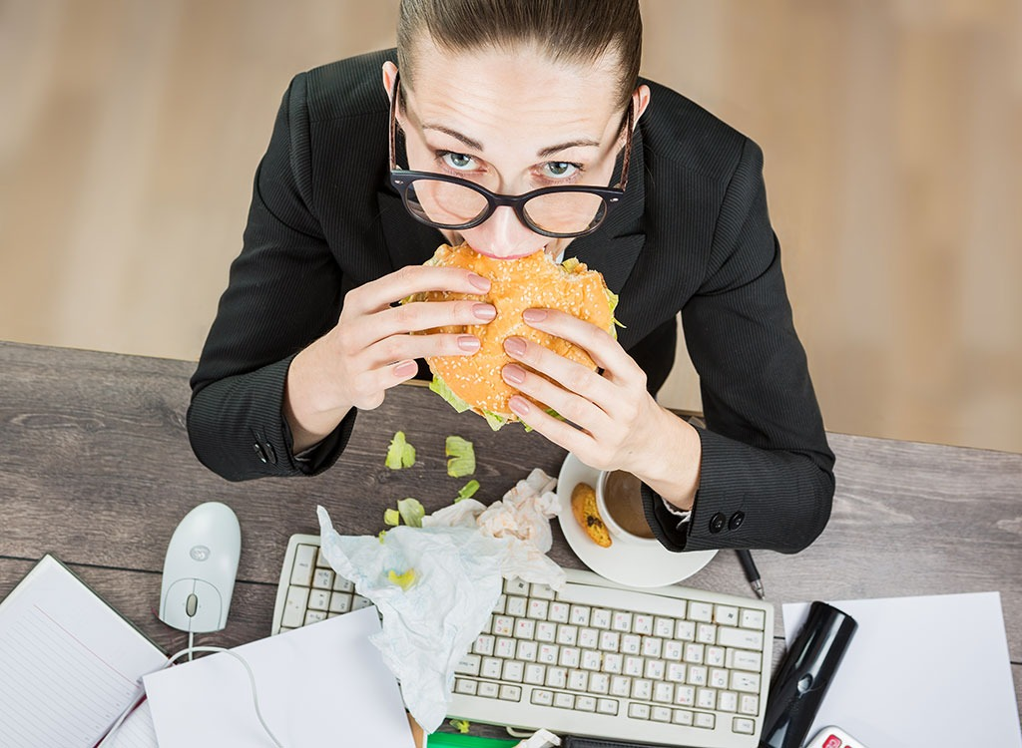
With such a furious pace of life it is incredibly difficult to stay healthy.

Slide 34
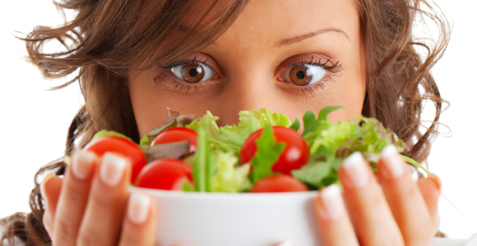
We Are What We Eat

Slide 35
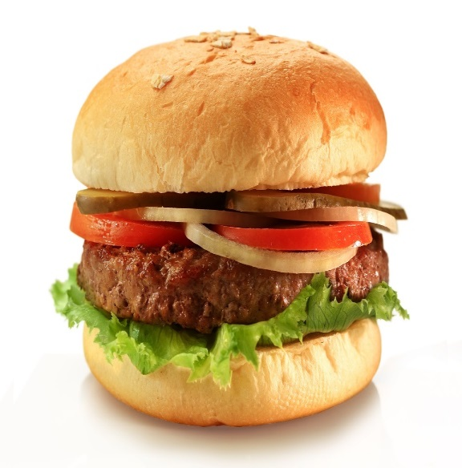
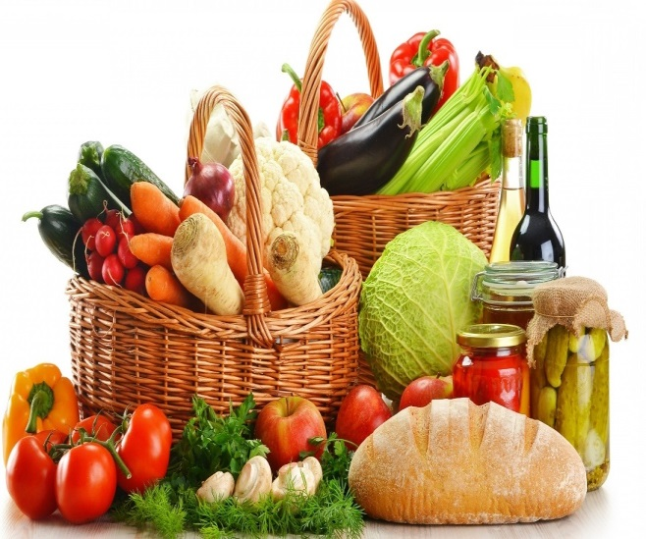
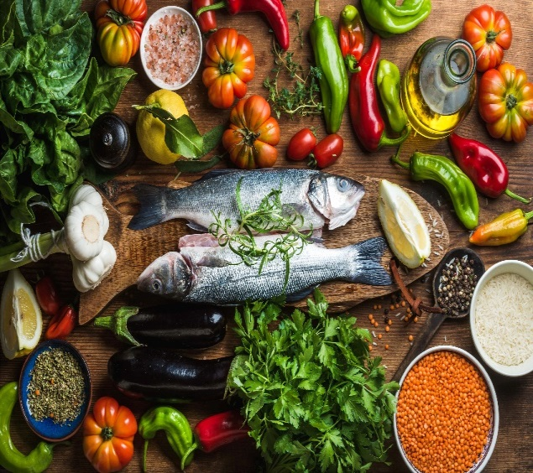
The State of Your Health Depends on What You Eat

Slide 36
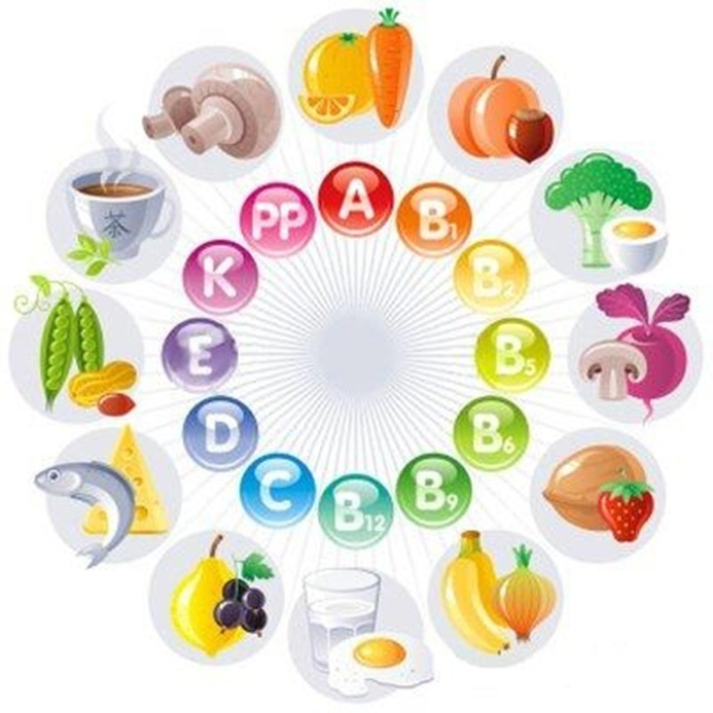
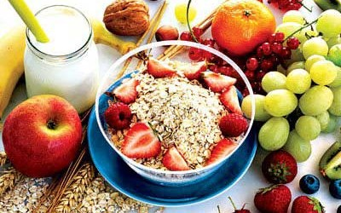
Three Basic Requirements of Nutrition:

Slide 37
Two simple facts:

Slide 38
Have You Ever Tried Mussels?

Slide 39
Are You Used to Jogging?

Slide 40
White Bread: For and Against

Slide 41
How Often Do You Feel Grumpy?

Slide 42
Is Drinking Juice Good For Your Teeth?

Slide 43
Are You a Chocoholic?

Slide 44
Grammar
Grammar
We use an infinitive:

Slide 45
Grammar
- arter certain verbs:
need to make
fail to notice

Slide 46
Grammar
- after many adjectives :
easy to cook
important to see

Slide 47
Grammar
-to explain the purpose of an action:
Walk to let it slow down.
Add sugar to make it rise.

Slide 48
Grammar
We use a gerund (-ing form):

Slide 49
Grammar
-after certain verbs:
Avoid stopping
suggest sticking

Slide 50
Grammar
-as the subject of a sentence:
making , eating

Slide 51
Grammar
-after prepositions:
reduce the risk of having
be good at making

Slide 52
Take a few cups of love,

Slide 53
one spoon of patience,

Slide 54
one glass of generosity,

Slide 55
one pint of kindness.

Slide 56
one quart of laughter,

Slide 57
one pinch of concern.

Slide 58
Mix willingness
with happiness,

Slide 59
add lots of faith

Slide 60
and stir it up well.

Slide 61
Then spread it over
a span of your lifetime

Slide 62
and serve it to each
and every deserving
person you meet.

Slide 63
Thank you for attention!!!

