Slide 1
The Tunnel of love
Made by
Olena Hnatkivska
10 B

Slide 2
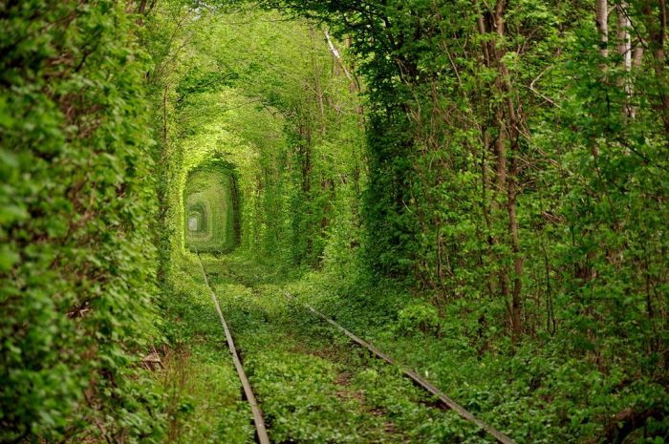
Earth has many hidden, unique and beautiful places. Paris is not the only place dedicated to love, Ukraine boasts one of the most romantic places in the world: Tunnel of Love. Located near the town Klevan, “The Tunnel of Love” became an unique attraction in the world. It formed on the train tracks, through union branches of trees, turning into a tunnel of emerald green vegetable known as Тунель кохання, which means “tunnel of love” in Ukranian.

Slide 3
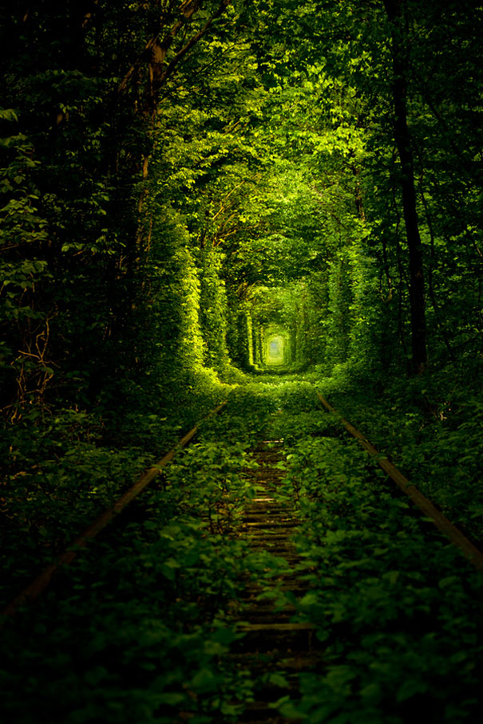
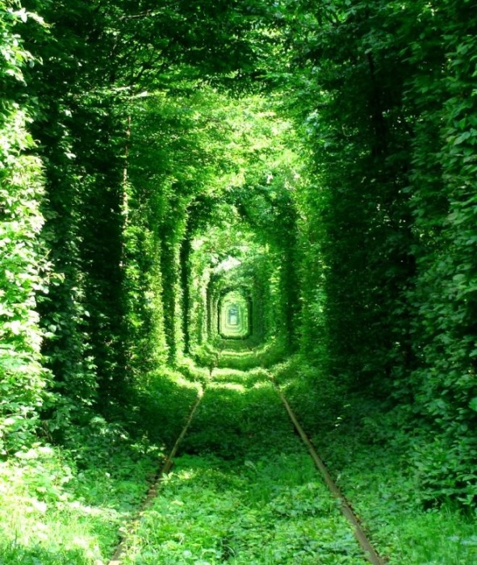
The tunnel formed by trees which grow in arch shape

Slide 4
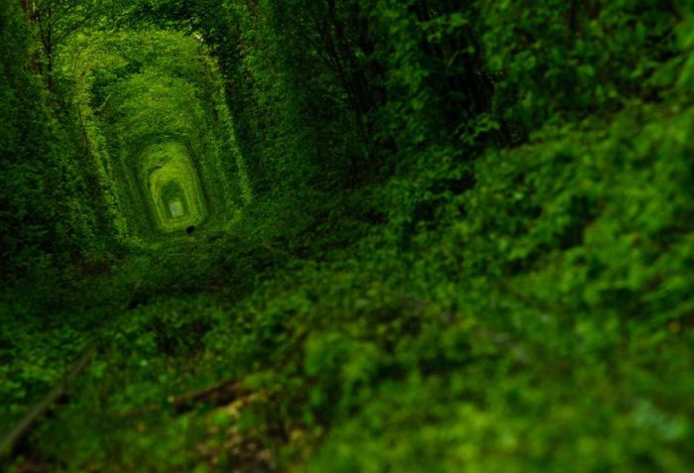
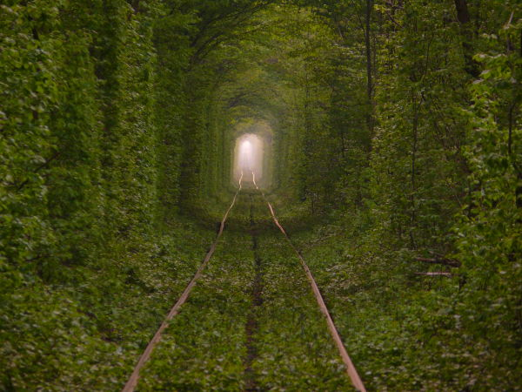
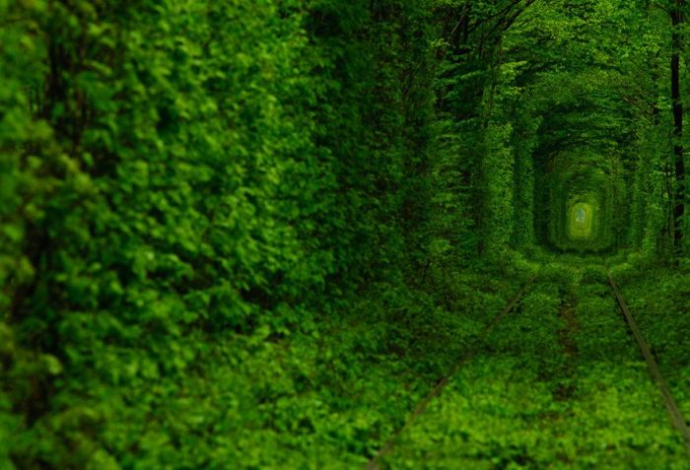
The tunnel of trees is so dense it is difficult to see outside from within the structure and the natural light that penetrates the canopy from above makes the space soothingly dark.

Slide 6
Потяг у Тунелі кохання. Клевань.mp4

Slide 7
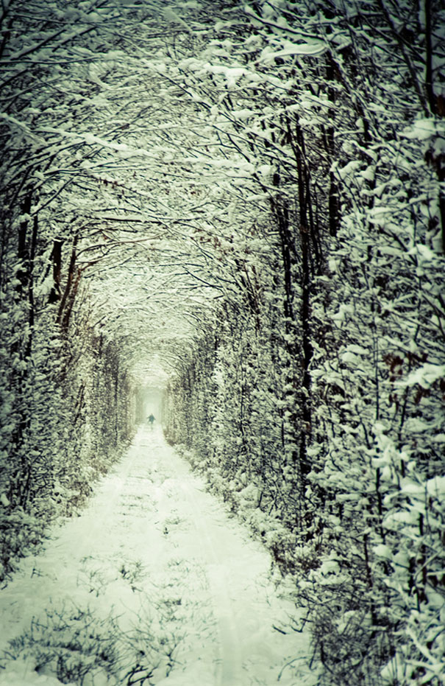
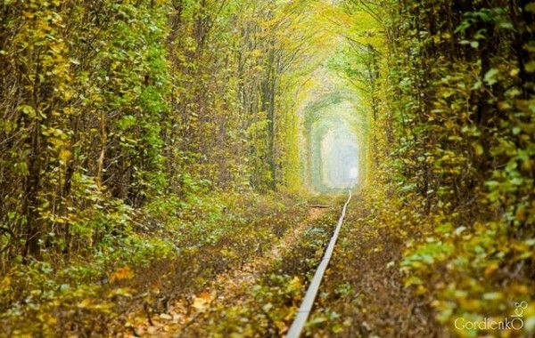
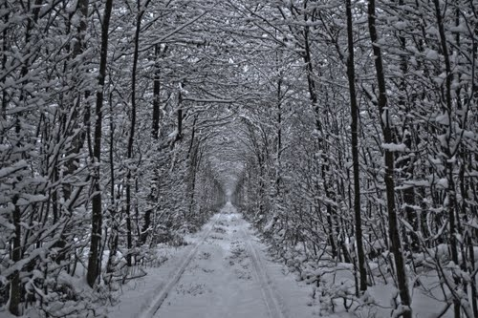

Slide 8
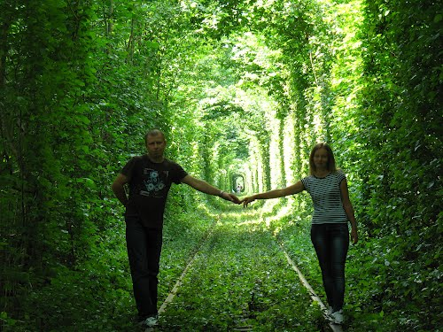

Slide 10
Thank you for attention!

