Slide 1
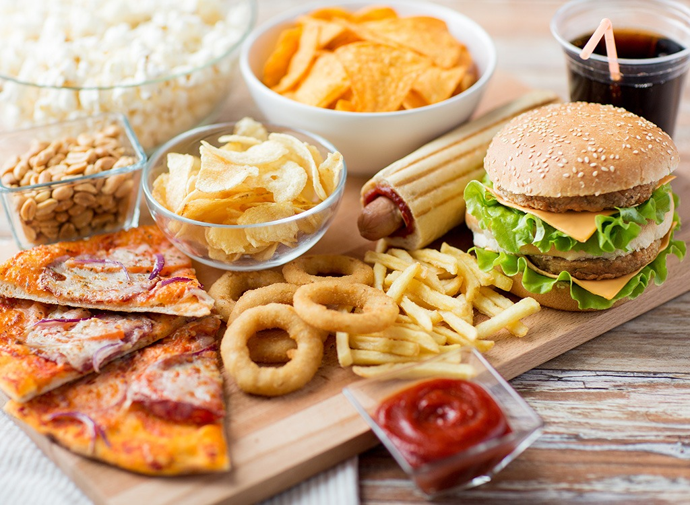
Fast Food

Slide 2
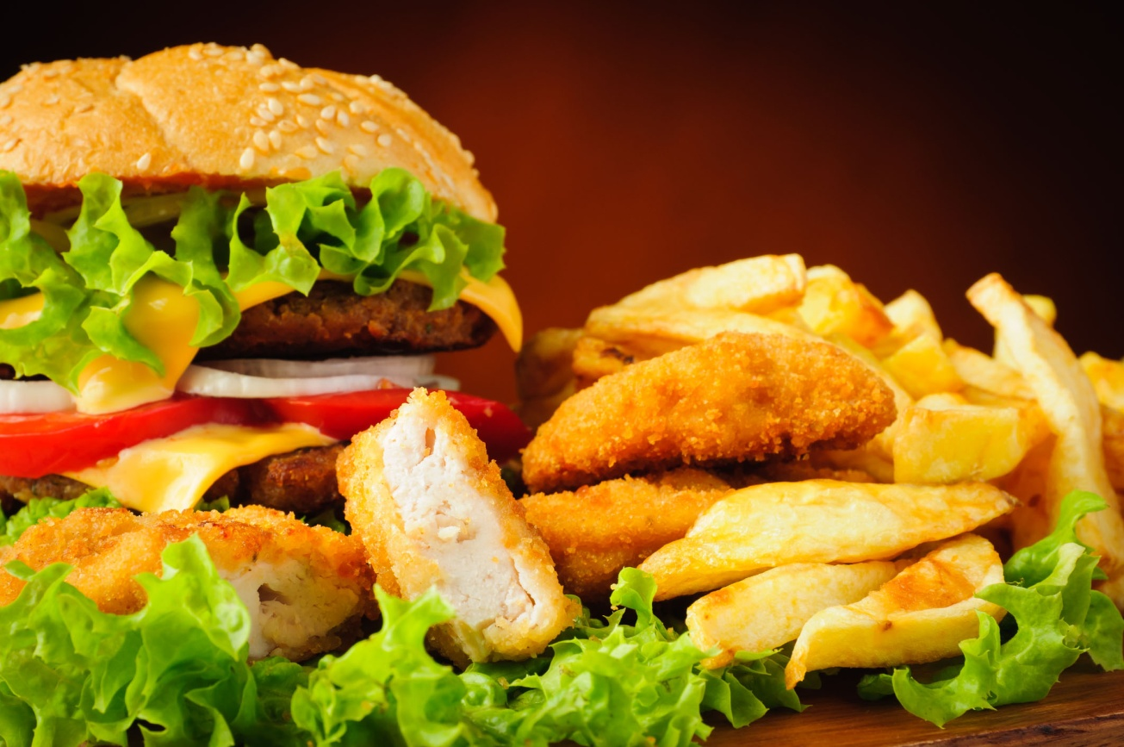
Fast food is the term given to food that can be prepared and served very quickly. Fast food can also be defined as any food that contributes little or no nutrient value to the diet, but instead provides excess calories and fat. Fast food costs relatively little and tastes good, but the negative effects on physical health last much longer than these immediate concerns.

Slide 3
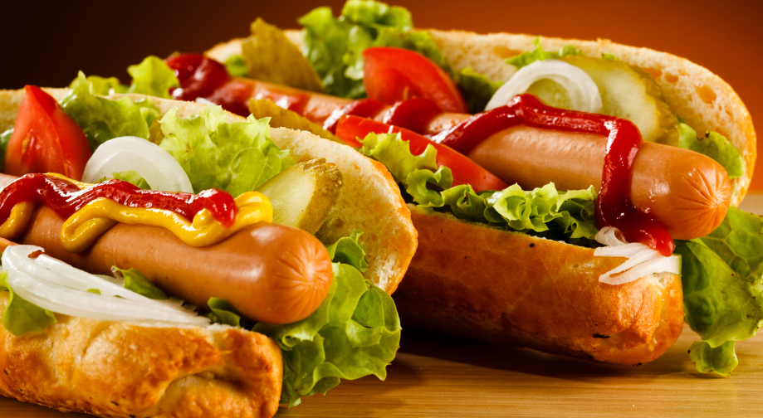
Fast food can be a good way to save time ,but it is not the proper way for nutrition. Some of these foods that are of little nutritional value and often high in fat, sugar, and calories. Common foods include salted snack foods, gum, candy, sweet desserts, fried fast food, and carbonated beverages. Fast food may include chips, hot pies ,pasties, sandwiches, burgers, croissants, kebabs, pizzas, chicken, soups, and salads. It also includes drinks, for instance, milkshakes, and soft drinks.

Slide 4
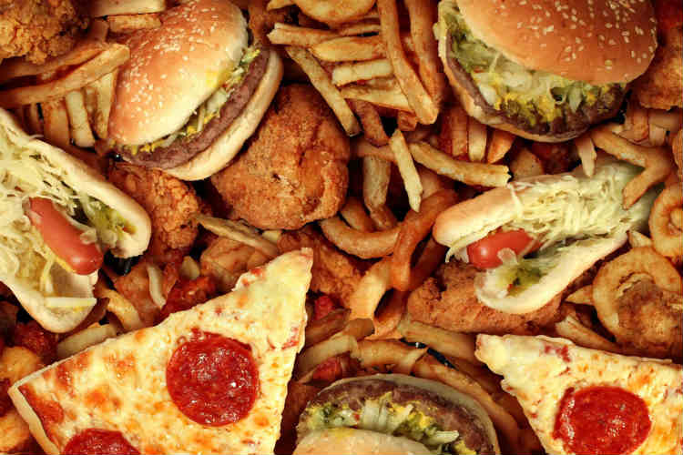
Disadvantages of fast food
When you feel like eating something and think of food, the things come to mind first are the taste, odor or color. Those who have to look after their weight will think of the portion size, many others think of energy, fats, sugars, vitamins or minerals. But do you know that the food we eat may cause side effects and a list of disadvantages.

Slide 5
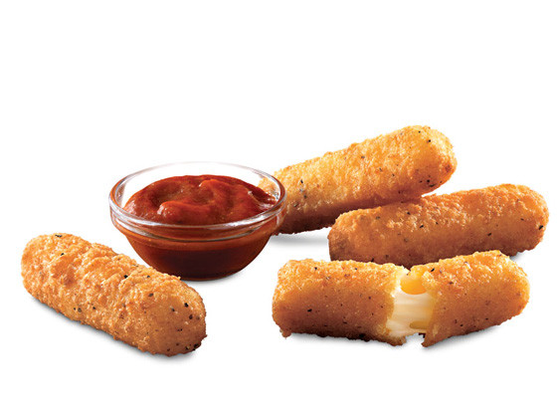
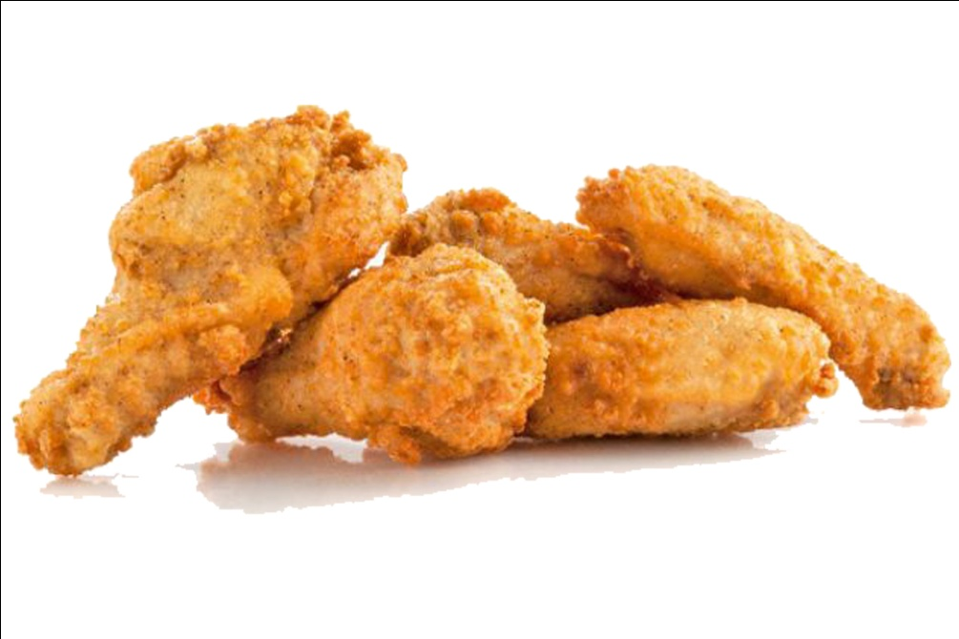
We are not talking about spoiled or poor quality food. Freshly harvested or just cooked food may also cause side effects, some are serious, some are just disturbing, and some may put you into embarrassing situation.

Slide 6
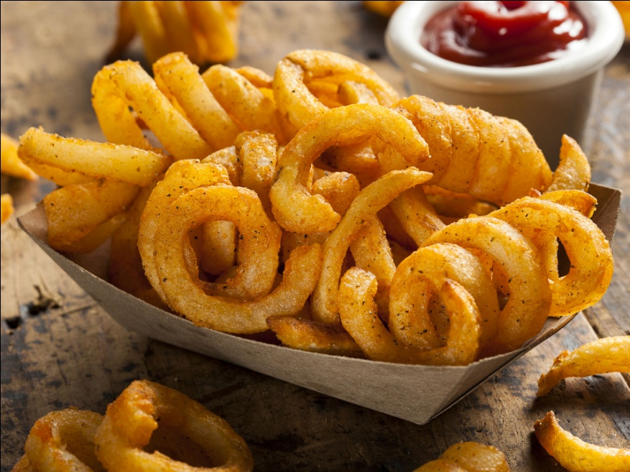
Over time, this can lead to an increased risk for illness and disease. Fast food is harmful to health. It is a cause of various diseases. Here we discus some most common disease and other side effects caused by fast food.

Slide 7
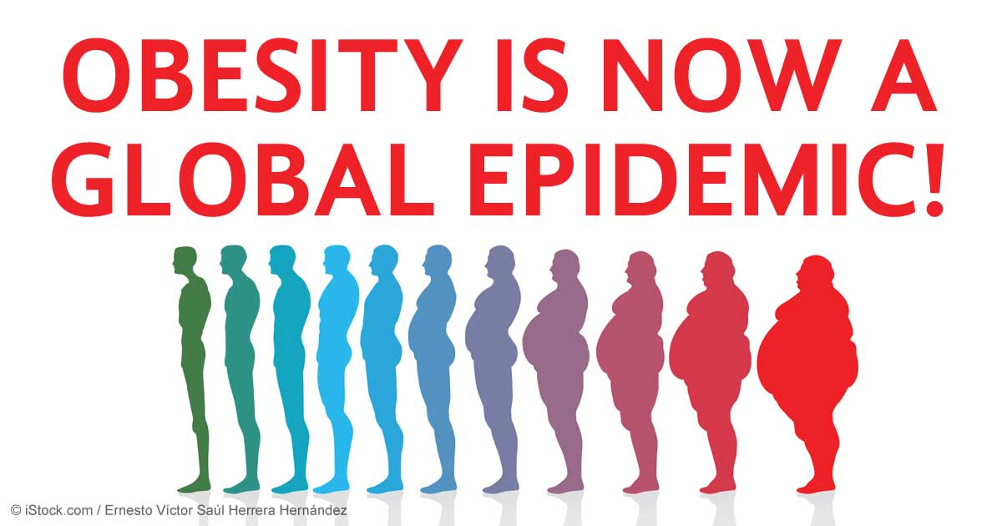
Obesity
Obesity means having too much body fat. It is not the same as being overweight, which means weighing too much. Fast food is high in calories and sugar that contribute to increased-weight gain. Even small amount of fast food can increase your calorie intake considerably. Fast foods also replace healthy eating habits, People who consume fast foods are less likely to eat fruits, vegetables, milk etc. This change in eating habits can easily lead to obesity.

Slide 8
Heart Disease
People who eat fast-food four or more times a week, up their risk of dying from heart disease by 80 percent. Fast foods create a much higher risk of heart disease because of the high level of saturated or trans fats found in much of the food. Those fats can clog the arteries and, over time, contribute to high cholesterol levels.

Slide 9
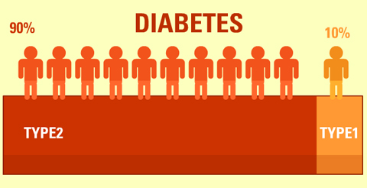
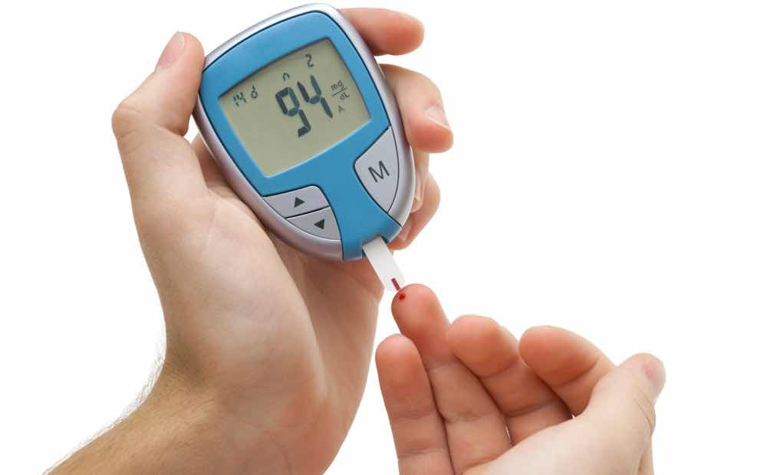
Type 2 Diabetes
Fast food has become a way of life for many busy persons seeking a fast and inexpensive alternative to cooking at home. Although they may develop type 2 diabetes, this type of diabetes is often caused by poor lifestyle choices, such as being overweight and not being physically active. There is a side effect to consuming frequent amounts of fast food ‘obesity’ which can lead to the development of diabetes.

Slide 10
Irregular Timing of Eating
A healthy person need to eat at a proper time which fast food doesn’t have. Fast food can be consumed at any time or some time twice or thrice a day, while home cooked food is served at proper time which provides opportunity to take rest after eating.
Loss of Appetite
Normal food contains appetizer which are not properly present in fast food. Continues use of fast food may cause loss appetite, abnormal digestion and sometime food poisoning. Fast food does not satisfy all needs of stomach.

Slide 11
Waste of Money
Fast food consumes too much money as compared to home prepared food. Low income people can hardly afford continuous use of fast food. It spends a lot of budget and is also cause of loss of healthy body.
Stress
It has been observed that a rich fat meal can increase your stress level and make you at a greater level of stress in comparison to those who have a low fat meal. Certain foods and drinks act as powerful stimulants to the body and hence are a direct cause of stress. Like caffeine containing foods (coffee, tea, colas and chocolates)

