Slide 1
Tips for a healthy routine from morning till night

Slide 2
Modern people are incredibly busy all day. They eat fast food and do not engage in sports Everything because they do not have time.
With such a furious pace of life is incredibly difficult to stay healthy. So here are some simple tips to help you plan your day.

Slide 3
Drink enough water with lemon during the day.

Slide 4
Do 30 minutes of cardiovascular exercise on an empty stomach.

Slide 5
Enjoy a smoothie for breakfast each morning during the work week.

Slide 6
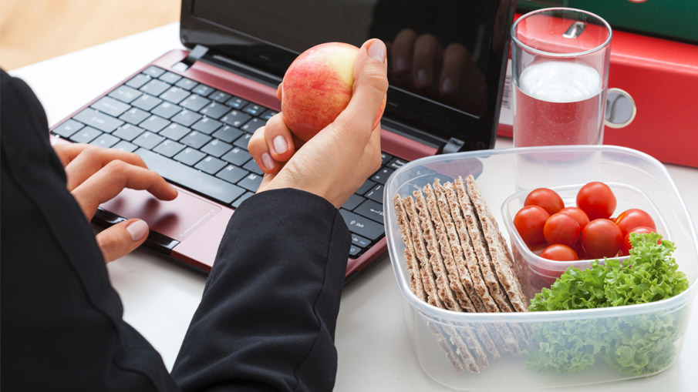
Have a snack that contains protein at mid-morning and mid-afternoon each day.

Slide 7
Eat your dinner two hours before bed to promote uninterrupted sleep.

Slide 8
Aim to get to bed before 11pm, sleeping in a darkened room

Slide 9
I hope these tips will help you plan your day and stay healthy in spite of anything.

