Slide 1
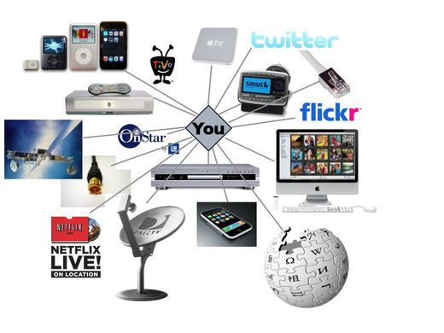
Mass Media in Our Life

Slide 2
At our today’s lesson we are going to:
- learn new words and word combinations;
Speak about mass media in our life;
Read the new text and work with it;
Work in pairs and in groups.
Good luck!

Slide 3
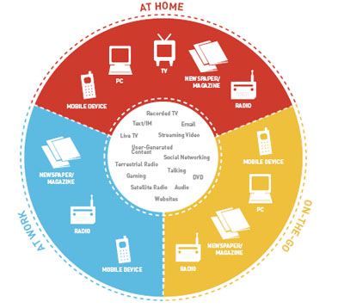
Radio is the theatre of the mind; television is the theatre of the mindless Steve Allen
Cinema, radio, television, magazines are a school of inattention: people look without seeing, listen in without hearing Robert Bresson

Slide 4
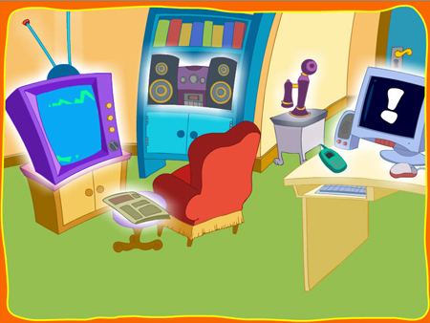
New words and expressions:
to be curious about
to get a picture of
to keep informed
to be extremely interesting
to be important at the moment
sensational news
in recent events
an advertisement
interesting items

Slide 5
Make up questions and answer them:
you/ often/ TV/ do/ watch/ How ?
How often do you watch TV?
2) to/TV/you/watch/What/prefer/programmes/ do?
What TV programmes do you prefer to watch?
3)about/you/events/Where/from/the/do/recent/
know/usually?
- Where do you usually know about the recent events from?

Slide 6
Read the text of ex.3,p.146 and be read to answer the question: How do the mass media shape our views and influence the way we see the world?
Work in groups:
Group A – ex.5,p.147
Group B – ex.4,p.146
Group C – ex.6,p.147

Slide 7
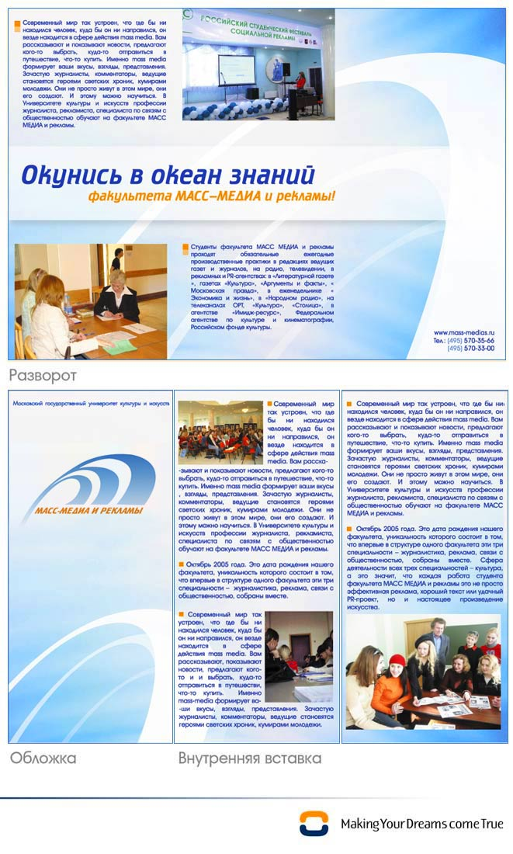
Home task:
learn the new words and phrases;
reread the text of ex.3,p.146 once again;
Group A – retell the text
Groups B,C – make the plan to the text

