Slide 1
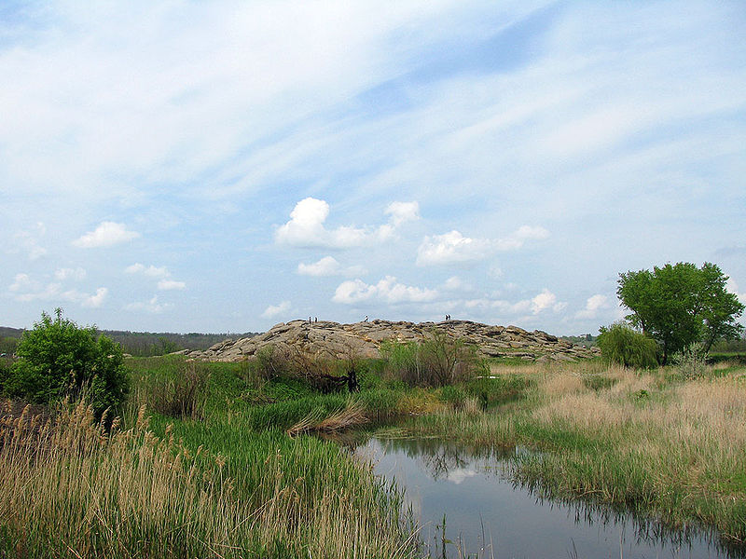
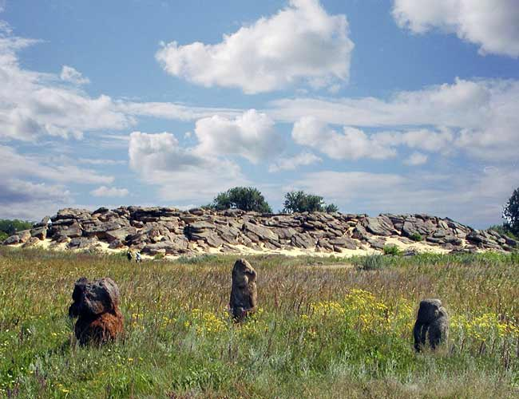
Kamyana Mohyla.
10 C
O. Stefanyshyn

Slide 2
Plan.
Location.
Size.
Historical details.
Petroglyphs.
Nowadays.
Gallery.

Slide 3
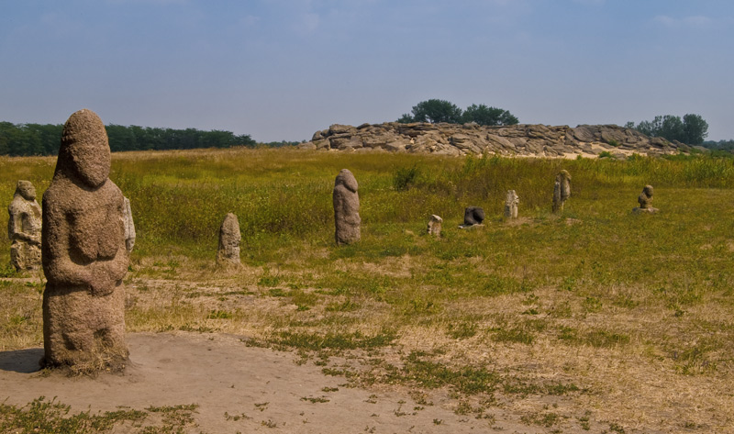
Kamyana Mohyla. Location.
Is an archaeological site in the Molochna River (literally "Milk river") valley, about a mile from the village of Terpinnya, Zaporizhia Oblast, Ukraine. (Official Site http://ua.stonegrave.org )

Slide 4
Kamyana Mohyla.
Size.
The site encompasses a group of isolated blocks of sandstone, up to twelve meters in height, scattered around an area of some 3,000 square meters.

Slide 5
Kamyana Mohyla.
History.
The legend says that it resulted from a scuffle of two baghaturs who took turns throwing rocks at each other. In truth, the site had its origins in a sandbank of the Tethys Ocean. For a long time it was an island in the Molochna River, which has since been silted up and now flows a short distance to the west.

Slide 6
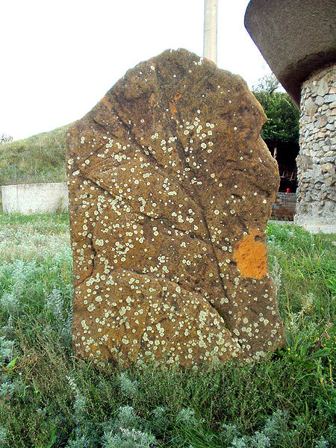
Kamyana Mohyla. History.
The first reference is from 1778. During the Russian-Turkish war, Suvorov was put there to protect the position of post road.
First researcher mentioning Kamyana Mohyla, was Peter Koppen in 1837.
Study sites began in 1889 by Nicholas Veselovsky. He found "stone mound," suggested that an artificial structure.
From 1983 to 2006 research conducted by Boris Mikhailov. Scientists have discovered 65 grottoes and caves, the ceilings are found several thousand rare rock images.

Slide 7
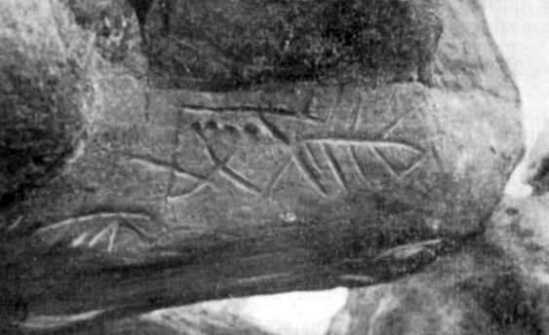
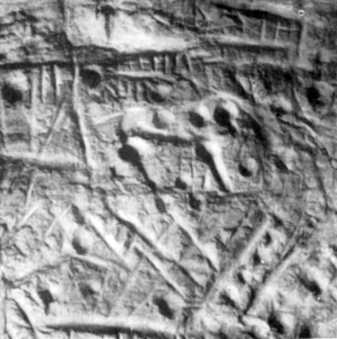
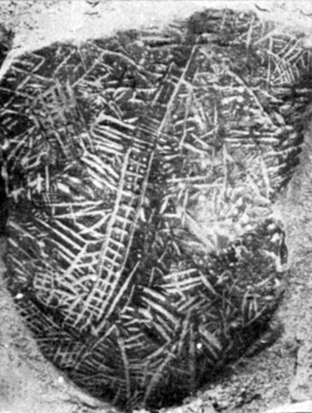
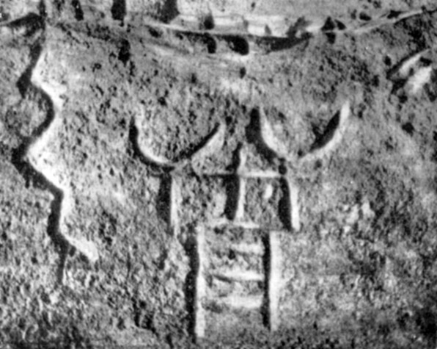
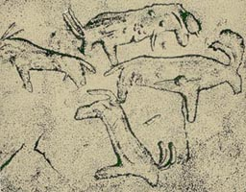
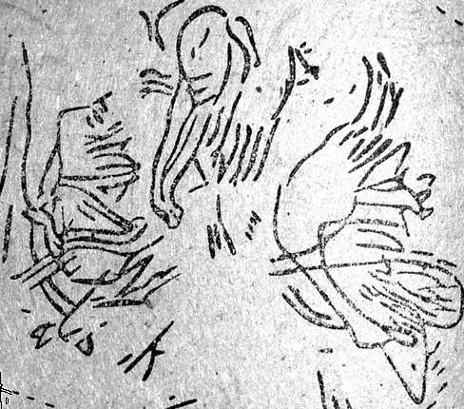
Petroglyphs (rock images):

Slide 8
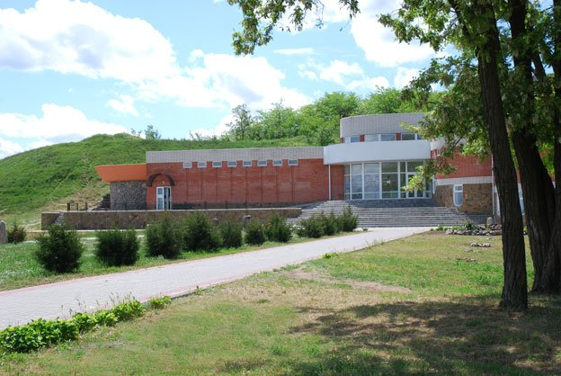
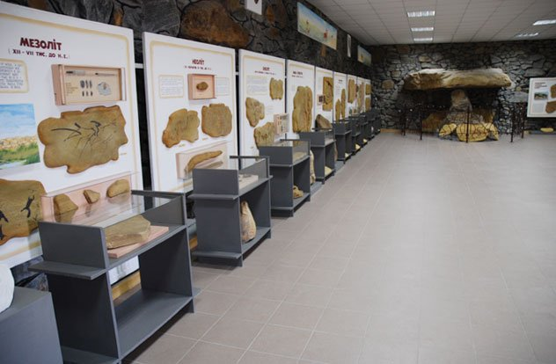
Kamyana Mohyla.
Nowadays Kamyana Mohyla became a place of mass tourism, here come from different parts of the country and from abroad, many fans of the "antiquity." From the north there is building of the museum "Prehistoric Art Stone Grave", which contains unique exhibits of the history of the inhabitants of the southern steppes from the late Paleolithic to the Bronze Age and the Middle Ages.

Slide 9
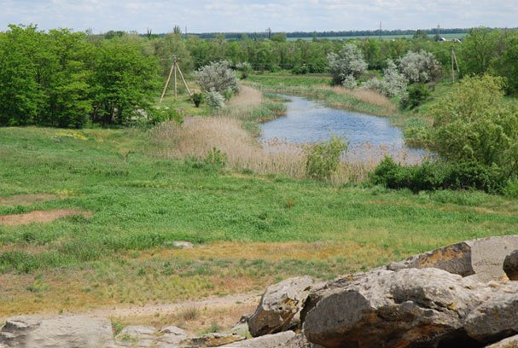
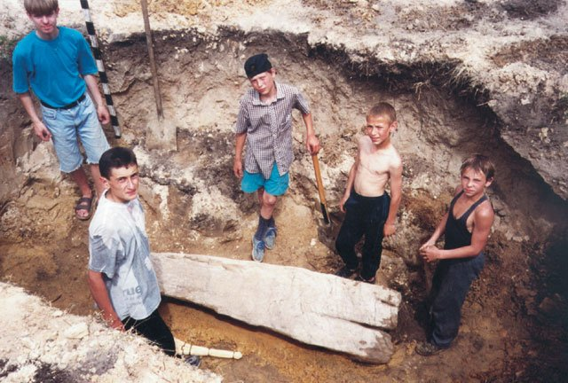
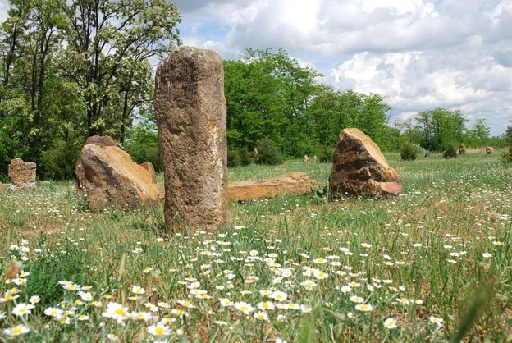
Gallery.

Slide 10
Kamyana Mohyla.

Slide 11
Thanks for attention!

