Slide 1
Sofiyvka

Slide 2
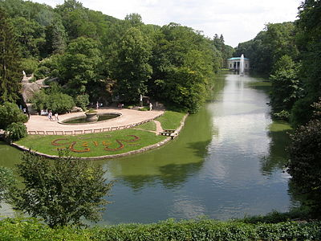
Sofiyivsky PARK PARK Park

Slide 3
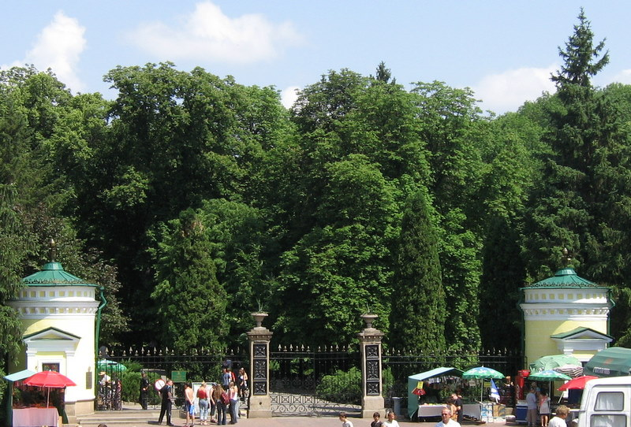
The park is located in the northern part of the Uman city, near the river Kamianka. Some areas of the park are reminiscent of an English garden. Today the park is a popular recreational spot, annually visited by 500 000 visitors. Sofiyivka is a scenic landmark of the world gardening design at the beginning of 19th century. The park accounts for over 2,000 types of trees and brush (local an exotic)

Slide 4
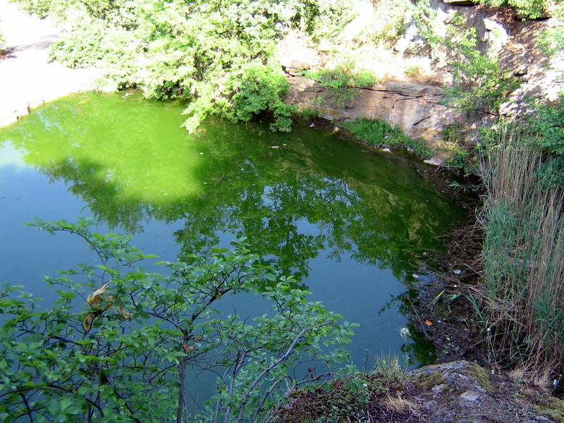
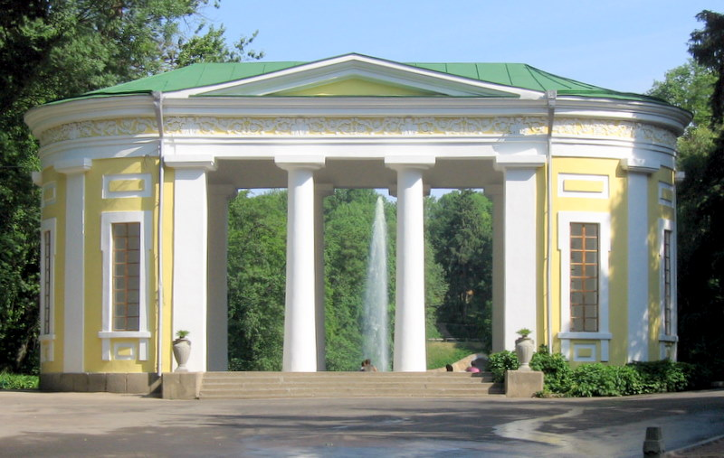
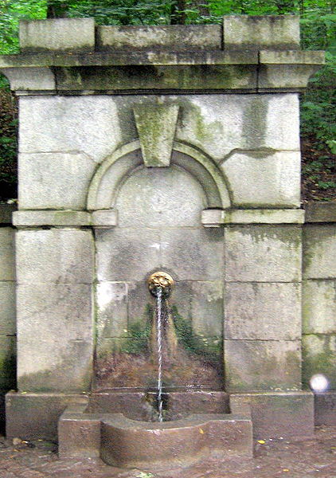
Park begins with the main entrance on Sadovaya street. This is followed by a central walkway. Tower main entrance, built in 1850 - 1852 years, preserved to our time together with an entrance gate and the gate. Right at the entrance to the park, behind a wall of arborvitae was home History Museum Park. It was opened in September 1985. Now, from the place where it was a museum, overlooking the granite rocks and a small Lake Geneva - which appeared in the 30-ies of XX century. Before Flora Pavilion, right, the source - "Silver springs." Making it done in the ancient style. Alley ends Pavilion of Flora. When considering the Pavilion of Flora looks stylish thanks to its precise architectural
forms

Slide 6
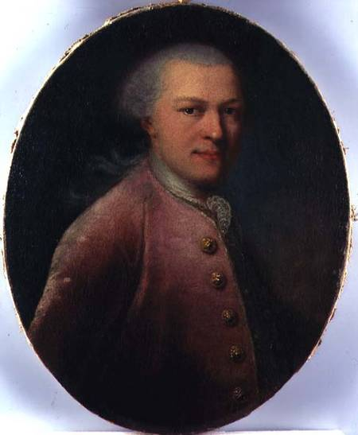
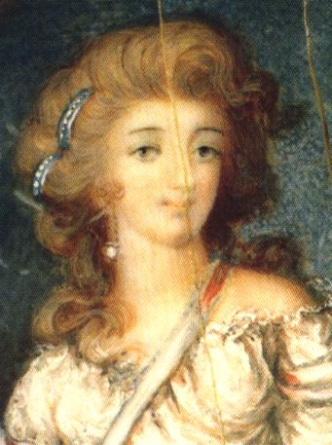
History
It was founded in 1796 by Count Stanisław Szczęsny Potocki, a Polish noble who rebuilt Uman after the Koliyivschyna. The city of Uman at that time was part of the Russian Empire. The park is named after his Greek wife Sofia (Zofia Potocka) and was built in 1802, it was a gift of Statinslaw Potocki to his wife on her birthday.The cost of the original park was estimated at roughly 15 million złoty

Slide 7
National arboretum "Sofievka" (Ukrainian Sofіїvka) - Park, Research Institute of the National Academy of Sciences of Ukraine, located in the northern part of the city of Uman, Cherkasy region, Ukraine, on the banks of the Kamenka River. Today it is a place of rest. Every year it is visited by about 500,000 people. The area - 179.2 hectares.

Slide 9
"Sofiyvka" is a monument of landscape type of world landscape gardening art of the late XVIII - early XIX century. It grows more than 3323 taxa ( species, forms , varieties, cultivars ) of native and exotic trees and shrubs , such as: cypress , white pine , tulip tree , sycamore , ginkgo, spruce and many others. The staff of the park issued a catalog of plants, which employs 1,994 taxa , of which 1,220 trees and shrubs and herbaceous plants of 774 , including 25 taxa of hazel , 24 - beeches , 41 - oil , 100 - lianas , 320 - Rose , 57 - rhododendrons , 376 - and groundcover 98 - flowering plants. In 2007, a collection of plants in the park include 2103 taxon tree and herbaceous 1212 [ citation needed 985 days ] .

Slide 11
The author of topographical and architectural design and construction manager of the park was designated a Polish military engineer Ludwig Metzel , and all work performed in the park directly fortress of Uman .
The park was created in an almost treeless terrain , divided river Kamenka , beams and canyons that cut into the granite, often come to the surface . When you create a terrain park skillfully used , but not to the plan . In the process of completing the work in some areas have been planted with local and exotic trees and shrubs , but then constructed the first architectural structures and set up the decorations in the form of sculptures , mostly antique .
The main entrance to the park
Main composition of the park runs along the bed of the Kamenka where built a number of independent pools and ponds : Upper - more than 8 hectares, lower - about 1.5 hectares , and others, waterfalls (one of them 14 meters tall) , gateways , waterfalls , underground river Acheron ( length 224 m ) .
The park is decorated with rocks ( Lefkadiaki , Tarpeian ) , caves ( Venus, " nut ", " fear and doubt" ) promo ( Flora , Pink ) , gazebo , sculpture.

Slide 13
The end

