Slide 1
Healthy Way of Life
Alcohol Abuse
and Its Harmful Influence on the Young

Slide 2
Just about everyone knows that the legal drinking age throughout the United States is 21. But according to the National Center on Addiction and Substance Abuse, almost 80% of high school students have tried alcohol. Ukraine takes the first place in the world ratings of alcohol consumption among children and youth, according to the World Health Organization research. In fact, Ukrainian children start drinking alcohol when they are 10 – 13 years old. So, no wonder, that according to the statistics of Ministry of Health of Ukraine about 60% of children poisoning is caused by alcohol. If it goes like this in future, Ukrainians take all chances to become the drunkiest nation on the planet. Especially startles such fact, that 70% of Ukrainian kids have got their first glass of alcohol from their parents.

Slide 3
Absence of juridical division into strong alcoholic and low-alcoholic beverages contributes to the development of alcoholism in Ukraine.
Meanwhile, there is no difference between strong alcoholic and low-alcoholic drinks from the medical point of view. In fact, the damage from low-alcoholic drinks is not less than from vodka. No wonder, that nowadays beer dependence grows rapidly.
Statistics testify, that for the last 10 years the number of persons, which use low-alcoholic drinks regularly grew in 10-12 times

Slide 4
Deciding whether to drink is a personal decision that we each eventually have to make. This presentation provides some information on alcohol, including how it affects your body, so you can make an educated choice.

Slide 5
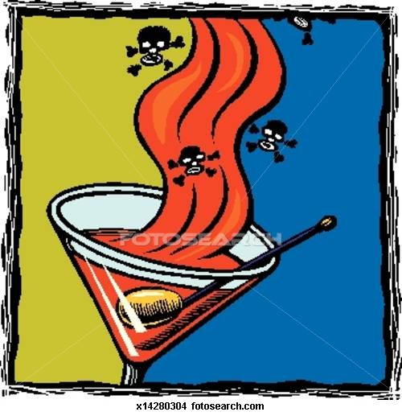
What Is Alcohol?
Alcohol is created when grains, fruits, or vegetables are fermented. Fermentation is a process that uses yeast or bacteria to change the sugars in the food into alcohol. Fermentation is used to produce many necessary items — everything from cheese to medications. Alcohol has different forms and can be used as a cleaner, an antiseptic, or a sedative.

Slide 6
So if alcohol is a natural product, why do teens need to be concerned about drinking it? When people drink alcohol, it's absorbed into their bloodstream. From there, it affects the central nervous system (the brain and spinal cord), which controls virtually all body functions. Because experts now know that the human brain is still developing during our teens, scientists are researching the effects drinking alcohol can have on the teen brain.

Slide 7
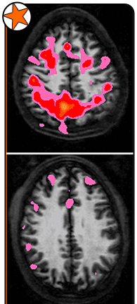
How does alcohol affect a body?
Alcohol is a depressant, which means it slows the function of the central nervous system. Alcohol actually blocks some of the messages trying to get to the brain. This alters a person's perceptions, emotions, movement, vision, and hearing.
In very small amounts, alcohol can help a person feel more relaxed or less anxious. More alcohol causes greater changes in the brain, resulting in intoxication. People who have overused alcohol may stagger, lose their coordination, and slur their speech. Depending on the person, intoxication can make someone very friendly and talkative or very aggressive and angry. Reaction times are slowed dramatically — which is why people are told not to drink and drive. People who are intoxicated may think they're moving properly when they're not. They may act totally out of character.
The images show how much more active a 15-year-old nondrinker’s brain is (top) than a drinker’s brain (bottom).

Slide 8
When large amounts of alcohol are consumed in a short period of time, alcohol poisoning can result. Alcohol poisoning is exactly what it sounds like — the body has become poisoned by large amounts of alcohol. Violent vomiting is usually the first symptom of alcohol poisoning. Extreme sleepiness, unconsciousness, difficulty breathing, dangerously low blood sugar, seizures, and even death may result.

Slide 10
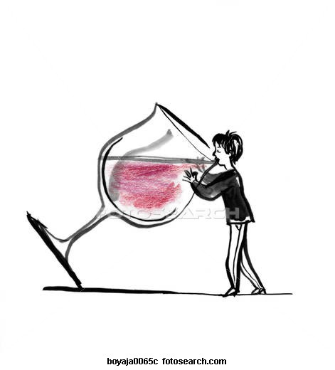
Why Do Teens Drink?
Experimentation with alcohol during the teen years is common. Some reasons that teens use alcohol and other drugs are:
curiosity
to feel good, reduce stress, and relax
to fit in
to feel older
From a very young age, kids see advertising messages showing beautiful people enjoying life — and alcohol. And because many parents and other adults use alcohol socially — having beer or wine with dinner, for example — alcohol seems harmless to many teens.

Slide 11
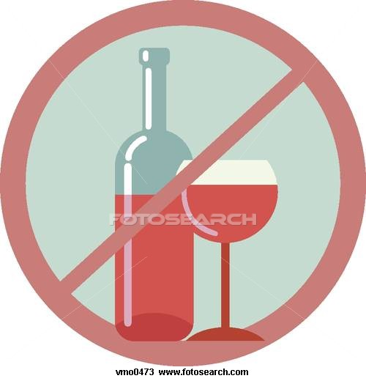
Why Shouldn't I Drink?
Although it's illegal to buy alcohol in the United States until the age of 21, most teens can get access to it. It's therefore up to you to make a decision about drinking. In addition to the possibility of becoming addicted, there are some downsides to drinking:
The punishment is severe. Teens who drink put themselves at risk for obvious problems with the law (it's illegal; you can get arrested). Teens who drink are also more likely to get into fights and commit crimes than those who don't.
People who drink regularly also often have problems with school. Drinking can damage a student's ability to study well and get decent grades, as well as affect sports performance (the coordination thing).

Slide 12
You can look really stupid. The impression is that drinking is cool, but the nervous system changes that come from drinking alcohol can make people do stupid or embarrassing things, like throwing up or peeing on themselves. Drinking also gives people bad breath, and no one enjoys a hangover.

Slide 13
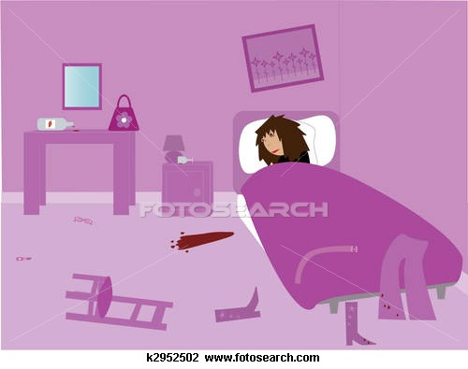
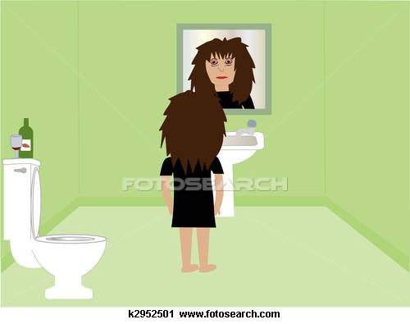
The morning after
Hangover

Slide 14
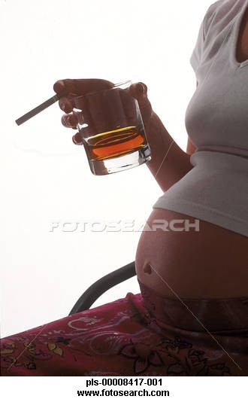
Alcohol puts your health at risk. Teens who drink are more likely to be sexually active and to have unsafe, unprotected sex. Resulting pregnancies and sexually transmitted diseases can change — or even end — lives. The risk of injuring yourself, maybe even fatally, is higher when you're under the influence, too. One half of all drowning deaths among teen guys are related to alcohol use. Use of alcohol greatly increases the chance that a teen will be involved in a car crash, homicide, or suicide.

Slide 15
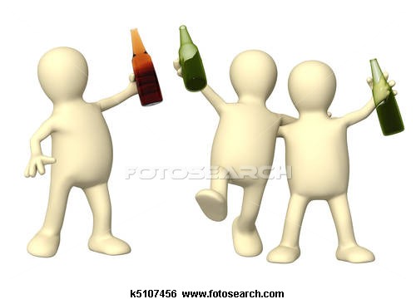
Teen drinkers are more likely to get fat or have health problems, too. One study by the University of Washington found that people who regularly had five or more drinks in a row starting at age 13 were much more likely to be overweight or have high blood pressure by age 24 than their nondrinking peers. People who continue drinking heavily well into adulthood risk damaging their organs, such as the liver, heart, and brain.

Slide 16
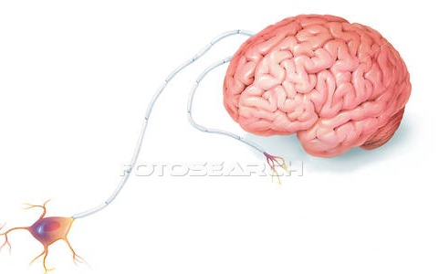
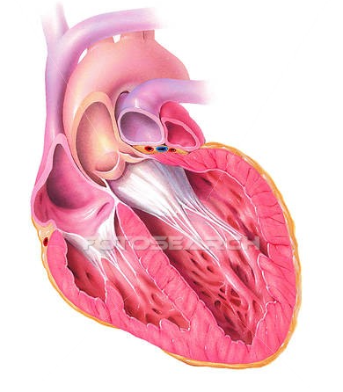
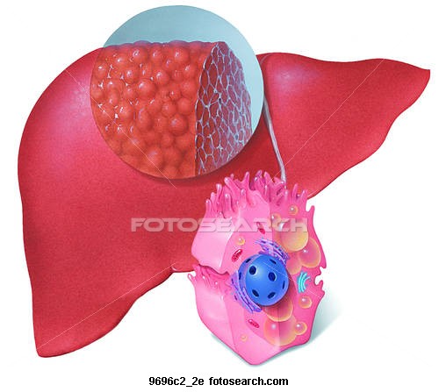
Effects of Alcohol on Digestive System
Effect of Alcohol on Heart
Effects of Alcohol on Liver

Slide 17
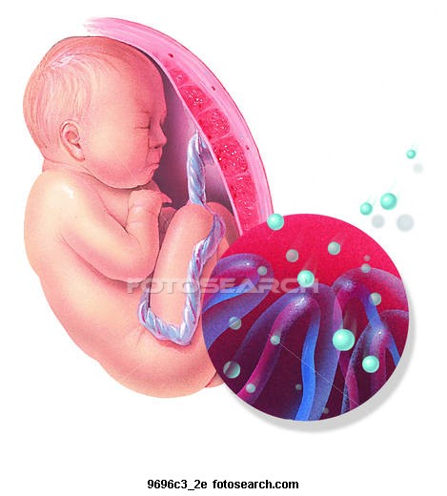
Of all of the effects that alcohol abuse can have on the human body, the effects on an unborn fetus have proven to be the most horrifying. Though many doctors may say that it can be okay to have a glass of wine or so while pregnant, you are still playing a dangerous game with the life and health of your baby at risk. Would you put alcohol into a baby bottle and have them drink it? Well, then it should be obvious that a pregnant woman should not drink, because whatever the mother eats and drinks, it also goes through the body of the unborn fetus.

Slide 18
Alcohol is a drug and that's the bottom line. It affects millions of people each day. Unfortunately, the person doing the drinking is not the only one who feels the impact of this abuse. It has a profound and direct impact on their families as well as their friends and acquaintances. Besides what it can do to hurt everyone in the immediate social circle, alcohol has strong and lasting impact on the human body.

Slide 19
Everyone makes decisions about whether to drink and how much — even adults. It's possible to enjoy a party or other event just as much, if not more so, when you don't drink. And with your central nervous system working as it's supposed to, you'll remember more about the great time you had!

