Slide 1
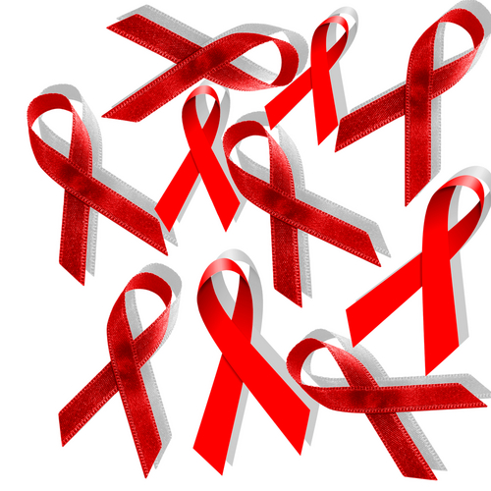

HIV & AIDS FOUNDATIONS

Slide 2
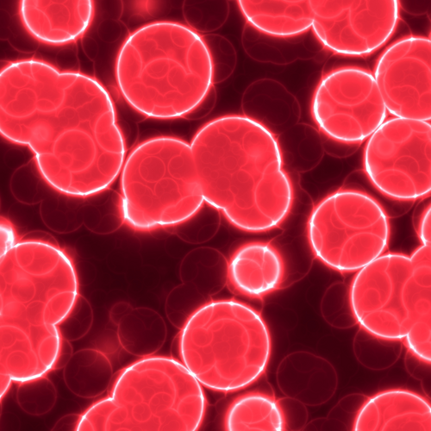
ABOUT HIV/AIDS
What is HIV?
HIV stands for human immunodeficiency virus. It is the virus that causes AIDS. HIV infects human cells and uses the energy nutrients provided by those cells to grow and reproduce.
What is AIDS?
AIDS stands for acquired immunodeficiency syndrome. It is a disease in which the body’s immune system breaks down and is unable to fight off infections and other illnesses that take advantage of a weakened immune system.

Slide 3

The AIDS Epidemic
AIDS was originally called Gay-Related Immune Deficiency when it was first discovered in five gay men in Los Angeles. But doctors realized that HIV and AIDS affect people of all ages, genders and nationalities - regardless of whether they're gay or straight. It starts as a virus called HIV (human immunodeficiency virus) that turns into the disease AIDS (acquired immune deficiency syndrome) once it has seriously damaged the immune system. Unfortunately, there is no cure for AIDS, but there are drugs that can slow down the disease.

Slide 4
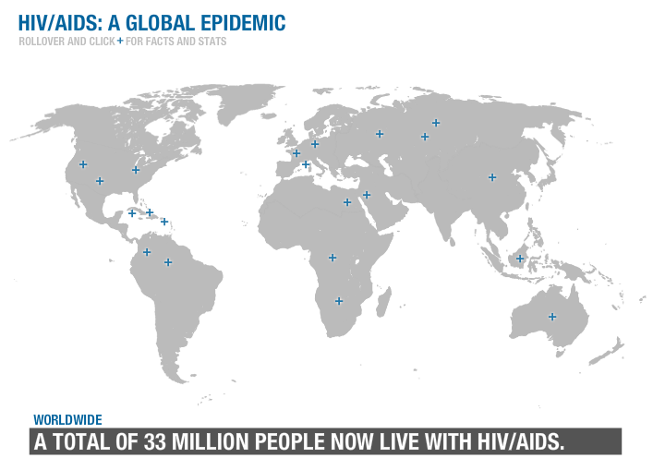

Slide 5
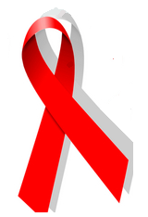
Did You Know?
October is World AIDS Awareness Month.
World AIDS Day is celebrated on December 1st.
People wear red ribbons to support the fight against AIDS.

Slide 6

AIDS Foundations Come to Your Aid
The Fight Against AIDS
With HIV infecting more than 45 million people around the world, organizations have sprung up to help spread the word, not the disease. AIDS foundations work to prevent infections, find a cure and raise awareness through education, research and funding. They also offer health and social programs to help people adapt to living with HIV/AIDS.

Slide 7
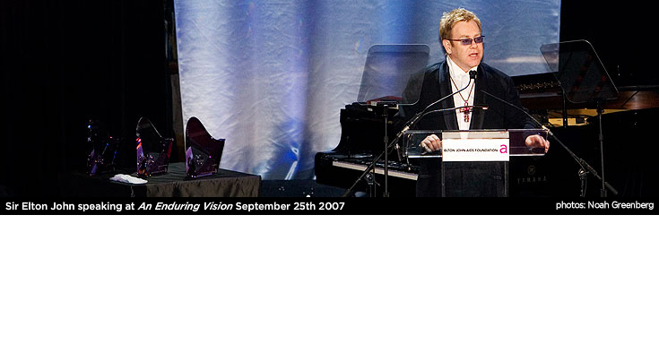
In 1992 Elton John established the Elton John AIDS Foundation and decided to donate money from the sales of his singles to AIDS research.

Slide 8
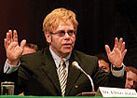
At the end of May, 2007 the ANTIAIDS Foundation launched the new program 'On The Edge', aimed at helping to change the trends of HIV/AIDS epidemic in Ukraine. In the context of this program Elena Franchuk and the Elton John AIDS Foundation united efforts to improve the lives of children involved in the epidemic, and to attract the attention of Ukrainians towards HIV/AIDS problem. In the spirit of this cooperation, Victor Pinchuk Foundation and Olena Franchuk ANTIAIDS Foundation pledged a $2.5 million grant for the 5 year program of the Elton John AIDS Foundation in Ukraine.

Slide 9
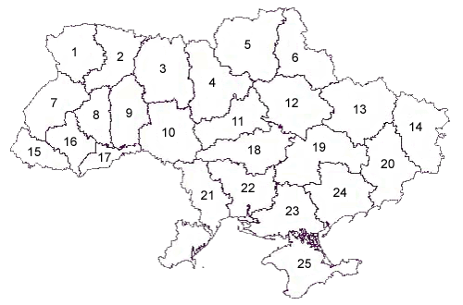
Latest update on HIV/AIDS situation in Ukraine
Current state on 01.07.2007 registers 76 772 people with HIV/AIDS (164,2 persons per 100 thousands), 8 199 people were diagnosed with AIDS (17,4 persons per 100 thousands). Most affected regions remain Donetsk (364,1 persons per 100 thousands), Dnepropetrovsk (391,3 persons per 100 thousands) and Odessa (391,0 persons per 100 thousands).
Altogether starting from 1987, 114 770 HIV cases were registered, 20 587 AIDS cases, 11 391 people died of AIDS. 15 754 children were born to HIV-positive mothers, among them 636 got AIDS and 228 died of AIDS.
For six months of 2007, 10 125 new cases of HIV infection were registered in Ukraine, 2 736 AIDS cases. 1 408 people died of AIDS.
According to the current state on 01.07.2007 5 989 patients receive ARV treatment, among them 750 children (120 - at the expense of the national budget, 630 due to Global Foundation financing), and 5 239 adults ( 1 461 - at the expense of the national budget, 3 778 - due to Global Foundation financing).

Slide 10
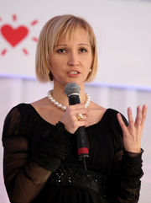
UKRAINE
The charitable ANTIAIDS Foundation was established by Olena Franchuk in September
2003. It is the first and the sole foundation, established with private funds, in
Ukraine committed to fighting HIV/AIDS.
The Foundation’s goals are:
to combat the HIV/AIDS epidemic in Ukraine;
to reduce its escalation;
to support people living with HIV/AIDS by improving their quality of life.

Slide 11
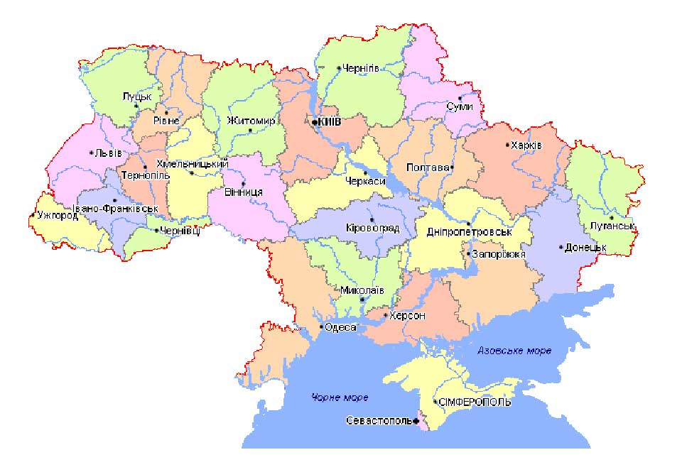
The Foundation activities aim at:
drawing attention of opinion makers,
government authorities and business leaders
to the HIV/AIDS problem;
implementing of the large-scale informational
and educational campaigns;
providing the direct support to people living
with HIV/AIDS and attracting of the resources
for supporting relevant projects on HIV/AIDS
prevention and treatment;
diminishing the stigma and discrimination of
people living with HIV/AIDS.

Slide 12
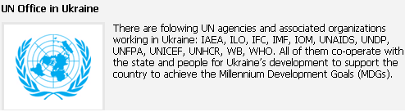
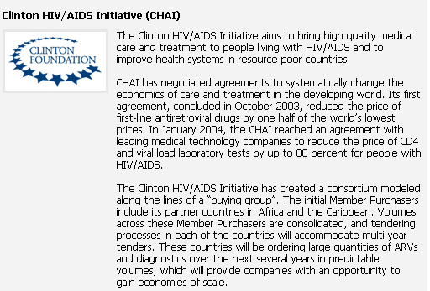
Partners

Slide 13
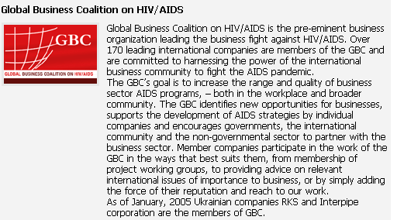

Slide 14
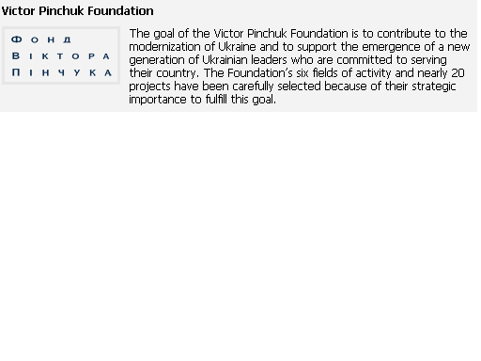
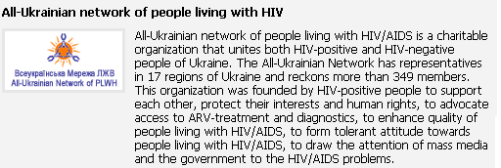

Slide 15
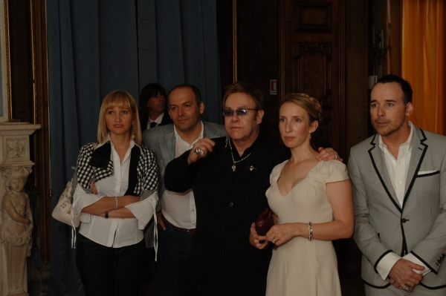
Elton John charitable concert
World-famous composer and singer Sir Elton John gave the free charitable concert on June, 16 in Kyiv. The concert took place on Maidan Nezalenosty and broadcasted live on the “New Channel”. The concert is appealed to the fight against HIV/AIDS epidemic in Ukraine.
Before and during the concert 220 volunteers, mainly students, disseminated 60 thousands flayers about HIV/AIDS, 150 thousands flayers with the information about testing and counseling centers, provided by Kyiv AIDS Center, and 49 thousands condoms, provided by TM DUREX.

Slide 16
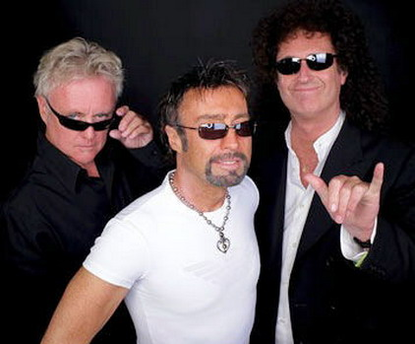
Life must go on!
Queen + Paul Rodgers Support the Call
With ANTIAIDS Concert In Kharkiv Freedom Square
Queen + Paul Rodgers headed a massive outdoor concert in one of Europe’s biggest public squares ahead of the start of their forthcoming European tour to support Ukraine’s Anti-Aids campaign.
Promoting the message “Don’t let AIDS ruin your life!”, Queen performed a free concert in Kharkov’s historic Freedom Square on September 12, 2008.

Slide 17
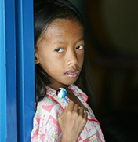
How You Can Help
There are so many ways you can help - donate some of your allowance, volunteer your time or just be a friend to someone living with HIV/AIDS.
                Most AIDS foundations have programs that you can get involved with, such as:
                the annual toy drive offered by
the Magic Johnson Foundation. It
also plans the Children's Mardi
Gras, where over 2,000 inner-city kids
enjoy carnival rides and games, eat ice cream, meet celebrities and much more!
                Contact your local AIDS organization
                on more ways to help.

