Slide 1
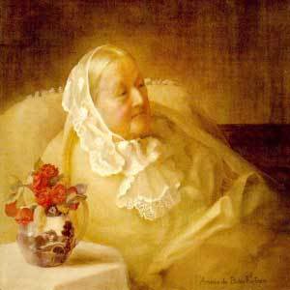
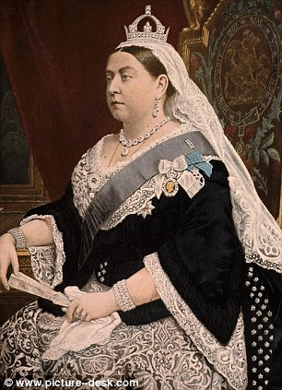
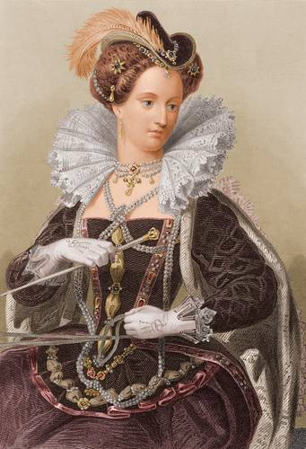
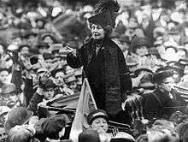
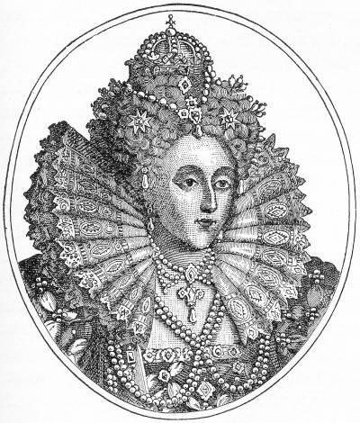
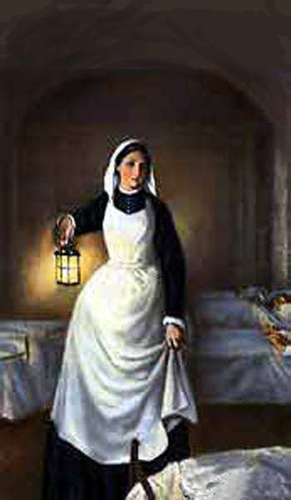
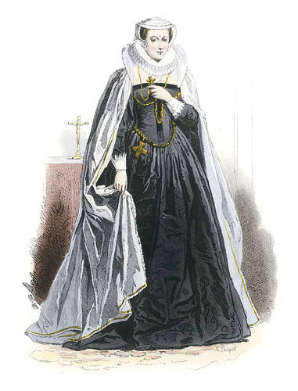
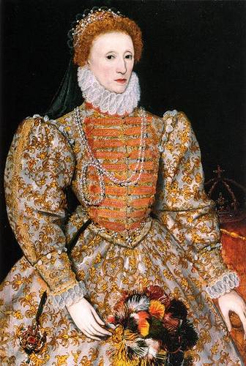
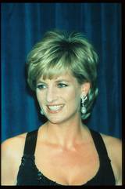
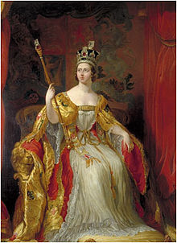
Parade of the British women

Slide 2
Queen Elizabeth I
England and Great Britain have had a few reigning queens when the crown had no male heirs (Great Britain still has primogeniture -- inheritance by the oldest son takes precedence over any daughters). These women rulers include some of the best-known, longest-reigning and culturally most successful rulers in British history.
Queen Elizabeth I of England is one of the most fascinating women of history. Taking the throne in her own right was unusual for the time -- the only previous woman Queens in England other than Queen Consorts were her older sister, Mary I, the Nine Day Queen Lady Jane Grey, and the Empress Matilda whose attempt to be crowned Queen resulted in decades of civil war. During Mary's reign, there had been signficant conflict over religion. Jane Grey's brief reign ended with her imprisonment and later execution. Elizabeth I was able to do what her predecessors had not been able to do.

Slide 3
Daughter of King Henry VIII of England and his second wife, Anne Boleyn, Elizabeth I ascended the throne of England on the death of her sister Mary. She reigned from 1558-1603.
In these images, Queen Elizabeth I of England is depicted in her full royal regalia, with ruffle lace collar and plenty of jewels plus her signature curled hairstyle.

Slide 4
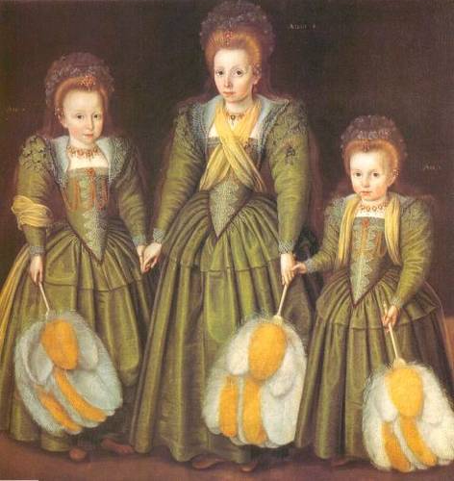
Queen Elizabeth I as a Young Girl
Queen Elizabeth I as a Young Girl
A crayon drawing of Queen Elizabeth I of England by the artist Fredrico Zucchero or Zuccero.
Queen Elizabeth I as a Young Girl

Slide 5
Queen Elizabeth I reigned from 1558 until her death, and her early years were subject to much concern whether she would succeed -- or even survive.

Slide 6
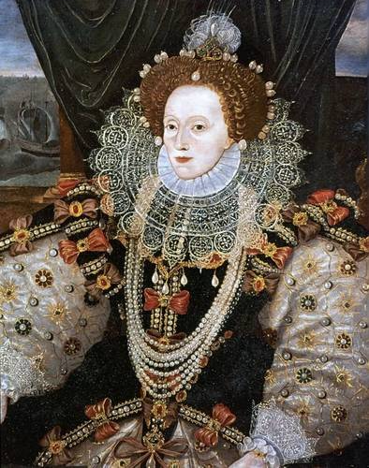
Elizabeth I of England by Hilliard
A painting depicting the Tudor monarch Queen Elizabeth I of England by painter George Gower.

Slide 7
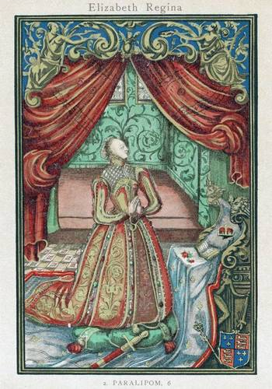
Elizabeth I of A portrait of Queen England by the painter Hilliard
Image of Queen Elizabeth I at prayer, from the frontispiece to a prayer book

Slide 8
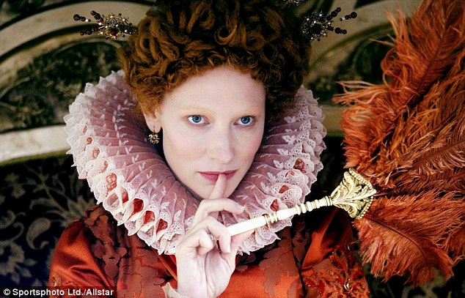
Selected Queen Elizabeth I Quotations
• Monarchs ought to put to death the authors and instigators of war, as their sworn enemies and as dangers to their states.
• For me it will be enough that a marble stone should declare that a queen having reigned such a time, lived and died a virgin.
• I know I have the body but of a weak and feeble woman; but I have the heart and stomach of a king, and of a king of England, too.
• I would rather go to any extreme than suffer anything that is unworthy of my reputation, or of that of my crown.
• I have the heart of a man, not a woman, and I am not afraid of anything.
• A clear and innocent conscience fears nothing.
• It is a natural virtue incident to our sex to be pitiful of those that are afflicted.
• Though the sex to which I belong is considered weak you will nevertheless find me a rock that bends to no wind.
• Ye may have a greater prince, but ye shall never have a more loving prince.
• To be a king and wear a crown is a thing more glorious to them that see it than it is pleasant to them that bear it.

Slide 9
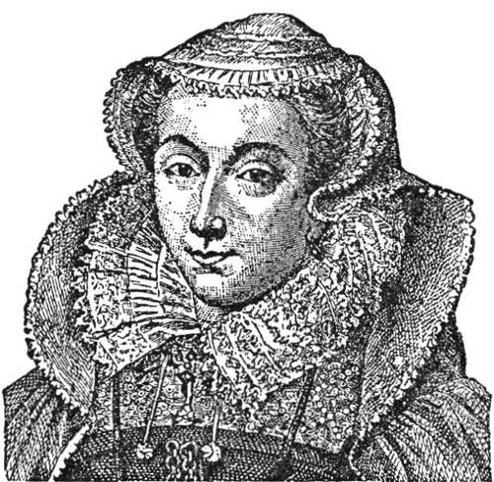
Mary, Queen of Scots
Known for: tragic ruler of Scotland whose marriages were disasters and who was imprisoned and eventually executed as a threat by her cousin, Queen Elizabeth I of England
Dates: December 8, 1542 - February 8, 1587
Also known as: Mary Stuart, Mary Stewart
The mother of Mary, Queen of Scots, was Mary of Guise (Mary of Lorraine) and her father was James V of Scotland, each in their second marriage. Mary was born on December 8, 1542, and her father James died on December 14, so the infant Mary became Queen of Scotland when she was just a week old.
James Hamilton, duke of Arran, was made regent for Mary, Queen of Scots, and he arranged a betrothal with prince Edward, the son of Henry VIII of England. But Mary's mother, Mary of Guise, was in favor of an alliance with France instead of England, and she worked to overturn this betrothal and instead arranged for Mary to be promised in marriage to France's dauphin, Francis.

Slide 10
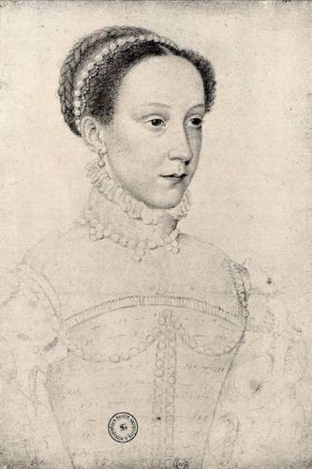
Queen of France and Claimant to the English Throne
The young Mary, Queen of Scots, only six years old, was sent to France in 1548 to be raised as the future queen of France. She married Francis in 1558, and in July 1559, when his father Henry II died, Francis II became king and Mary became queen consort of France.
Mary, Queen of Scots, also known as Mary Stuart (she took the French spelling rather than the Scottish Stewart), was the granddaughter of Margaret Tudor; Margaret was the older sister of Henry VIII of England. In the view of many Catholics, the divorce of Henry VIII from his first wife, Catherine of Aragon, and his marriage to Anne Boleyn were invalid, and the daughter of Henry VIII and Anne Boleyn, Elizabeth, was therefore illegitimate. Mary, Queen of Scots, in their eyes, was the rightful heir of Mary I of England, Henry VIII's daughter by his first wife.
When Mary I died in 1558, Mary, Queen of Scots, and her husband Francis asserted their right to the English crown, but the English recognized Elizabeth as the heir. Elizabeth, a Protestant, supported the Protestant reformation in Scotland as well as in England.
Mary Stuart's time as queen of France was very short. When Francis died, his mother Catherine de Medici assumed the role of regent for his brother, Charles IX. Mary's mother's family, the Guise relatives, had lost their power and influence, and so Mary Stuart returned to Scotland, where she could rule in her own right as queen.

Slide 11
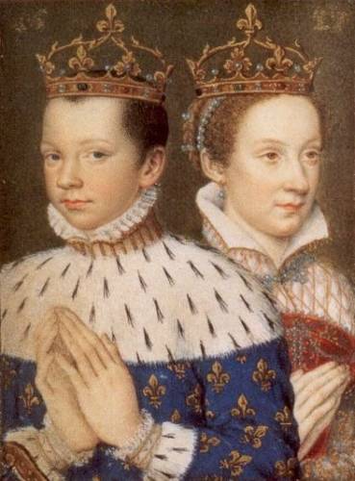
Mary in Scotland
In 1560, Mary's mother died, in the middle of a civil war she stirred up by attempting to suppress the Protestants, including John Knox. After the death of Mary of Guise, the Catholic and Protestant nobles of Scotland signed a treaty recognizing Elizabeth's right to rule in England. But Mary Stuart, returning to Scotland, managed to avoid signing or endorsing either the treaty or recognition of her cousin Elizabeth.
Mary, Queen of Scots, was herself a Catholic, and insisted on her freedom to practice her religion. But she did not interfere with Protestantism's role in Scottish life. John Knox, a powerful Presbyterian during Mary's rule, nevertheless denounced her power and influence.
Mary, Queen of France, with Francis II, during their brief
reign, in a portrait from the Book of Hours of Catherine
of Medici, mother of Francis.

Slide 12
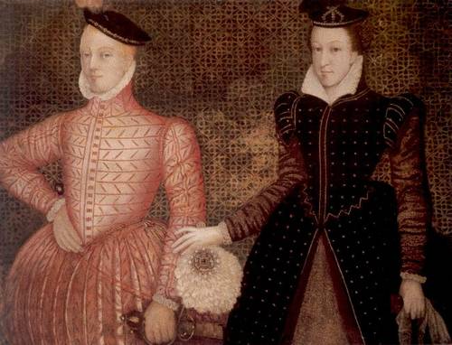
Marriage to Darnley
Mary, Queen of Scots, held on to hopes of claiming the English throne by right. She turned down Elizabeth's suggestion that she marry Lord Robert Dudley, Elizabeth's favorite, and be recognized as Elizabeth's heir. Instead, in 1565 she married her first cousin, Lord Darnley, in a Roman Catholic ceremony.
Darnley, another grandson of Margaret Tudor and heir of another family with a claim to the Scottish throne, was the next in line to Elizabeth's throne after Mary Stuart herself.
.
She was briefly Queen of France, and became Queen of Scotland from her infancy. Mary, Queen of Scots, was considered a rival for the throne of Queen Elizabeth I - a special threat since Mary was a Catholic and Elizabeth a Protestant. Mary's choices in marriage were questionable and tragic and she was accused of plotting to overthrow Elizabeth. Mary Stuart's son, James VI of Scotland, was the first Stuart king of England, named by Elizabeth as her successor.

Slide 13
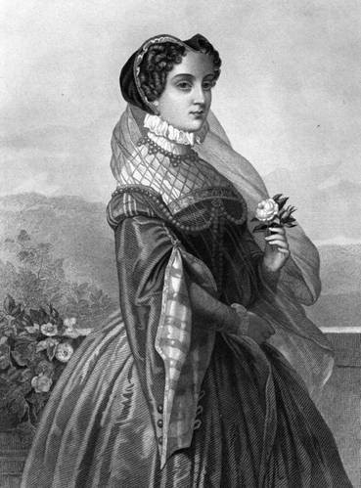
Long after her death, artists have continued to depict Mary, Queen of Scots.

Slide 14
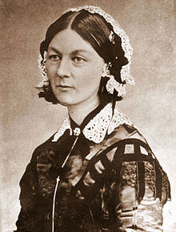
Dates: May 12, 1820 - August 13, 1910
Florence Nightingale
Occupation: nurse, reformer
Known for: founder of the modern nursing profession as a trained profession. Head British nurse, Crimean War.
Also known as: Lady with the Lamp; Flo
Born to a comfortable family, Florence Nightingale was educated by governesses and then by her father, with her older sister, Parthenope. She was familiar with the Greek and Latin classical languages, and modern languages of French, German, and Italian. She also studied history, grammar, and philosophy. At twenty, she overcame parental objections to receive tutoring in mathematics.
Called to a Mission in Life:
On February 7, 1837, Florence Nightingale heard, by her account, the voice of God telling her that she had a mission in life. It took her some years of searching to identify that mission. This was the first of four occasions where Florence Nightingale said she heard the voice of God.

Slide 15
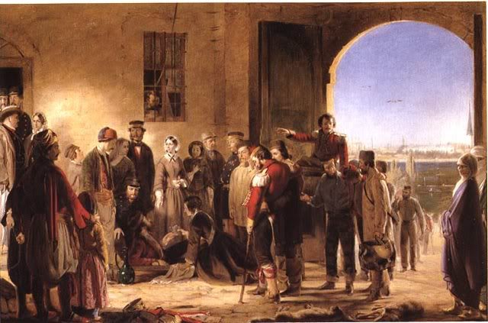
Young Florence rebelled against the life of her family, and became determined to serve society. She developed an ambition to work in hospitals. Her family was horrified, as nursing, in the early 1800s, was not considered a respectable profession.
In 1853, Florence Nightingale became the (unpaid) superintendent of London's Institution for the Care of Sick Gentlewomen.

Slide 16
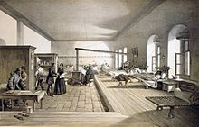
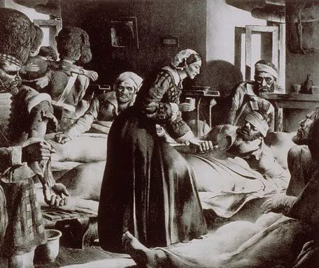
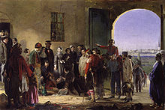
Florence Nightingale in the Crimea:
When the Crimean War began, reports came back to England about terrible conditions for wounded and sick soldiers. Florence Nightingale volunteered to go to Turkey, and at the urging of a family friend, then secretary of state at war, she took a large group of women as nurses. Thirty-eight women, including 18 Anglican and Roman Catholic sisters, accompanied Florence Nightingale to the warfront.
Florence Nightingale left England on October 21, 1854, and entered the military hospital at Scutari, Turkey, on November 5, 1854.

Slide 17
From 1854-56, Florence Nightingale headed nursing efforts in English military hospitals in Scutari, Turkey. She established more sanitary conditions and ordered supplies, beginning with clothing and bedding. She gradually won over -- at least enough to get cooperation -- the military doctors. She used significant funds raised by the London Times.
Soon, Florence Nightingale focused more on administration than on actual nursing. But she continued to visit the wards, and to send letters back home from injured and ill soldiers. Her rule that she be the only woman in the wards at night earned her the title "The Lady with the Lamp." The mortality rate at the military hospital fell from 60% at her arrival to 2% six months later.
Florence Nightingale applied her education and interest in mathematics to develop statistical analyses of disease and mortality, inventing the use of the pie chart.
Return to England:
Florence Nightingale was already a heroine in England when she returned, though she actively worked against the adulation of the public. She helped to establish the Royal Commission on the Health of the Army in 1857, and gave evidence to the commission and compiled her own report, published privately in 1858.
Florence Nightingale was quite ill from 1857 until the end of her life, living in London, mostly as an invalid.
In 1860 she founded the Nightingale School and Home for Nurses in London, England.

Slide 18
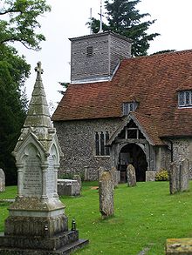
By 1901, Florence Nightingale was completely blind. The King awarded her the Order of Merit in 1907, making Florence Nightingale the first woman to receive that honor.
Florence Nightingale declined the offer of a national funeral and of burial at Westminster Abbey, requesting that her grave be marked simply.

Slide 19
Queen Victoria
Known for: Longest-ruling monarch of Great Britain, ruled during a time of economic and imperial expansion. Gave her name to the Victorian Era.
Occupation: Queen of Great Britain
Dates: May 24, 1819 - January 22, 1901
Also known as: Alexandrina Victoria, Victoria Alexandrina
Alexandrina Victoria was the only child of the fourth son of King George III: Edward, duke of Kent. Her mother was Victoria Maria Louisa of Saxe-Coburg, sister of King Leopold of the Belgians.
Victoria became heiress-apparent of the British crown on the death of her uncle George IV, and when her uncle William IV died childless in 1837, she became Queen of Great Britain. She was crowned the next year.

Slide 20
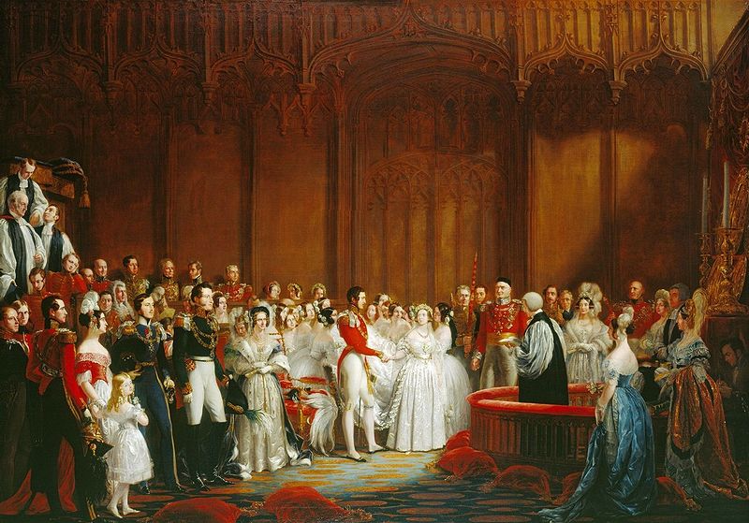
She'd met her cousin, Prince Albert of Saxe-Coburg and Gotha, when they were both seventeen. When they were twenty, he returned to England, and Victoria, in love with him, proposed marriage. They were married on February 10, 1840.

Slide 21
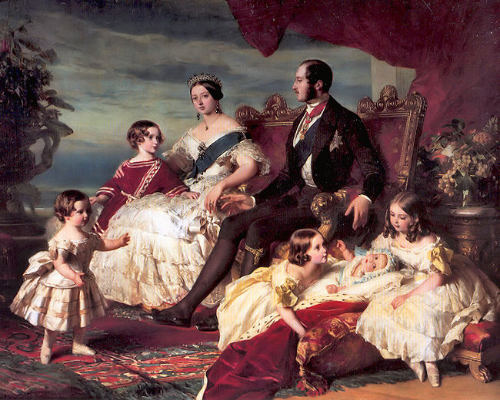
Their first child, a daughter, was born in November 1840, and the Prince of Wales, Edward, in 1841. Three more sons and four more daughters followed.

Slide 22
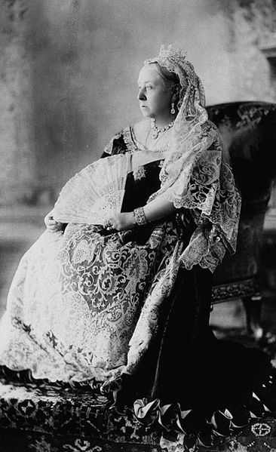
Victoria had traditional views on the role of the wife and mother, and though she was Queen and Albert was Prince Consort, he shared government responsibilities at least equally. His death in 1861 devastated her; her prolonged mourning lost her much popularity.
The marriage of her daughters into other royal families, and the likelihood that her children bore a mutant gene for hemophilia, both affected the following generations of European history.
Queen Victoria in her Diamond Jubilee photograph (London, 1897)

Slide 23
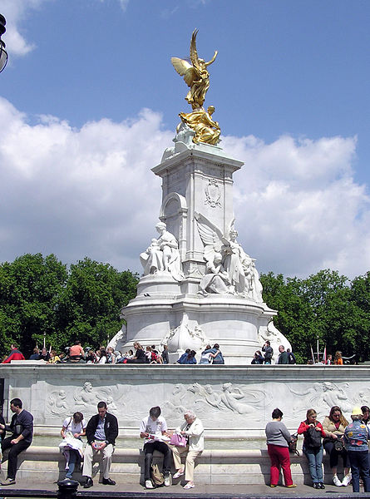
The Victoria Memorial in front of Buckingham Palace was erected as part of the remodelling of the façade of the Palace a decade after her death.

Slide 24
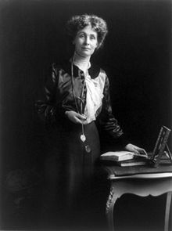
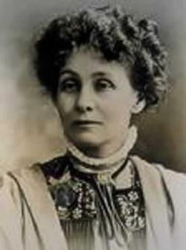
Emmeline Pankhurst (born Emmeline Goulden) (15 July 1858 – 14 June 1928) was a British political activist and leader of the British suffragette movement which helped women win the right to vote. In 1999 Time named Pankhurst as one of the 100 Most Important People of the 20th Century, stating: "she shaped an idea of women for our time; she shook society into a new pattern from which there could be no going back."She was widely criticized for her militant tactics, and historians disagree about their effectiveness, but her work is recognized as a crucial element in achieving women's suffrage in Britain

Slide 25
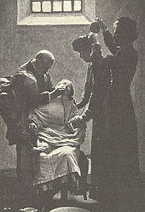
Pankhurst was horrified by the screams of women being force-fed during hunger strikes. In her autobiography she wrote: "I shall never while I live forget the suffering I experienced during the days when those cries were ringing in my ears."

Slide 26
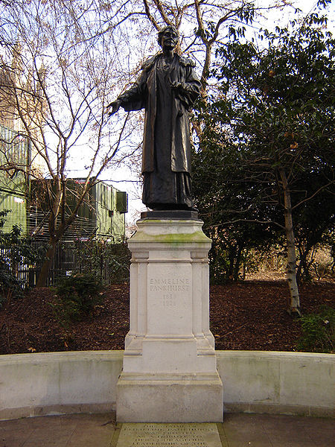
Westminster Emmeline Pankhurst statue

Slide 27
Princess Diana
Proper title is Diana, Princess of Wales, rather than Princess Diana, though the latter is how so much of the world knows her.
Dates: July 1, 1961 - August 31, 1997
Occupation: consort, Charles, Prince of Wales; charity worker; celebrity
Known for: charity work; press focus on her fashion image; public scandals
Also known as: Lady Diana Frances Spencer, Lady Diana, Lady Di, Princess Diana. (Princess Diana, the name by which many knew and know her, was not her proper title; it was "Diana, Princess of Wales")
Princess Diana's Family Background:
Diana Spencer was a direct descendant of King Charles II
Father: (Edward) John Spencer, Viscount Althorpe, later Earl Spencer. He was a personal aide to King George VI and to Queen Elizabeth II, and was a godson of Queen Mary
Mother: the Hon. Frances Shand-Kydd, formerly the Hon. Frances Ruth Burke Roche
Parents divorced in 1969. Mother ran away with a wealthy heir, and father gained custody of the children. Father later married Raine Legge, whose mother was Barbara Cartland, a romance novelist.
Diana was the third of four children. Her siblings: Lady Sarah, married Neil McCorquodale; before she married, Sarah and Prince Charles dated.

Slide 28
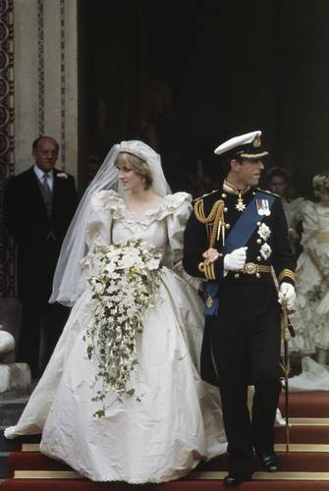
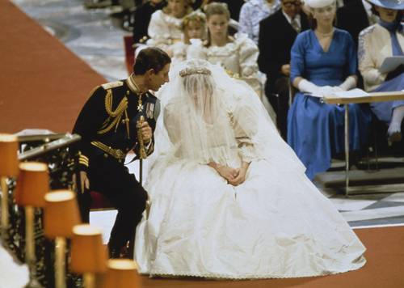
Princess Diana's Education:
spotty, undistinguished educational career
educated at home to age 9 Riddlesworth Hall (age 9-12) ;West Heath School (Kent) (age 12-16); dropped out finishing school in Switzerland, Chateau d'Oex; left after a few months
Marriage, Children:
husband: Charles, Prince of Wales (married July 29, 1981; divorced August 28, 1996; heir-apparent to the throne of Great Britain)
children: William Arthur Philip Louis, Prince William, born June 21, 1982
Henry Charles Albert David, Prince Harry, born September 15, 1984

Slide 29
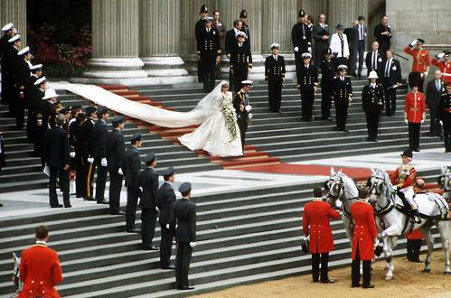
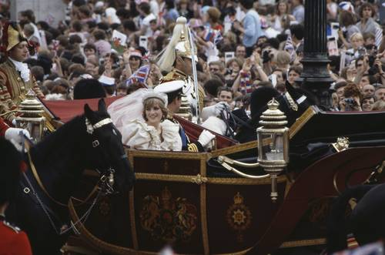
Diana and Charles on Their Wedding Day.

Slide 30
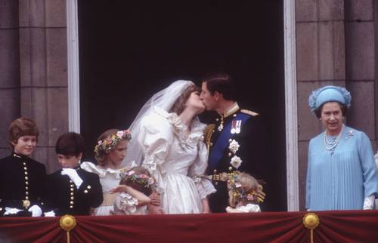
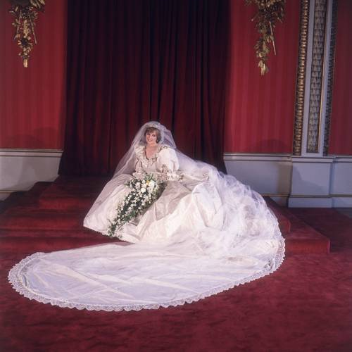

Slide 31
Just after midnight on August 31, 1997, in Paris, a car carrying Diana, Princess of Wales, and her new love interest, "Dodi" Fayed, plus a bodyguard and a driver, went out of control in a Paris tunnel and crashed. Fayed and the driver were killed instantly; Diana died later in a hospital despite efforts to save her. The bodyguard survived despite critical injuries.
The world reacted.
First came horror and shock. Then blame: at first, the entire blame seemed directed at the paparazzi, photographers who were following the princess' car, and from whom the driver was apparently trying to escape. Later tests showed the driver had been well over the legal alcohol limit, but immediate blame was on the photographers and their seemingly incessant quest to capture images of Diana that could be sold to the press.
Then came an outpouring of sorrow and grief. The Spencers, Diana's family, established a charitable fund in her name, and within a week, $150 million in donations had been contributed.
Tabloid newspapers with sensationalist headlines written about the Diana/Dodi affair just before her death were pulled from newstands by request of the publishers.
Diana's funeral, on September 6, drew worldwide attention. About half the people in the world saw it on television. Millions turned out to line the path of the funeral procession.

Slide 32
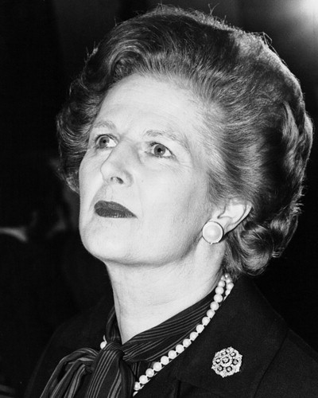
Margaret Thatcher (1925 - )
Margaret Thatcher was Britain's first female prime minister and served three consecutive terms in office. She is one of the dominant political figures of 20th century Britain, and Thatcherism continues to have a huge influence.
Margaret Hilda Roberts was born on 13 October 1925 in Grantham, Lincolnshire, the daughter of a grocer. She went to Oxford University and then became a research chemist, retraining to become a barrister in 1954. In 1951, she married a wealthy businessman, Denis Thatcher, with whom she had two children.
Thatcher became Conservative member of parliament for Finchley in north London in 1959, serving as its MP until 1992. Her first parliamentary post was junior minister for pensions in Harold Macmillan's government. From 1964 to 1970, when Labour were in power, she served in a number of positions in Edward Heath's shadow cabinet. Heath became prime minister in 1970 and Thatcher was appointed secretary for education.

Slide 33
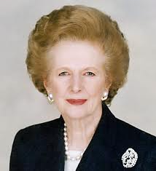
After the Conservatives were defeated in 1974, Thatcher challenged Heath for the leadership of the party and, to the surprise of many, won. In the 1979 general election, the Conservatives came to power and Thatcher became prime minister.
An advocate of privatisation of state-owned industries and utilities, reform of the trade unions, the lowering of taxes and reduced social expenditure across the board, Thatcher's policies succeeded in reducing inflation, but unemployment dramatically increased.
Victory in the Falklands War in 1982 and a divided opposition helped Thatcher win a landslide victory in the 1983 general election. In 1984, she narrowly escaped death when the IRA planted a bomb at the Conservative party conference in Brighton.
In foreign affairs, Thatcher cultivated a close political and personal relationship with US president Ronald Reagan, based on a common mistrust of communism, combined with free-market economic ideology. Thatcher was nicknamed the 'Iron Lady' by the Soviets. She warmly welcomed the rise of reformist Soviet leader Mikhail Gorbachev.

Slide 34
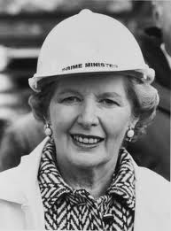
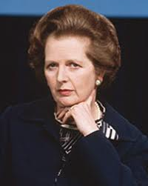
In the 1987 general election, Thatcher won an third term in office. But controversial policies, including the poll tax and her opposition to any closer integration with Europe, produced divisions within the Conservative Party which led to a leadership challenge. In November 1990, she agreed to resign and was succeeded as party leader and prime minister by John Major.
In 1992, Thatcher left the House of Commons for the House of Lords as Baroness Thatcher of Kesteven.

Slide 35
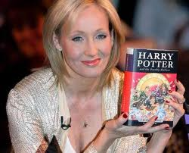
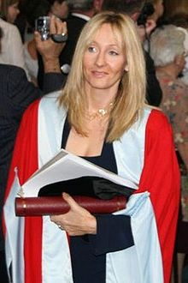
J.K. Rowling
Born: 31 July 1965. Birthplace: Chipping Sodbury, England . Best Known As: The creator of the fictional wizard Harry Potter
Joanne K. Rowling (pronounced rolling) is the author of the Harry Potter series of books, which began with the 1997 tale Harry Potter and the Philosopher's Stone.
Rowling has led a "rags to riches" life story, in which she progressed from living on social security to multi-millionaire status within five years. As of March 2011, when its latest world billionaires list was published, Forbes estimated Rowling's net worth to be US$1 billion.
As a child, Rowling often wrote fantasy stories, which she would usually then read to her sister. She recalls that "I can still remember me telling her a story in which she fell down a rabbit hole and was fed strawberries by the rabbit family inside it. Certainly the first story I ever wrote down (when I was five or six) was about a rabbit called Rabbit. He got the measles and was visited by his friends, including a giant bee called Miss Bee. When she was a young teenager, her great aunt, who Rowling said "taught classics and approved of a thirst for knowledge, even of a questionable kind", gave her a very old copy of Jessica Mitford's autobiography, Hons and Rebels. Mitford became Rowling's heroine, and Rowling read all of her books.

Slide 36
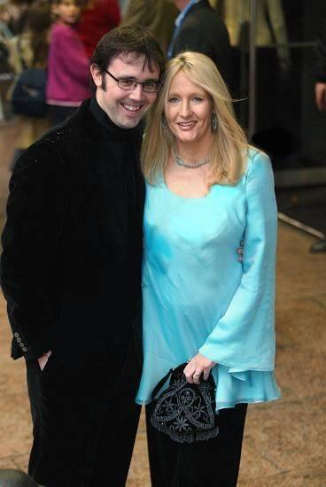
In 1990, while she was on a four-hour-delayed train trip from Manchester to London, the idea for a story of a young boy attending a school of wizardry "came fully formed" into her mind.She told The Boston Globe that "I really don't know where the idea came from. It started with Harry, then all these characters and situations came flooding into my head.
Rowling then moved to Porto in Portugal to teach English as a foreign language. While there, on 16 October 1992, she married Portuguese television journalist Jorge Arantes. Their child, Jessica Isabel Rowling Arantes (named after Jessica Mitford), was born on 27 July 1993 in Portugal.They separated in November 1993. In December 1993, Rowling and her daughter moved to be near Rowling's sister in Edinburgh, Scotland. During this period Rowling was diagnosed with clinical depression, and contemplated suicide.It was the feeling of her illness which brought her the idea of Dementors, soul-sucking creatures introduced in the third book.

Slide 37
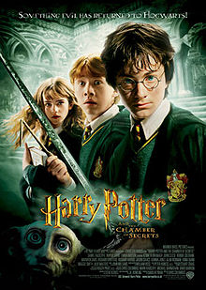
Harry Potter series:
Harry Potter and the Philosopher's Stone (26 June 1997)
Harry Potter and the Chamber of Secrets (2 July 1998)
Harry Potter and the Prisoner of Azkaban (8 July 1999)
Harry Potter and the Goblet of Fire (8 July 2000)
Harry Potter and the Order of the Phoenix (21 June 2003)
Harry Potter and the Half-Blood Prince (16 July 2005)
Harry Potter and the Deathly Hallows (21 July 2007)

Slide 38
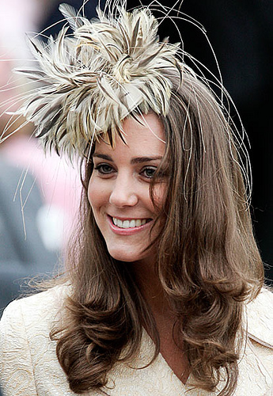
Kate Middleton
Kate Middleton, born with her real name Catherine Middleton, is a wife of the prestigious Prince William of Wales. She was born and raised in the small town of Buckleberry in the county of Berkshire in the southern area of the country of England. Her father is Michael Middleton who is a business man in England. Along with her mother Carole, both parents own the company “Party Pieces” which as the name suggests, sell party supplies. She also has a younger sister named Pippa and a brother named James.
As for her education, she attended Marlborough College which is a public British boarding school nearby Berkshire County in the county of Wiltshire. She was a very good student in college. She got eleven General Certificate of Secondary Education! These certificates certify various courses a student has passed very strenuous tests in. Not only did she do that, but of these eleven certificates, three of them were at the A level.

Slide 39
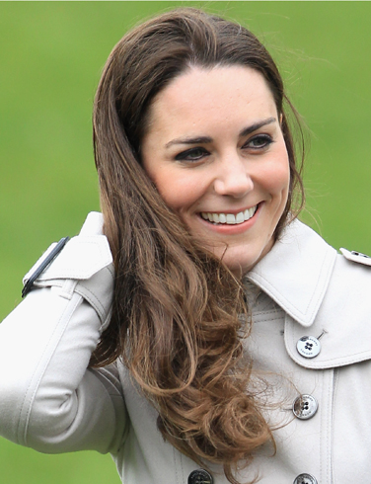
In 2001, she was a student at the University of St. Andrews in the Fife, Scotland. It was here at St. Andrews where she met her sweetheart Prince William of Wales. At first they were just friends. Then in 2003, she broke up with her then boyfriend and befriended William. They have been a couple ever since. They were seen as a couple for the first time on a ski trip to Switzerland.

Slide 40
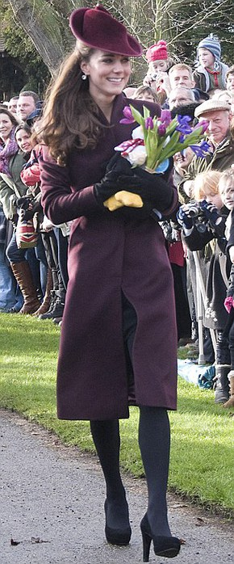

Slide 41
On April 29, 2011, the couple married at Westminster Abbey in London. Kate wore a dress designed by Sarah Burton—a fact that remained a closely guarded secret until the big day. Shortly before the wedding, Queen Elizabeth conferred Kate with the title of Catherine, Her Royal Highness the Duchess of Cambridge. She will not officially be declared a princess until the current Prince of Wales, Prince Charles, inherits the throne.

Slide 42
Elizabeth II
1952-Present
Elizabeth II became queen of the United Kingdom of Great Britain and Northern Ireland in 1952. In addition she is head of the Commonwealth.
Elizabeth was born on 21 April 1926 in London, the first child of Albert, Duke of York (Герцог Йоркський), and his wife, formerly Lady Elizabeth Bowes-Lyon. She initially had little prospect of succeeding to the throne until her uncle, Edward VIII, abdicated in December 1936. Her father then became George VI and she became heir.

Slide 43
Elizabeth and her younger sister Margaret were educated at home. On the outbreak of war in 1939, they were evacuated to Windsor Castle. In 1945, Elizabeth joined the war effort, training as a driver in the Women's Auxiliary Territorial Service (WATS) (Жіноча допоміжна територіальна служба (існувала в часи 2-ї світової війни)). In November 1947, she married a distant cousin, Philip Mountbatten (formerly Prince Philip of Greece and Denmark), who was created duke of Edinburgh. The couple have four children.

Slide 44
George VI died on 6 February 1952 while Elizabeth and Philip were in Kenya. She returned home immediately, and was crowned at Westminster Abbey in June 1953. For more than 50 years, during a period of great change in Britain, the Queen has carried out her political duties as head of state, the ceremonial responsibilities of the sovereign and a large annual programme of visits in the United Kingdom as well as numerous foreign tours. In 1953 "Head of the Commonwealth" was added to the long list of royal titles which she possesses.

Slide 46
The Queen meets thousands of people each year in the UK and overseas. Before meeting Her Majesty, many people ask how they should behave. The simple answer is that there are no obligatory codes of behaviour - just courtesy.
However, many people wish to observe the traditional forms of greeting.
For men this is a neck bow (from the head only) whilst women do a small curtsy. Other people prefer simply to shake hands in the usual way.
On presentation to The Queen, the correct formal address is 'Your Majesty' and subsequently 'Ma'am'.
You can write to Her Majesty at the following address:
Her Majesty The Queen
Buckingham Palace
London SW1A 1AA
If you wish to write a formal letter, you can open with 'Madam' and close the letter with the form 'I have the honour to be, Madam, Your Majesty's humble and obedient servant'.
This traditional approach is by no means obligatory. You should feel free to write in whatever style you feel comfortable.

