Slide 1
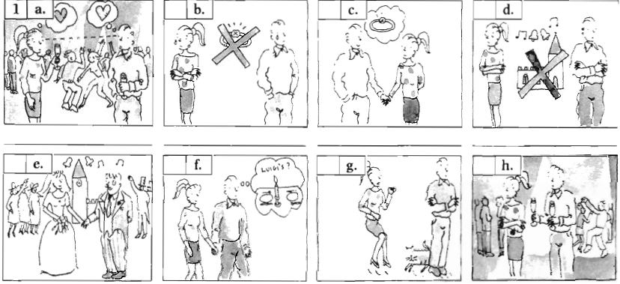
Relationship
Relationship

Slide 4
relationship
Definition: connection; friendship
Synonyms: accord, affair, affiliation, affinity, alliance, analogy, appositeness, association, bond, communication, conjunction, consanguinity, consociation, contact, contingency, correlation, dependence, dependency, exchange, homogeneity, hookup, interconnection, interrelation, interrelationship, kinship, liaison, likeness, link, marriage, nearness, network, parallel, pertinence, pertinency, proportion, rapport, ratio, relation, relativity, relevance, similarity, tie, tie-in, tie-up

Slide 7
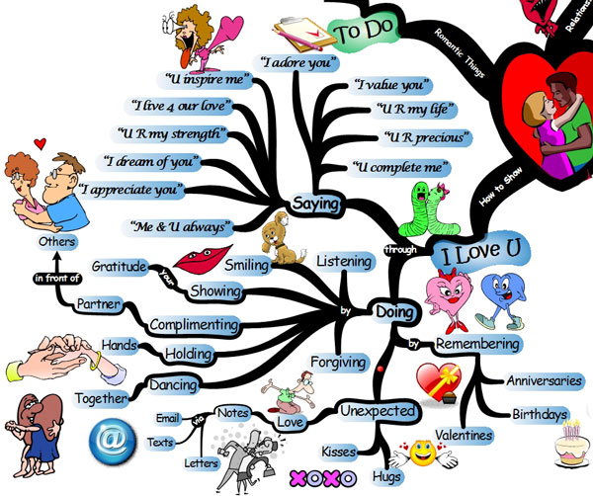
Homework assignments
WB p.58,
Ex. 3, 4

Slide 8
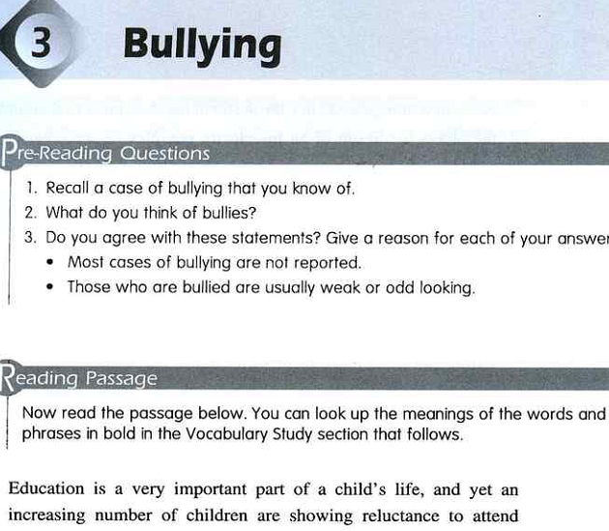

Slide 9
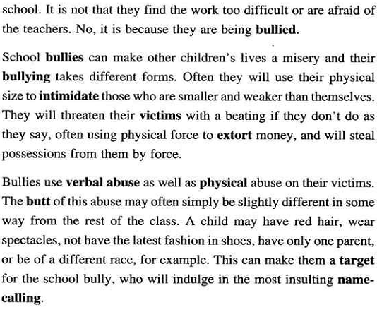

Slide 10
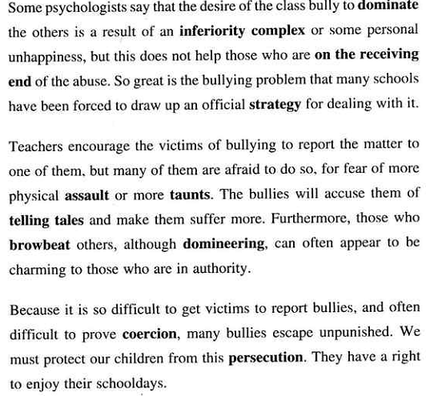

Slide 11
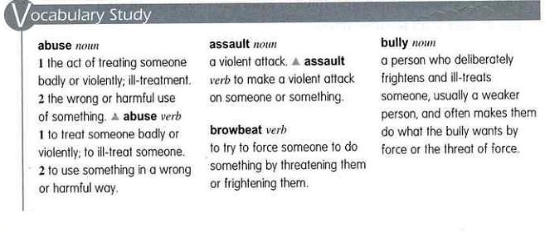

Slide 12
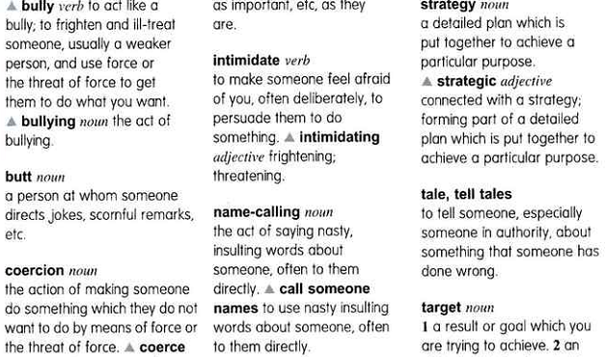

Slide 13
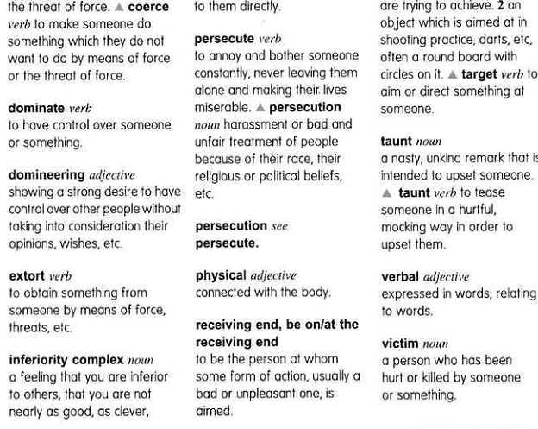

Slide 14
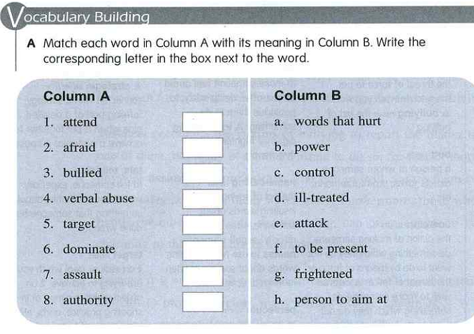

Slide 15
