Slide 1
English for Media Literacy
Tylyatynska Natalia,
a teacher of English
Buchach lyceum

Slide 2
The Public Affairs Section of the U.S. Embassy in Ukraine is supporting a nationwide Massive Open Online Course (MOOC) project on Media Literacy.

Slide 3

Targets for today
Get to know each other
Define media and media literacy
Identify media literacy and its importance
Analyze and interpret media messages through guided questions
Compare and contrast traditional and social media

Slide 4
Identify what an advertisement is and how it is used
Discover the positive and negative aspects of advertising
Analyze ads and TV commercials
Create ads
List types of bias
Value the importance of including people from various races, cultures, and genders in mainstream media

Slide 5
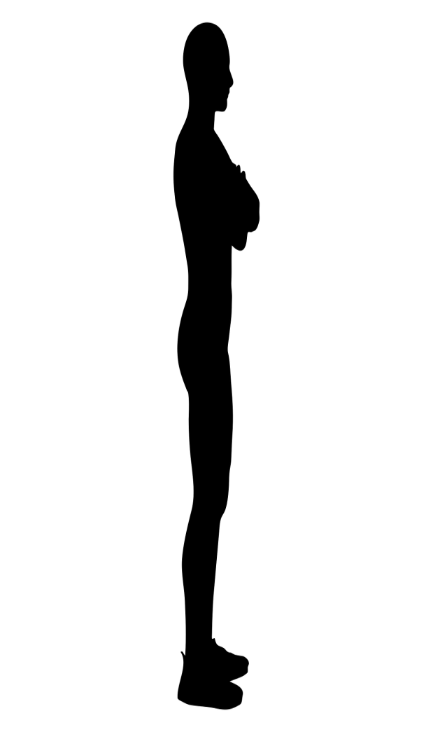
Stand up if…
You travelled more than 20 mins to get here
You know what MOOC stands for
You are pretty good with computers
You have ever taken an online course
You are familiar with Coursera
You LOVE food
Notes:
(5 min) Warm-up

Slide 6
Ice breaking activity
FOUR CORNERS
 | “what are the most important things in your life?”
“favorite hobbies”
“favorite place on the Earth for vacation”
“if you were an animal, which one would you be?”

Slide 7

What is Media?

Slide 8
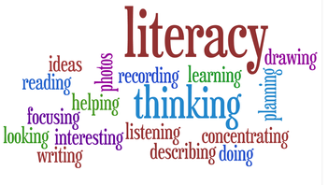
What is Literacy?
Literacy is the ability to read, write, speak and listen in a way that lets us communicate effectively and make sense of the world.

Slide 9
What is Media Literacy?
Access Media
Analyze/Critique Media
Evaluate Media
Make/Produce Media
An active process. Learn by doing media literacy.
This process of learning media literacy skills is media education.

Slide 10
Media literate youth and adults are better able to understand the complex messages we receive from television, radio, Internet, newspapers, magazines, books, billboards, video games, music, and all other forms of media.
Many educators have discovered that media literacy is an effective and engaging way to apply critical thinking skills to a wide range of issues.

Slide 11

Do you read a newspaper or follow the news online? Why?
Do you watch the news on TV or listen to it on the radio? Why?
Do you enjoy using social media to see what people are talking about and to give your opinion? Why?
Do you ever wonder who created the news stories you see and hear?
How are different groups of people shown in the media?

Slide 12
Why? Rationale?
Discussion Points:
  Why should we study the media?
  What is the social significance of media today?
  Watch the Portlandia “Mind Fi” clip.
    Briefly discuss.

Slide 13



Media is a powerful cultural force.
Media Messages Affect Our Thoughts, Attitudes, & Actions
Media uses specific techniques.(like flattery, repetition, fear, and humor)
Media uses "The Language of Persuasion"
Inspires people to do unwise things.

Slide 14
Media Constructs Fantasy Worlds
People receive & interpret them differently.
Individuals Constructs Their Own Meaning From Media
Our values & viewpoints influences our choice of words, sounds, & images.
Media Messages Contain "Texts" & "Subtexts"

Slide 15
Media Messages Reflect The Values & Viewpoints of Media Marketers
Media Messages Can Be Decoded

Slide 16
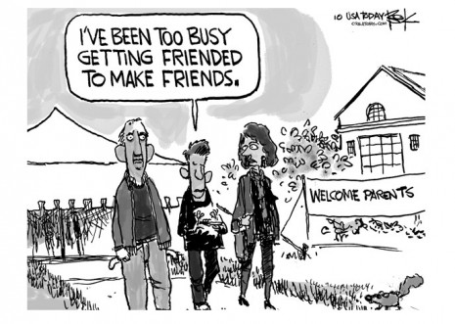

Slide 17
The media plays a vital role in promoting the existing social roles, values and beliefs of a society. It greatly informs “what we know.”
Studying the media is the best (one of the best) way to understand ourselves and the society we live in.

Slide 18
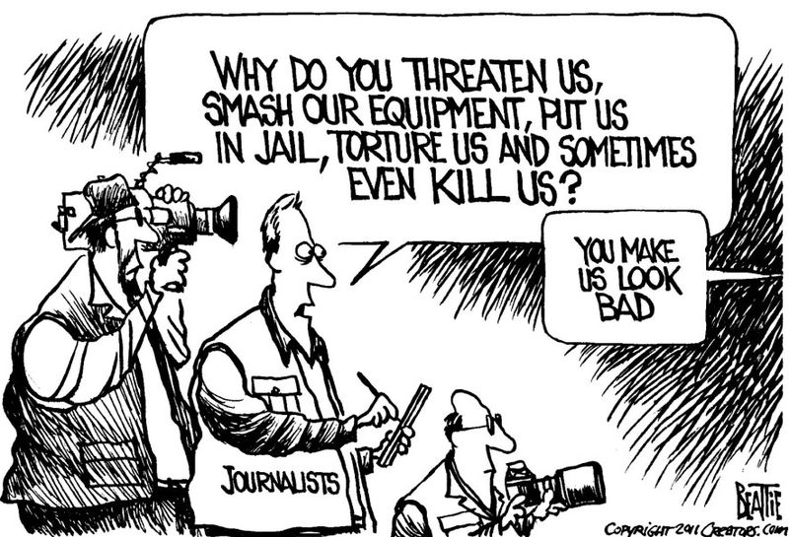

Slide 19
We Must Have a Critical Understanding of Media
What is media saying?
What is media NOT saying?
Who is speaking?
Who is NOT speaking?
Who is represented? Who is NOT represented?
Who is making decisions about media/content?
What are the motivations of media owners?
Ask yourself:
What is the purpose of media?
How do we come to know what we know?
Notes:
Don’t take media at face value – interrogate what media is, what it’s saying, why it’s saying it, what it’s NOT saying, who’s speaking, who’s left out
What is the purpose of media?
→ ‘Media literacy’
Holistic model: media are communicative events that are part of entire structure and set of ideas circulating…

Slide 20
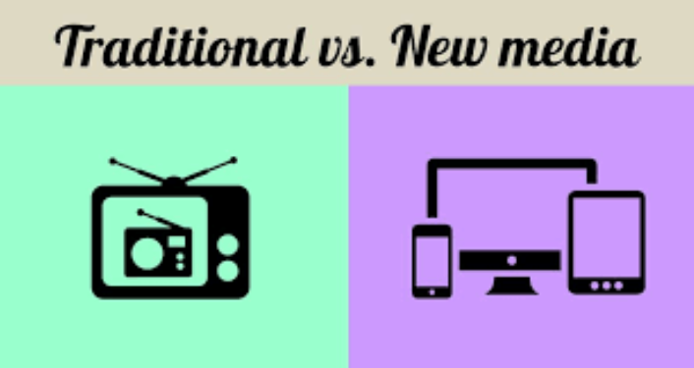

Slide 21

Traditional Media
is the type of media that has been used since before the Internet and mobile phone technology were developed.
In other words, traditional media includes television, radio, print such as newspapers and magazines, mail, and outdoor messages.

Slide 22

Social Media
is the websites and applications, or apps, that allow you to create and share media messages with other people.

Slide 23
Discuss
Is Social Media replacing Traditional Media?
Is Traditional Media going to go away?
Is Traditional Media going to come back and outplace Social Media?
How do you use Facebook?
Why do you use Facebook?
Is YouTube important?

Slide 24

What is advertising?
Advertising is creating messages to tell people about a product or service, and to convince them to buy it.

Slide 25
Key points
Advertisement,or ad for short
Advertisers
Consumers
A commercial
the message that is created about a product for sale
people who create advertisements
people who buy products or services
is an advertisement played on the radio or television.

Slide 26
Analyzing the ad
Who created the message that is being sent?
What techniques were used to attract my attention?
How might other people understand or interpret this message differently from me?
What points of view and values are included or omitted from this message?
Why was this message sent?

Slide 27
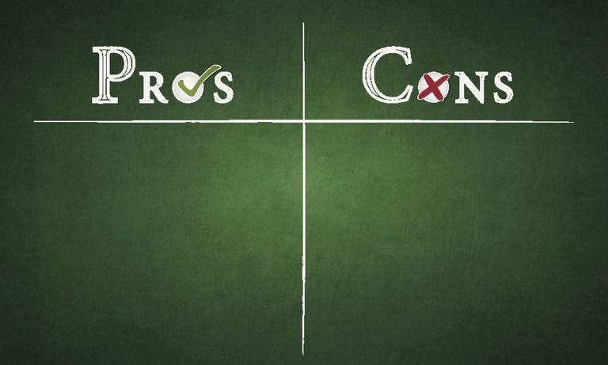

Slide 28
Flipping Technique
How to challenge our normalized ways of seeing media? Do the flipping technique to find out!
  Imagine the men are women. Imagine the women are men. What happens?
  Imagine a white character is black. Or Asian. What happens?
  Imagine a rich person is poor. Imagine a poor person is rich. What happens?
  Imagine a young person is old. Imagine an old person is young.
What does all this do to our normalized ways of seeing?

Slide 29
Critical TV Commercial Analysis
Consider the following:
  Who created the ad? For what purpose?
  What techniques were used to attract your attention?
  What information was missing regarding the product?
  How were men and women represented?
  How might others different from me interpret the ad?
  What does the set and costumes say about class?
  What happens if we do the flipping technique?

Slide 30
Television commercials
What makes a good television commercial?
What is your favourite commercial on the television? Why?
You are about to see 3 different commercials. As you watch them you are to complete task 1 on the worksheet provided
You will have the chance to see the adverts twice.
Commercial 1 : http://www.youtube.com/watch?v=yETwfFz-MWE&feature=related
Commercial 2: http://www.youtube.com/watch?v=_ve4M4UsJQo
Commercial 3 : http://www.youtube.com/watch?v=Ho7gIb91Jc0
Now that you have seen all of the commercials, you are able to complete the remaining tasks on the worksheet.

Slide 31
Advert Number | Product Advertised | Was the commercial humorous, thought provoking, innovative etc ? | How effective was the commercial? (Extremely, Very, Not Very, Ineffective)
1
2
3

Slide 32
Task 2
After you watch:
1. Which advert was the most effective in your opinion?
………………………………………………………………………………………………………………………………………………………………………………………………………………………………………………………………………………………………………………………………………
2. What was it about the advert that made it effective?
……………………………………………………………………………………………………………………………………………………………………………………………………………………………………………………………………………………………………………………………………………………………………………………………………………………………………………………………………………………………………………………………………………………………………………………………………………………………………………………………………………
3. What style (humorous, innovative…) of advert do you prefer? Why?
…………………………………………………………………………………………………………………………………………………………………………………………………………………………………………………………………………………………………………………………………………………………………………………………………………………………………………………………………………………………………………………………………………………………………………………………………………………………………………………………………………………………………………………………………………………………………………………………..
4. Which of the adverts in your opinion “sold” their product to you? How did they achieve the sell?
……………………………………………………………………………………………………………………………………………………………………………………………………………………………………………………………………………………………………………………….

Slide 33
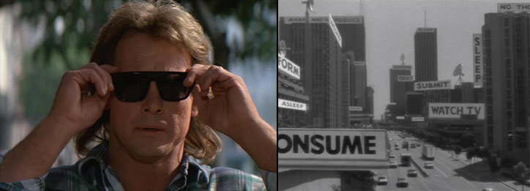
They Live!
Watch and briefly discuss the They Live clip.
Use the They Live sunglasses to be media literate!

Slide 34
BIAS
Showing an opinion about something that is not based on all of the facts

Slide 35
MEDIA BIAS:
By Omission
By Placement
By Spin

Slide 36
BIAS BY OMISSION
Avoiding coverage
One-sided story

Slide 37
COVERAGE
Publishing media messages about an event

Slide 38
ONE-SIDED
only one point of view being presented

Slide 39
BIAS BY PLACEMENT
Top of a page
Beginning of a video
Beginning of a radio broadcast

Slide 40
SPIN
Giving a positive or negative point of view about subject in order to change the opinion of the audience

Slide 41
BIAS BY SPIN
Pundit (a person who has a lot of knowledge and experience about a subject and gives opinions about the subject in public)
Negative or positive connotations

Slide 42
Denotinations vs. Connotations
DENOTINATION – the basic definition of a word that you can find in a dictionary (what people say)
Cheap – something doesn’t cost a lot of money
Inexpensive – something isn’t expensive, it has a low price
CONNOTATIONS – the feeling that we have about a word, usually positive or negative
Cheap – negative connotation
Inexpensive – neutral connotation

Slide 43
OVERCOMING BIAS:
What points of view are being omitted from this message?
How important is this situation for my daily life or society in general?
Does this message want me to have positive or negative opinion about the topic?
Bias can affect your decision about how to act in the world

Slide 44
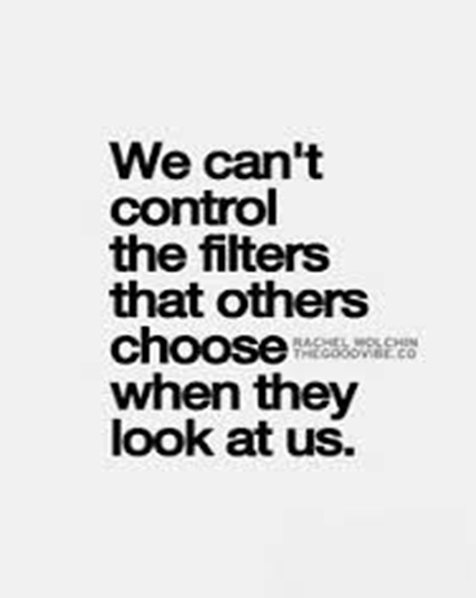
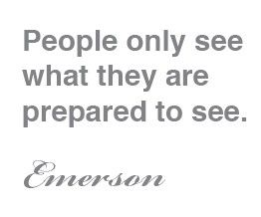
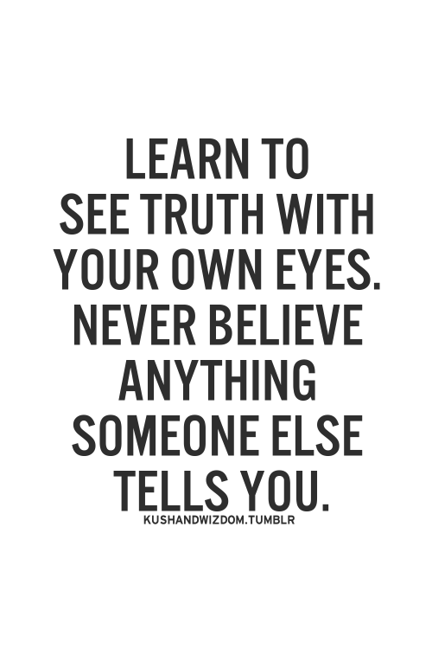
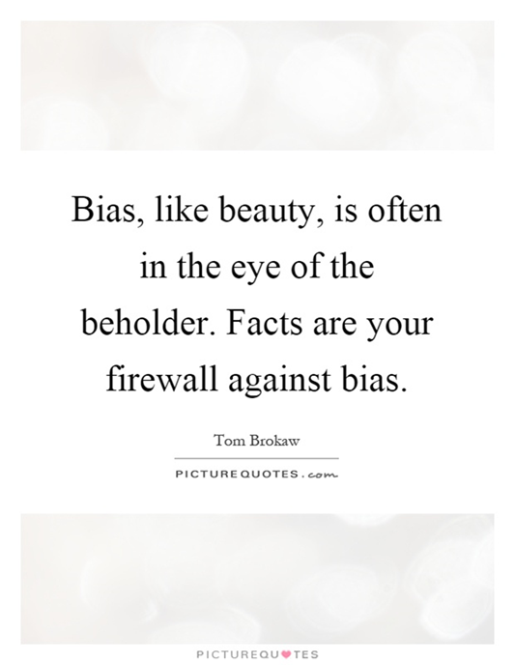
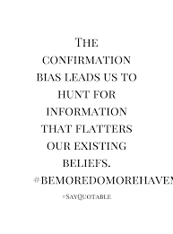
YOUR THOUGHTS ON THE QUOTES?

Slide 45
EXPERIMENT blue eyes vs brown eyes
https://www.youtube.com/watch?v=onKVeZaDzWg

Slide 46
QUIZ
FINISH THE SENTENCE: INFORMATION ON A WEB PAGE MAY BE BIASED WHEN IT…
is not supported by facts
convincingly presents an author’s point of view
represents both sides of a controversial issue fairly

Slide 47
WHICH QUESTION IS BEST FOR DETECTING BIAS ON A WEB PAGE?
What information seems convincing?
What information has the author omitted?
What professional vocabulary does the author use?

Slide 48
WHAT IS AN EXAMPLE OF BIAS COMMONLY FOUND IN PROPAGANDA?
Words that excite
Limited use of exaggeration
Arguments that appeal to reason

Slide 49
WHAT IS THE PURPOSE OF BIAS?
MORE THEN 1 IS POSSSIBLE
To change the reader’s mind
To provide balanced views on issues
To establish the superiority of one idea over another

Slide 50
PREJUDICIAL BIAS MAY BE DETECTED IN …
MORE THEN 1 IS POSSSIBLE
The facts that the author includes
The facts that the author excludes
Descriptions that are objective and fair
Words an author uses to create positive impressions
Words an author uses to create negative impressions

Slide 51
SELECT ALL THE STATEMENTS THAT ARE TRUE:
Biased documents rarely include facts
Words in a biased document are often extreme
Biased documents appeal more to logic than to emotion
Biased documents may contain “all or nothing” statements

Slide 52
DIVERSE
Showing a great deal of variety of differences

Slide 53
DIVERSITY
Having or including people from different background

Slide 54
A DIVERSE MEDIA MEANS:
Representing different groups of people
Different people creating and delivering the media messages

Slide 55
GROUPS:
DOMINANT GROUP – group of people that has the power and status in society
MINORITY GROUP – group of people in society that have less power and opportunity

Slide 56
To be diverse, media must:
Tell stories of dominant and minority groups
People from both groups must create and deliver messages

Slide 57
The importance of diversity in the media:
Including different points of view (the full story)
Avoiding stereotypes (true story)
Stereotype – to unfair group all people with a particular characteristic together

Slide 58
RACE AND ETHNICITY IN THE MEDIA
Are different groups included in the media messages we see?
Are those messages fairly and accurately describing and showing people from different groups?

Slide 59
CULTURE IN THE MEDIA
Reading and listening to media messages from different sourses
To truly understand a culture: analyze what you see and hear

Slide 60
WOMAN IN THE MEDIA
BECHDEL TEST QUESTIONS:
Are there more than two women in the movie?
Do they speak to each other?
Do they discuss something other than man?

Slide 61
WOMAN IN THE MEDIA
The media puts women in certain roles and describes them in certain ways
The media influences how we understand what it means to be a man or woman
We must analyze if these understandings are accurate

Slide 62
Tic tac toe
1
2
3
5
6
4
7
8
9

Slide 63



