Slide 1
England

Slide 2
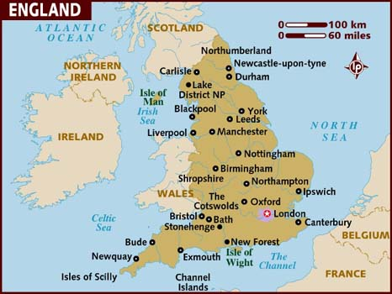
England is the biggest part of the United Kingdom of Great Britain and Northern Ireland. It occupies the central part of island Great Britain.

Slide 3
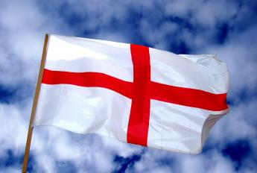
The Flag of England is the St. George's Red Cross on the white background

Slide 4
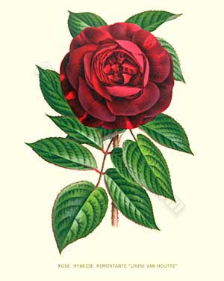
The emblem of England is a red rose

Slide 5
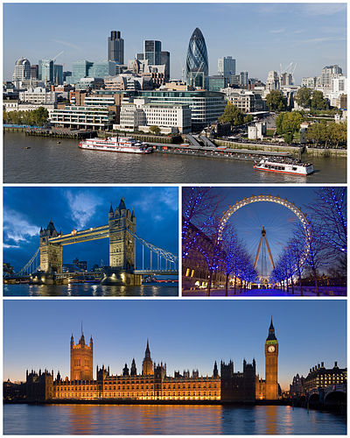
London is the capital of England

Slide 6
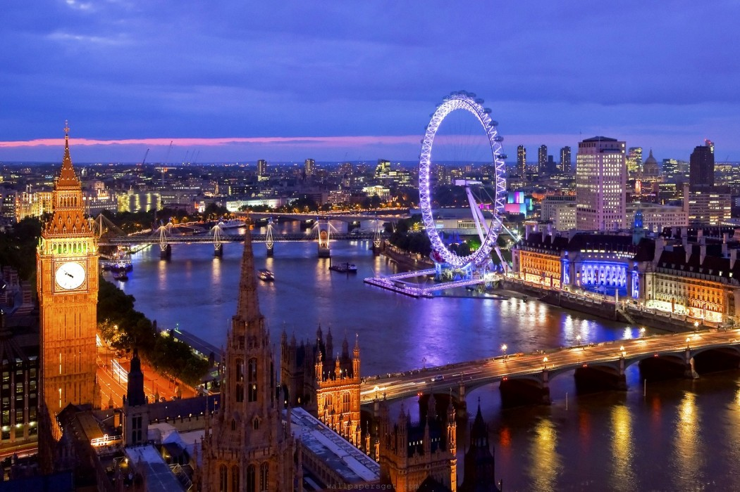
London is the most important economic and financial center of the United Kingdom and Europe, one of the world's financial centers.
London is a city of dreams, to visit in which any traveler dreams. The British capital, which stretches out on the banks of the Thames, attracts tourists with a unique color, unique to it.

Slide 7
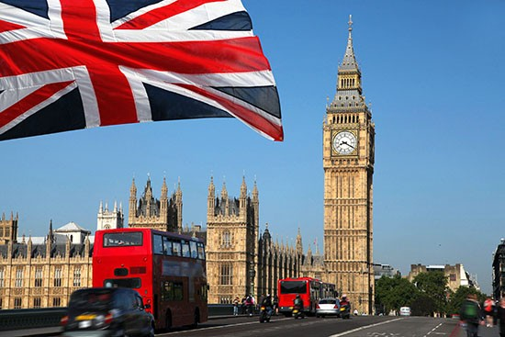
Big Ben

Slide 8
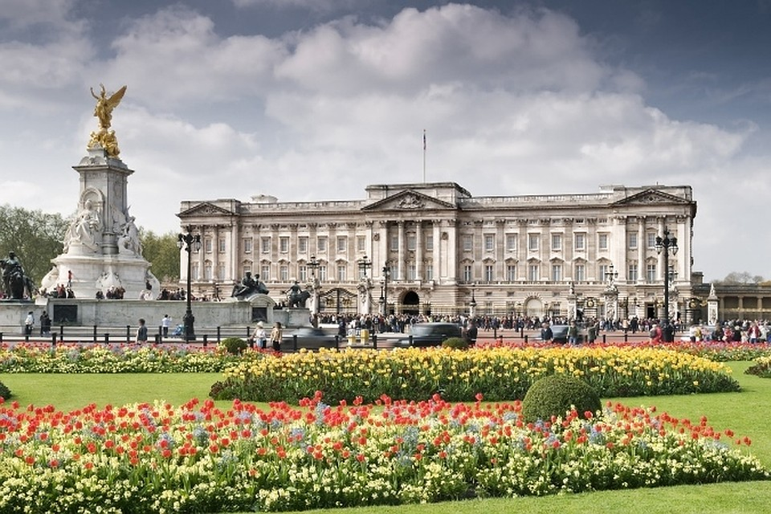
Queen's Palace
On August 7, 1993, part of Buckingham Palace, the residence of the English Queen Elizabeth II, was first opened to tourists.

Slide 9
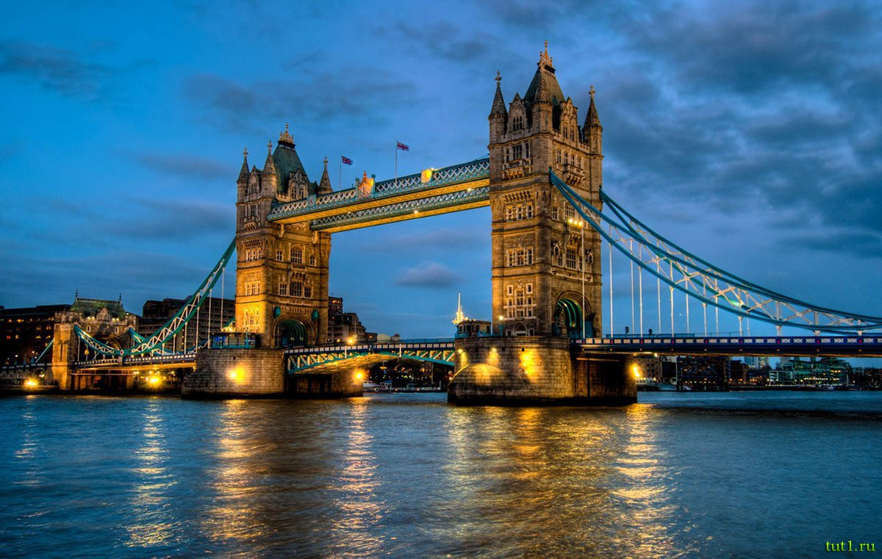
Tower Bridge
There is an interesting fact that in 1952 the bridge began to rise when a double-decker bus moved along it. The driver decided not to stop and jump over the formed gap, which he successfully managed to do - he landed safely on the opposite side.

Slide 10
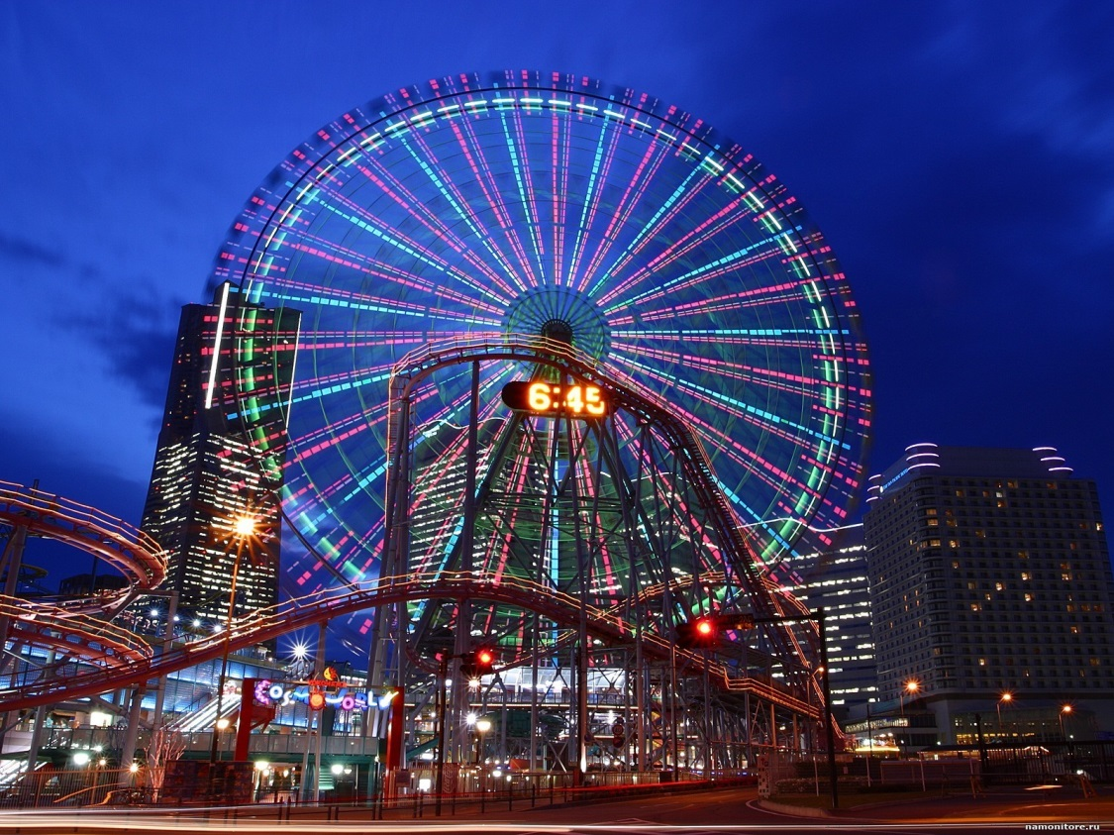
The London Eye
From a height of 135 meters, the view opens to almost the entire city. The review was made on the project of the marriage of David Marx and Julie Barfield
"London Eye" has 32 closed cubicles. Cabs represent 32 suburbs of London.

