Slide 1
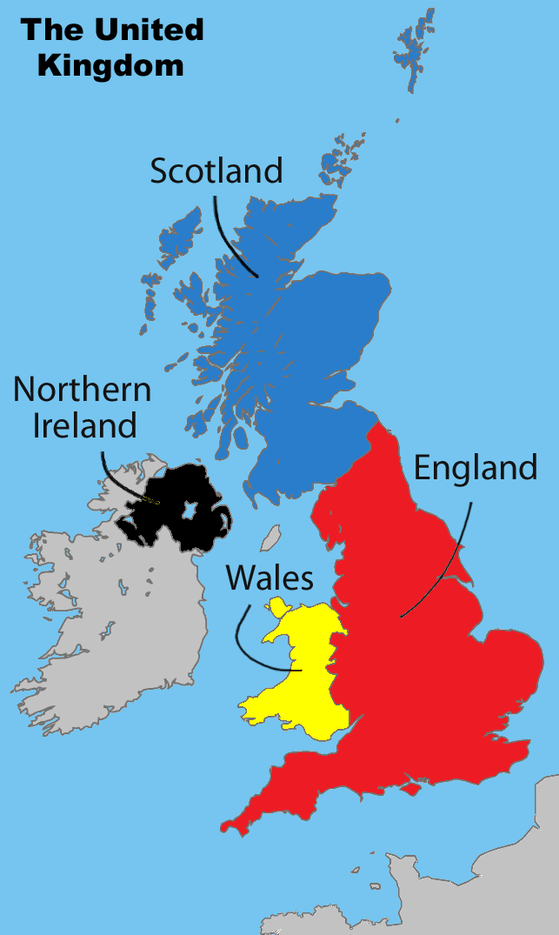
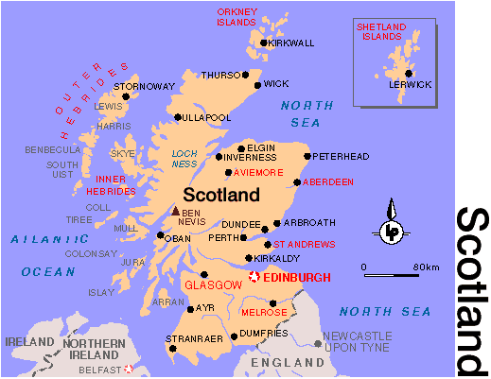
United Kingdom: Scotland

Slide 2
Scotland is a country, a part of the United Kingdom, a once-independent state. Occupies the northern part of Great Britain, in the south borders with England, the North Sea is flowing in the east, in the north and west, the Atlantic Ocean, in the southwest, the Northern Strait and the Irish Sea. In addition, Scotland is made up of about 790 islands

Slide 3
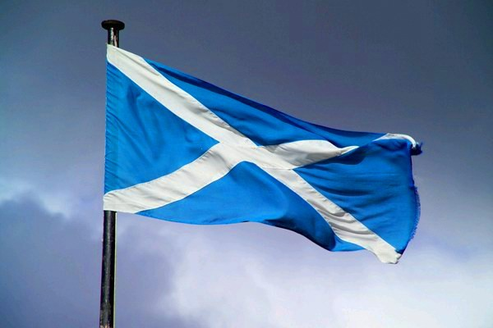
Flag of Scotland
The flag of Scotland is a blue cloth with a white, oblique cross. The Scottish flag is one of the oldest national flags in the world, its appearance, according to legends, dates back to 832, when the King of Scots Angus before the Anglo-Saxons battle saw a sign in the sky in the shape of an X-shaped cross on which Andrew was crucified First-born. The Scots in the battle won, and the image of the white cross in the sky-blue field became one of the symbols of Scotland

Slide 4
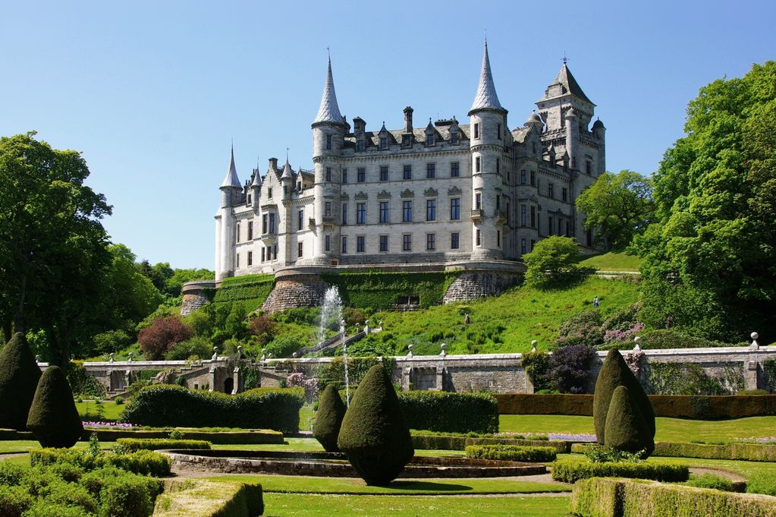
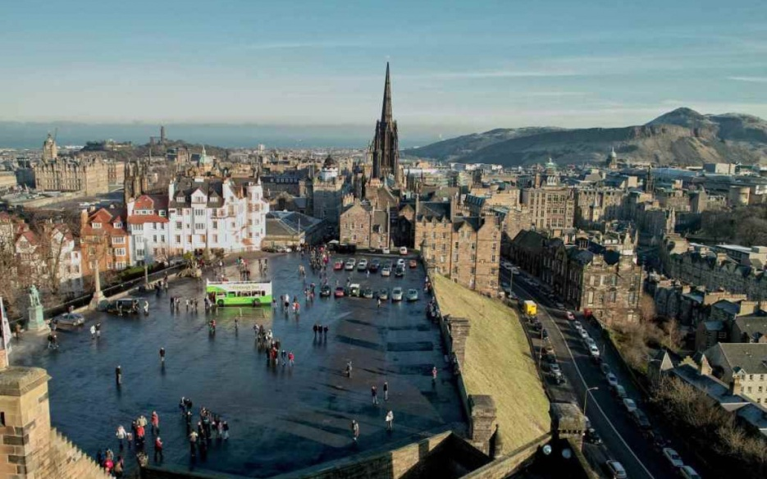
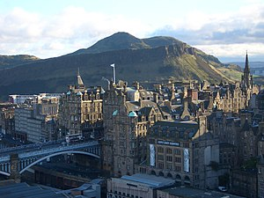
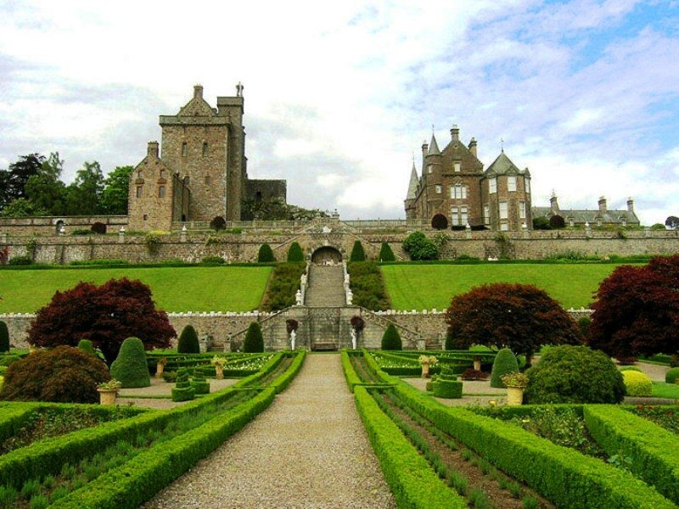
Edinburgh is the capital and the second largest city in Scotland
Located on the east coast of Scotland on the southern coast of the Bay of Firth-of-Forth.

Slide 5
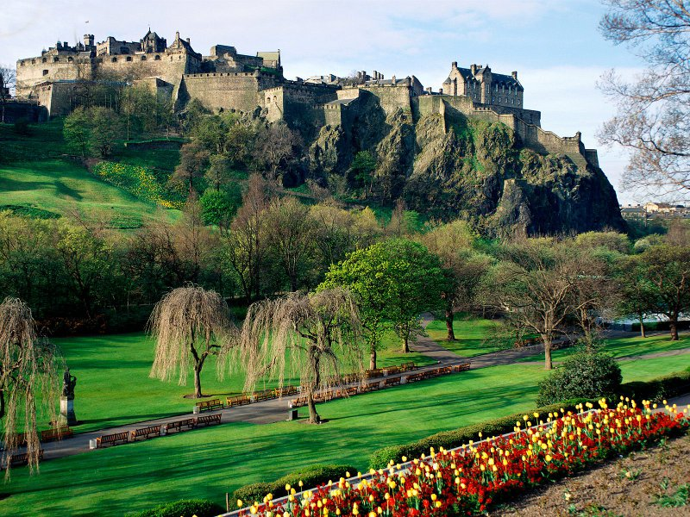
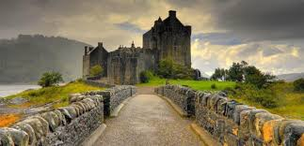
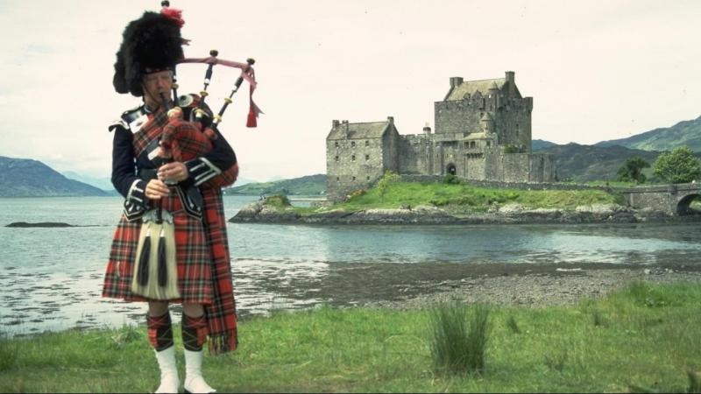
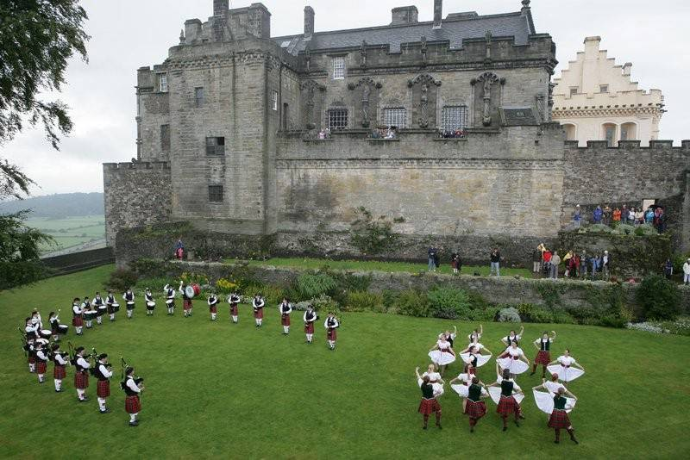
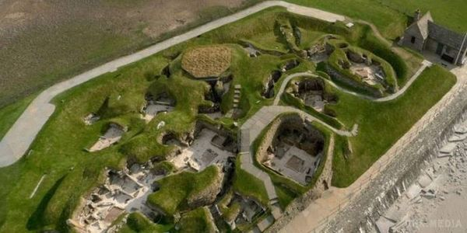

Slide 6
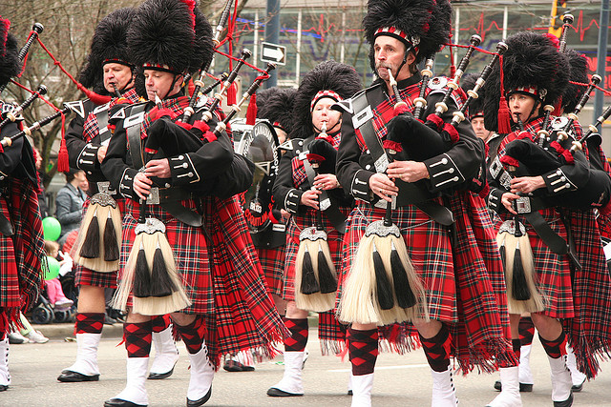
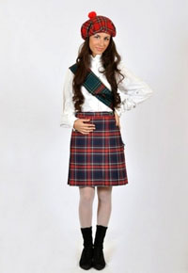
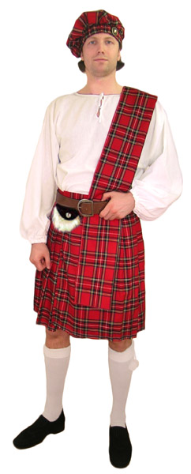
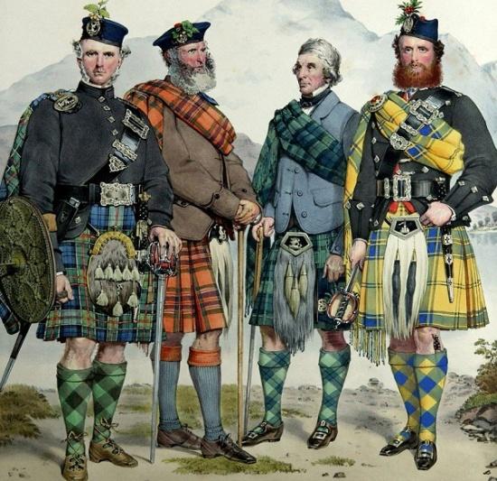
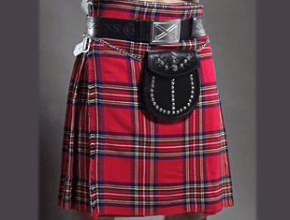
Kilt is the national Scottish men's skirt in the form of skirts, the traditional clothing of the Scottish Highlanders. Usually it is a piece of fabric folded together, wrapped around the waist and secured with buckles and straps; Traditionally, the kilt is worn with a special handbag for money and other small things called sporen

Slide 7
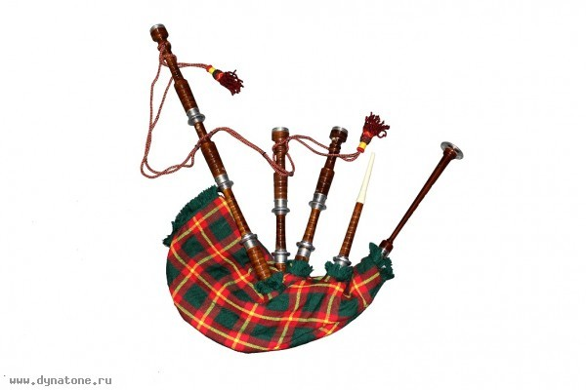
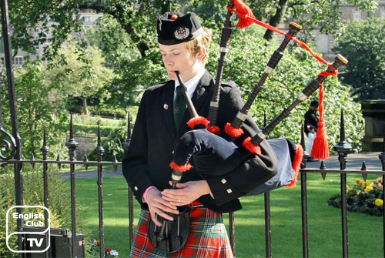
Bag pipe is an old folk musical instrument. Bag pipes consist of several tubes attached to the sack or bubble with air. One tube has game holes and it can perform simple melodies - other tubes during the game issue a continuous monotonous low sound on the tonic or the dominant from where and the expression went - pull a lobster. During the game, the singer keeps the fox under the armpit or in front of him, pushing on the sack

