Slide 1
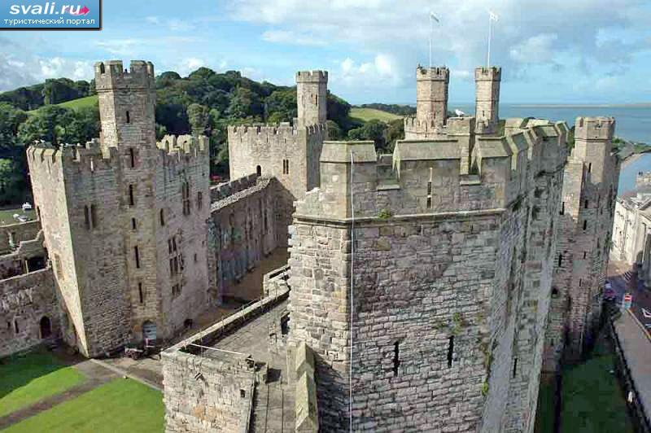
Wales
Wales is one of the four constituent parts of the United Kingdom. Located in the southwest of the island of Great Britain. The capital is the city of Cardiff. The inhabitants of Wales are Welsh. Wales is located in the southwest of Great Britain, in the east bounded by England, surrounded by the sea on three sides: in the south it is the Bristol canal (the mouth of the Severn River), in the south-west - the St George Strait, in the north and west - the Irish Sea, in the northeast - the mouth of the river DiWales has never been a sovereign state in modern frontiers. True, approximately from 1057 to 1063, Griffith and Llovelin owned almost all the lands that make up the present Wales. After the death of Griffith, this was not the case, and during the Norman conquest of Western Wales in 1282, the country was again divided between several kingdoms. In 1400, the descendant of two ancient royal families of Wales, Owen Glindour, led the uprising against the British and was proclaimed King of Wales, but completely lost support until 1410 and was forced to hide. Welsh laws were not completely superseded by English until 1542. Only in 1955, the Queen officially proclaimed Cardiff the capital of Wales (there was no such capital in the country), although the Prince of Wales usually passes an investor in the Welsh castle of Carnarvon. In 1997, the National Assembly of Wales, which has the right to amend the laws adopted by the British Parliament, was formed. In 2006, a second Welsh Management Act was adopted, which extended the authority of the National Assembly.

Slide 2
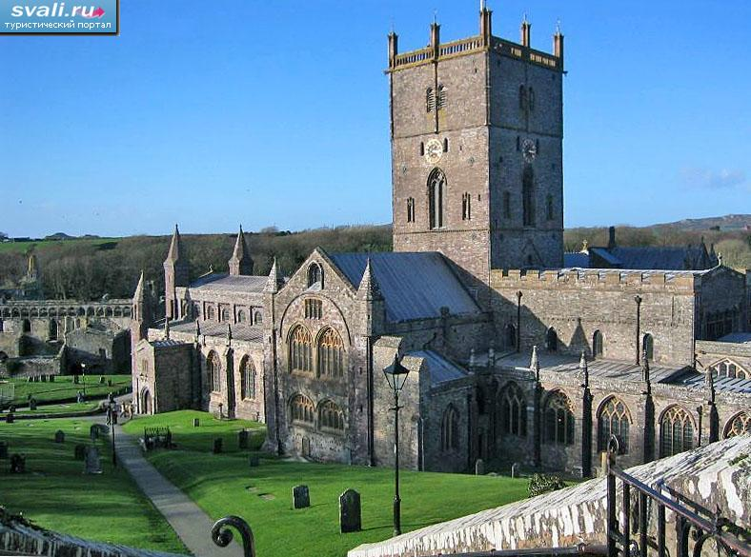
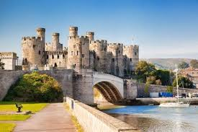
St. David's Cathedral, Wales, United Kingdom.
The famous Conway Castle in Wales, UK

Slide 3
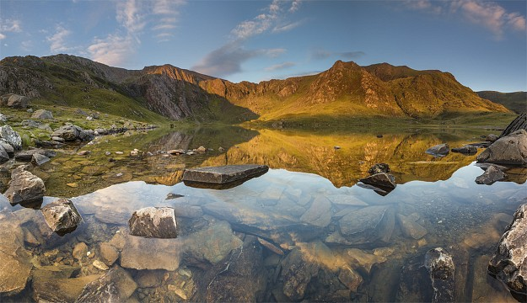
Climate or sunbathing is a long-term weather regime based on long-term meteorological observations, 25-50 year cycles, one of the main geographical characteristics of a particular area. The main features of the climate are caused by atmospheric pressure, speed and direction of the wind, temperature and humidity of the air, cloudiness and precipitation, duration of solar radiation, range of visibility, temperature of the upper layers of soil and reservoirs, evaporation of water from the earth's surface into the atmosphere, height and condition of snow cover, various atmospheric phenomena and terrestrial
hydrometeors (dew, ice, fog, thunderstorms, clouds, etc.). In the XX century, the number of climatic indicators introduced the characteristics of elements of the thermal balance of the earth's surface - the total solar radiation, the radiation balance of the heat transfer between the earth's surface and the atmosphere, the cost of heat for evaporation. The geographic factors influencing the climate of a particular region are the most significant: the latitude and elevation of the terrain, altitude, proximity to the seacoast, the impact of ocean currents, peculiarities of vegetation, the presence of snow and ice, degree of pollution of the atmosphere (greenhouse effect, destruction of ozone layer) that forms local climate options

Slide 4
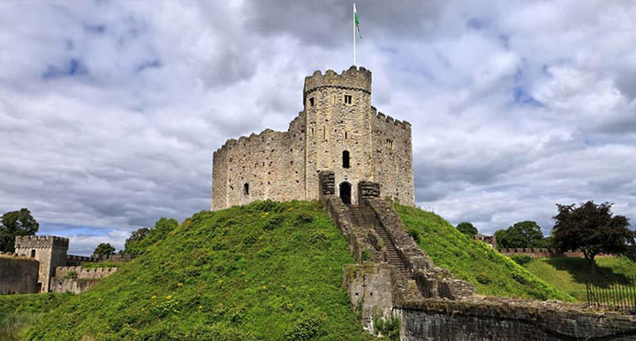
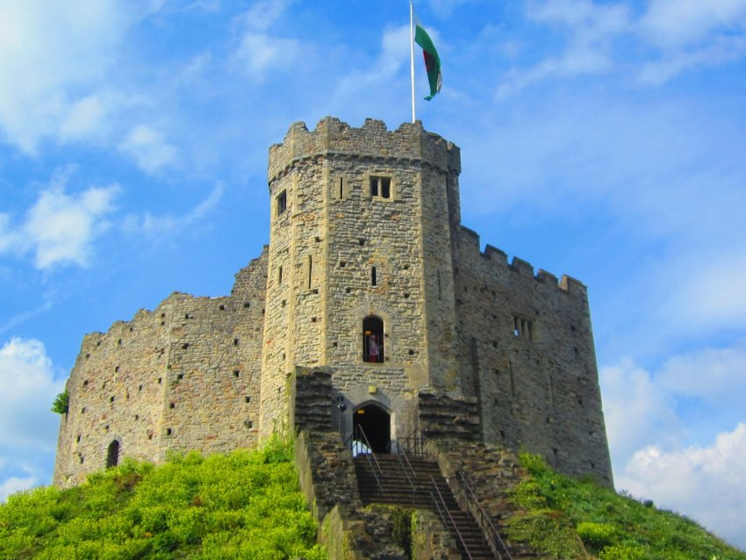
Wales is one of the four administrative-political parts of the United Kingdom of Great Britain. In addition to Wales, Britain also includes England, Scotland and Northern Ireland. Everyone has heard that Prince Charles is called the Prince of Wales, which is very symbolic. The history of the region is quite saturated with intriguing and confusing events.

Slide 5
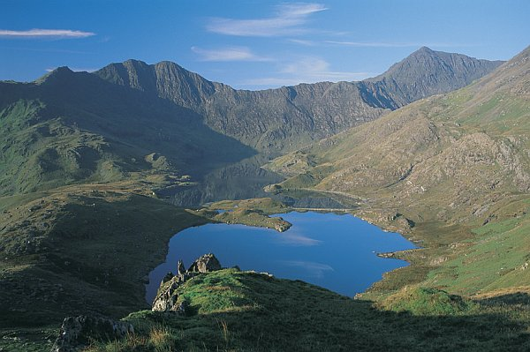
Geographical position - geospatial relation of a certain object to the external environment, the elements of which have or may have a significant effect on it. Consequently, the geographical position is the "targeting" of a geographic object, its characteristic, which shows connections with the environment. At the same time, the entire diversity of geographical objects varies by species and scale, and geospatial relations are formed on the micro, meso- and macro levels of a particular country or region. Objects can be settlements, economic districts, countries, natural territorial complexes, etc.
The microposition is determined by the local environment in the place of direct contact with other geographical objects, mesopulation - relations in the region or country, macroposition - relations with significant areas of the geographical environment or geosystem as a whole. In this case, in the hierarchy of geospatial relations, there is a certain threshold - the boundary of the territory of a sovereign state. Beyond the state, the count of the micro-, meso- and macro levels, of course, goes only with respect to the scales of the whole world system.

Slide 6


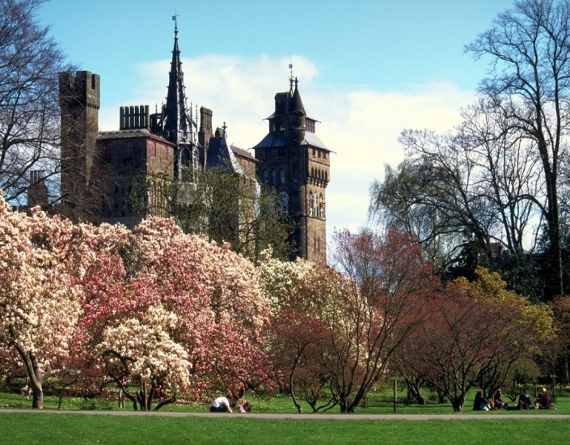
Cathay National Park
Park Roth
Tours to Wales

Slide 7
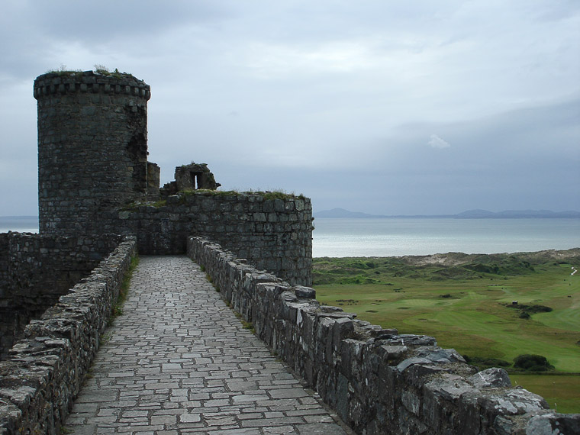
Wales Castle Harlech

Slide 8
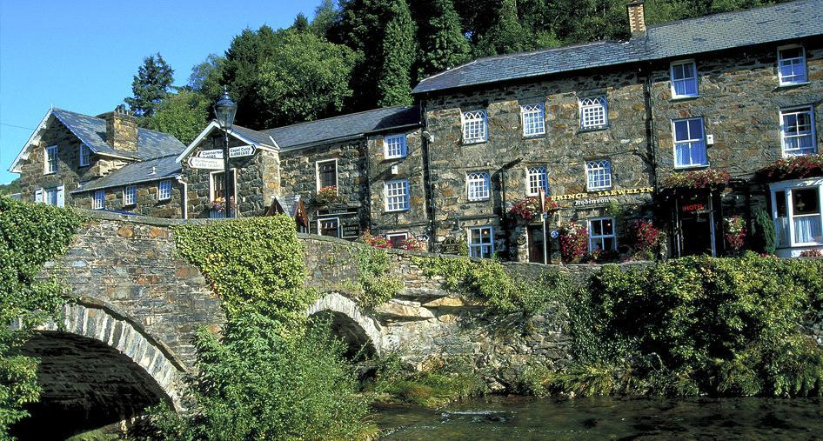
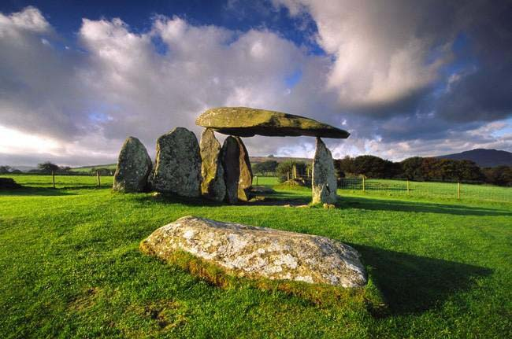
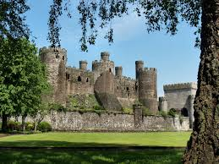

Slide 9
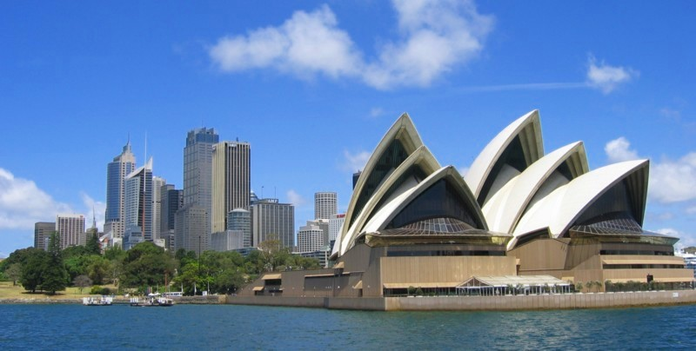
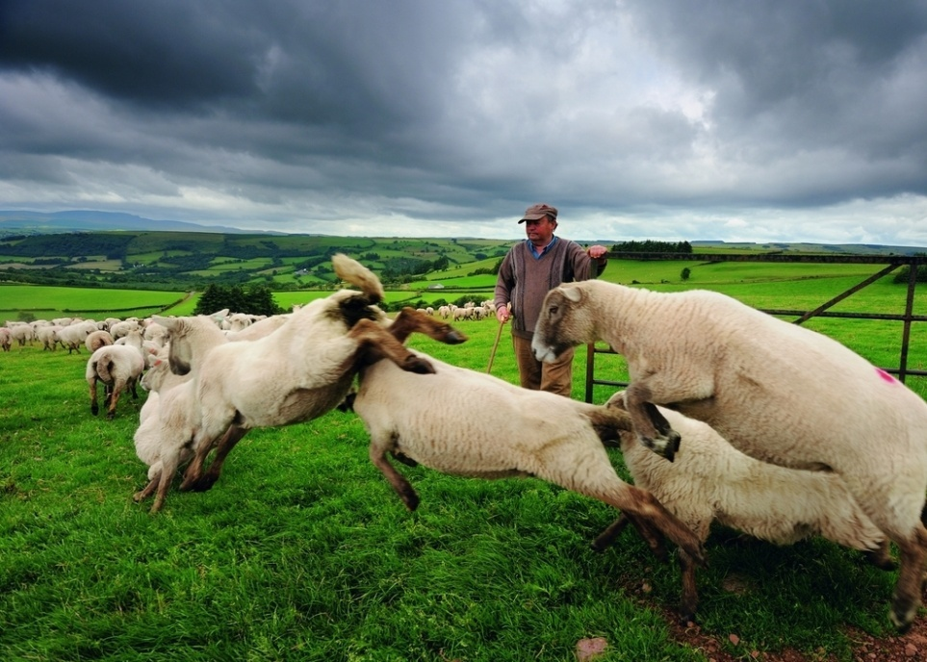
New South Wales
It's said that sheep in Wales are more than humans and it seems that this is true

Slide 10
