Slide 1

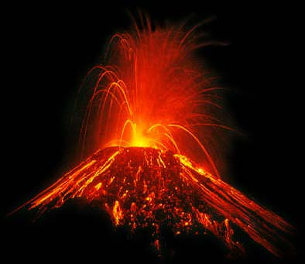
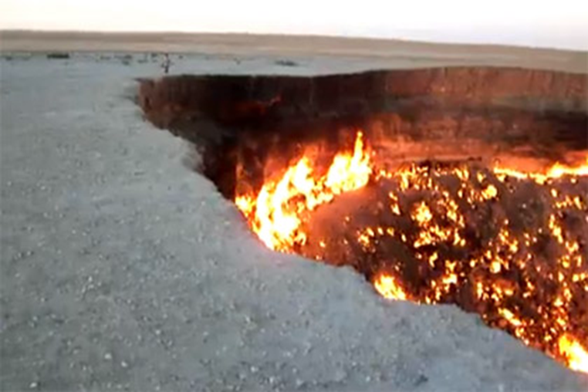
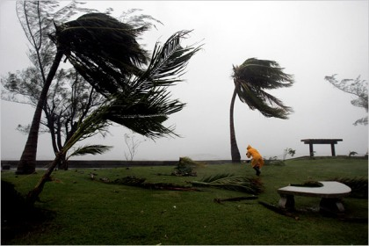
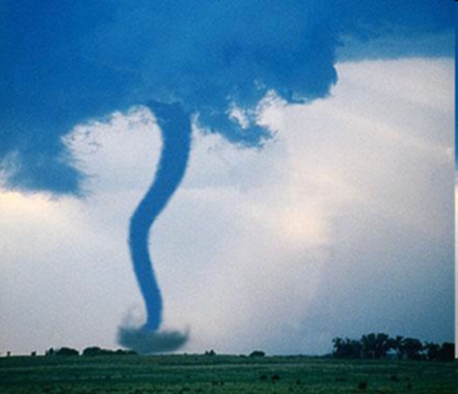
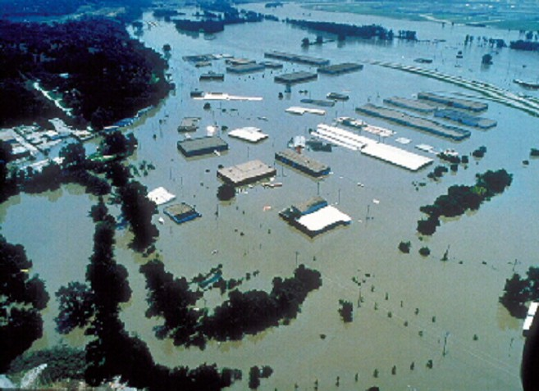
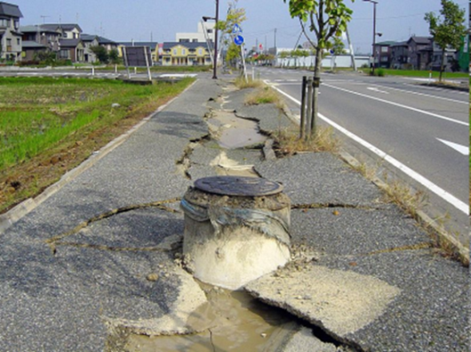

Slide 2
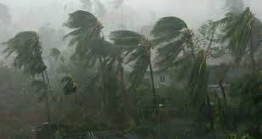
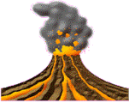
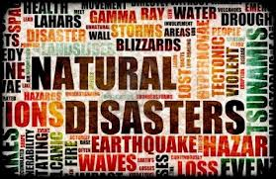
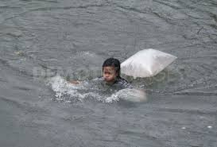
The topic of our lesson:
NATURAL DISASTERS

Slide 3
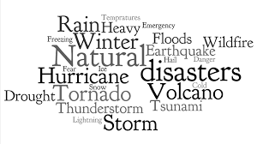
The aims of the lesson
talk about natural disasters
Learn the names of some natural disasters
learn some new verbs: “destroy”, “injure”, “damage”
Write a news report about some of the dangerous natural disaster: tornado

Slide 4
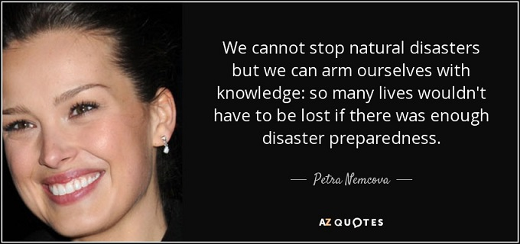

Slide 5
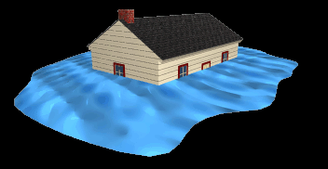
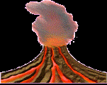
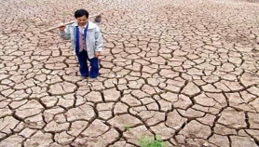
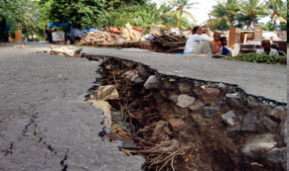

Read the sentences and substitute the picture with the suitable words
Yesterday, a terrible hit the rural area.
Families rushed away after the erupted.
A severe ruined the crops.
Hundreds of houses were destroyed
when the shook the city.
There are a lot of in the USA every year

Slide 6


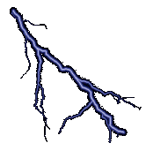
Natural disasters: what to do
Listen to the radio news
Remain calm Don’t panic
Take all necessary things (documents, money, photos) out of the house
Take some food and drinking water
Prepare some candles and a flashlight
Turn off gas and electricity
Turn off water
Close doors and windows
Don’t go to the balcony
Don’t run

Slide 7
What have you learnt from this lesson?
Are the natural disasters dangerous for our world?
Can they destroy our world?
Is there anything you can do about natural disasters?

Slide 8



How do you fell about the lesson

Slide 9
Hometask
Create a mini-project about natural disasters which happened in our region. Don’t forget about safety measures.

Slide 10
Thanks for the lesson!

Slide 11
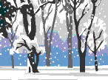
What do you think?
Can natural disasters ever be a good thing?
Why do you think there are so many movies about natural disasters?
Have you ever experienced the earthquake?
Do you know any countries where the earthquake can occur?
Can people protect the world from the earthquake?

