Slide 1
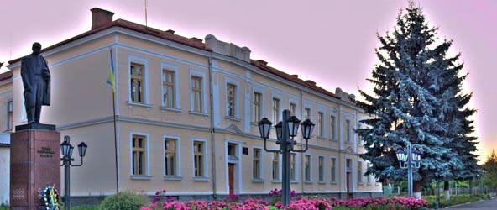
Навчально-виховний комплекс
“Загальноосвітня школа І-ІІІ ст.№1-гімназія” м.Копичинці
Сприяння розвитку життєвих компетентностей та вмінь учнів
Нової української школи у світі,
що швидко змінюється
вч. Танькова О.М.

Slide 2

This is a story about … whether an entire generation of kids will fail to make the grade in the global economy because they can’t think their way through abstract problems, work in teams, distinguish good information from bad, or speak a language other than [their own].”
How to Build a Student for the 21st Century, TIME Magazine, December 18, 2006

Slide 3
Життєві компетентності це …
A competence that allows us to:
manage a challenging situation
deal with a problem
negotiate a favourable outcome in
order to move on

Slide 4
Life skills touch upon issues that are:
real: they actually affect people’s lives
topical
sometimes sensitive: they can affect people on a personal level, especially when family or friends are involved
often controversial: people disagree and hold strong opinions about them
ultimately moral: they relate to what people think is right or wrong, good or bad, important or unimportant in society.

Slide 5
Важливість життєвих компетентностей
Democracies depend upon citizens who, among other things, are:
aware of their rights and responsibilities as citizens
informed about social and political issues
concerned about the welfare of others
able to clearly articulate their opinions and arguments
capable of having an influence on the world
active in their communities
responsible in how they act as citizens.

Slide 6
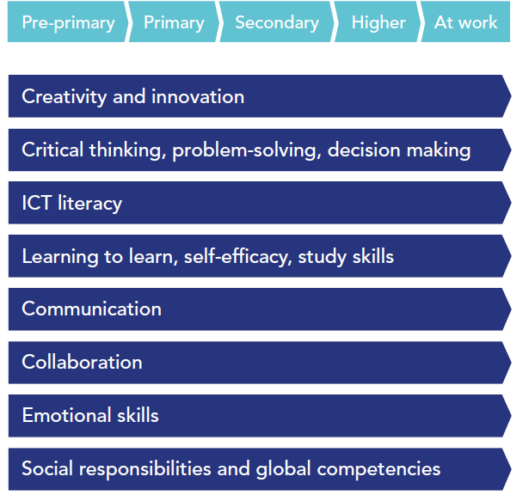
Етапи навчання

Slide 7

Ключові компетентності:
critical thinking and problem solving
creativity and imagination
collaboration and communication
digital literacy
citizenship
student leadership and personal
development

Slide 8
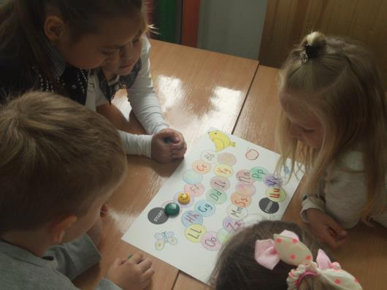
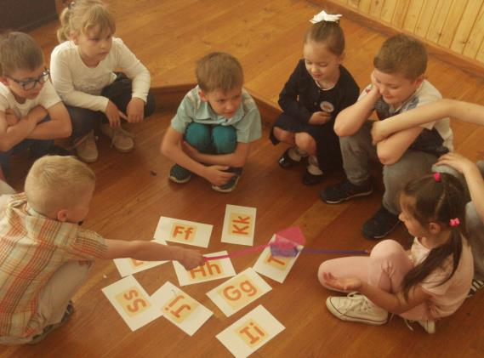
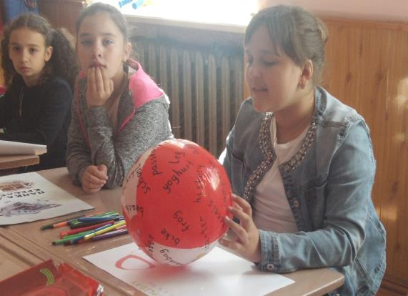
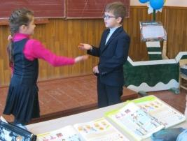

Slide 9
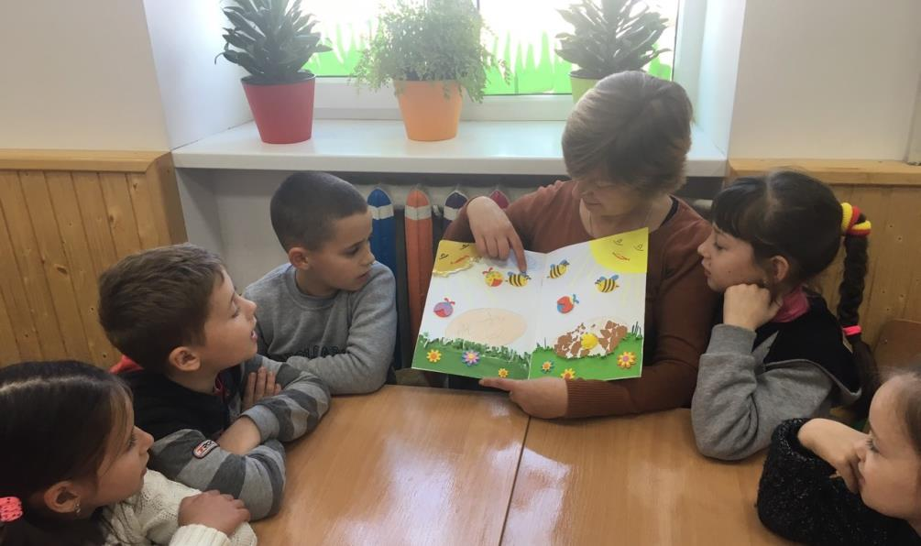
Критичне мислення
Model 1: Language and the development of
cognitive tools (Egan)
Story thinking

Slide 10
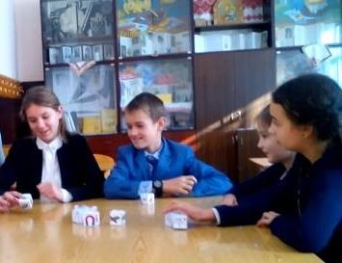
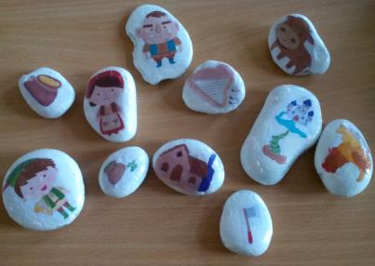
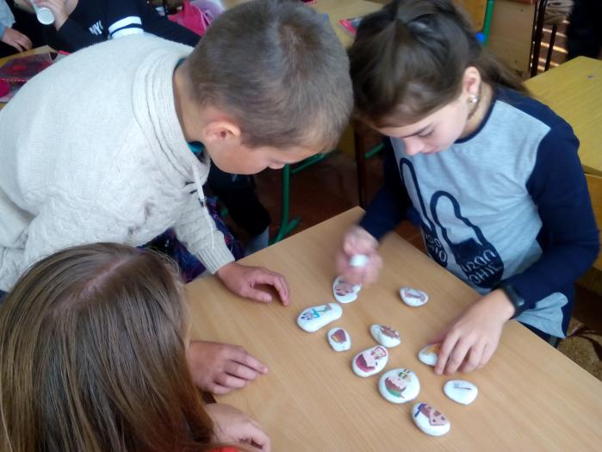
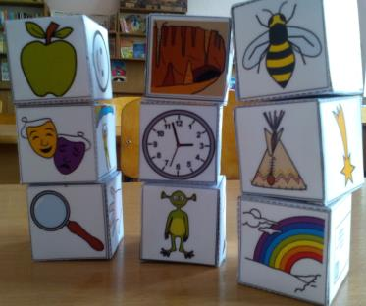
Story stones
Story cubes

Slide 11
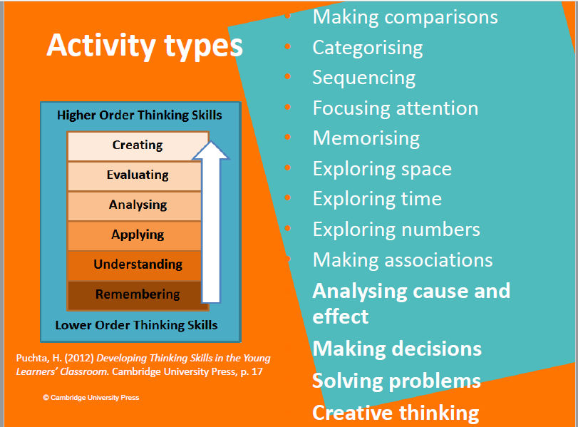
Model 2: Combining the teaching of thinking with language teaching (Puchta)

Slide 12
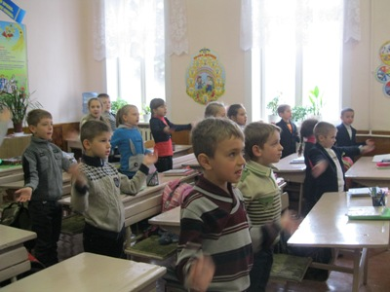
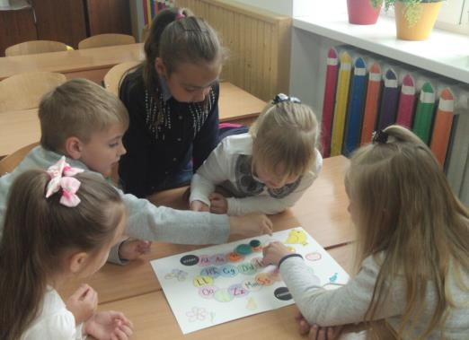
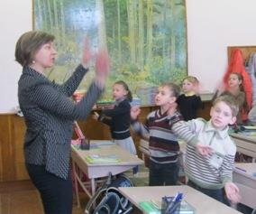
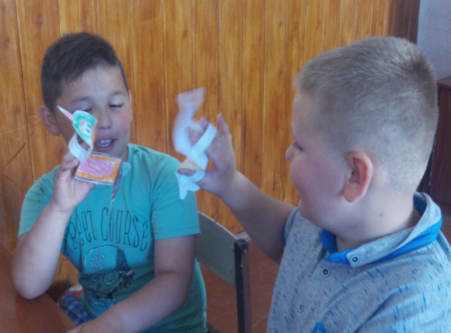
Rhythm and rhyme
Images and imaginative thinking

Slide 13

Креативність та уява
Don’t feel you have to have
climbed Mount Everest in
order to have
a story to share!
Losing your house keys,
having a snake come into
your house, having a
bad dream and
worrying about your
grandmother
are perfect subjects
ANDREW WRIGHT

Slide 14
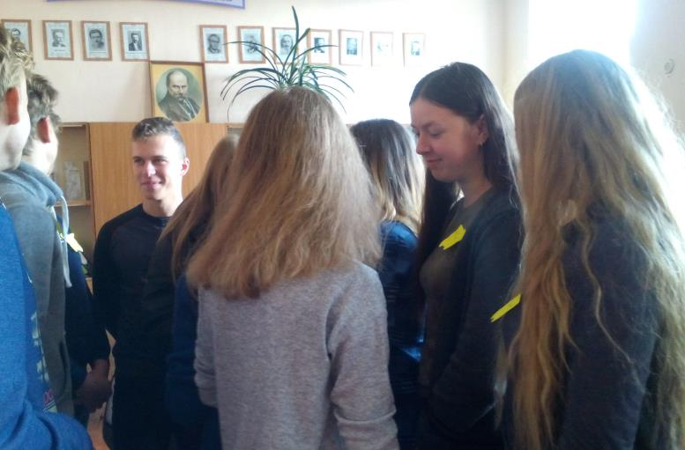
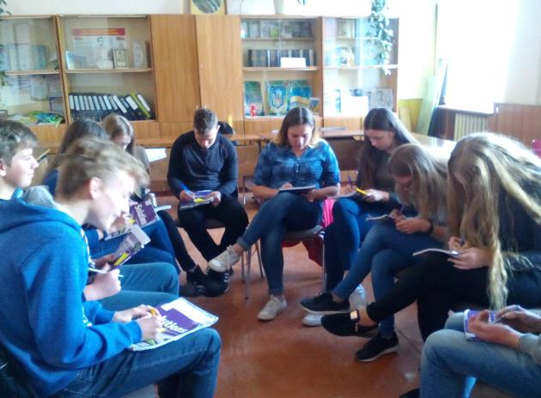
Завдання для розвитку креативності
ON MAKING COURSE BOOK DIALOGUES MORE CREATIVE
ON TELLING LIES
ON BEING AN OBJECT
ON MUSIC AND IMAGES
OBJECTS IN A FIRE

Slide 15
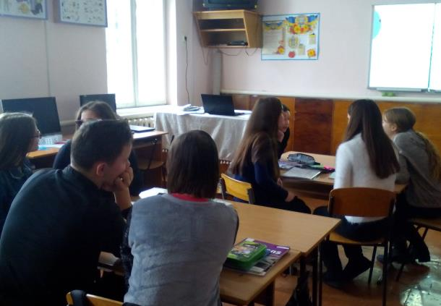
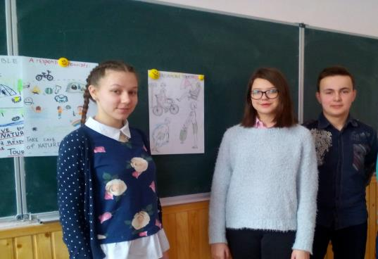
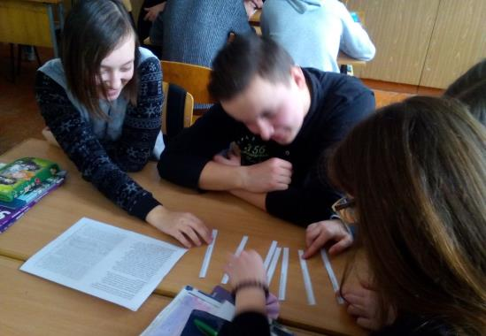
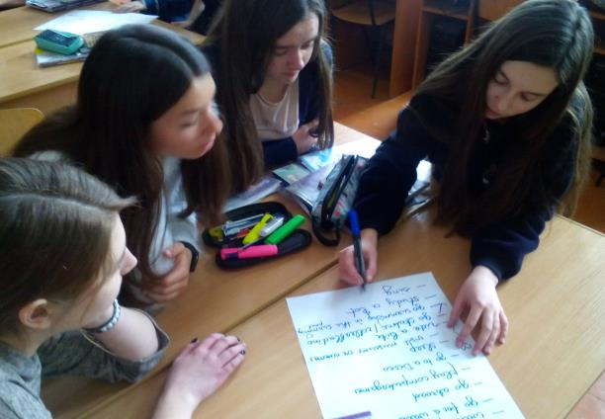
TBL LESSON “A RESPONSIBLE TOURIST”

Slide 16
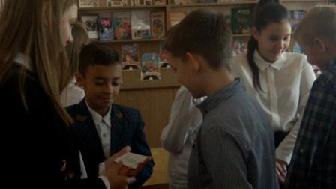
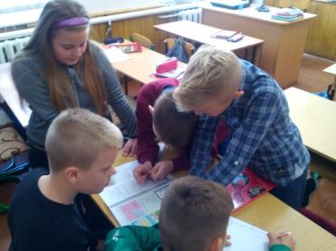
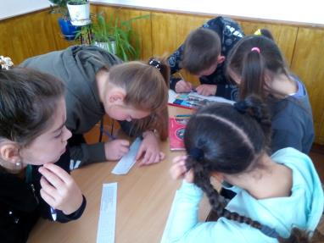
Співпраця та спілкування
Співпраця та спілкування
Establish group goals
Keep groups mid-sized
Build trust and promote open communication
For larger tasks, create group roles
Group interaction strategies
Ten collaborative learning tips
The jigsaw technique
Scaffolding
Snowballing
Real-world problems
Six thinking hats
Technology makes collaborative learning easier
Enhancing problem-solving and critical thinking skills
Gender balance of your groups

Slide 17
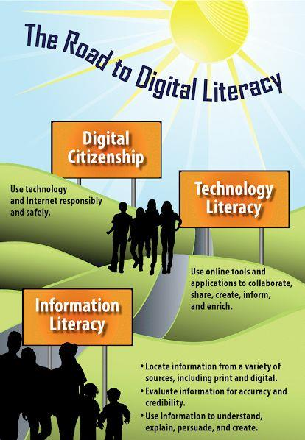
Цифрова грамотність

Slide 18
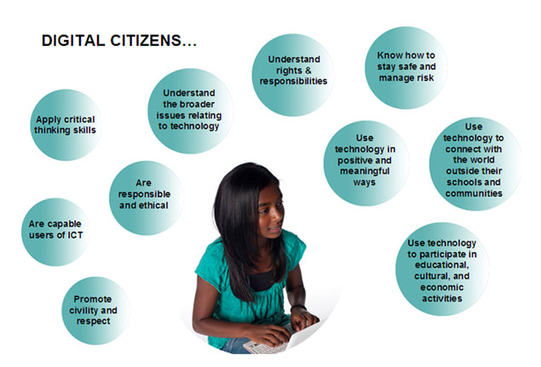

Slide 19
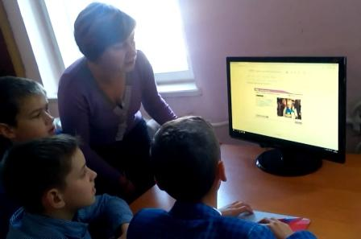
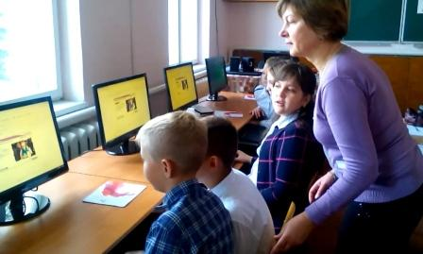

Slide 20
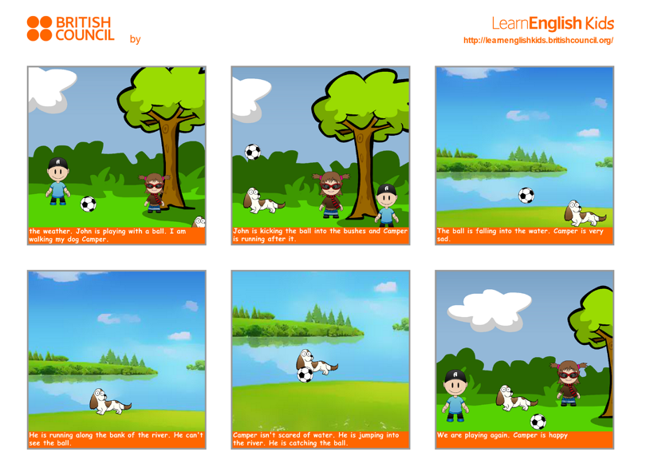

Slide 21


Slide 22
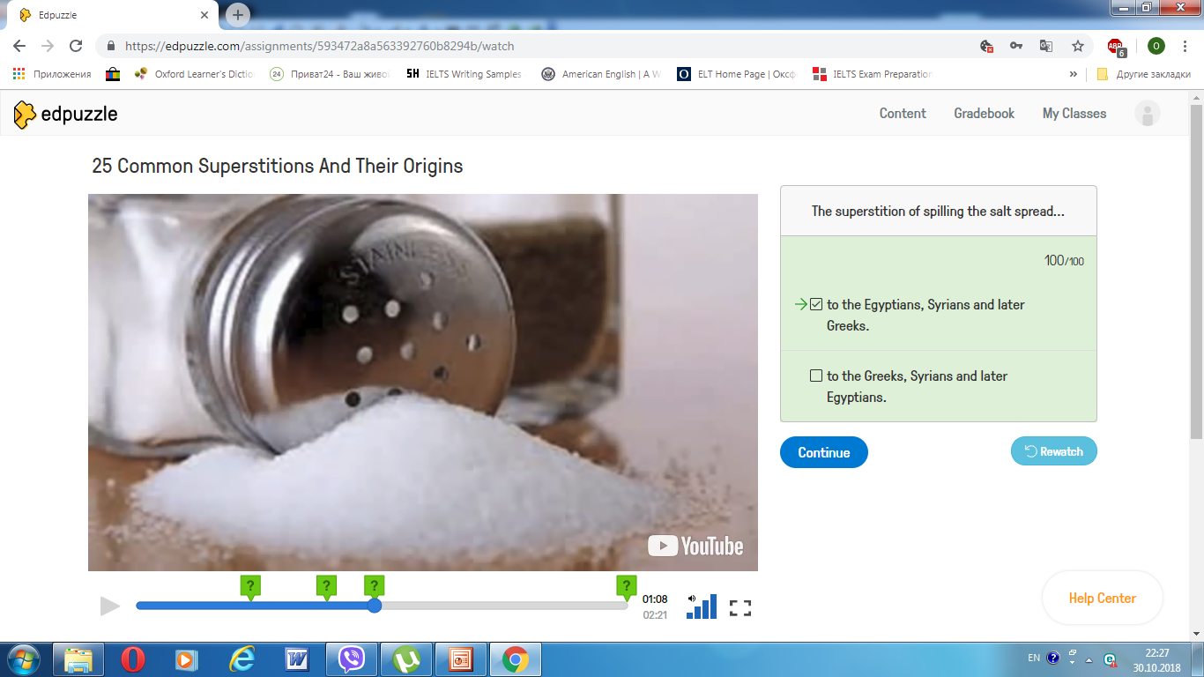

Slide 23
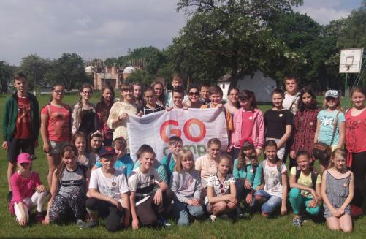
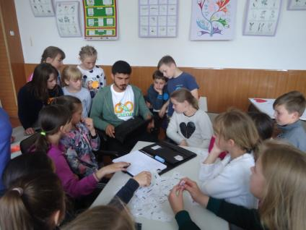

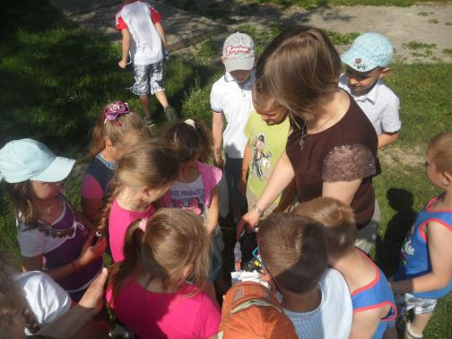
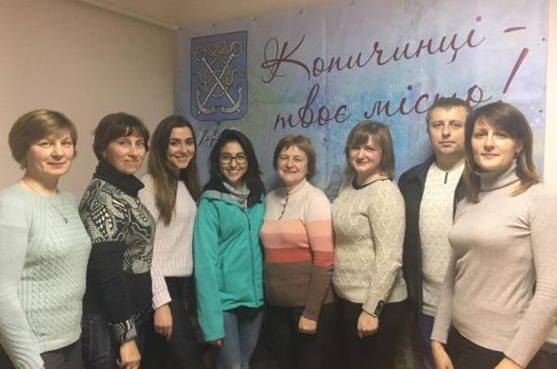
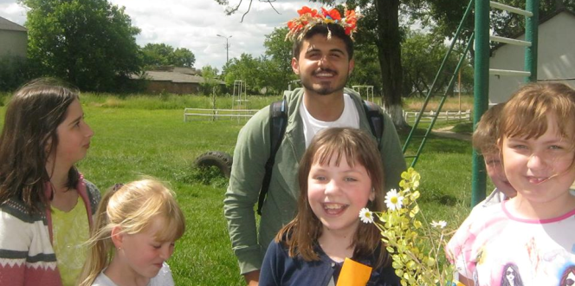
EXTRA-CURRICULAR ACTIVITIES

Slide 24
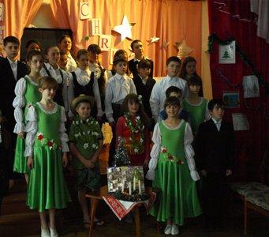
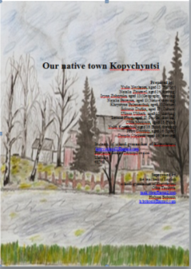
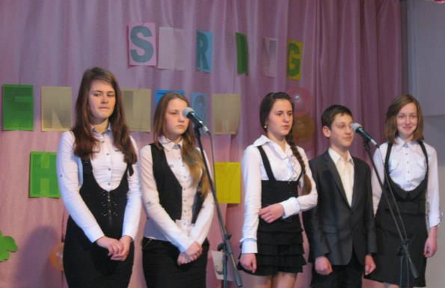
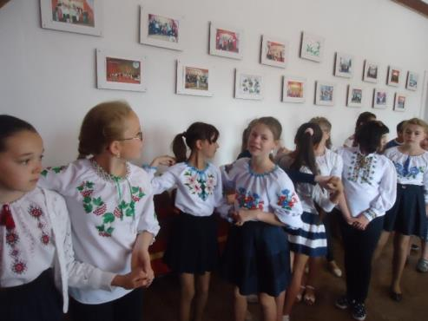
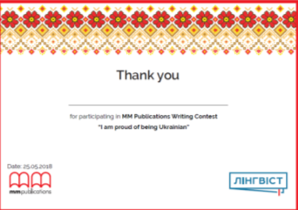
Cultural Reader Contest
FLEX
My Motherland: the place I love the most.
Learn the languages –
learn the world

Slide 25
LITERATURE
1. Creativity in the English language classroom./ Maley, Alan and Nic Peachey.
The British Council, 2010
2. . Developing Thinking Skills in the Young Learners’ Classroom/ Puchta, Herbert.
Cambridge: Cambridge University Press, 2012
3. Developing Thinking Skills at an early age/ Raczkowski, Andrzej
4.The Cambridge Framework for Life Competencies in Education, Cambridge:
Cambridge University Press, 2012
21stCentury Skills: How can you prepare students for the new Global Economy? /
Fadel Charles, Global Lead, Education Cisco Systems, Inc., Paris, 2008

