Slide 1
Making your house green

Slide 2
bother [ˈbɒðə] – турбуватися, хвилюватися;
separate [ˈsɛprɪt] ─ сортувати, відокремлювати;
rubbish bin [ˈrʌbɪʃ bɪn ] – смітник;
litter [ˈlɪtə] – сміття;
wherever [weərˈɛvə] – будь-де;
keep up [kiːp ʌp ] – підтримувати;
pale [peɪl] – блідий.

Slide 3
Quiz answers
Mostly a’s – Well done! You are doing everything you can to help our planet. Keep up the good work, you are dark green.
Mostly b’s – You know about the problems concerning our environment. There are still some more things that you could do though. You’re mid green.
Mostly c’s – There is a lot more you could do to help the environment. Every little bit can help make our planet a better place for everyone. You are pale green.

Slide 4
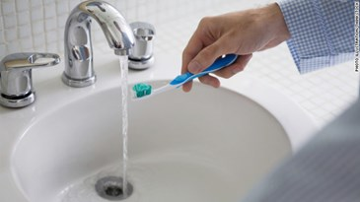
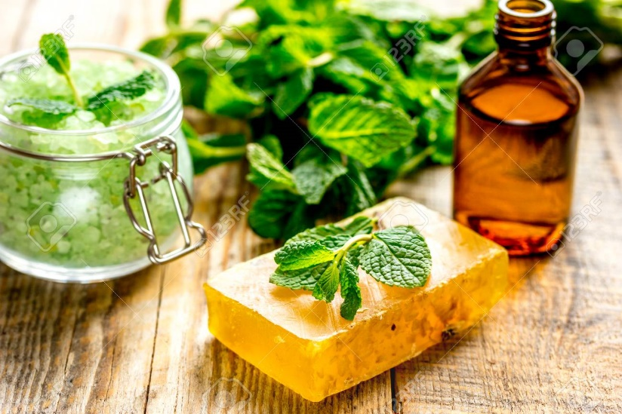
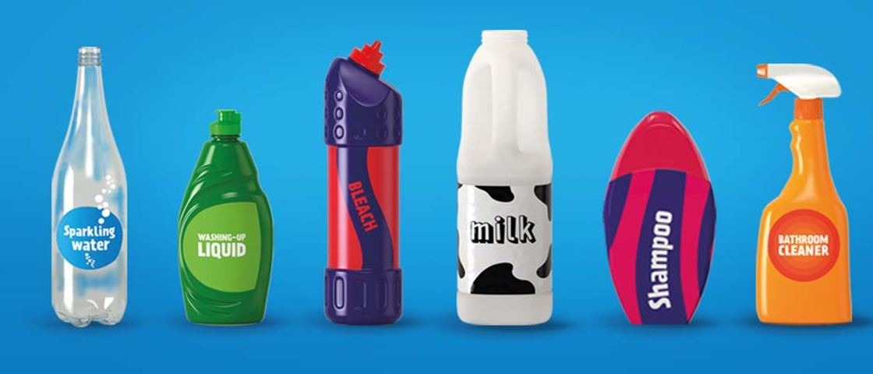
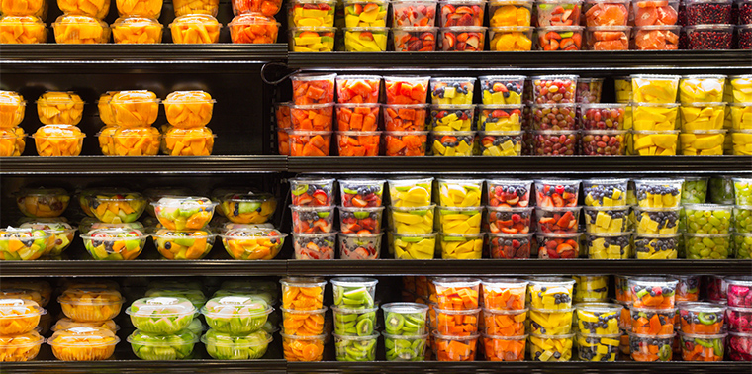
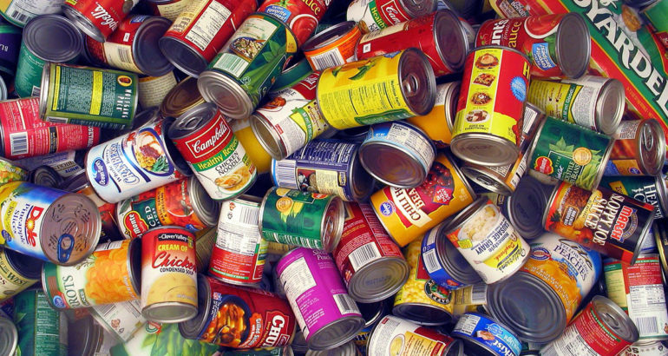
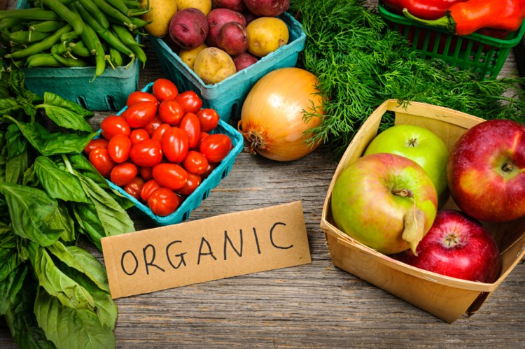


Slide 5
Answers to exercise 7a
a F
b F
c T
d T
e T
f F

Slide 6
Answers to exercise 7b
1 B
2 C
3 A
4 F
5 D
6 E

Slide 7
Your programme has finished...
turn the TV off properly.
2. You are the last person to leave the room...
turn the lights off.
3. You finish listening to your music...
turn the radio off.
4. Someone makes a cup of tea...
tell them just to boil the amount of water they need.
5. It’s getting dark outside...
remember to draw the curtains.

Slide 8
Fill the gaps with one word
Lights, unplug, open, computer, showers, video, off, windows

Slide 9
1. Turn off your video games when you’re done playing.
2. Keep windows closed when the heat or air conditioning is on.
3. Unplug your cell phone charger when you’re not using it.
4. Take short showers instead of baths.
5. Decide what to eat before you open the refrigerator door and let cold air escape.
6. Always turn off the lights when you leave a room.
7. Turn off your computer when you’re done using it.
8. Turn off the TV when you’re done watching it.

Slide 10
Be eco-friendly and save the planet!
Thank you!

