Slide 1
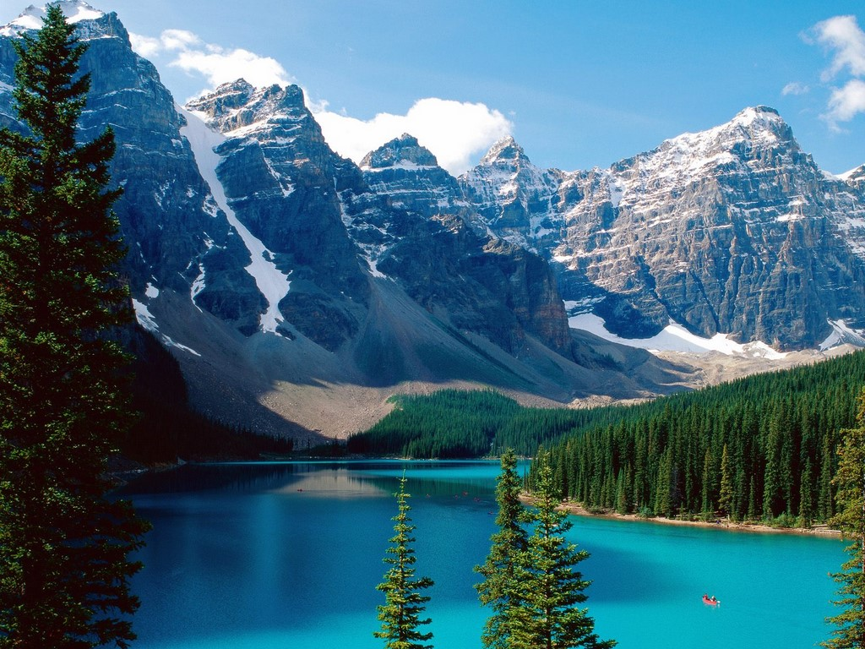
Welcome to Canada

Slide 2
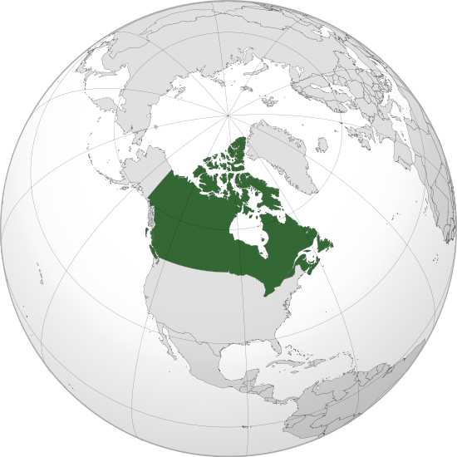
Canada is the second largest country in the world. It is situated to the north of the United States of America. It is a very large country, larger then the USA. Its territory is about ten million square kilometres.
In Canada many people speak English because they also came from England
many years ago.

Slide 3
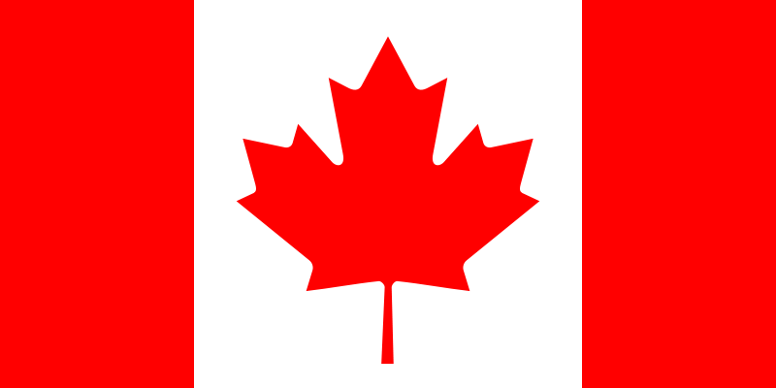
The flag of Canada

Slide 4
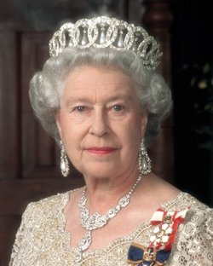
Now Canada is an independent country. But the British Queen is still the head of the state.

Slide 5
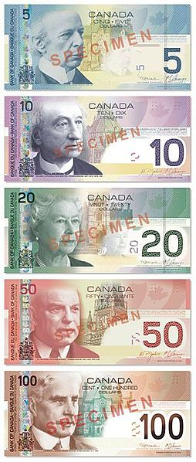
The Canadian Dollar is the official currency of Canada.

Slide 6
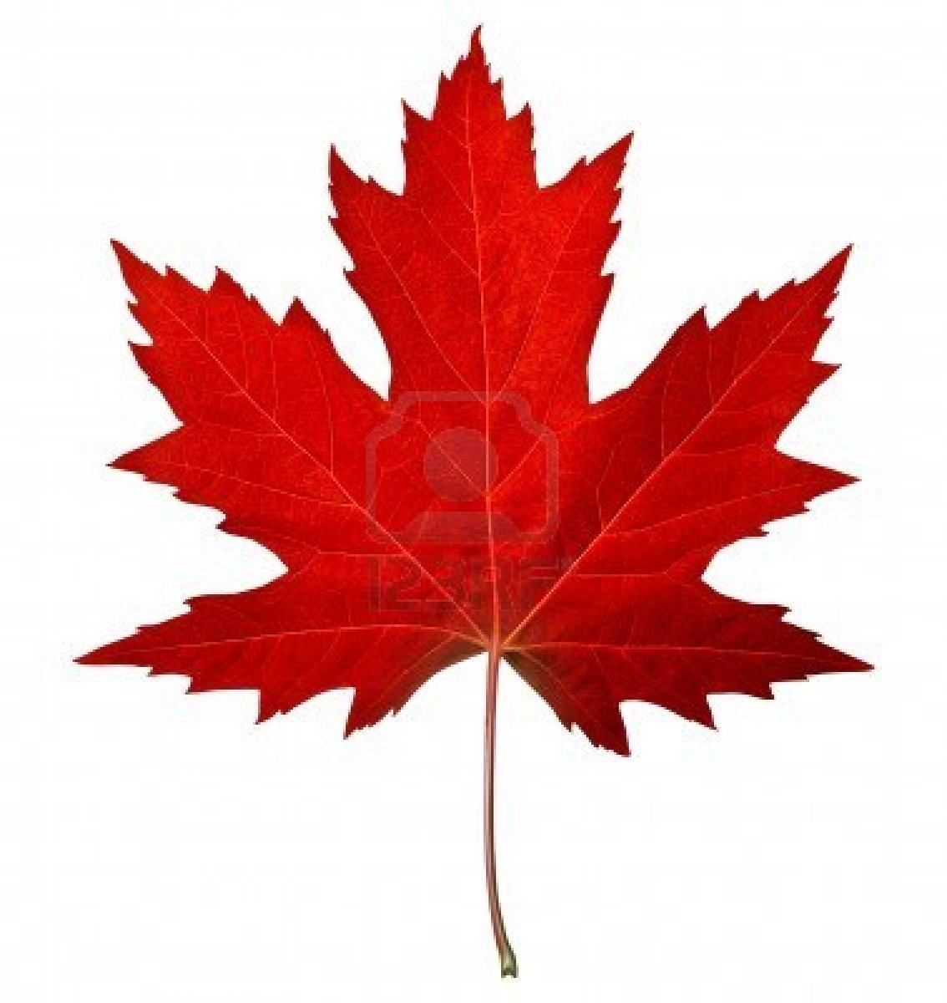
The symbol of Canada is a maple leaf.

Slide 7
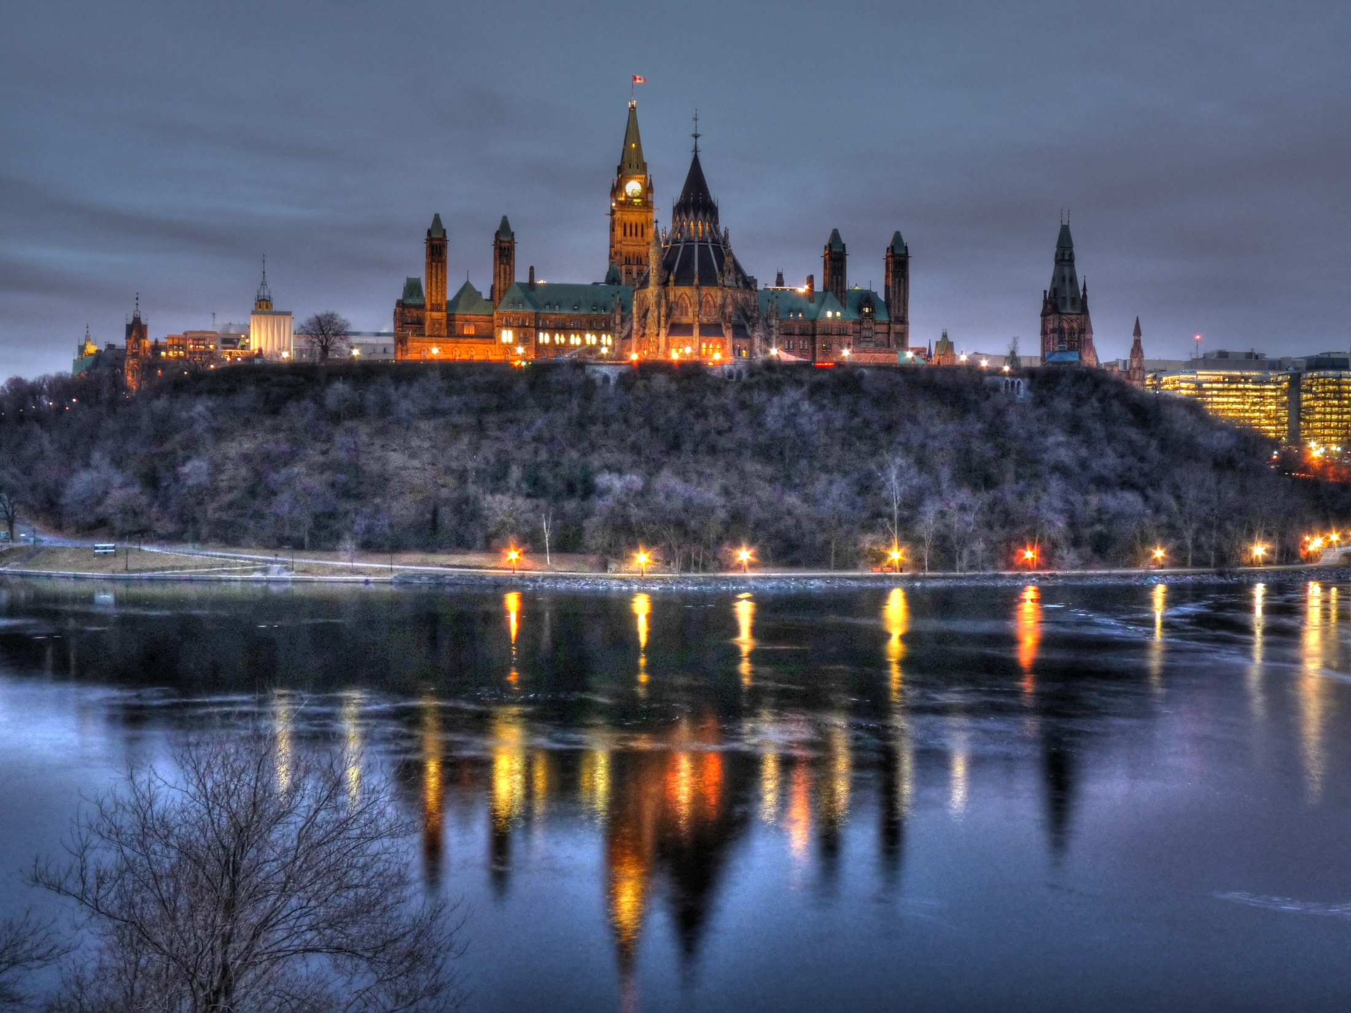
The capital of Canada is Ottawa

Slide 8
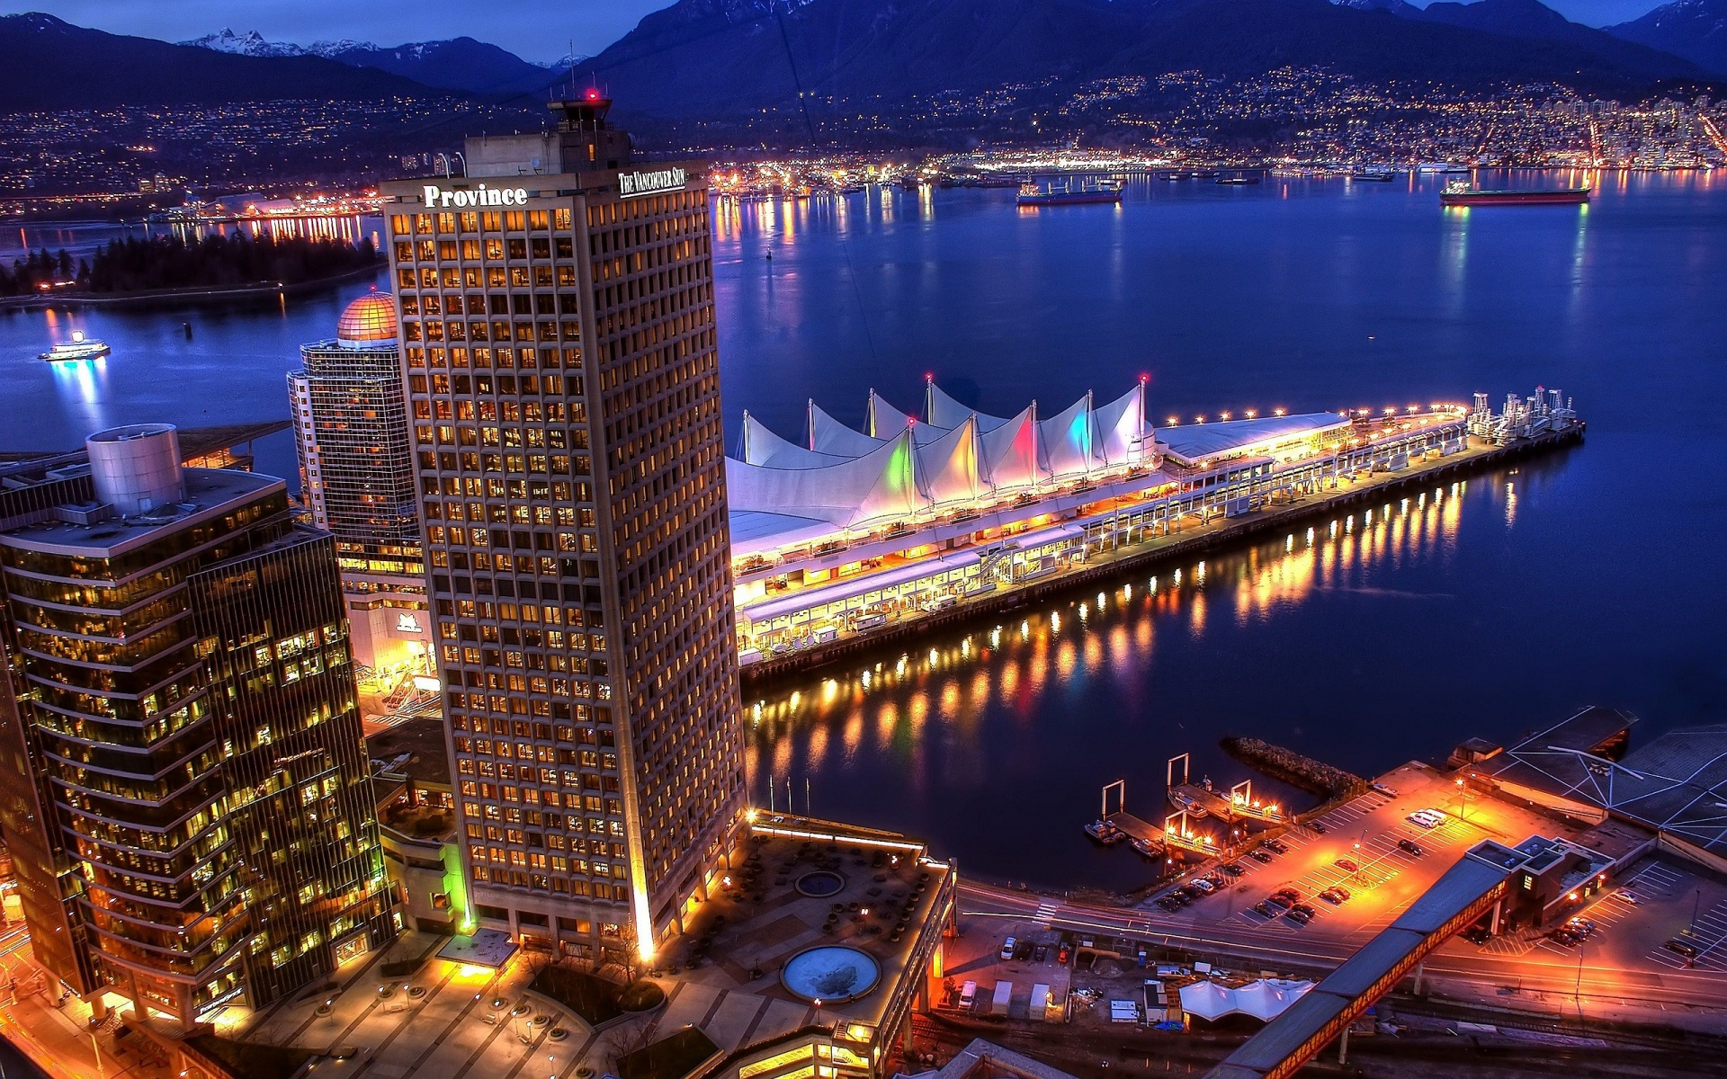
Vancouver

Slide 9
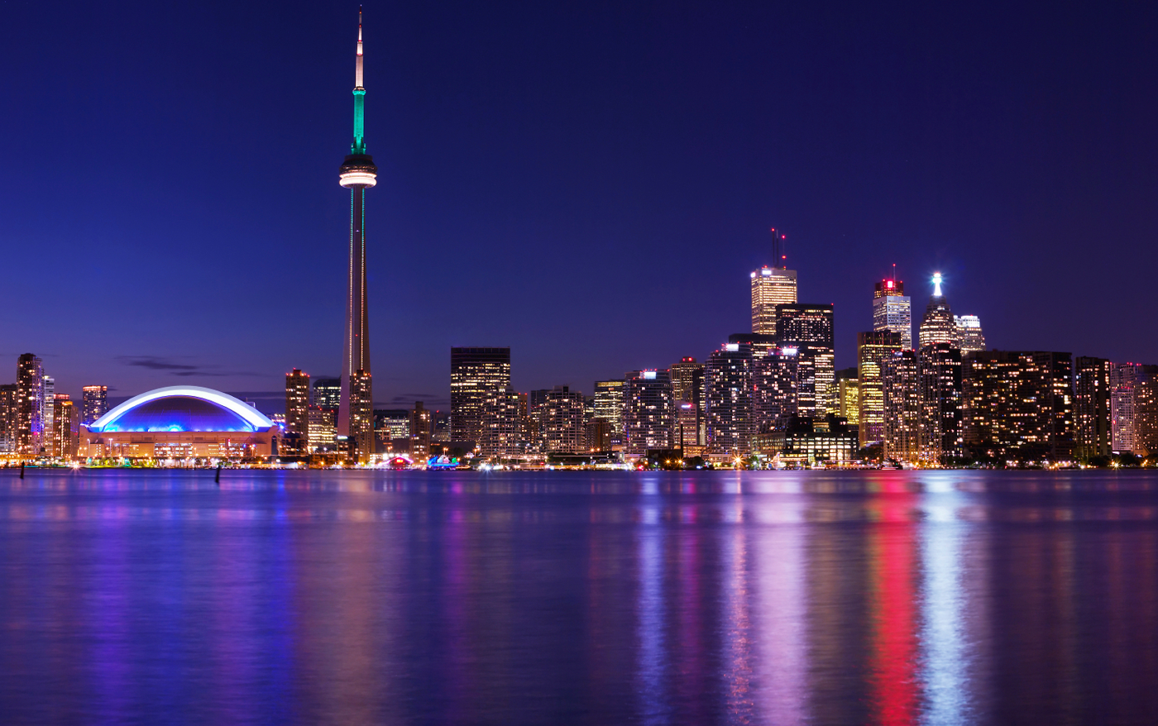
Toronto

Slide 10
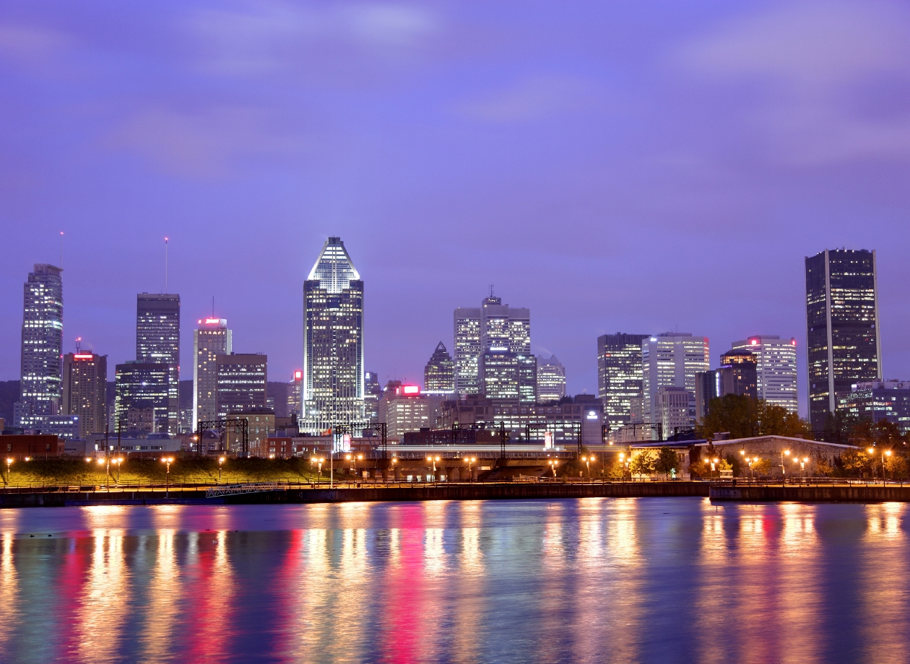
Montreal

Slide 11
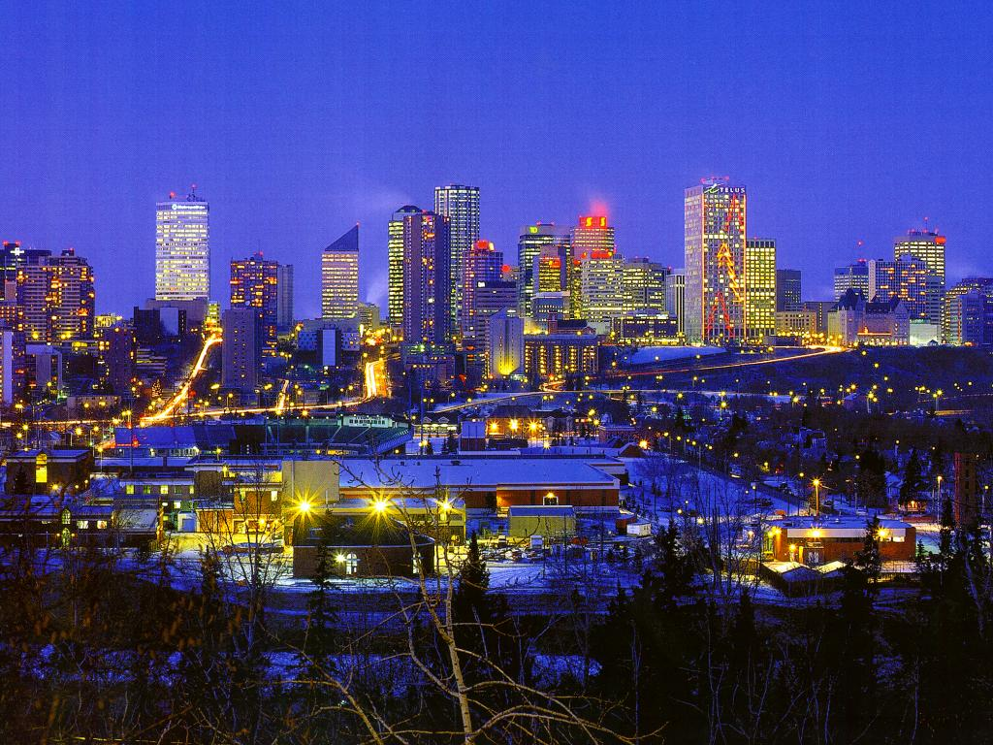
Edmonton

Slide 12
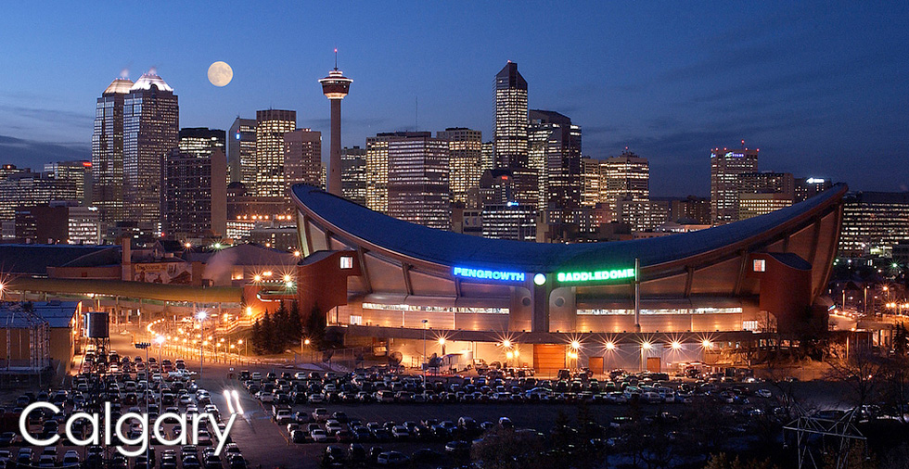
Calgary

Slide 13
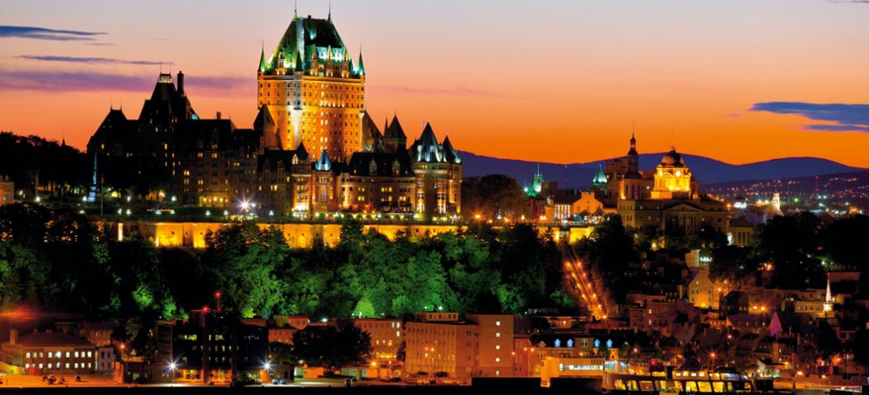
Quebec

Slide 14
Places of interest in Canada

Slide 15
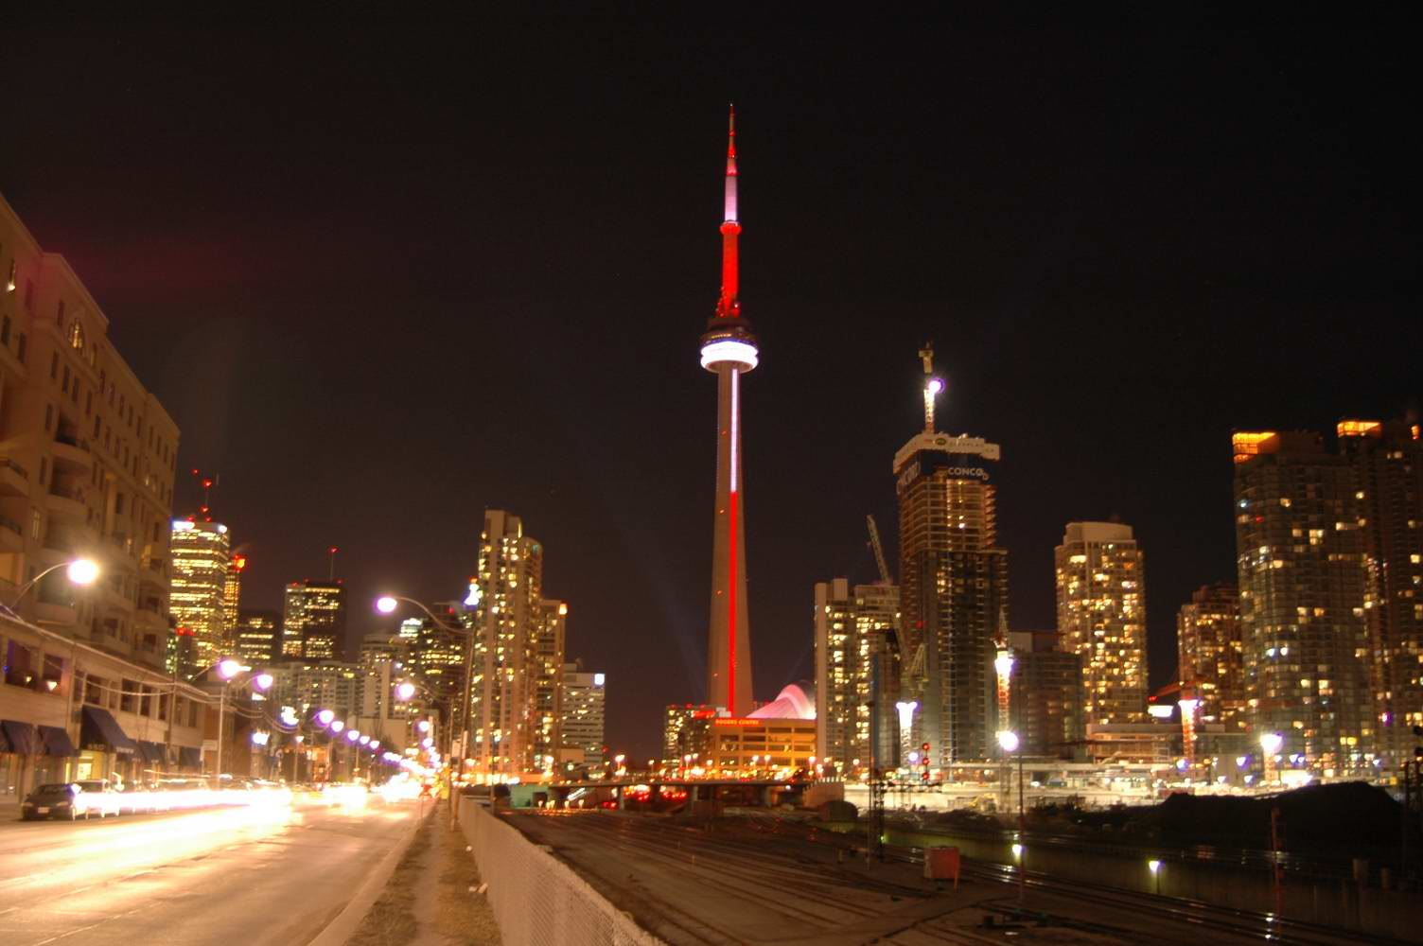
CN Tower in Toronto

Slide 16
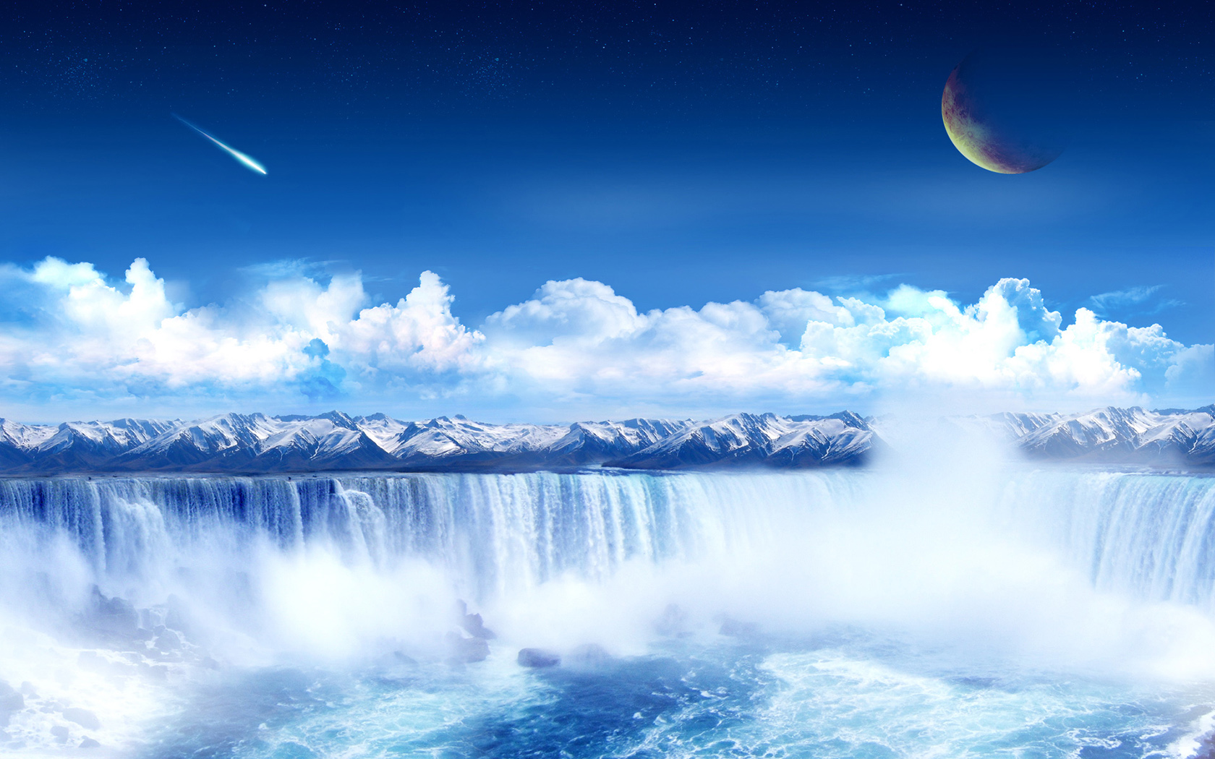
Niagara Falls

Slide 17
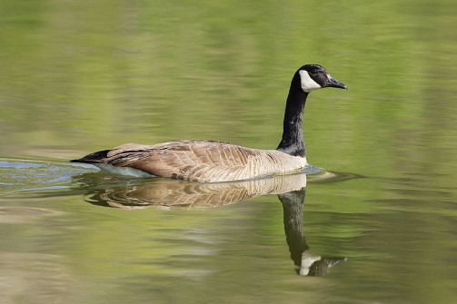
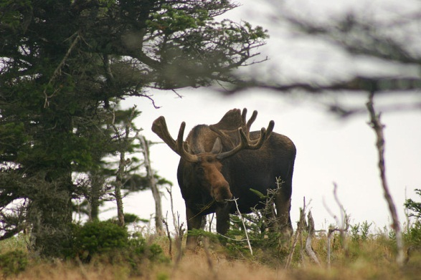
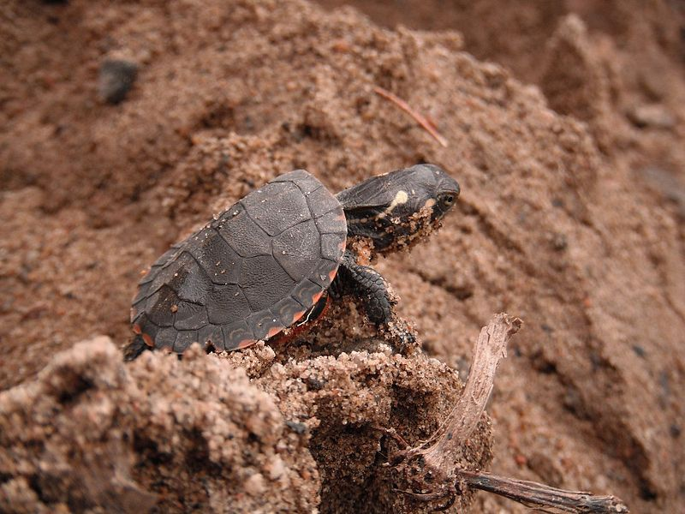
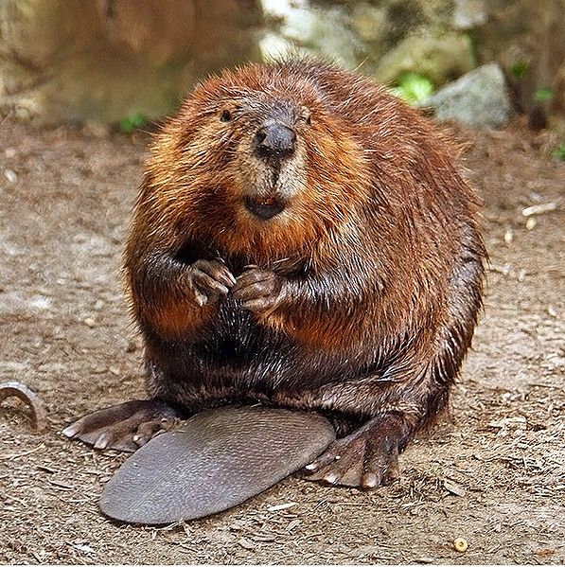
Canada Goose
Eastern moose
Typical animals
Painted turtle
North American Beaver

Slide 18
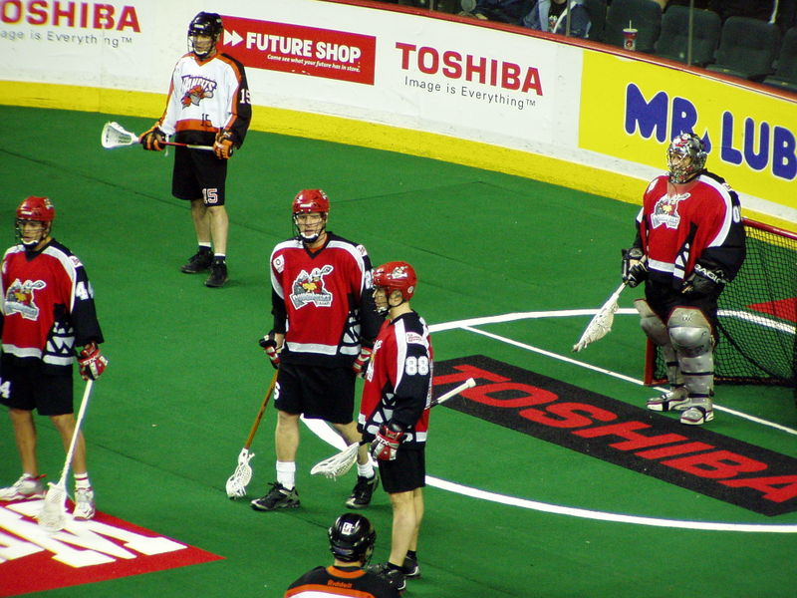
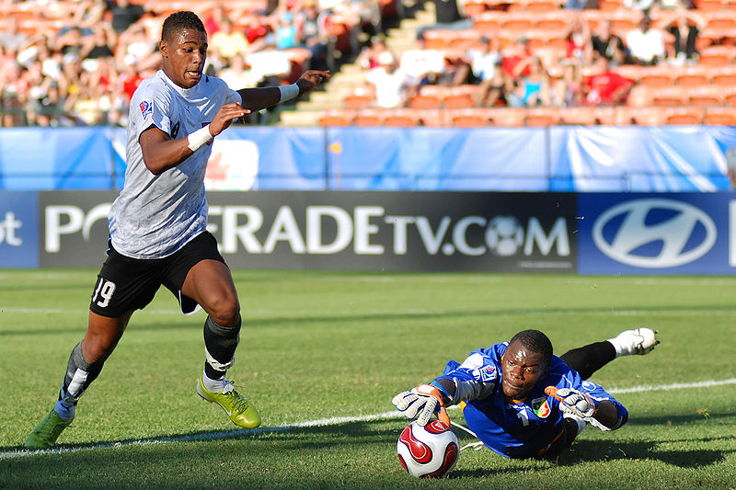
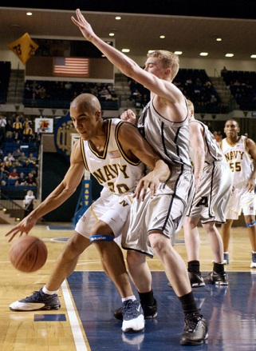
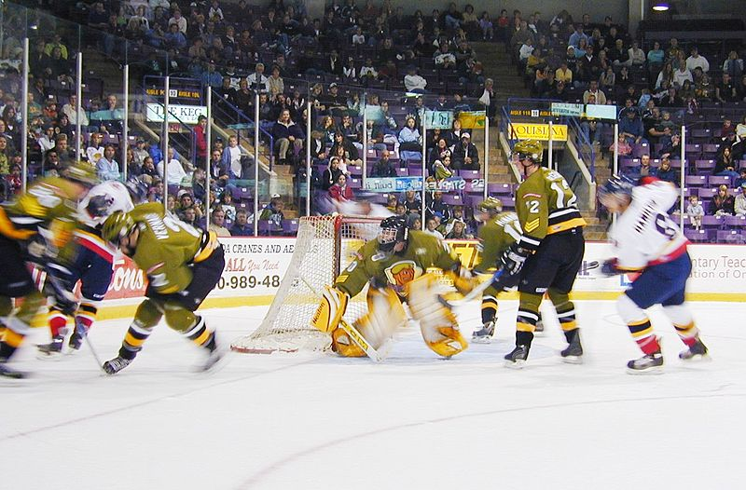
Lacrosse
Soccer
Sport in Canada
Ice hockey
Basketball

Slide 19
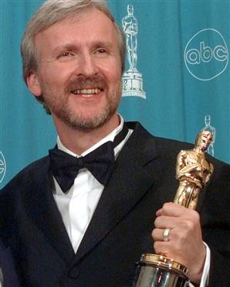
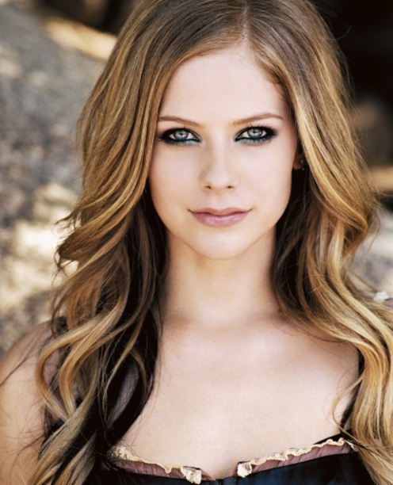
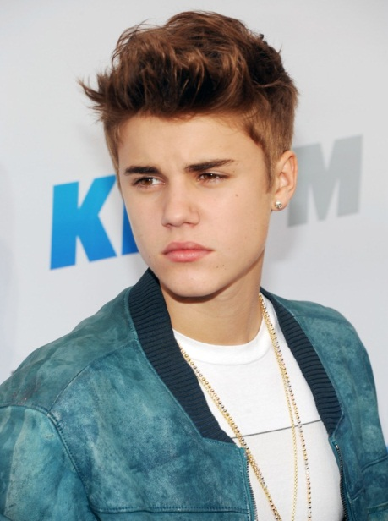
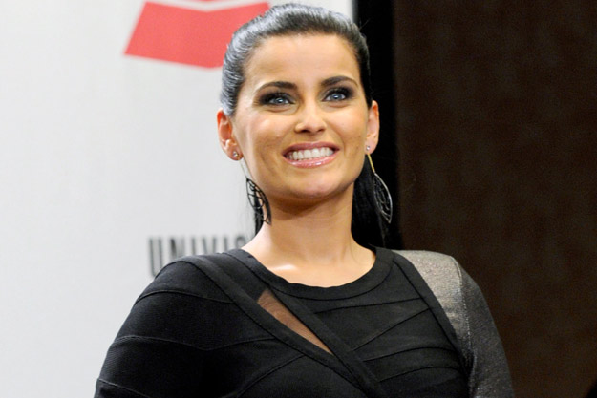
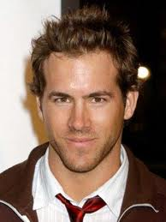
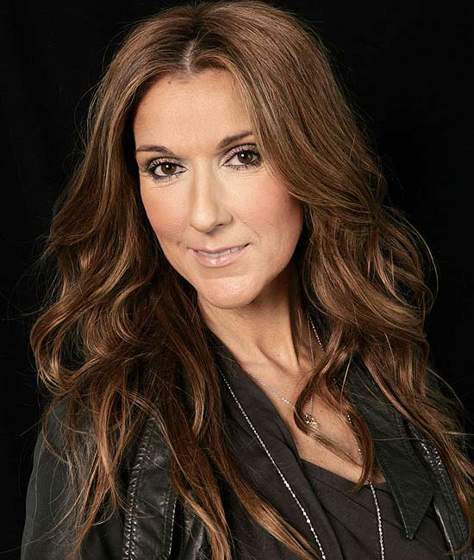
James Cameron, film director
Avril Lavigne, singer
Justin Bieber, singer
Nelly Furtado, singer
Ryan Reynolds, actor
Celine Dion, singer

