Slide 1
Welcome to England

Slide 2
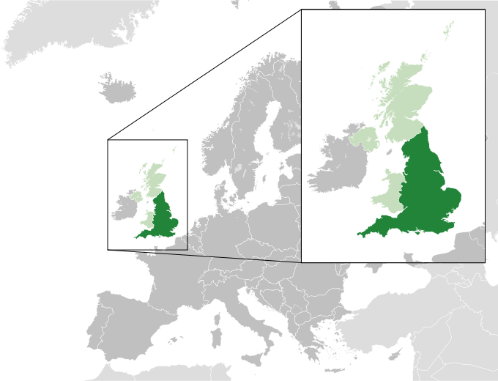
England is the country that is a part of the United Kingdom. It shares land borders with Scotland to the north and Wales to the west; the Irish Sea is to the north west, the Celtic Sea to the south west, while the North Sea to the east and the English Channel to the south separate it from continental Europe. The country also includes over 100 smaller islands. The population of England is 53 million people.

Slide 3
The flag of England

Slide 4
The symbols of England

Slide 6
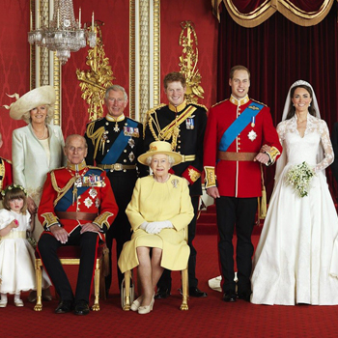
As a part of the United Kingdom, the basic political system in England is a constitutional monarchy and a parliamentary system.
The royal family

Slide 7
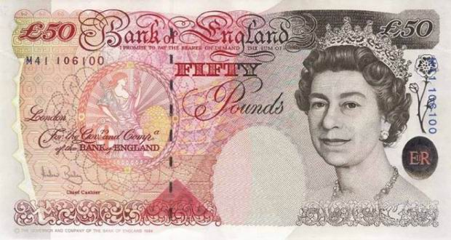
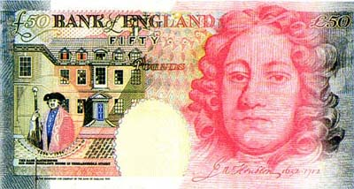
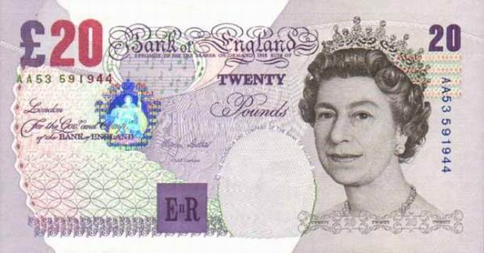
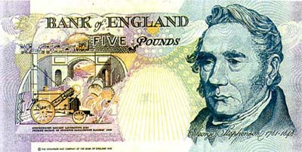
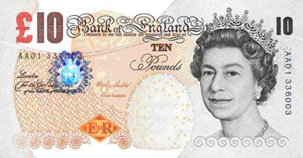
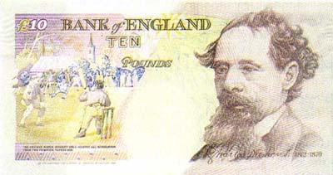
The pound sterling is the official currency of England.

Slide 8
The capital of England is London

Slide 9
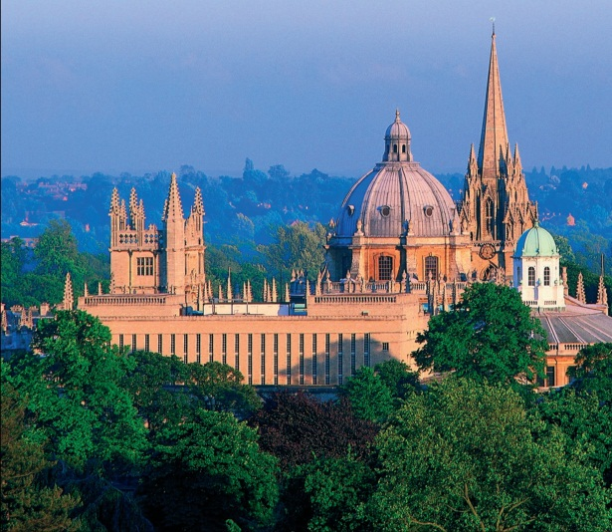
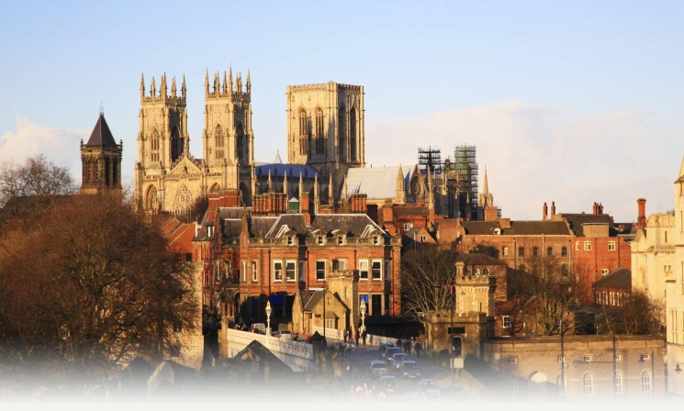
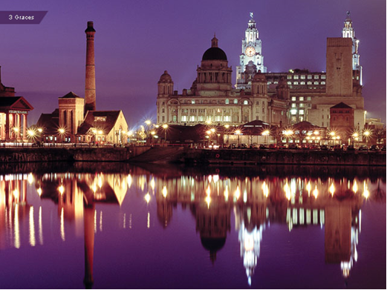
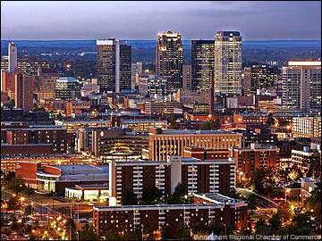
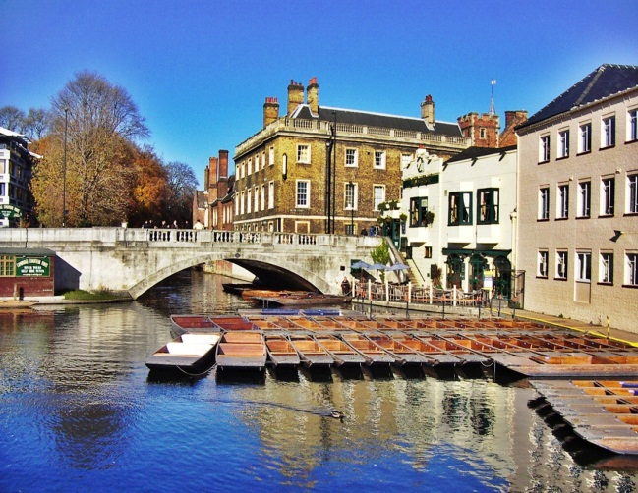
York
Oxford
Liverpool
The cities of England
Birmingham
Cambridge

Slide 10
Places of interest in England

Slide 11
Madame Tussaud’s Museum

Slide 12
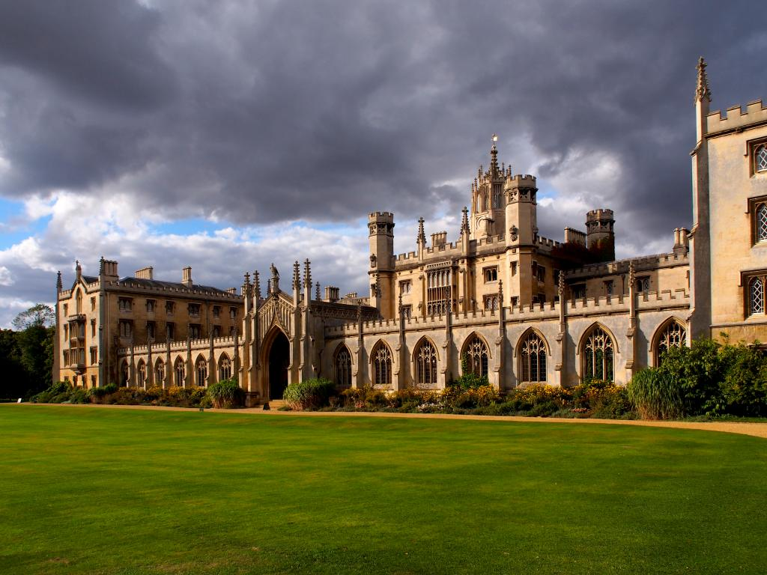
Cambridge University

Slide 13
Oxford University

Slide 14
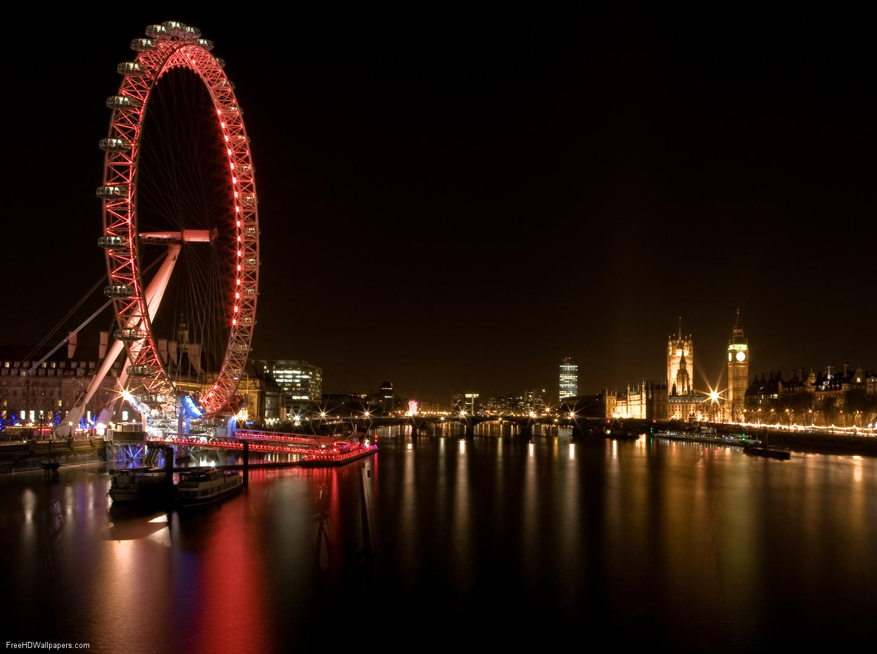
London Eye

Slide 16
Westminster Abbey

Slide 17
The Houses of Parliament

Slide 18
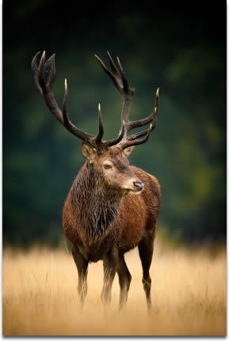
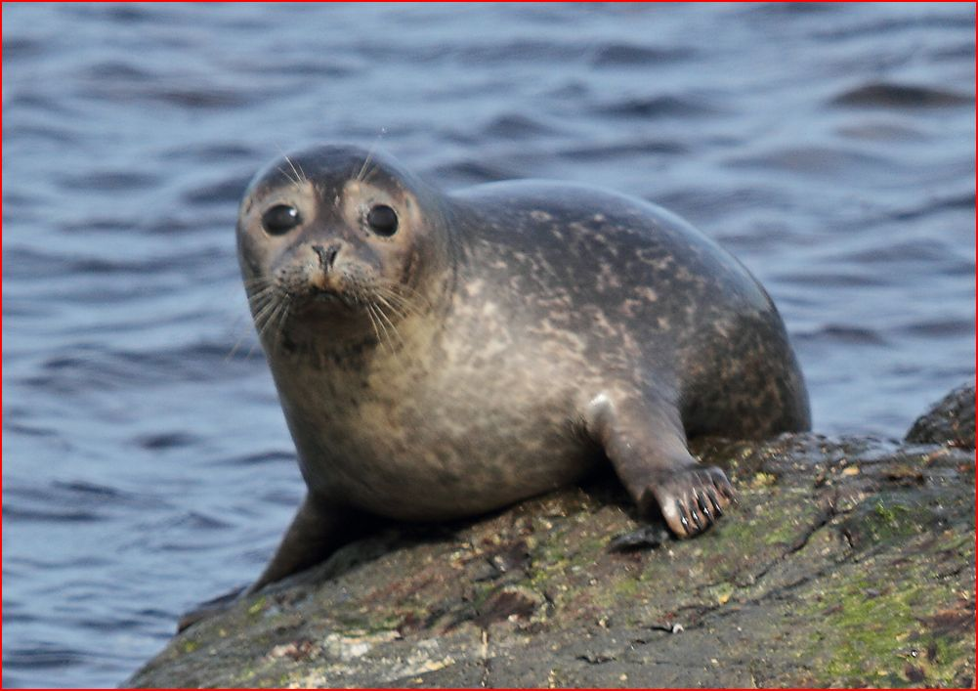
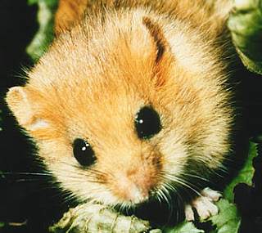
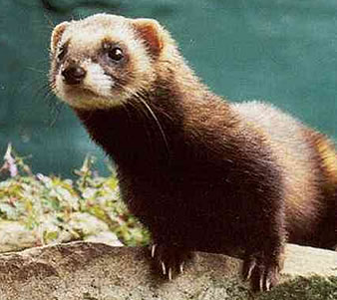
Common Seal
TYPICAL ANIMALS
Red Deer
Hazel Dormouse
Polecat

Slide 19
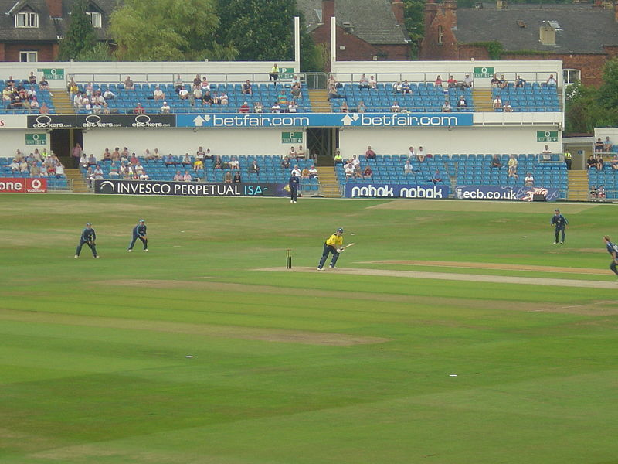
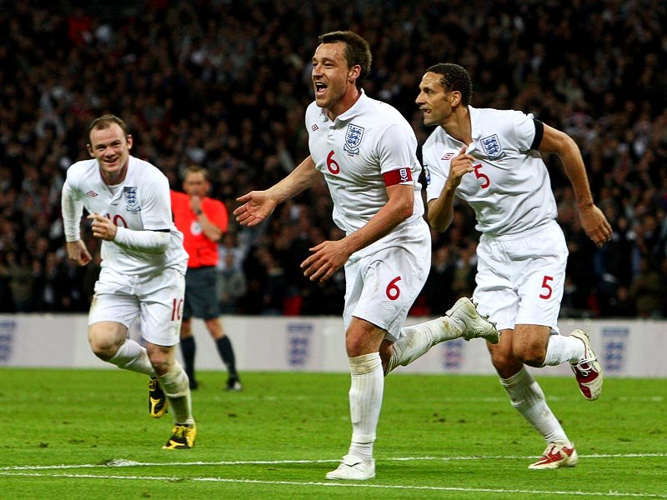
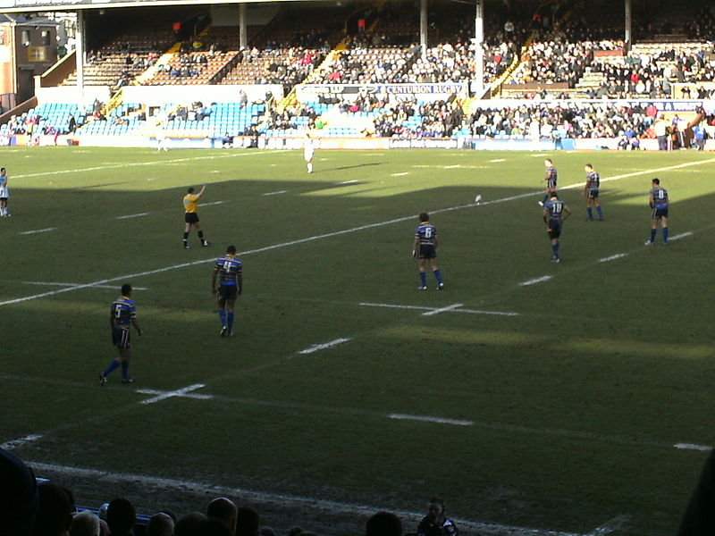
cricket
football
Sport in England
rugby
badminton

Slide 20
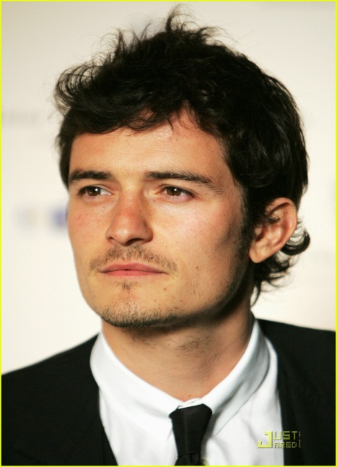
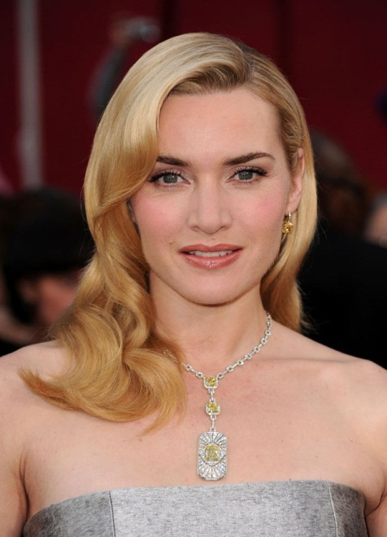
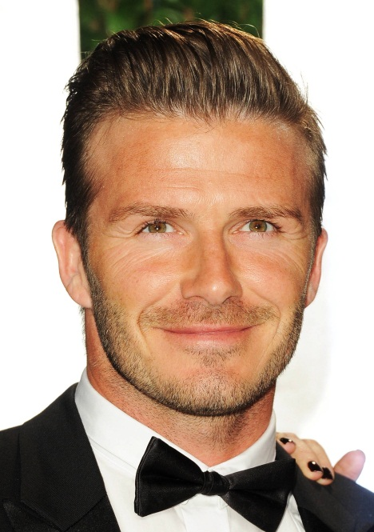
Adele
Orlando Bloom
Emma Watson
Famous People
Kate Winslet
David Beckham
Victoria Beckham

